Slide 1
CodeClub Tutorial Introduction into Relational Databases
Václav Papež
Arturo González-Izquierdo

Slide 2
Motivation example
Blood pressure
Systolic
Diastolic
Pulse
Name | Surname | Address | Systolic BP | Diastolic BP | Pulse
Patient
Name
Surname
Address
Same name for many patients? -> Patient ID
Multiple measurements for one patient? -> Date
Sort patients according to place of living? -> Postcode

Slide 3
Motivation example
ID | Name | Surname | Address | Postcode | Systolic BP | Diastolic DB | Pulse | Date
1 | Bobbi | Forrest | 222 Euston Rd., London | NW1 2DA | 120 | 80 | 52 | 3.1.2017
2 | Henry | Elliot | 31 Orchardson St | NW8 8NN | 150 | 100 | 102 | 3.1.2017
3 | Rob | Head | 55 Bolton St., London | E154JY | 131 | 83 | 69 | 3.1.2017
1 | Bobbi | Forrest | 222 Euston Road, London | NW1 2DA | 125 | 82 | 60 | 1.4.2017
4 | Henry | Elliot | London, Cobbold Rd. 15 | NW109SU | 147 | 87 | 95 | 4.1.2017
1 | Bobbi | Forrest | 222 Euston Rd. London | NW1 2DA | 143 | 95 | 74 | 4.1.2017
5 | Judi | Gilliam | 120 Abbott St., Cairns, Australia |  | 138 | 91 | 82 | 5.1.2017
6 | Nan | Wyndham | Majakovskeho 28, Plzen, CR | 31200 | 111 | 70 | 51 | 5.1.2017
1 | Bobbi | Forrest | 222 Euston Rd. | NW1 2DA | 130 | 86 | 48 | 5.1.2017
Let’s buy thermometer and glucometer…

Slide 4


Relational modelling
Input: real world system / organization
Output: list of tables, keys, attributes, data types and relationships
What?

Slide 5
Relational model
ID | Name | Surname | Postcode | Systolic BP | Diastolic DB | Date
1 | Bobbi | Forrest | NW1 2DA | 120 | 80 | 3.1.2017
2 | Henry | Elliot | NW8 8NN | 150 | 100 | 3.1.2017
3 | Rob | Head | E154JY | 131 | 83 | 3.1.2017
1 | Bobbi | Forrest | NW1 2DA | 125 | 82 | 1.4.2017
Tuple
Attribute
Relation
A unique vector of values
A model describing how data is represented as tables, rows, columns
Bobbi
Attribute has name and data type
Textual (fixed length, variable length)
Numerical (integer, decimal)
Temporal (date, time)…
Rob
Henry
Domain

Slide 6
Entity-Relational model
Real-world concept in tabular structures
RM
structure of data values
Relations (tables)
E-RM
structure of entities
relationships
a collection of time-varying tabular relations
entity and reference integrity
relational algebra
A formal representation of how one data table is related to another data table

Slide 7
Relationships between tables - keys
ID | Surname | NIN | Phone No. | Address
1 | Forrest | GB 17 55 69 M | 0749155698 | 1
2 | Gilliam | TN 31 12 58 F | 0733545569 | 2
Primary key
Foreign key
Entity Integrity: No primary key is NULL
ID | Street | No | Postcode | City
1 | Euston Road | 222 | NW1 2DA | 1
2 | Bolton Street | 55 | E154JY | 1

Slide 8
Relationships between tables - keys
ID | Surname | NIN | Phone No. | Address
1 | Forrest | GB 17 55 69 M | 0749155698 | 1
2 | Gilliam | TN 31 12 58 F | 0733545569 | 2
Primary key
Foreign key
Reference Integrity: No foreign key reference is lost
ID | Street | No | Postcode | City
1 | Euston Road | 222 | NW1 2DA | 1
2 | Bolton Street | 55 | E154JY | 1

Slide 9
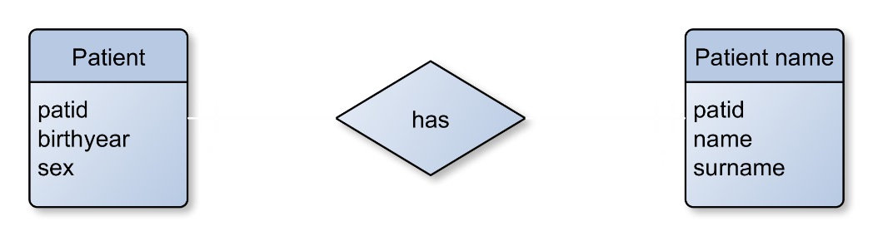
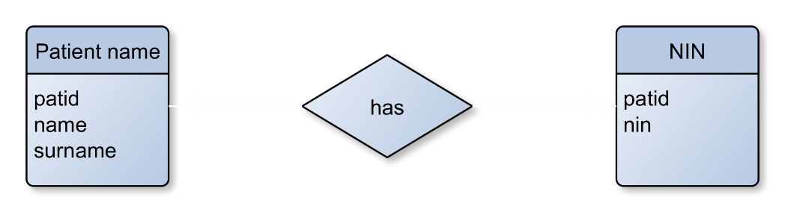
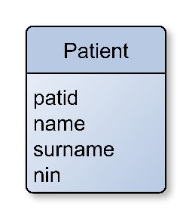
Relationships between tables - cardinality
1:1
?

Slide 10
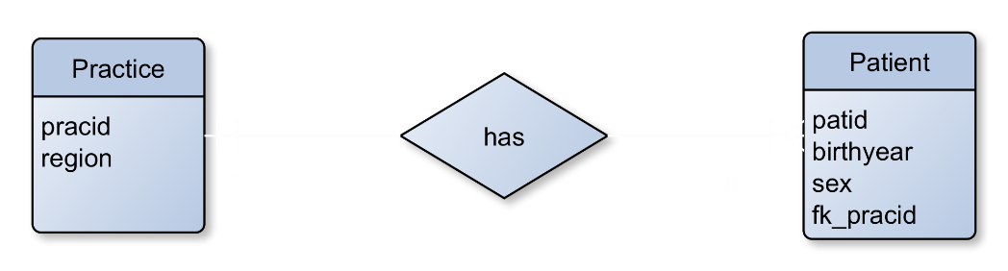
Relationships between tables - cardinality
1:n

Slide 11
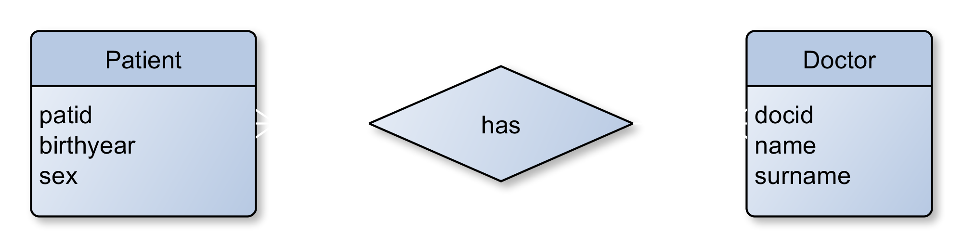
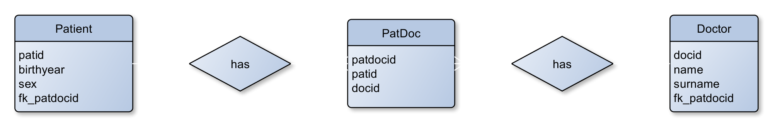
Relationships between tables - cardinality
m:n
Foreign keys

Slide 12
Relational modelling
Input: real world system / organization
Output: list of tables, keys, attributes, data types and relationships
How?

Slide 13
Where to start
Natural language
Open vs. Closed World
Abstraction level
Domain borders
External factors
Common sense

Slide 14
Natural language
Simplify and identify
Subjects and nouns
Objects
Predicates
Numerals

Slide 15
Natural language
Simplify and identify
Subjects and nouns
Objects
Predicates
Numerals
One - hospital – has - several - clinics
One - clinic - belongs to - one - hospital
One - consultant - works at - one or more - clinics
One - clinic - has - one or more - consultants
One - hospital - has - many - admissions

Slide 16
Natural language
Simplify and identify
Subjects and nouns -> Relations
Objects -> Attributes/keys
Predicates -> Relationships
Numerals -> Cardinalities
One - hospital – has - several - clinics
One - clinic - belongs to - one - hospital
One - consultant - works at - one or more - clinics
One - clinic - has - one or more - consultants
One - hospital - has - many - admissions

Slide 17
Natural language
A patient can be registered with a single general practitioner (GP) at any time. Each patient has a unique NHS number and their demographic details are recorded in the surgery’s files. During the consultation, the GP can record a number of diagnoses, prescribe a number of medications and order blood tests. The patient can also be referred to a hospital for specialist care.

Slide 18
Natural language
A patient can be registered with a single general practitioner (GP) at any time. Each patient has a unique NHS number and their demographic details are recorded in the surgery’s files. During the consultation, the GP can record a number of diagnoses, prescribe a number of medications and order blood tests. The patient can also be referred to a hospital for specialist care.

Slide 19
Datatypes
Numeric (and Logical – disguised numeric ☺)
Textual
Date and time

Slide 20
NULL Values
“no data”, “a missing unknown value”
Different from ‘0’ or empty string
Expressions containing NULL will always produce NULL
No arithmetic comparisons
Handling: IS NULL, IS NOT NULL, IFNULL()

Slide 21
Where to start
Natural language
Open vs. Closed World
Abstraction level
Domain borders
External factors
Common sense

Slide 22

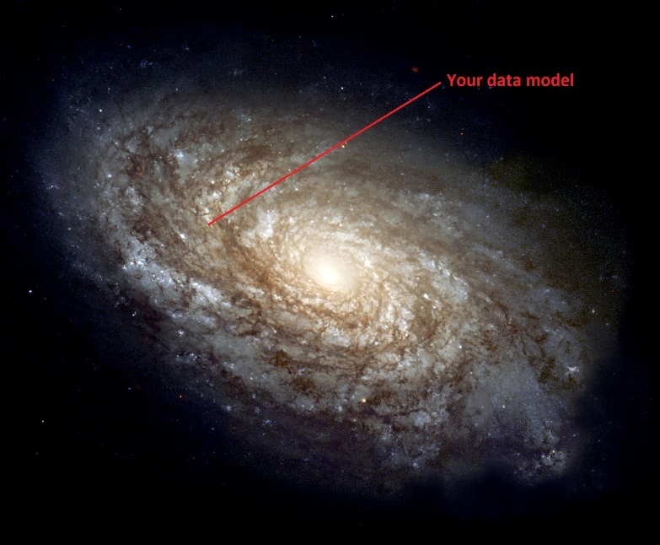
Closed world vs. Open World
vs.
Pink Floyd: The Wall (1982)
NGC 4414: The Hubble Heritage Team (AURA/STScI/NASA) NASA Headquarters
- Greatest Images of NASA (NASA-HQ-GRIN)

Slide 23

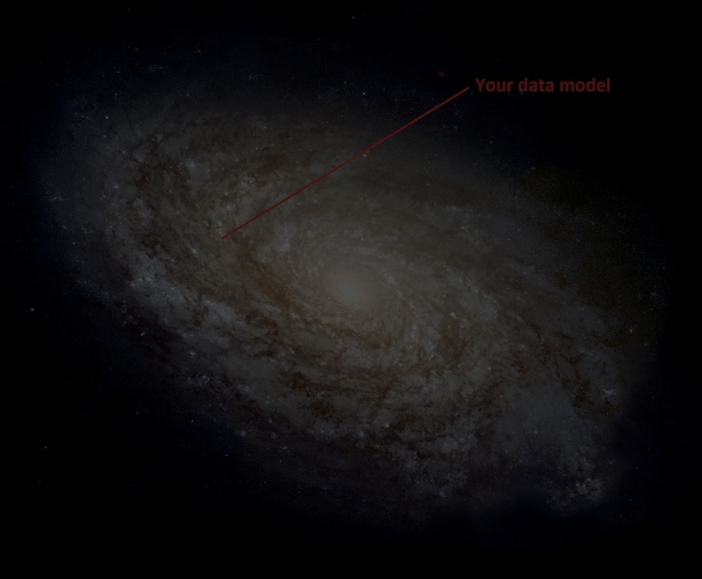

Closed world vs. Open World
Address | Postcode
222 Euston Rd., London | NW1 2DA
31 Orchardson St | NW8 8NN
Majakovskeho 28, Plzen, CR | 31200
Address | Postcode
222 Euston Rd., London | NW1 2DA
31 Orchardson St | NW8 8NN
vs.
Pink Floyd: The Wall (1982)
NGC 4414: The Hubble Heritage Team (AURA/STScI/NASA) NASA Headquarters
- Greatest Images of NASA (NASA-HQ-GRIN)

Slide 24
Where to start
Natural language
Open vs. Closed World
Abstraction level
Domain borders
External factors
Common sense

Slide 25
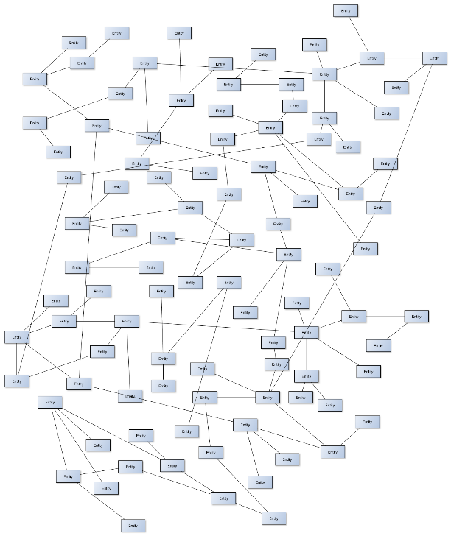

Abstraction level
vs.

Slide 26
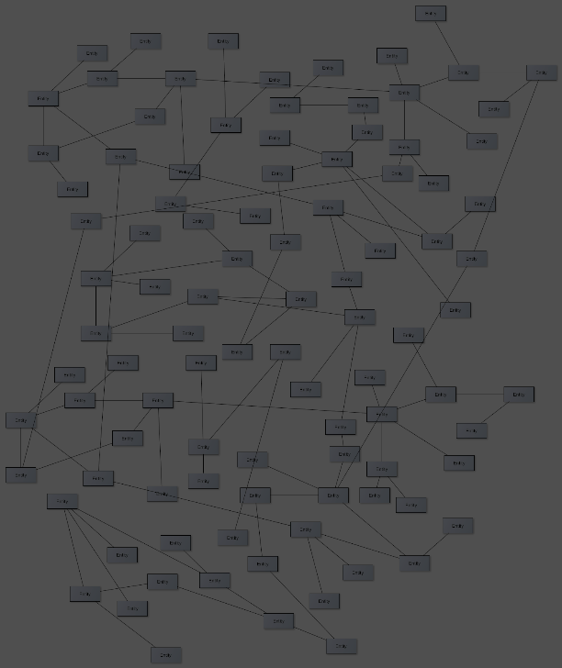

Abstraction level
Name
Name
Patient
Surname
NIN
Patient
vs.
Country
Region
Postcode
Prefix
Alphabet
Address
Street
Post fix
City

Slide 27
Where to start
Natural language
Open vs. Closed World
Abstraction level
Domain borders
External factors
Common sense

Slide 28
Domain borders
Blood pressure
External factors
???
Weather
Beaufort wind force scale
Wind speed
Humidity
Temperature

Slide 29
Where to start
Natural language
Open vs. Closed World
Abstraction level
Domain borders
External factors
Common sense

Slide 30
External factors
Extensibility
Part of federative database
Large files limited by 50MB
Data from external resource
Frequent access to statistics

Slide 31
Where to start
Natural language
Open vs. Closed World
Abstraction level
Domain borders
External factors
Common sense

Slide 32
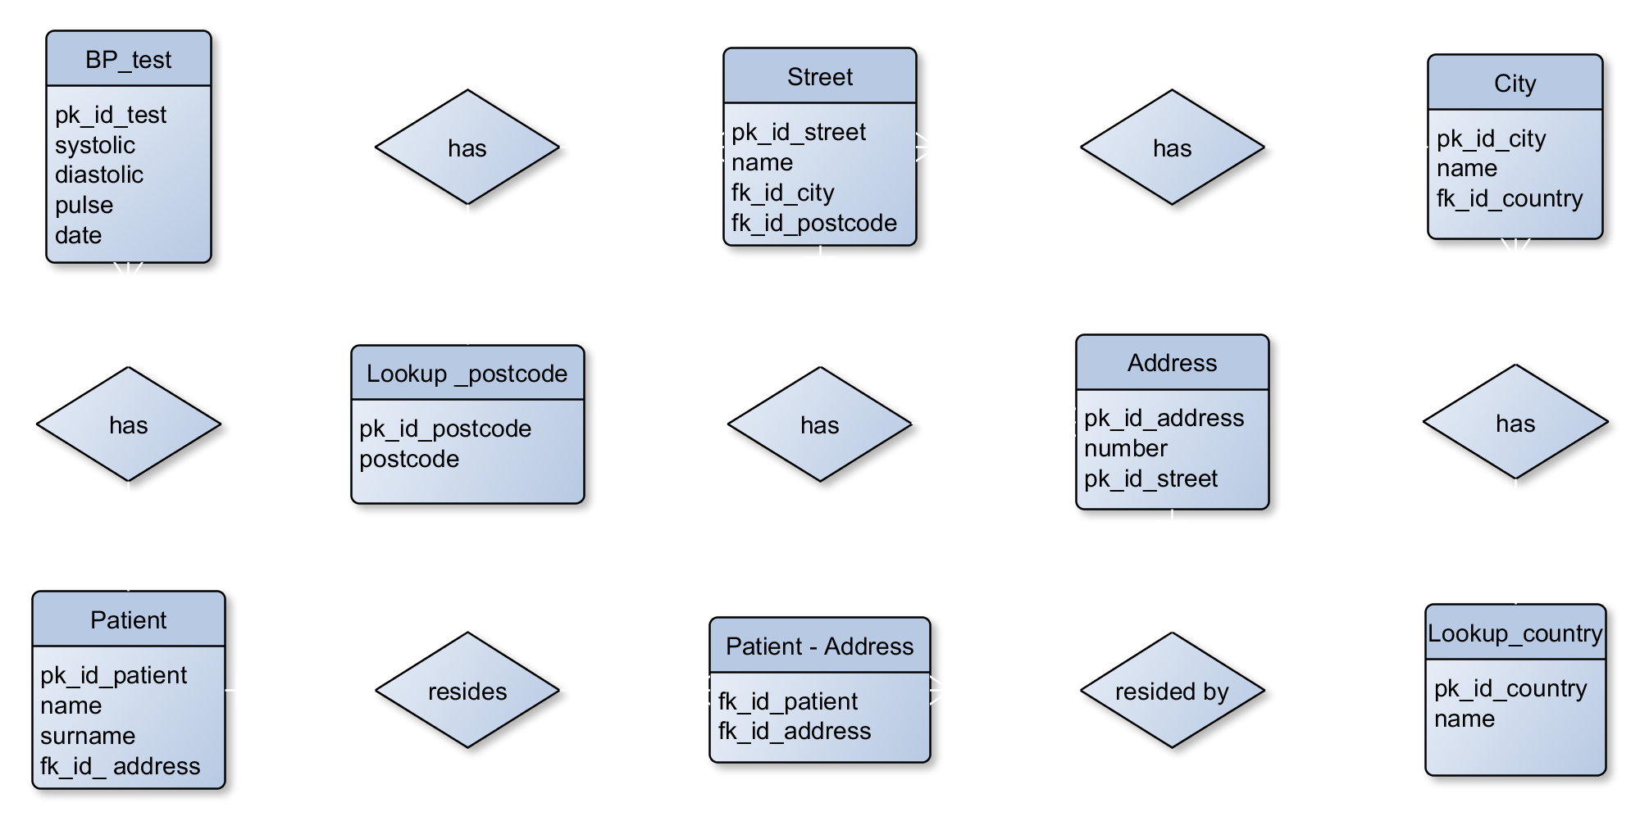
Motivation example (one of many)

Slide 33
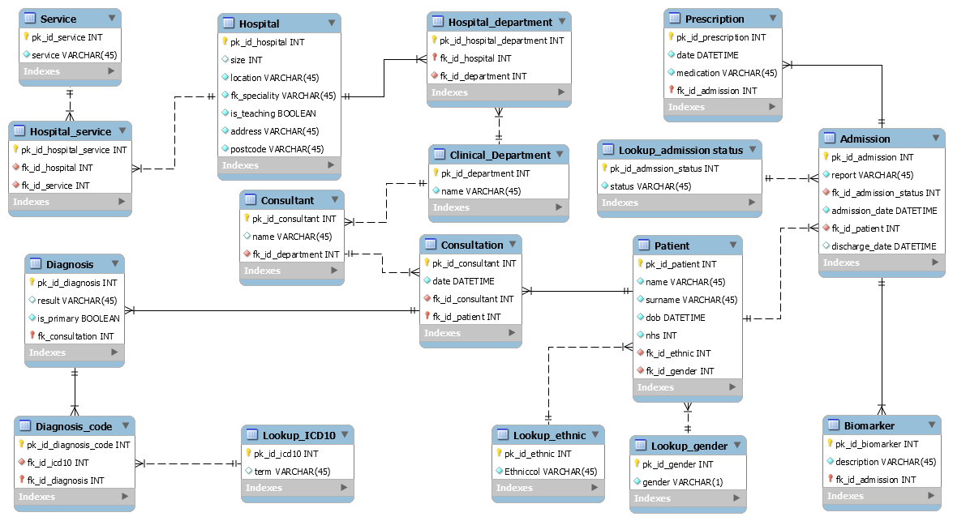

Slide 34
EHR DB model
Database:
electronic_health_records
Primary care
Practices
Patients
Consultations
Secondary care
Procedures
Diagnoses
ONS…
Disease registry…

Slide 35




DBMS
Client – Server Architecture
MySQL server
Terminal / Command line
Mobile App
MySQL Workbench

Slide 36


Brief networking theory
Host: 128.40.171.134
Network identification
MySQL server
3306
128.40.171.007
PostgreSQL server
Your computer
5432
Hello 128.40.171.134:3306, my name is 128.40.171.007, be so kind and give me all data from table Patients. My username is Bond, my password is “JamesBond”.
Email server
25

