Slide 1

Team
Encrypted

Slide 2
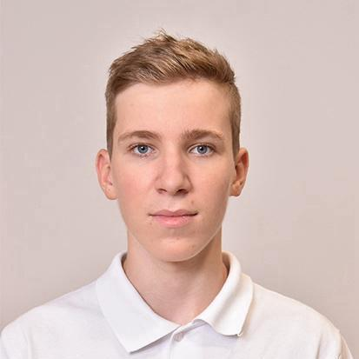
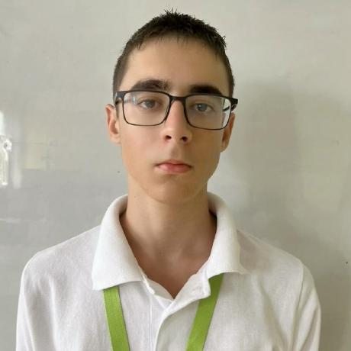
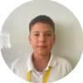

Our team
Maksim Iliev 9B
Iliyan Iliev 9V
Dimitar Dimitrov 9V
Ivan Kolozenko 9A

Slide 3






Used technologies

Slide 4
Our goal
Create a working school site
Write organized code
Create a simple interface for users
Practice teamwork

Slide 5
Let's get to the app!

