Slide 1

USWDS Monthly Call
October 2021
1

Slide 2

Hi!
Thanks for being here!
2

Slide 3
A quick poll
Which of these services are you able to access at your job?
Email
GitHub
Slack
YouTube
3

Slide 4
Agenda Site launches Community, connection, and contribution Q&A
4

Slide 5
Site launches
5

Slide 6
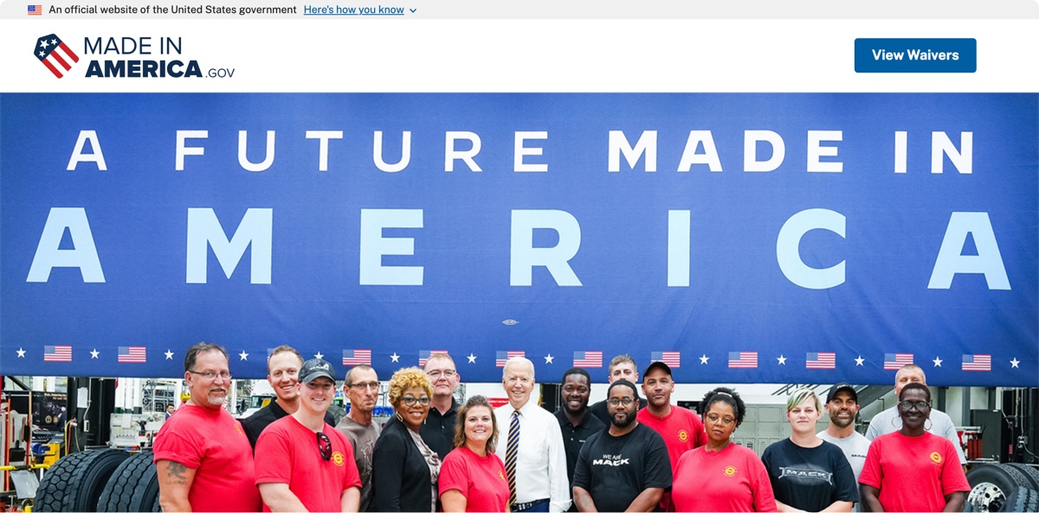
MadeInAmerica.gov
6

Slide 7
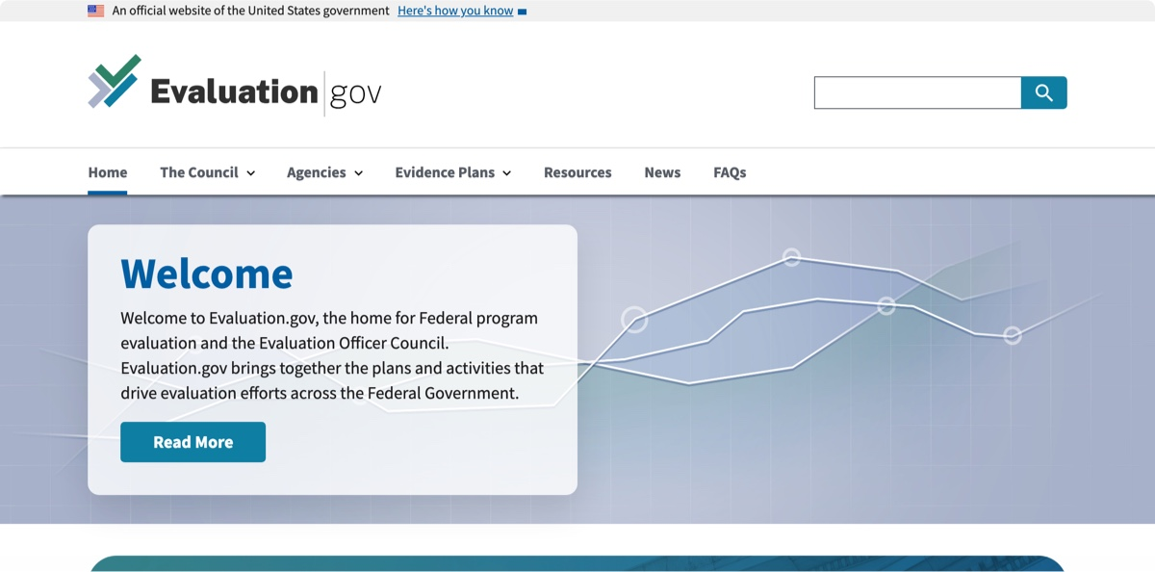
Evaluation.gov
7

Slide 8
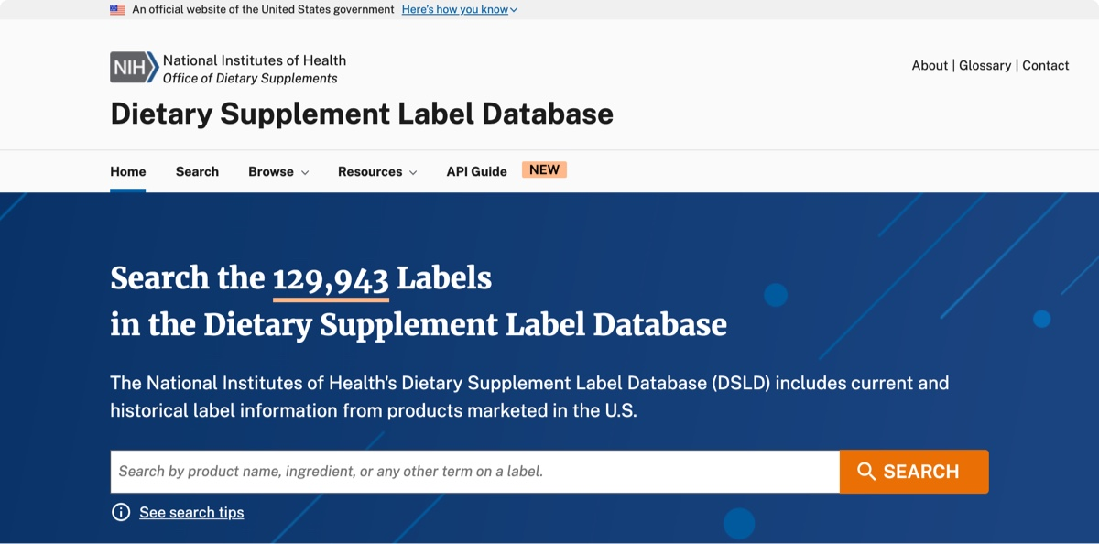
Dietary Supplement Label Database
dsld.od.nih.gov
8

Slide 9
Great work!
9

Slide 10
Community, connection, and contribution
10

Slide 11
Scaling things that work
11

Slide 12
It’s hard to build websites and digital services
12

Slide 13
Design system projects are collaborative projects
13

Slide 14
The flip side of fragmentation
14

Slide 15
“The future is already here. It’s just not evenly distributed yet.”
15

Slide 16
This is normal.
16

Slide 17
It’s hard to learn a lesson you’ve never heard
17

Slide 18
We can’t do it alone.
18

Slide 19
Real talk: This is also hard.
19

Slide 20
Who’s the expert?
20

Slide 21
What’s the best place to have these conversations?
21

Slide 22
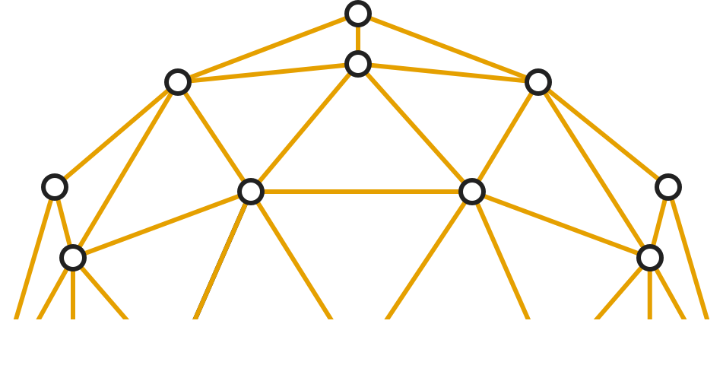
James Mejia
USWDS Core Team
Contractor
22

Slide 23
GitHub Discussions: A Discussion
23

Slide 24
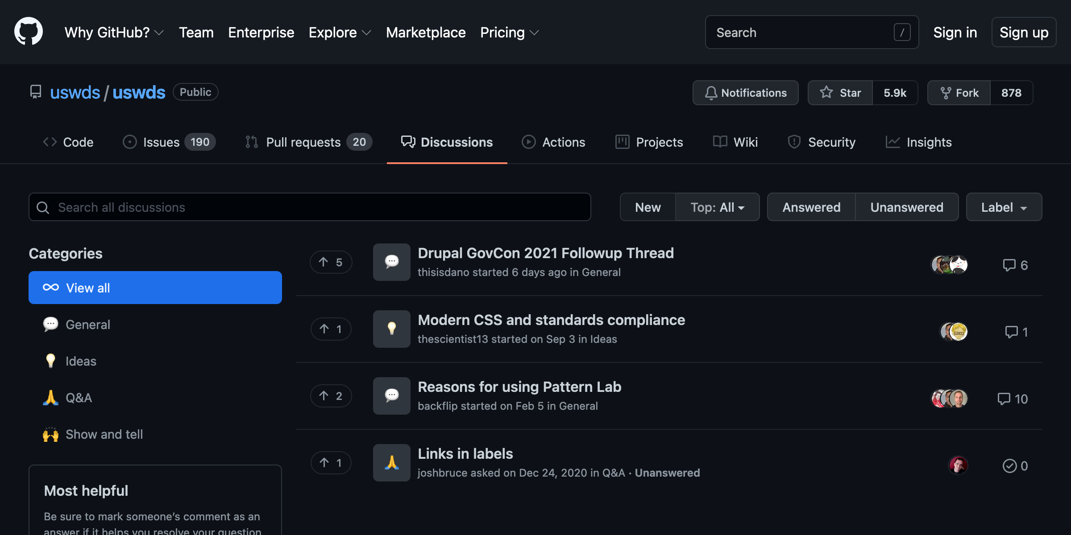
Anyone can see discussions
24

Slide 25
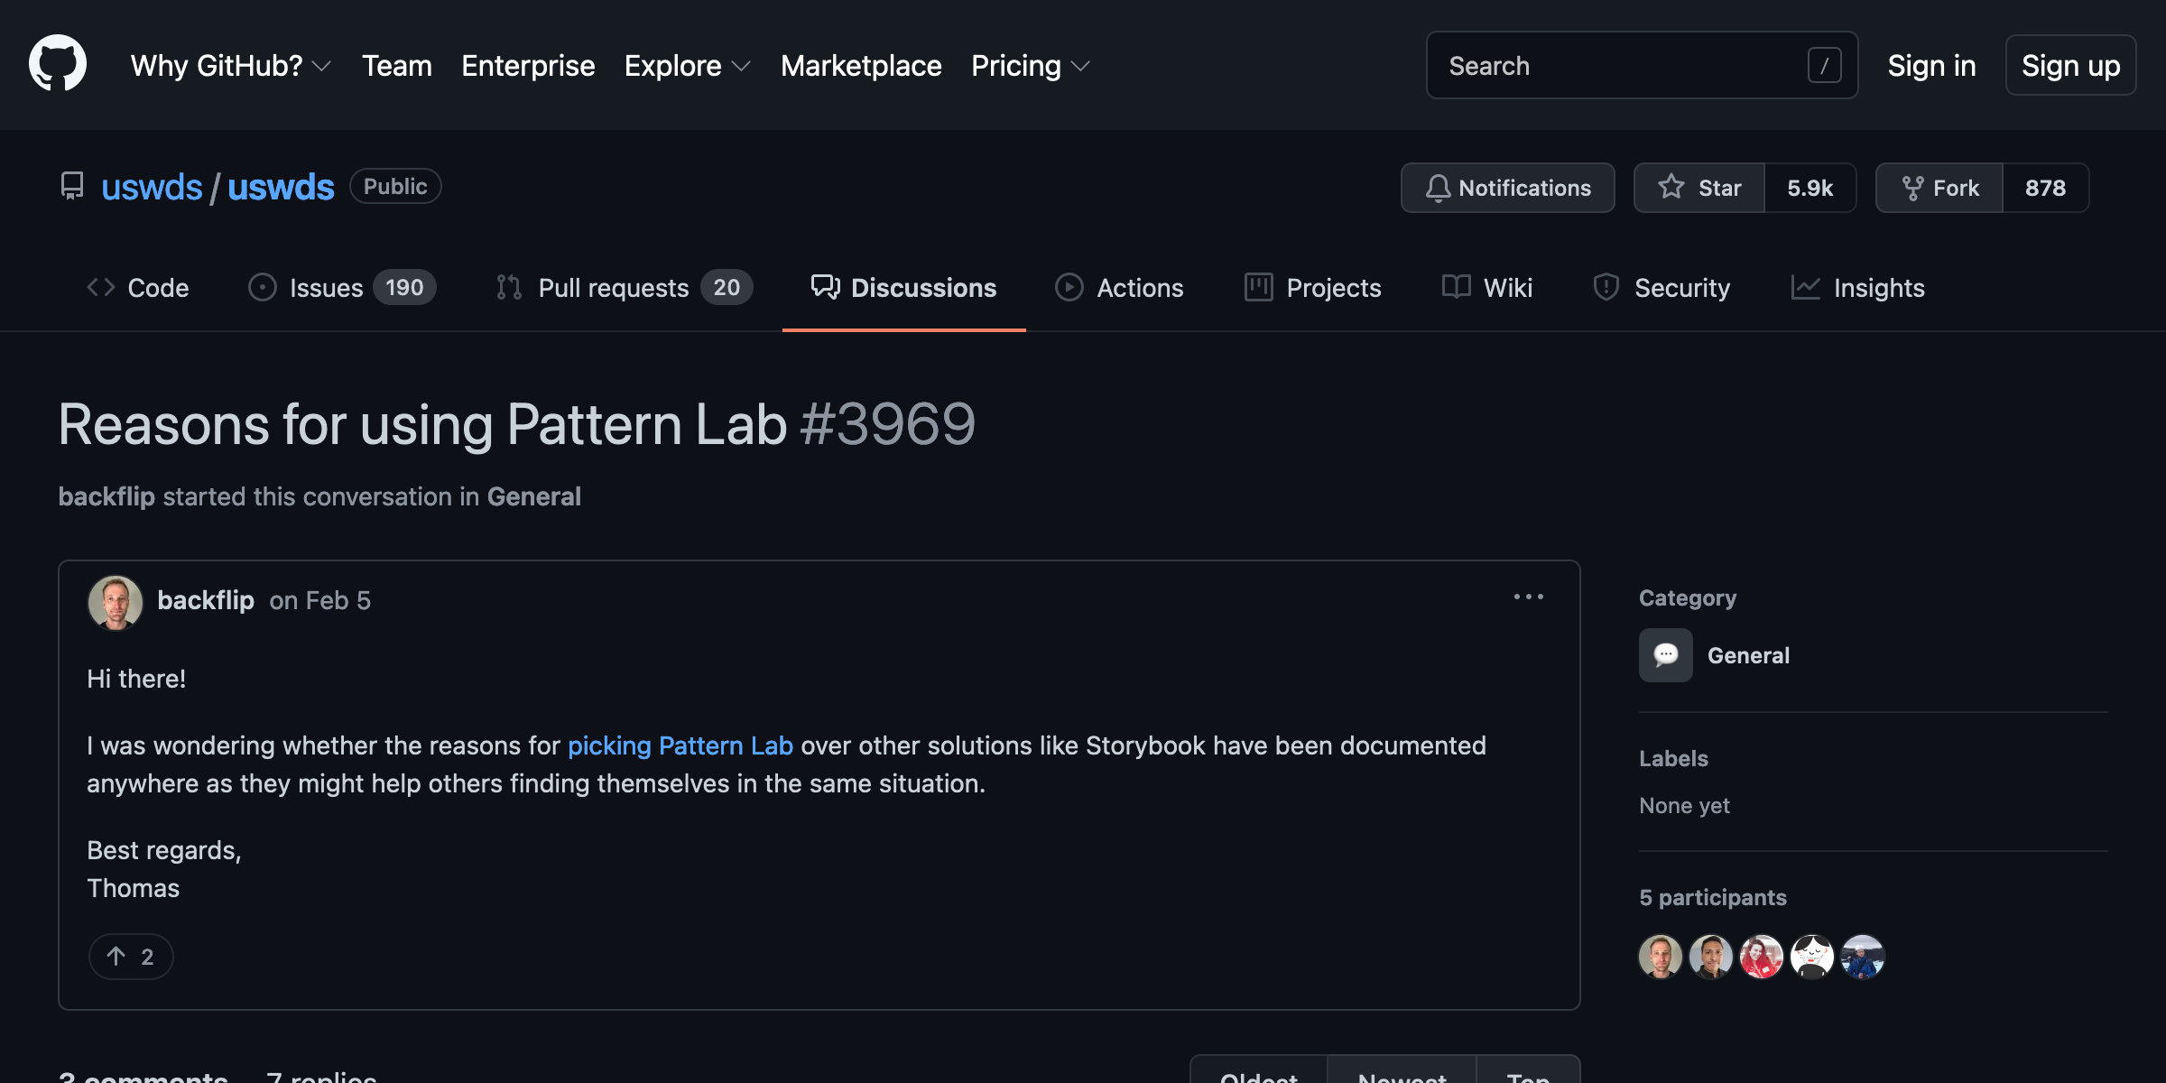
All discussions are welcome
25

Slide 26
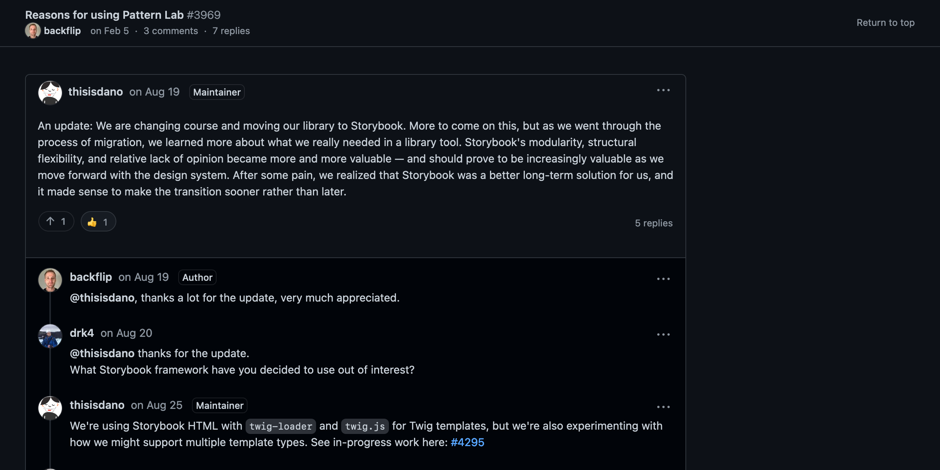
Don’t be afraid to contribute
26

Slide 27
Discussing the 3.0 Beta
27

Slide 28
Getting the word out Getting the word back
28

Slide 29
Kathryn Mullan
USWDS Core Team
Contractor
29

Slide 30
We want to be strategic and intentional
30

Slide 31
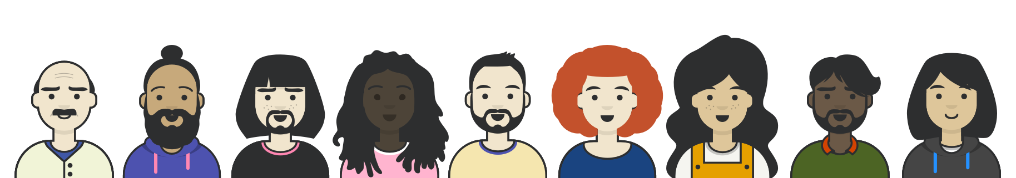
We communicate through different channels: sometimes more centralized
31

Slide 32
We communicate through different channels: sometimes less centralized
32

Slide 33
The important thing is that we’re able to meet folks where they are.
33

Slide 34
👋
34

Slide 35
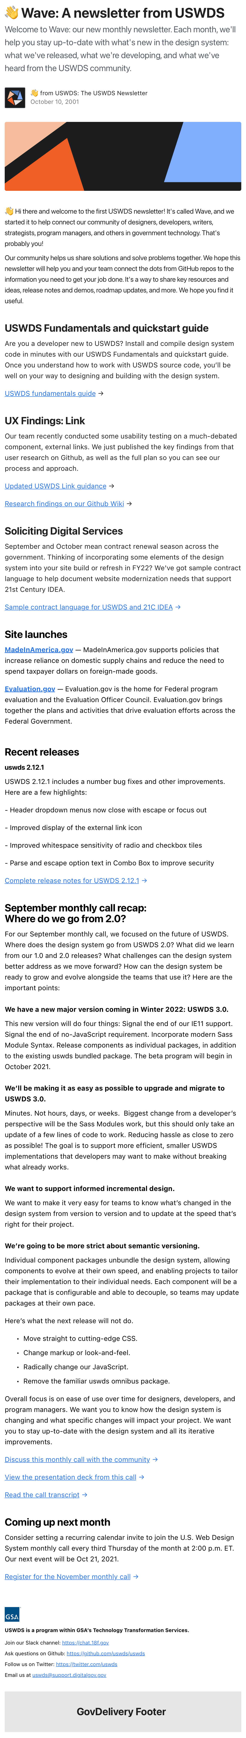
👋 A monthly newsletter
Monthly news from USWDS
Typically sent in the first week of the month
35

Slide 36
Things you might not know about
Content updates
Guidance improvements
New features
36

Slide 37
Product updates and recaps from the monthly call
Site launches
Recent releases
Monthly call recaps
37

Slide 38
Check your inbox 📫
38

Slide 39
Not alone
39

Slide 40
Q&A
40

Slide 41



Next month
What we’re thankful for
#uswds-public
github.com/uswds/uswds/discussions
designsystem.digital.gov
41

