Slide 1
Tecnologia de Armazenamento
Enio Goulart, Igor Martinelli, Marcelo Dolabella

Slide 2
Agenda
Dispositivos de armazenamento
Interfaces de Conexão
RAID
JBOD
DAS
SAN
NAS
Armazenamento em Banco da Dados
Cloud Computing

Slide 3
Review of Key Objectives & Critical Success Factors
What makes company unique.
What makes company successful.
Shared vision.
Review key undertakings of past year.

Slide 4
How Did We Do?
Brief overview of performance against each objective.

Slide 5
Organizational Overview
Introduction and broad goals of each organization.
Any changes.
Organization chart might be effective here.

Slide 6
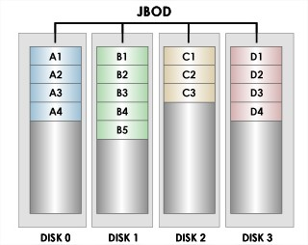
JBOD – “Just a Bunch of Disks”
“Apenas um monte de discos “
Concatenação de Discos Rígidos
Parecido com RAID
Facilidade para adicionar novos dispositivos
Caso falhe, somente perca no disco que falhou

Slide 7
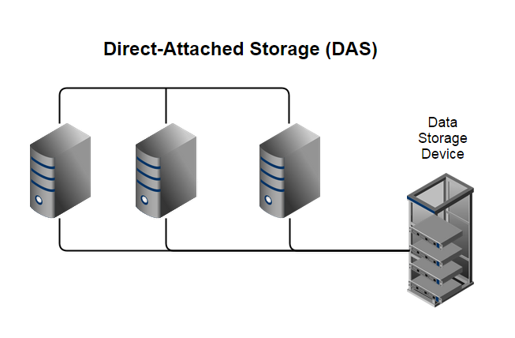
DAS – “Direct Attached Storage”
Também é conhecido como 'Server Attached Storage - SAS'.
Dispositivos interligados entre sí
Normalmente são usados Discos Rígidos
Os dispositivos não precisam estar em rede
Apelidado de “Ilhas da Informação”

Slide 8
Progress Against Goals
Summary of key financial results.
Revenue
Profit
Key spending areas
Headcount

Slide 9
Revenue and Profit
Forecast vs. actual
Gross margin
Important trends
Compare company to rest of market.
Use multiple slides to break out meaningful detail.

Slide 10
Key Spending Areas
R&D
Sales and marketing.
General and administration.
Areas of improvement.
Areas needing attention/caution.

Slide 11
Headcount
Goals
Results

Slide 12
Goals for Next Period
Strategic undertakings
Financial goals
Other key efforts

Slide 13
Summary
Summarize key successes/challenges.
Reiterate key goals.
Thanks

Slide 14
Dúvidas ?

