Slide 1
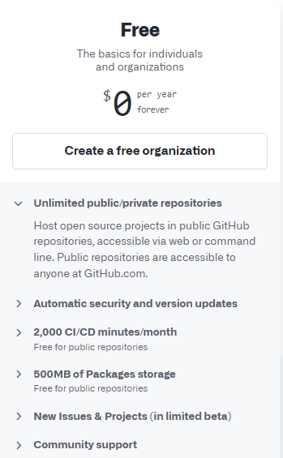
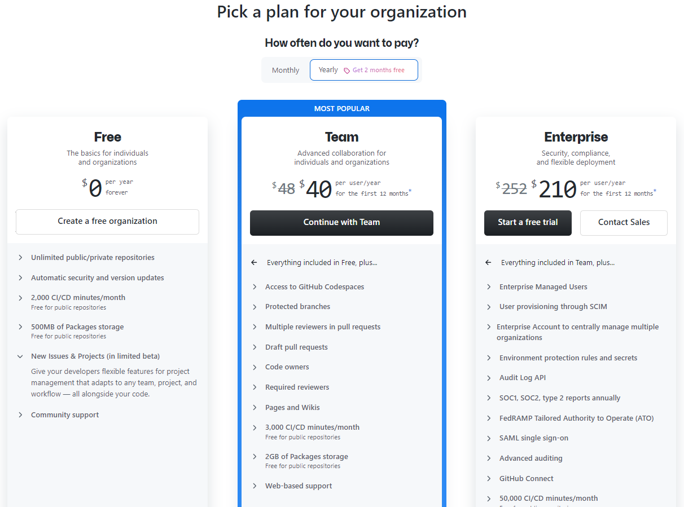
GitHub

Slide 2
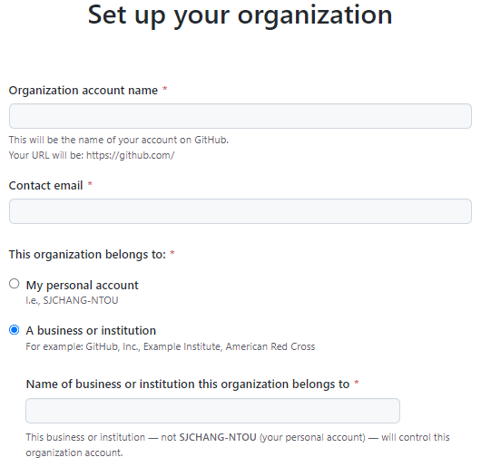
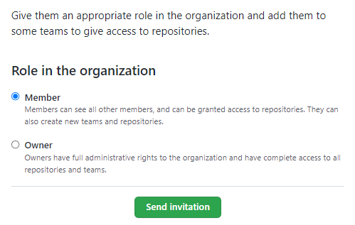
Owner of the Organization Account ?
Organization owners have complete administrative access to your organization. This role should be limited, but to no less than two people, in your organization

Slide 3
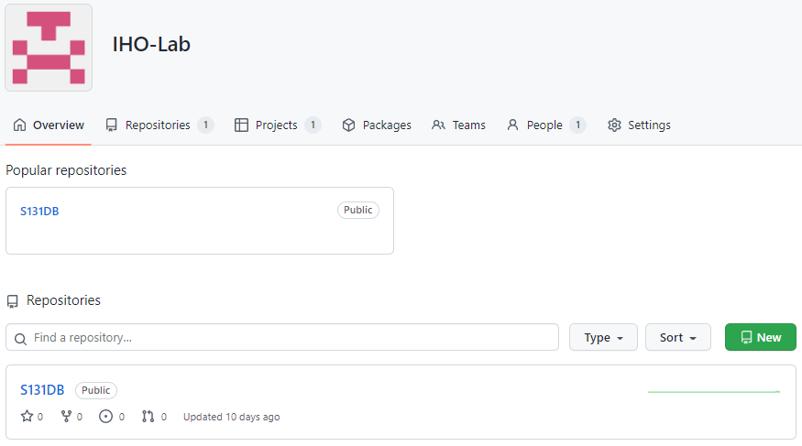
https://github.com/IHO-Lab

Slide 4
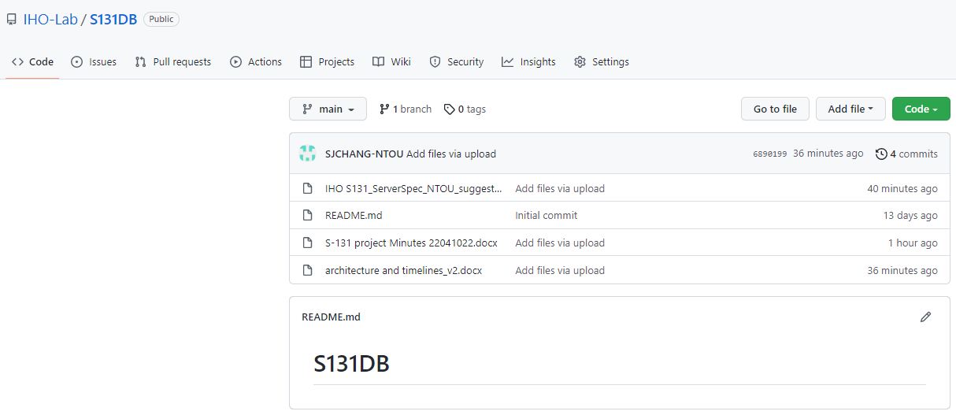
https://github.com/IHO-Lab/S131DB
(free) Organization: IHO-Lab , repository: S131DB

