Slide 1
IHU Lesson 05

Slide 2
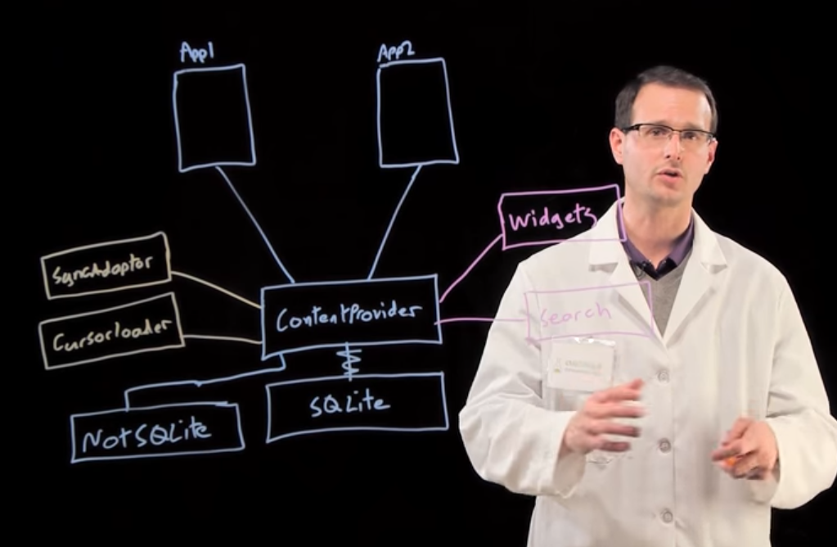
Content Providers

Slide 3
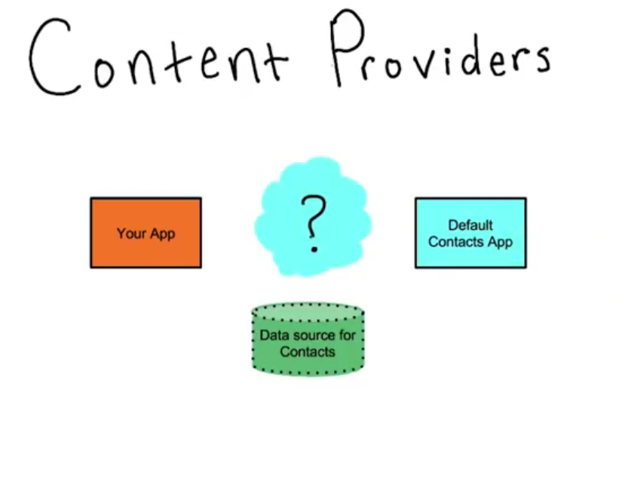
What is a content provider?

Slide 4
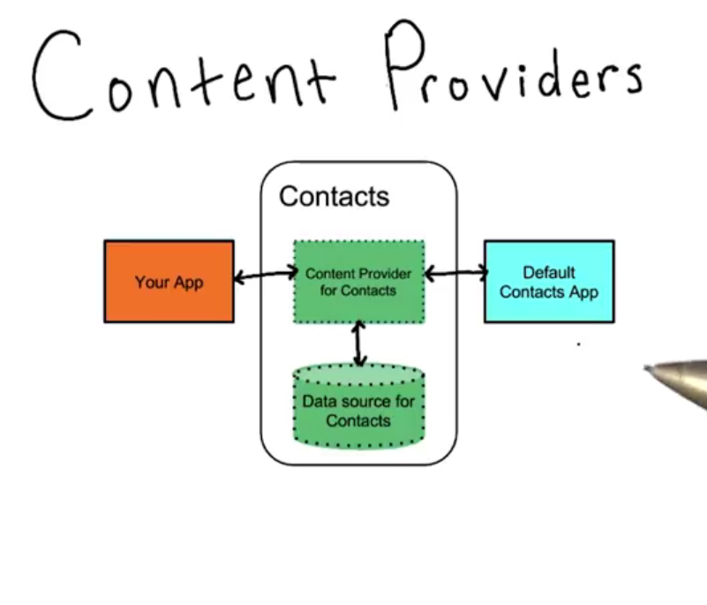
What is a content provider?

Slide 5
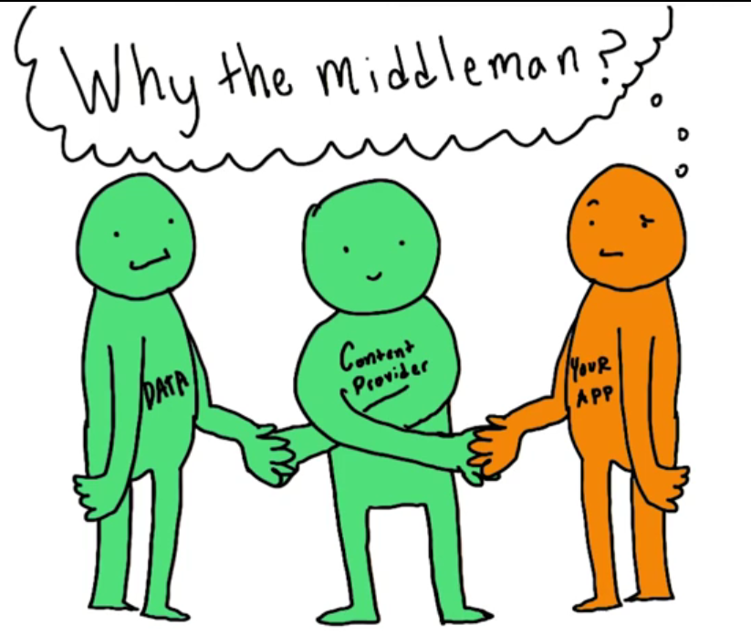
Do I need them?

Slide 6
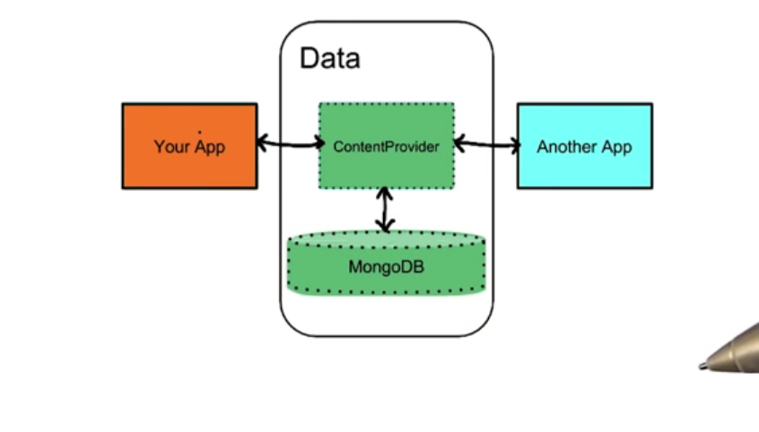
Do I need them?

Slide 7
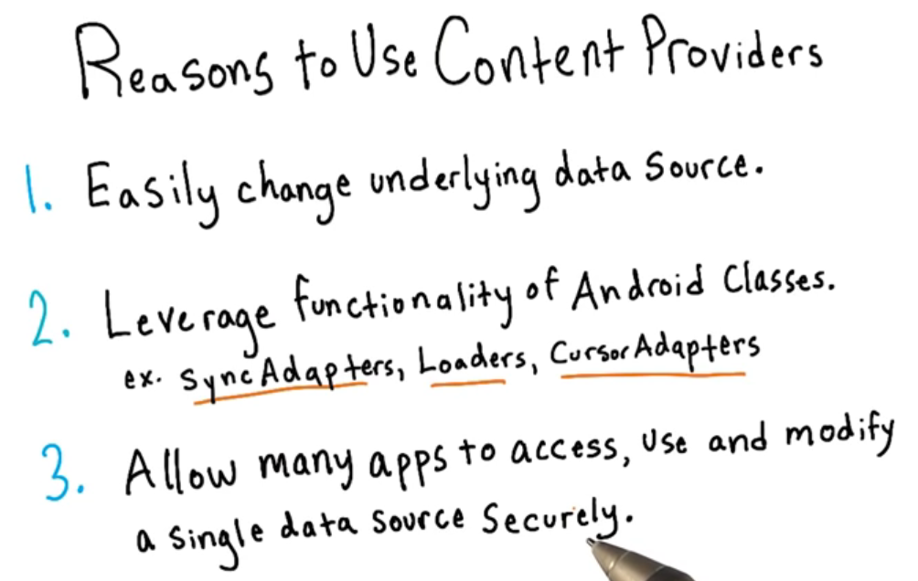
Do I need them?

Slide 8
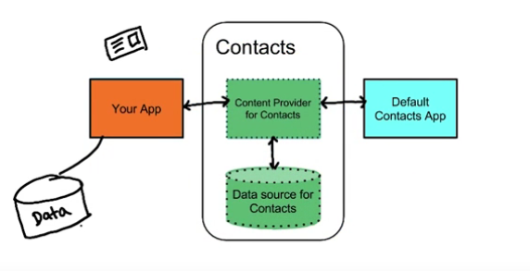
Do I need them?

Slide 9
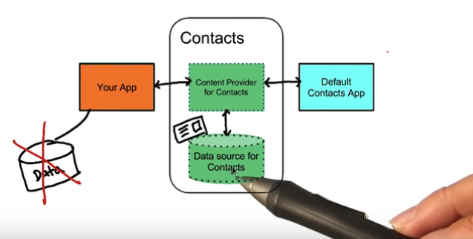
Do I need them?

Slide 10
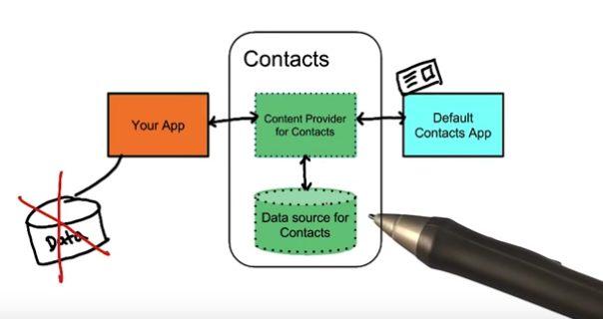
Do I need them?

Slide 11
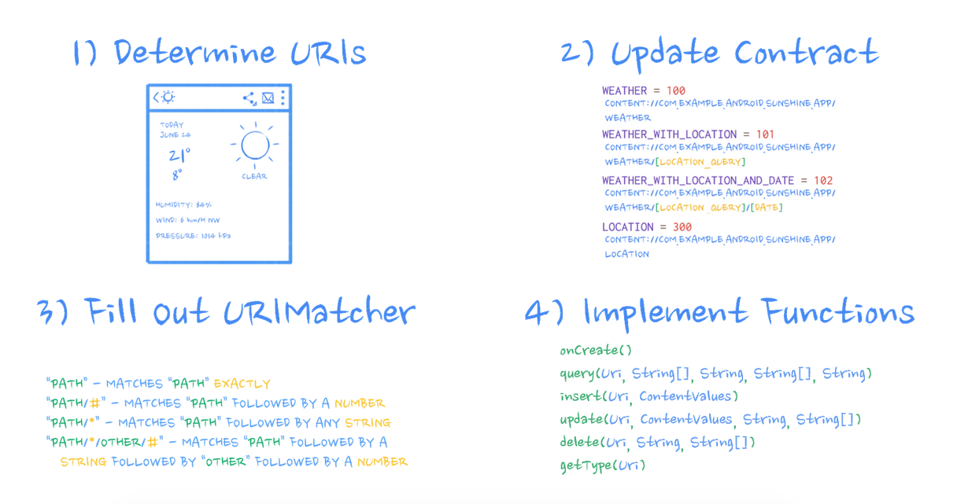
Our Content Provider: Weather Provider
Provider
Lesson: https://classroom.udacity.com/courses/ud258/lessons/3372188753/concepts/34096686680923#

Slide 12
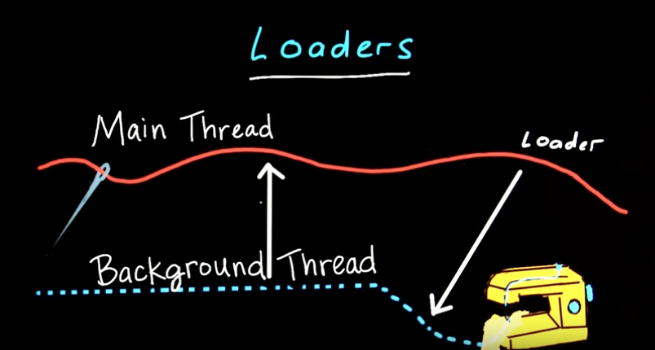
Loaders
Loaders Are Awesome
AsyncTaskLoader is a Loader that uses an AsyncTask behind the scenes to do its work.

Slide 13
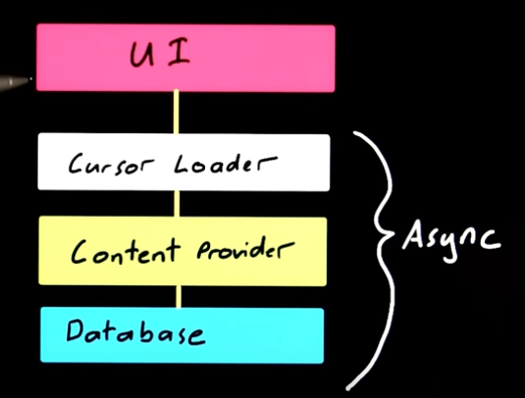
Loaders
- The best way to load data to UI
- Can monitor data source and update UI when necessary

Slide 14
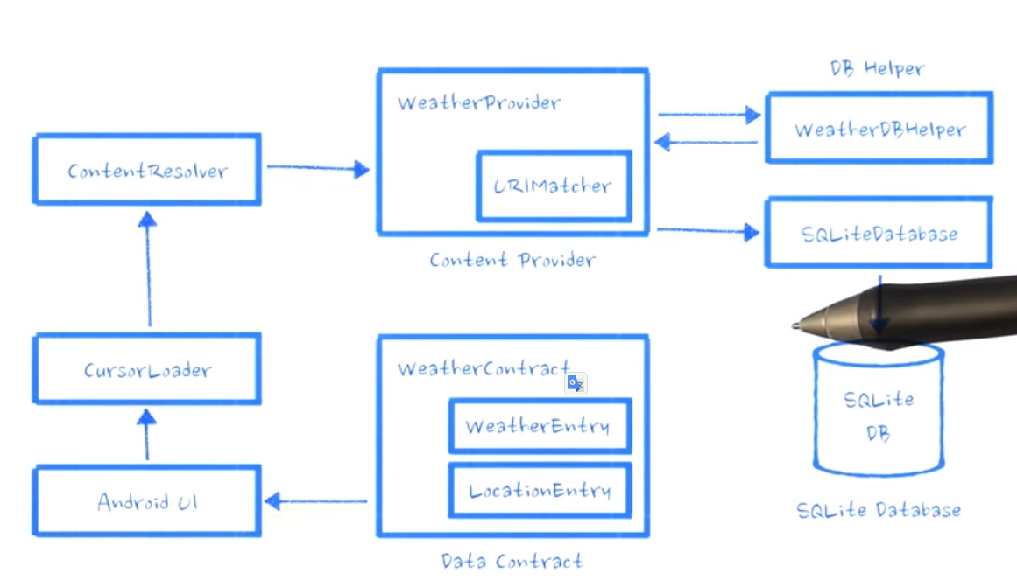
CursorLoader with WeatherProvider

Slide 15
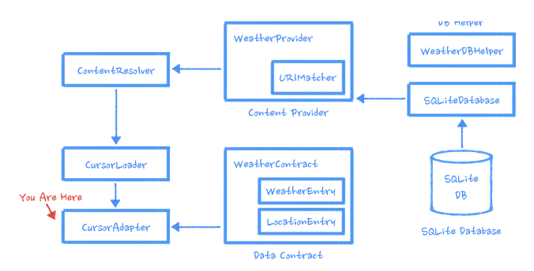
CursorLoader with WeatherProvider
List view

Slide 16
Refactoring Forecast Fragment to prepare it for Loader

Slide 17
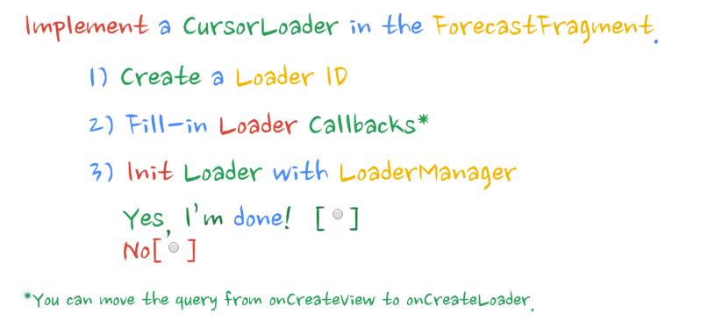
Use of Loaders in Forecast Fragment
see section: Use of Loaders in Forecast Fragment

