Slide 1

Kanpur Python Meetup Group
“Come for the Language , Stay for the Community„
- Brett Cannon
Himanshu Awasthi
@himanshu230195

Slide 2
who are we?
Kanpur Python Meetup group is the non profitable organization which only deal with technology.
KanpurPython Meetup is one of the local Python user groups in our city. Meet other local Python developers, learners, employers, and enthusiasts of all kinds.If you dont know how to code or if you are a beginner. No problem if you are interested in Python, we are interested in you!
You Can Find us here :
  Meetup Group Facebook Page Twitter

Slide 3
Some Stats about Kanpur Python
Kanpur Python Meetup founded by Himanshu Awasthi at March 27,2017.
April 8 ,2017 was the day when we successfully done our first meetup.
We reached 0 to 250+ member with in 6 month .
We are very fast growing Meetup Group in Kanpur.
We are only active group after PyDelhi in North India .
Tushar Mittal is now Assistant Organizer of this Meetup Group

Slide 4
Python Express
Python Express is the ongoing effort of PSSI with aim of increasing the awareness and awesomeness of Python Programming Language within the student community in India.
Python Express started as an initiative in the month of August 2013, just before the annual PyCon India conference, a bunch of volunteers came together and decided to spread the love of Python far and wide. A lot of colleges and instructors came together conducting numerous workshops, and we celebrated that month as the PythonMonth. Python Month shows how people passionate about python language , the response and enthusiasm was tremendous. PSSI decides if people wanted to learn, and there were people ready to teach, why restrict ourselves to just one month from that day PythonExpress brings tutors, organizations and students together to spread the love of Python far and wide.

Slide 5
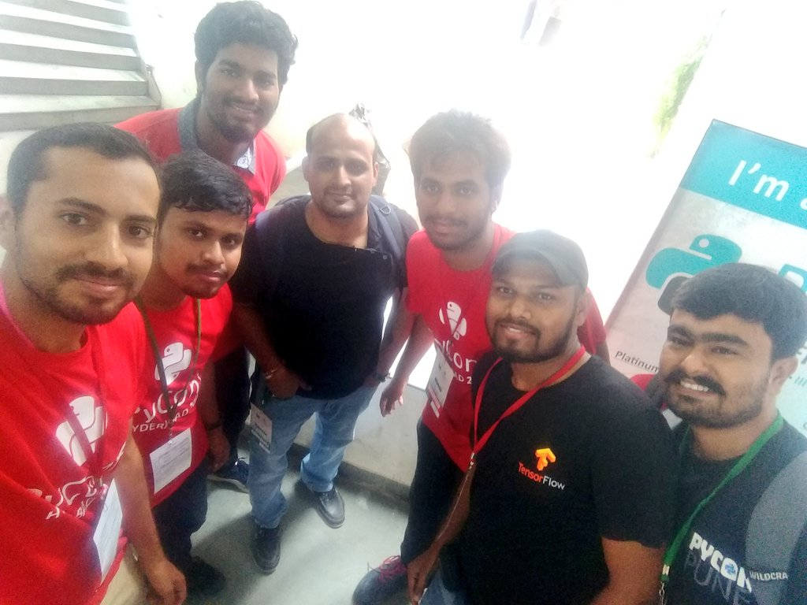
Python Express

Slide 6
Join Us
We try to make kanpur a better place where programmer can live

