Slide 1
Vehicle Depreciation:
Age and Mileage
An exploratory analysis of 1,431 Toyota Corolla listings
Itamar Hoshen · Elad Maisi · Ariel Koritcher
Data Analysis with Statistical Software · Dr. Orit Rafaeli · Research question 2
Notes:
Question 2: how age and mileage relate to price, and whether that relationship is the same for every car.

Slide 2
Two questions, not one
1
How are age and mileage related to price?
Is the relationship a straight line, or does it bend?
2
Is that relationship the same for every car?
Or does mileage matter more for some cars than for others?
1,436 listings · Three variables: Price · Age · Mileage
Notes:
We open with the two halves of the research question and return to them at the end.

Slide 3
Preparing the data
Checked
No missing values. No duplicates.
1,436 listings, three variables.
Removed
5 Verso models
A 7-seat MPV — a different market segment. Not because they were expensive.
Fixed
One engine size of 16,000 cc
A factor-of-ten typing error, corrected to 1,600 cc.
Kept
2 cars showing 1 km at 4 and 6 years old
Flagged as implausible, kept, and re-tested at the end.
Analysis sample: 1,431 cars
Notes:
Every exclusion is justified structurally, not because a value looked inconvenient.

Slide 4
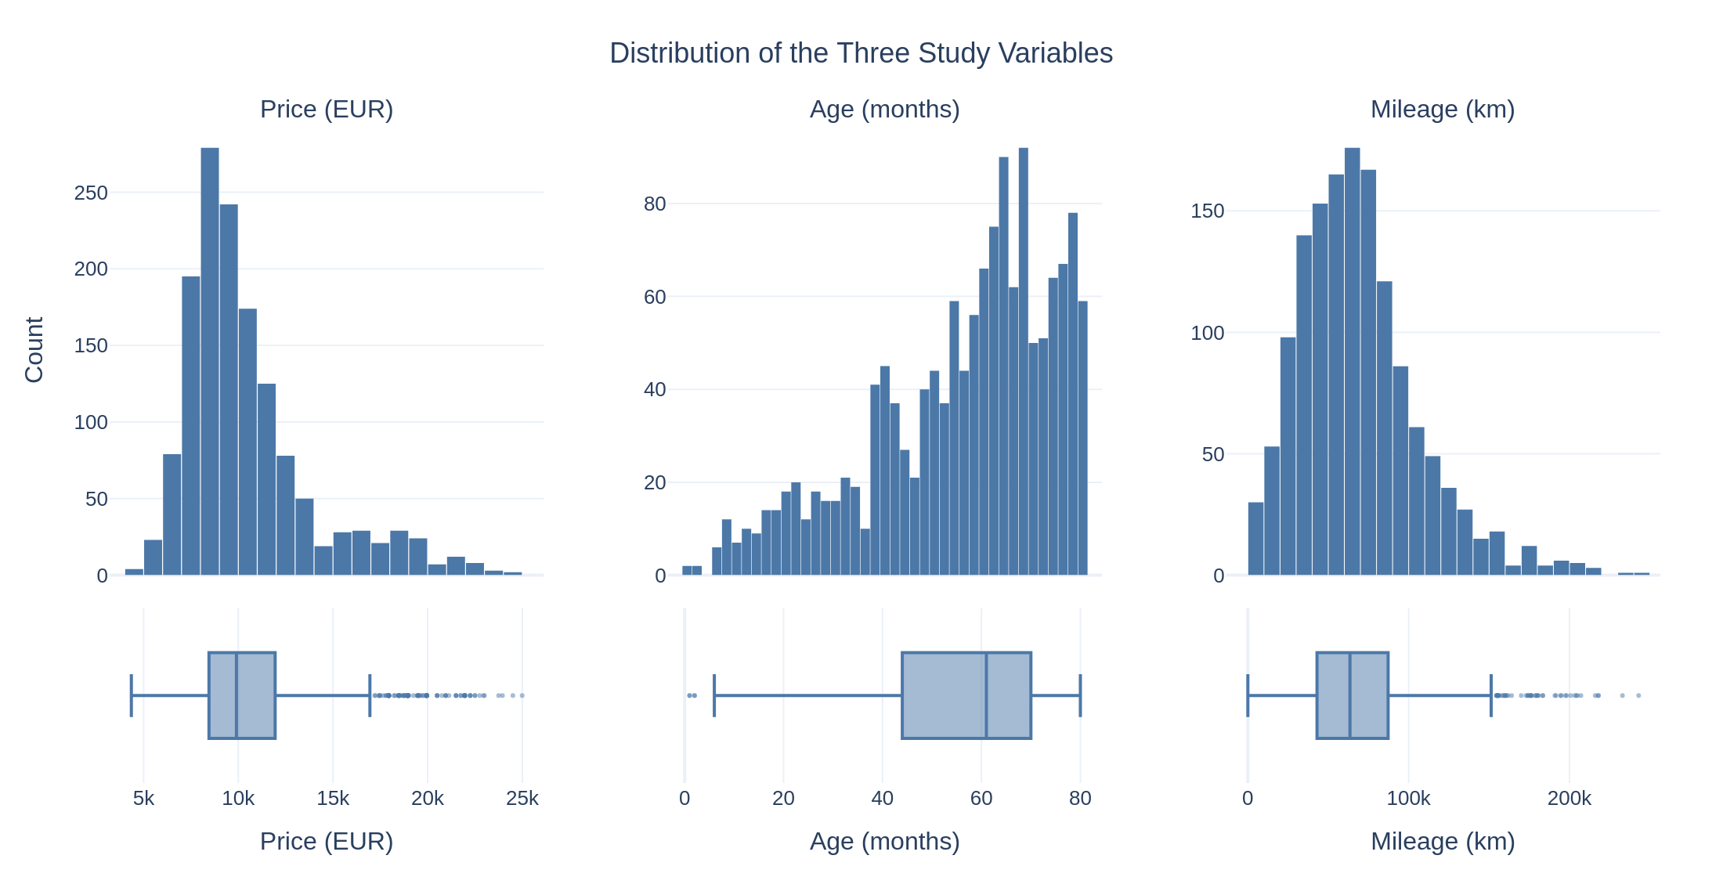
Prices are skewed, so we compared medians and ranks
Price leans right (skew +1.46) — the mean overstates a typical Corolla
Age leans left (skew −0.81) — the sample holds few young cars
7.4% of prices are flagged as extreme. They are young, low-mileage cars, so we kept them
Even a Box-Cox transformation could not make prices normal — so we used rank-based tests
How we checked: skewness, the 1.5×IQR rule, and Box-Cox with Shapiro-Wilk and Levene.
Notes:
Box-Cox reached a skew of −0.01 and normality was still rejected. Levene p = 8.7e-39.

Slide 5
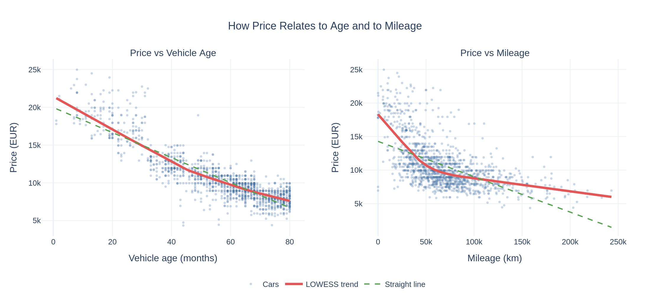
Both matter — but they behave differently
Age: r = −0.88. The trend is close to a straight line
Mileage: r = −0.57. The trend clearly bends — steep at first, then flat
A straight line tracks 32% of the mileage relationship; the curve tracks 44%
How we checked: LOWESS for shape, Pearson against Spearman to test for a straight line.
Notes:
Same direction, different shape. That difference is the first clue.

Slide 6
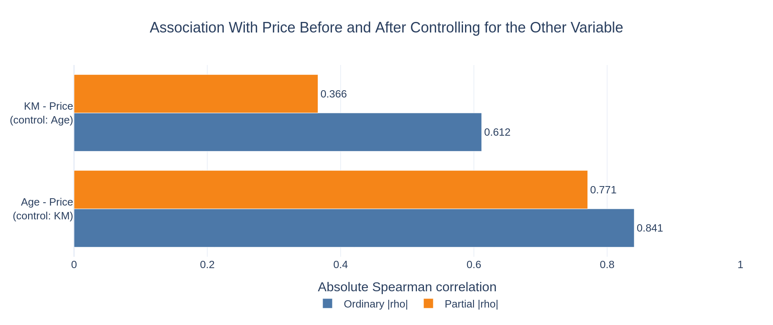
Two-thirds of the “mileage effect” is really age
Older cars have also driven further (r = +0.50), so the two overlap
Hold age constant → mileage falls from −0.61 to −0.37 (−40%)
Hold mileage constant → age falls from −0.84 to −0.77 (−8%)
Age is the real driver. Mileage is genuine, but secondary.
How we checked: partial Spearman correlation, controlling each variable for the other.
Notes:
This is the turning point of the analysis.

Slide 7
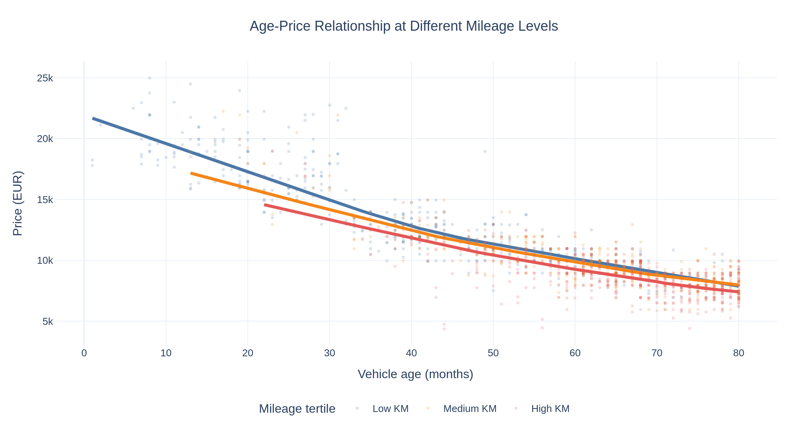
So is the mileage penalty the same for every car?
We split the cars into three mileage groups and plotted price against age
Among young cars the three curves sit far apart
Among old cars they come together
How we checked: quantile split into mileage tertiles, LOWESS fitted separately within each.
Notes:
The curves start at different ages because low-mileage cars are mostly young.

Slide 8
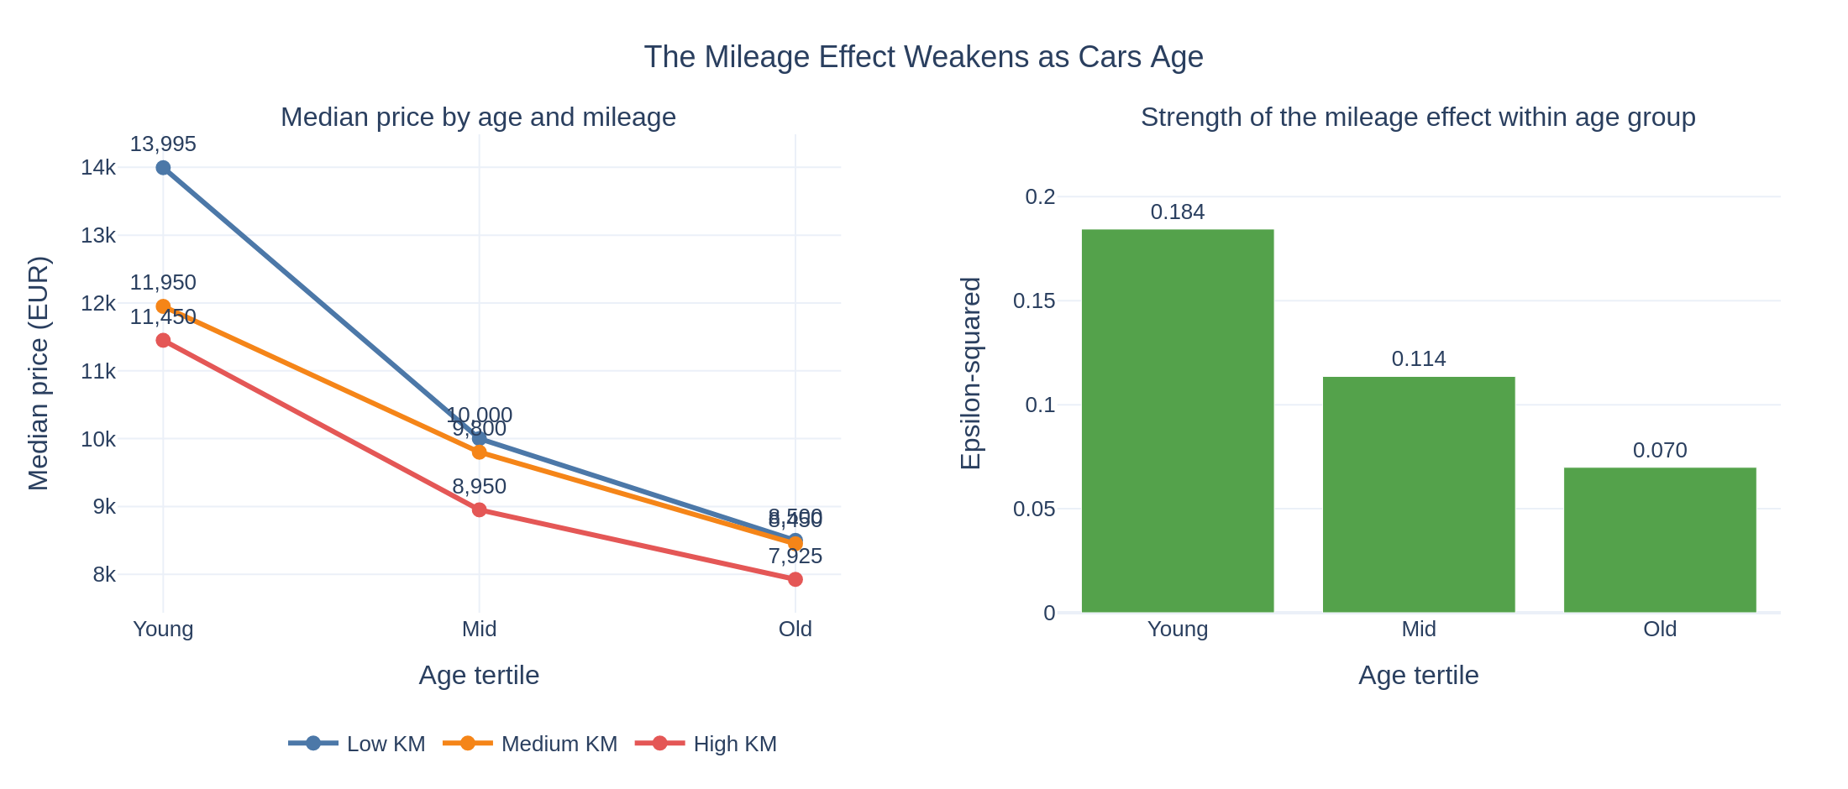
The penalty shrinks by 62% as cars age
 | Young | Mid | Old
Effect size (ε²) | 0.184 | 0.114 | 0.070
Median price gap | €2,545 | €1,050 | €575
Among old cars, low and medium mileage are no longer distinguishable (p = 0.81).
Only the highest-mileage cars still trade at a discount.
It weakens — it does not disappear. Every group stays significant.
How we checked: Kruskal-Wallis within each age group, effect size ε², Dunn post-hoc with Bonferroni.
Notes:
Effect size rather than p-values: at these sample sizes everything is significant.

Slide 9
Answering the research question
1
How are age and mileage related to price?
Both negatively. Age is the stronger and steadier of the two (ρ = −0.84, and −0.77 once mileage is held constant), and its relationship is close to a straight line. Mileage is real but secondary (ρ = −0.61 → −0.37), and its relationship bends: steep at first, then flat.
2
Is the relationship the same at every level of the other variable?
No. The mileage penalty falls 62% from young to old cars, and the price gap narrows from €2,545 to €575. Among old cars, low and medium mileage stop being distinguishable altogether.
The two variables do not act independently — each one weakens the influence of the other.
Notes:
Close the loop opened on slide 2.

Slide 10
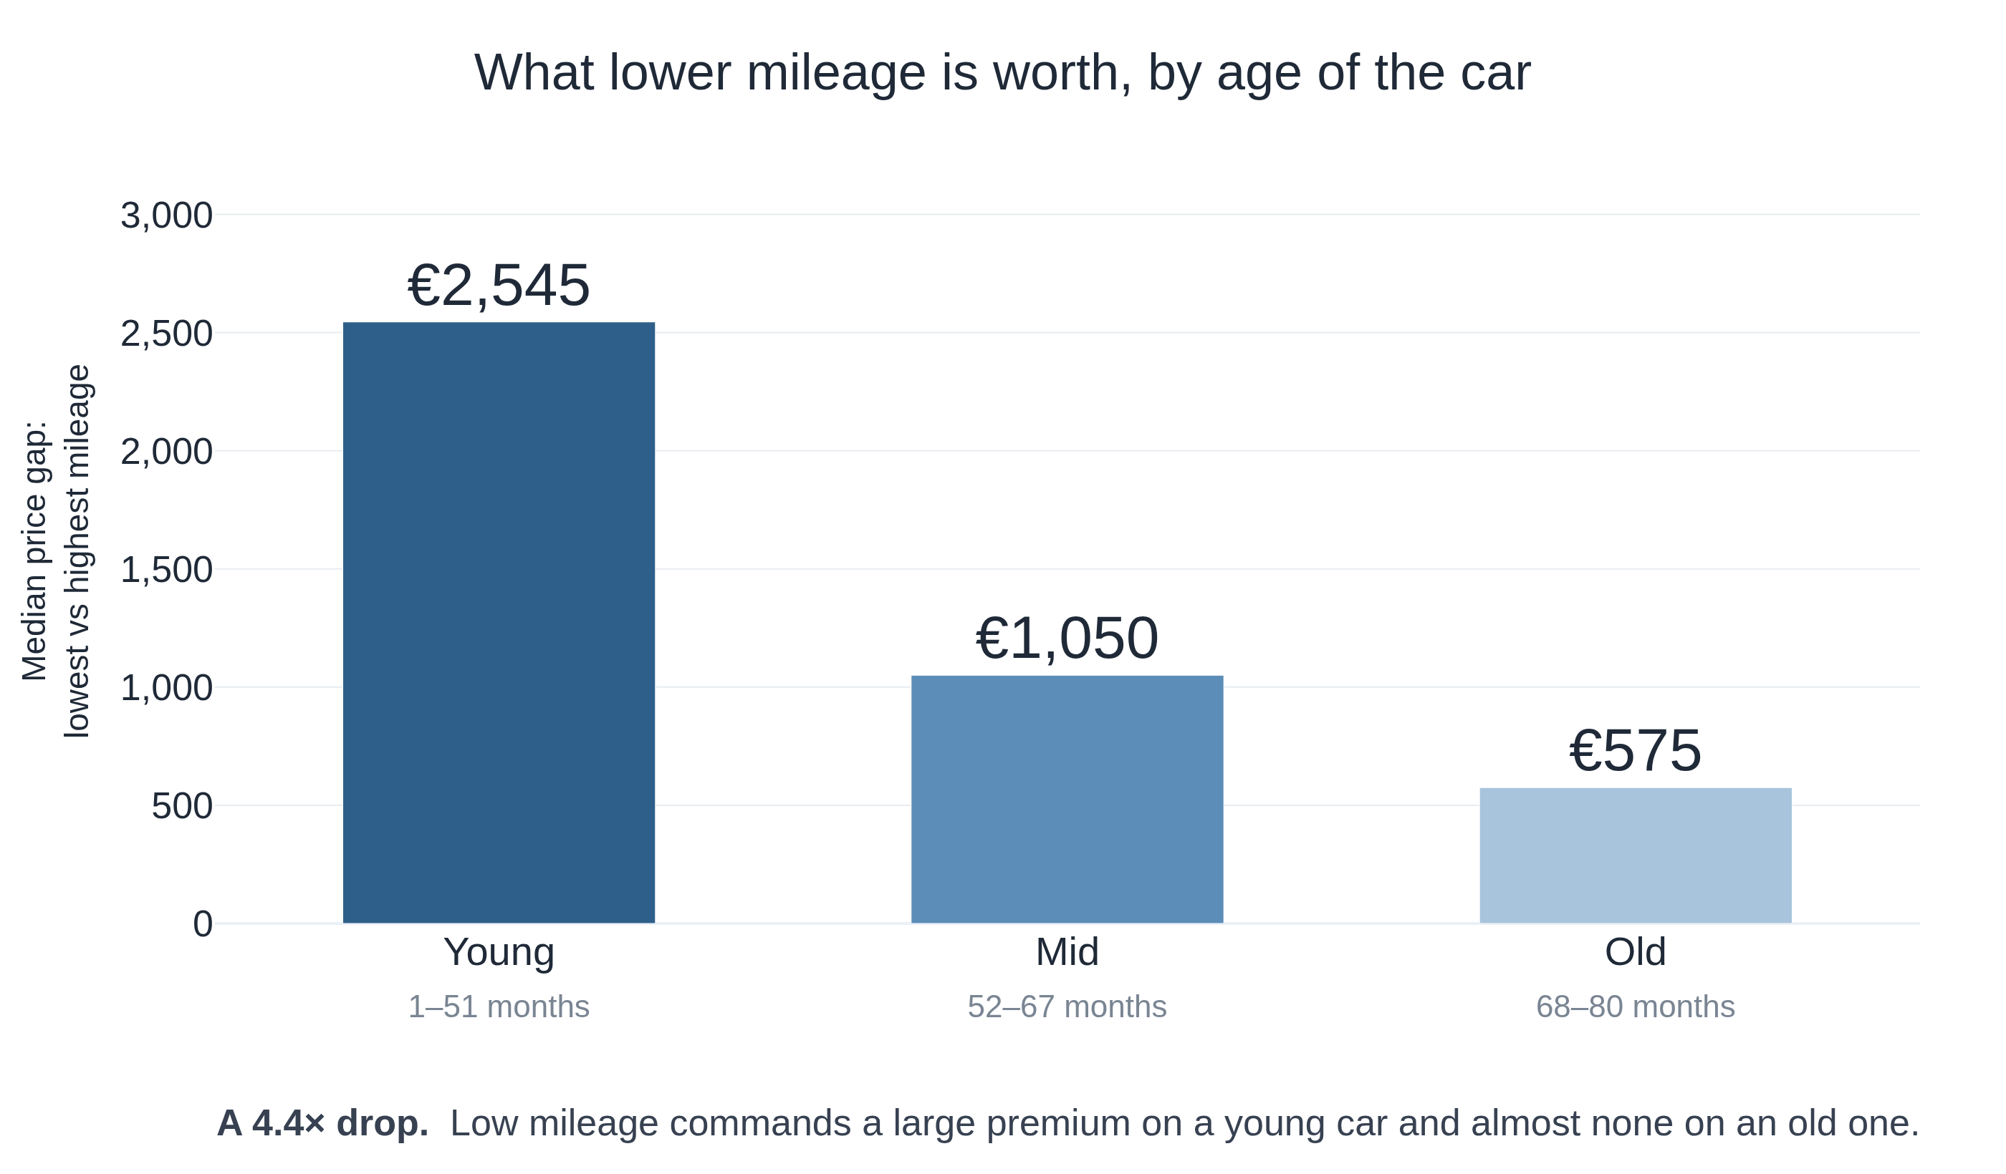
What this means in euros
Buying: check the odometer closely on a young car. On a six-year-old Corolla it barely moves the price
Selling: kilometres driven early are expensive. Kilometres driven late are almost free
Associations observed in one dealership's 2004 data — not causal effects.
Notes:
Keep the language associative. We never claim that adding kilometres causes a loss.

Slide 11
If we built a model
What we found | What we would do
Both variables carry their own information | Keep age and mileage — neither replaces the other
Prices are skewed and never normal | Model log(Price); use robust standard errors
The mileage relationship bends | Add a non-linear term for mileage
The penalty depends on how old the car is | Test an age × mileage interaction
No model was built. The EDA tells us what to test.
Notes:
Part C of the assignment: the EDA guides modelling decisions, it does not perform them.

Slide 12
Backup — how we tested each claim
Question | Method | Why this one
Is the relationship straight? | Pearson vs Spearman | Pearson assumes a line, Spearman does not
Do age and mileage overlap? | Partial Spearman correlation | Removes what the other variable explains
Does the effect change with age? | Kruskal-Wallis within strata, ε² | Makes no distributional assumption
Which groups actually differ? | Dunn, Bonferroni-corrected | Controls error across three comparisons
Could we have used ANOVA? | Levene, Shapiro-Wilk | Levene p = 8.7e-39 with unequal cells — no
Notes:
Not presented. Here in case the methodology is questioned.

Slide 13
Backup — does the conclusion hold?
Check | Result
Verso models included instead of removed | Decline of 63.4% (main analysis: 62.1%)
Two implausible mileage records removed | Decline of 62.4%
Four bins instead of three | Price gap still falls monotonically
Cell sizes | Unbalanced, 54 to 313 — reported as a limitation
The finding survives every cleaning decision we made.
Notes:
Not presented. Shows the conclusion is not an artefact of our choices.

