Slide 1
报告人：台建玮

Slide 2
Detecting Concept Drift in Malware Classication Models
USENIX Security Symposium
Thu Aug 17, 2017

Slide 3
摘要
基于恶意软件行为而建立的机器学习模型被广泛接受为有效的恶意软件分类方法。
这种分类模型的关键要求是需要一种可持续发展的学习模式，用以适应变幻多端的恶意软件样本。
但恶意软件发展迅速，因此不可能运用学习模式来对未来恶意软件的行为做出反应。大部分恶意软件分类器在变得不可持续运行，随着恶意软件的不断发展，迅速过时。

Slide 4
摘要
论文提出了Transcend，一个在部署期间识别体内老化分类模型的框架，这与传统方法有显着差异，当观察到不良的表现时，回顾性地重新训练老化模型。
论文展示了Transcend如何用于识别Android和Windows恶意软件的两个独立案例中的概念漂移，使得模型在由于过时的培训而持续做出不良决策之前，提出了一个警告和缓解办法。

Slide 5
小例子
Usually, a 2-phase process:
1. Training: build a model M, given labeled objects
2. Testing: given M, predict the labels of unknown objects
Objects are described as vectors of features

Slide 6
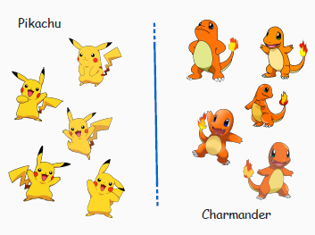
小例子

Slide 7
小例子
Concept drift is the change in the statistical properties of an object in unforeseen ways.
Drifted objects will likely be wrongly classified.

Slide 8
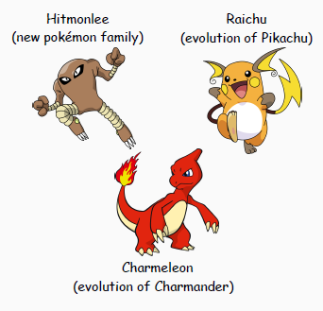
小例子

Slide 9
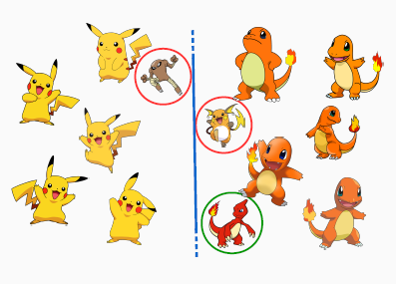
小例子

Slide 10
小例子
Of course, the problem exists in multiclass classication settings.
Multiclass classication is a generalization of the binary case.

Slide 11
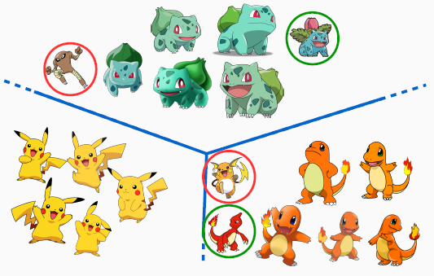
小例子

Slide 12
出发点
In non-stationary contexts classiers will suffer from concept drift due to:
malware evolution
new malware families
SVM
Need a way to assess the predictions of classifiers
Ideally classier-agnostic assessments
Need to identify objects that t a model and those drifting away

Slide 13
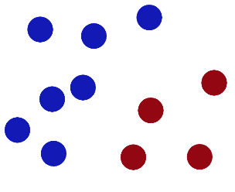
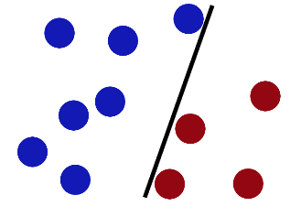
SVM
在很久以前的情人节，大侠要去救他的爱人，但魔鬼和他玩了一个游戏。魔鬼在桌子上似乎有规律放了两种颜色的球，说：“你用一根棍分开它们？要求：尽量在放更多球之后，仍然适用。”

Slide 14
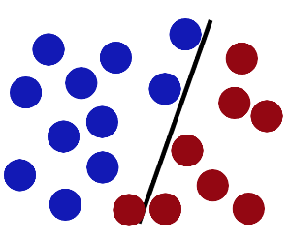
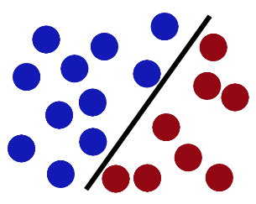
SVM
然后魔鬼，又在桌上放了更多的球，似乎有一个球站错了阵营。SVM就是试图把棍放在最佳位置，好让在棍的两边有尽可能大的间隙。现在即使魔鬼放了更多的球，棍仍然是一个好的分界线。

Slide 15
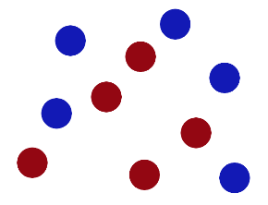
SVM
然后，在SVM 工具箱中有另一个更加重要的 trick。 魔鬼看到大侠已经学会了一个trick，于是魔鬼给了大侠一个新的挑战。

Slide 16
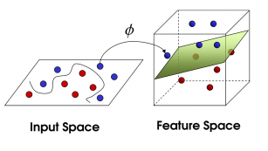
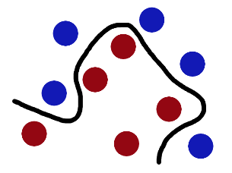
SVM
现在，大侠没有棍可以很好帮他分开两种球了，现在怎么办呢？当然像所有武侠片中一样大侠桌子一拍，球飞到空中。然后，凭借大侠的轻功，大侠抓起一张纸，插到了两种球的中间。现在，从魔鬼的角度看这些球，这些球看起来像是被一条曲线分开了。

Slide 17
SVM
再之后，无聊的大人们，把这些球叫做 「data」，把棍子 叫做 「classifier」, 最大间隙trick 叫做「optimization」， 拍桌子叫做「kernelling」, 那张纸叫做「hyperplane」。

Slide 18
目的
Assesses decisions made by a classifier
Mark each decision as reliable or unreliable
Builds and makes use of p-value as assessment criteria
Computes per-class thresholds to divide reliable decisions from unreliable ones

Slide 19
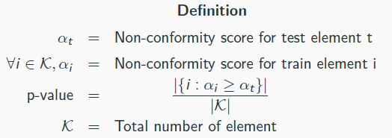
定义
Used to measure " how well" a sample fits into a single class
Conformal Evaluator computes a p-value for each class, for each test element

Slide 20
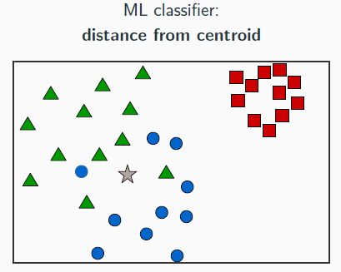
P值
Ratio between the number of training elements that are more dissimilar than the element under test

Slide 21
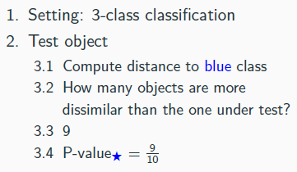
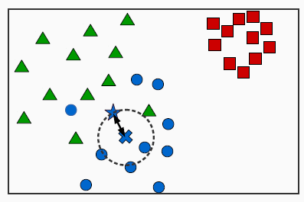
P值

Slide 22
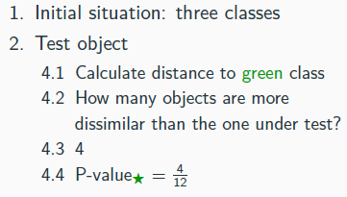
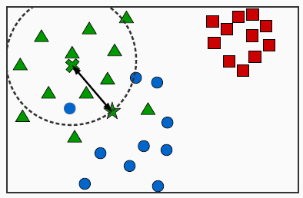
P值

Slide 23
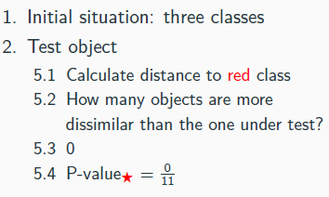
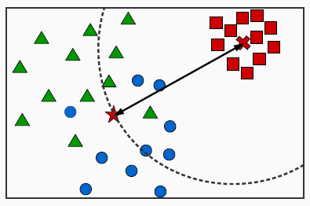
P值

Slide 24
NCM
1. Extracts the non-conformity measure (NCM) from the decision making algorithm
NCM provides non-conformity scores for p-value computations
Example: distance from hyperplane

Slide 25
流程
1. Extracts the non-conformity measure (NCM) from the decision making algorithm
2. Builds p-values for all training samples in a cross-validation fashion
3. Computes per-class threshold to divide reliable predictions from unreliable ones

Slide 26
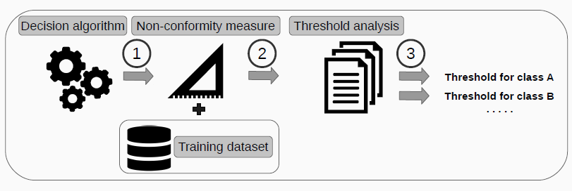
流程

Slide 27
假设
Performance of non-drifted elements are similar to the one declared by the algorithm
Predictions with high confidence will have higher p-values

Slide 28
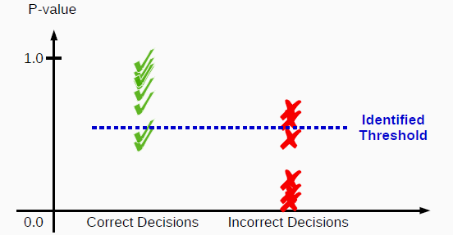
阈值选择
We use the p-values and prediction labels from training samples
From the thresholds that satisfy the constraints we chose the one that maximize one or the other

Slide 29
实验用例
Binary case study: Android malware detection algorithm
Reimplemented Drebin1 algorithm with similar results (0.95-0.92 precision-recall on malicious apps and 0.99-0.99 precision-recall on benign apps)
Static features of Android apps, linear SVM (used as NCM)
Concept drift scenario: malware evolution
Multiclass case study: Microsoft malware classication algorithm
Solution to Microsoft Kaggle competition2, ranked among the top ones
Static features from Windows PE binaries, Random Forest (used as NCM)
Concept drift scenario: family discovery

Slide 30
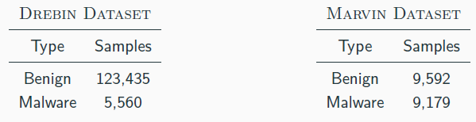
数据集
Drebin dataset: samples collected from 2010 to 2012
Marvin dataset3: malware apps collected from 2010 to 2014
We expect some object to drift from objects in the Drebin dataset

Slide 31
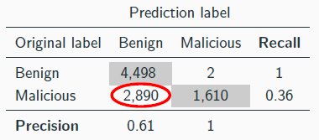
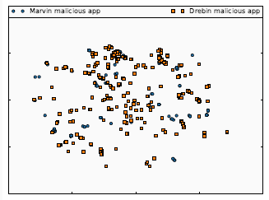
二进制样本实验
Experiment: Drift Conrmation
Training dataset: Drebin dataset
Testing dataset: 4,500 benign and 4,500 malicious random samples from Marvin dataset

Slide 32
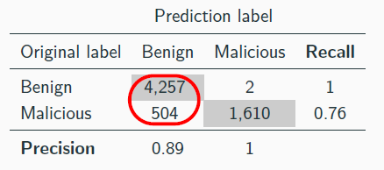
二进制样本实验
Make use of Conformal Evaluator's prediction assessment algorithm
Constraints: F1-score of 0.99 and 0.76 of elements marked as reliable

Slide 33
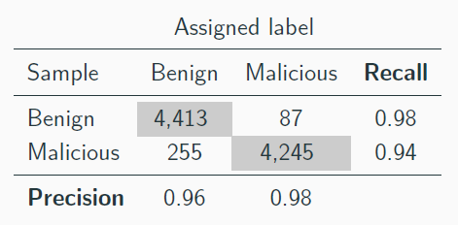
二进制样本实验
Experiment: Retraining
Training dataset: Drebin dataset + samples marked as unreliable from previous experiment
Testing dataset: 4,500 benign and 4,500 malicious random samples of Marvin dataset

Slide 34
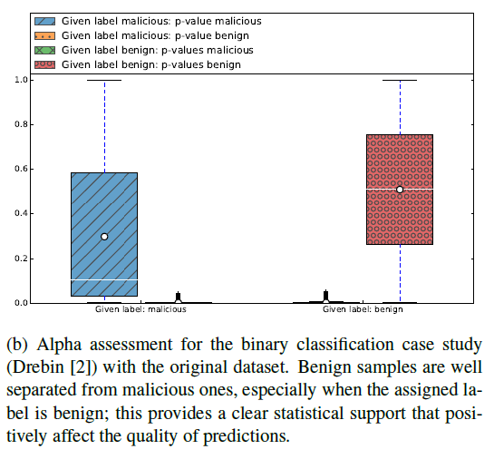
P值效果

Slide 35
P值 VS 概率
p-value and probability distribution for true malicious and benign samples
when the model is trained on Drebin dataset and tested on Marvin.
Graph (a): p-value distribution for true malicious samples.
Graph (b): p-value distribution of true benign samples.
Graph (c): probability distribution of true malicious samples.
Graph (d): probability distribution of true benign samples.

Slide 36
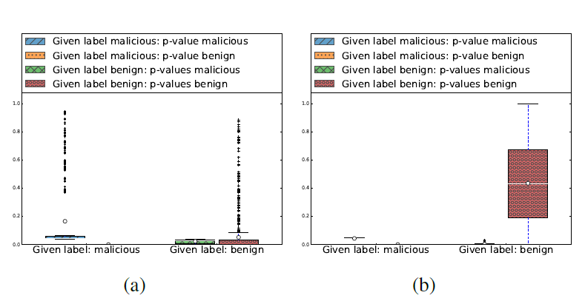
P值 VS 概率

Slide 37
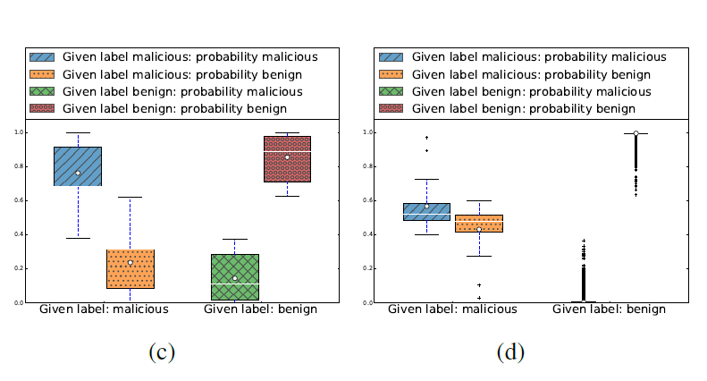
P值 VS 概率

Slide 38
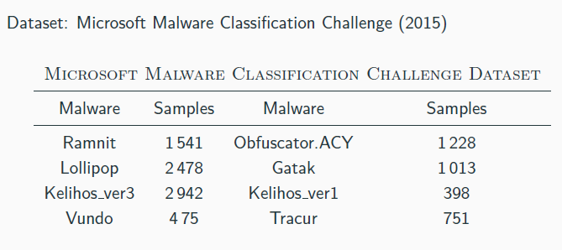
对恶意软件家族的分类

Slide 39
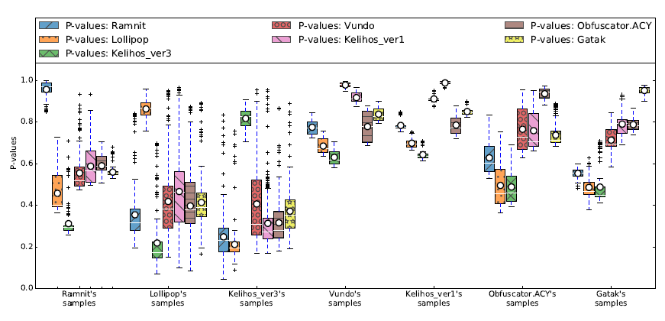
对恶意软件家族的分类

Slide 40
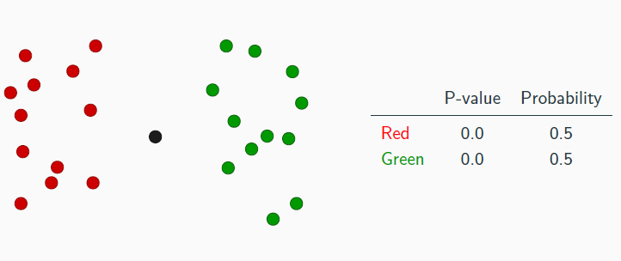
P值 VS 概率

Slide 41
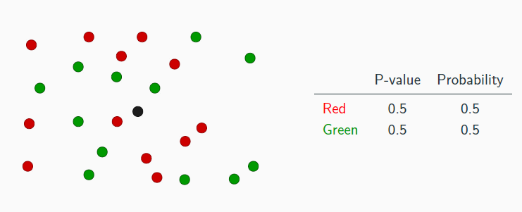
P值 VS 概率

Slide 42
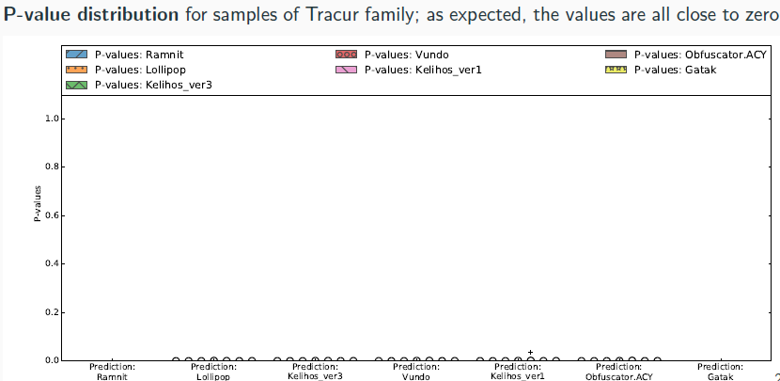
P值 VS 概率

Slide 43
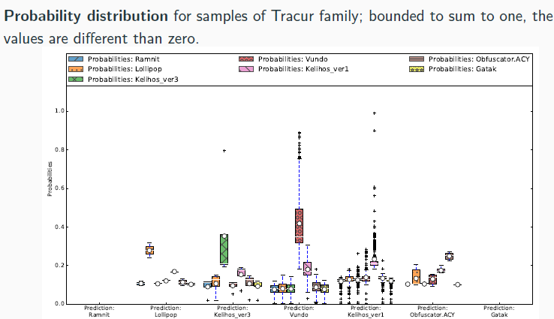
P值 VS 概率

Slide 44
总结
Conformal Evaluator (CE):
Statistical evaluation to assess predictions of ML classiers and identify concept drift
Algorithm Agnostic: Uses non-conformity measure (NCM) from the ML classier
Statistical Support: Builds p-values from NCM to statistically-support predictions
Quality Thresholds: Builds thresholds from p-values to identify unreliable predictions

Slide 45



谢 谢！

