Slide 1

Conservation, Poverty and Indigenous Peoples: are we learning from past mistakes ?
Cambridge 12-13 December 2005

Slide 2
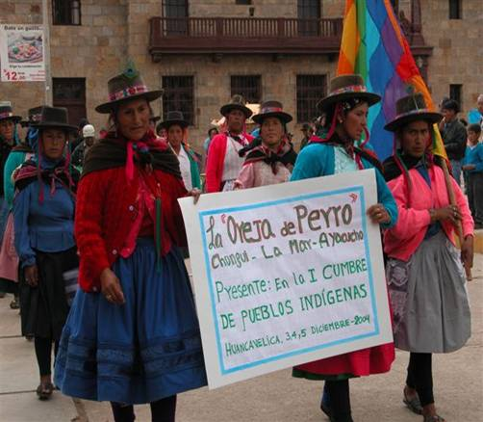
What causes indigenous poverty?
USA: lack of rights and self-governance (Harvard study)
Canada: Royal Commission on Aboriginal Peoples
General: MEA and repeated World Bank studies, Eversole et al.
Any kind of imposition which denies voice and rights has this effect

Slide 3
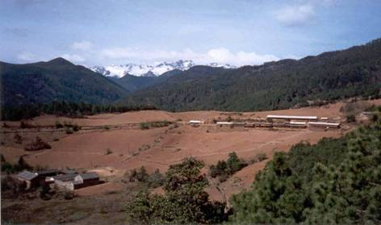
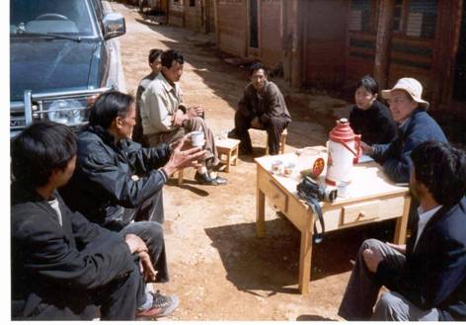
Social Impacts of Exclusion (1)
Denial of rights to land
Denial of use of, and access to, natural resources
Denial of political rights, validity of customary institutions
Kinship systems disrupted
Settlement patterns disorganized

Slide 4
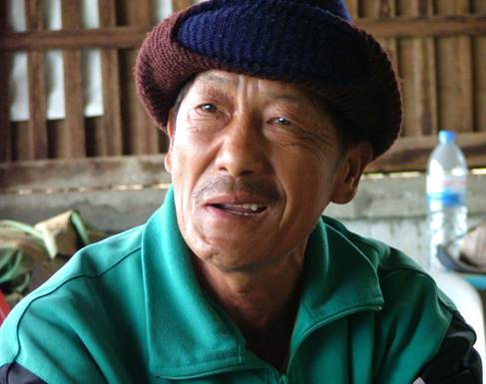
Social Impacts of Exclusion (2)
Loss of informal social networks, livelihoods, property, compensation.
Poverty creation
Disruption of customary systems of environment management
Enforced illegality, subjection to petty tyrannies of officials

Slide 5
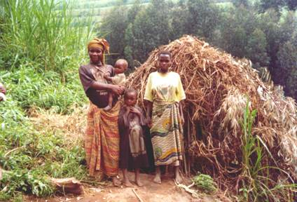
Social Impacts of Exclusion (3)
Forced resettlement
Leadership systems destroyed
Symbolic ties to environment broken
Cultural identity weakened
‘The cumulative effect is that the social fabric and economy are torn apart’
(World Bank)

Slide 6
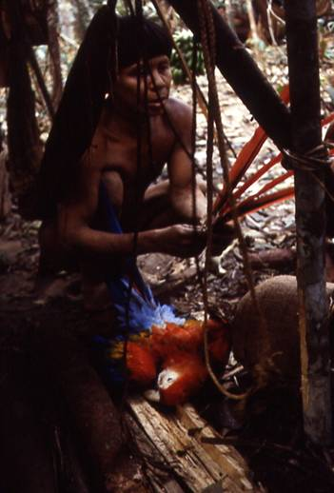
Conservation: same political effect
Conservation is the opposite of development ?
Wilderness is what needs to be preserved ?
People need to be kept out of ‘nature’ / PAs ?
N-S impositions: money and power
Rights not respected
People disempowered
Made poor

Slide 7
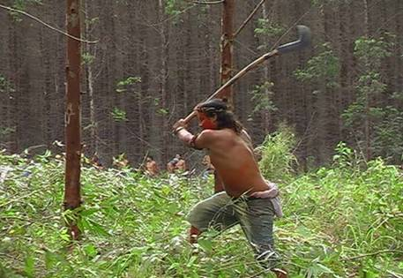
Environmental Impacts of Exclusion
Intensified pressure on natural resources outside the protected areas
Ecosystem decline
Loss of sense of stewardship
Loss of traditional ecological knowledge
‘Incendiarism’, conflict and alienation

Slide 8
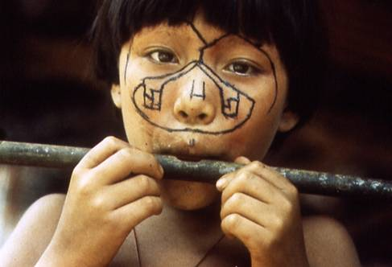
Rights based approaches (1)
There are a lot of rights: individual vs State
Equality before law
Fair trial
Life
Protection of family and children
Privacy and reputations

Slide 9
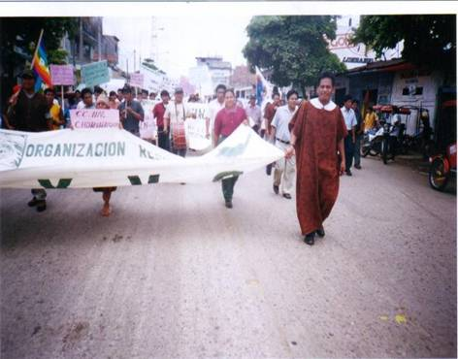
Rights based approaches (2)
Right to peaceful assembly and association
Information
Take part in public life
Rights of minorities
Non discrimination
Property
Healthy environment
Will they cut the mustard?

Slide 10
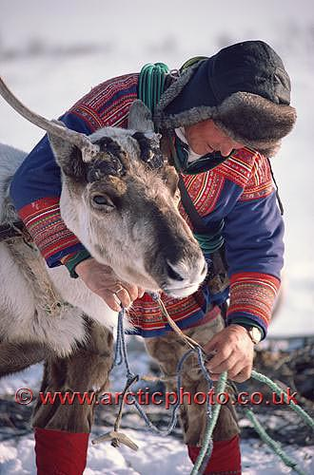
Rights of Indigenous Peoples (1)
Collective Rights of Peoples
Self-determination
Freely dispose of their natural wealth and resources
In no case be deprived of their means of subsistence
Own, develop, control and use their communal lands, territories and resources, traditionally owned or otherwise occupied by them

Slide 11
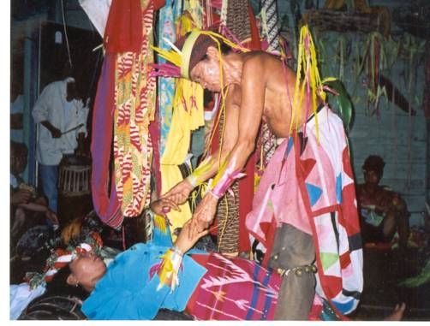
Rights of Indigenous Peoples (2)
The free enjoyment of their own culture and to maintain their traditional way of life
Free and informed consent prior to activities on their lands
Represent themselves via own institutions
Exercise customary law
Restitution of lands and compo for losses

Slide 12
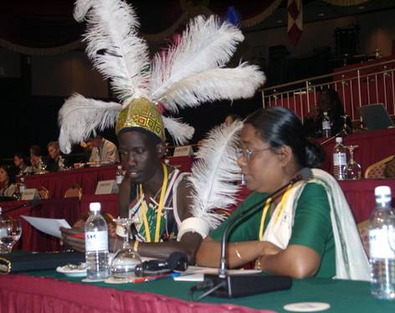
New Principles for Conservation
‘94 IUCN revised PA categories
’96 WWF Principles : rights
’96 IUCN Resolutions: rights
‘99 WCPA Guidelines co-management & negotiated agreements
2003 WPC ‘New paradigm’ Durban Accord and Plan
2004 WCC Endorses Durban Action Plan restitution by 2010
2004 CBD rights in PAs, no forced resettlement,

Slide 13
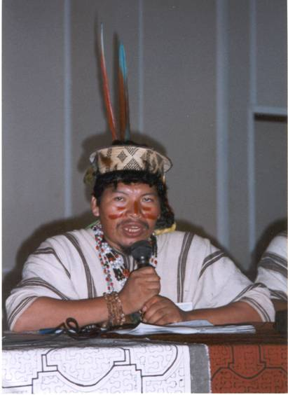
From Principles to Practice: FPP
Pucallpa Conf: 1997
16 Latin American case studies
Kundasang Conf: 1998
14 Asian case studies
Kigali Conf: 2001
11 African case studies
Mobile Peoples: 2002
Chatty and Colchester
GEF Review: 2004
10 Cases examined

Slide 14
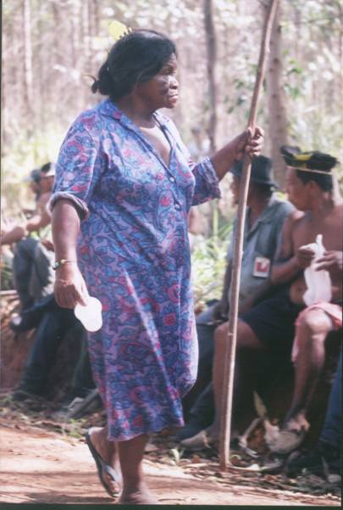
Obstacles to Reform (1)
Discrimination, denial of citizenship
Continuity in policy, laws and institutions
Assimilationist policies
Weak policy and laws with respect to land
Conservation policies/ laws based on old model (few countries adopted revised IUCN categories).

Slide 15
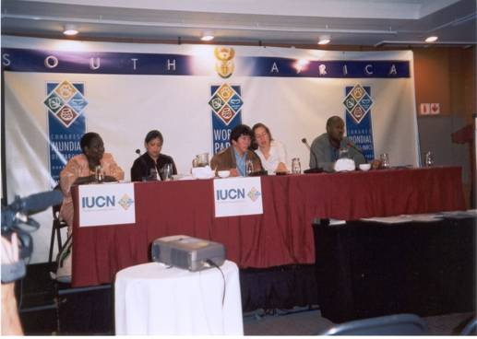
Obstacles to Reform (2)
Conservation NGOs lack appropriate training, staff and capacity to work with communities
No complaints/ redress mechanisms
Recognition of rights limited to ‘traditional’ technologies or conditioned on environmental performance.

Slide 16
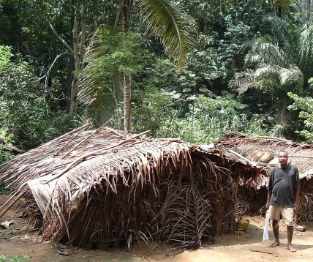
GEF study
Imposed PAs, No FPIC, no tenure
Mitigation not avoidance
Not participants let alone rightsholders
Alternative livelihood model (cf ICDP)
No IP policy
Involuntary resettlement not proscribed
Out of date OP s / no complaints mechanism
No baselines, indicators or M&E

Slide 17
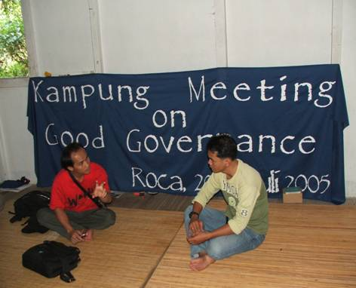
Major Gaps
Which agencies are using rights based approaches successfully?
Can Conservation change its approach?
Where have Conservation and IPs partnered for effective national framework change?
Restitution programme?

Slide 18
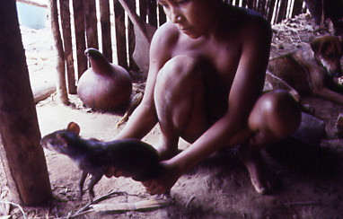
Convention on Biological Diversity
10c - …protect and encourage customary use of biological resources in accordance with traditional cultural practices that are compatible with conservation or sustainable use requirements.
Maps
Document customary use
Develop management plans based on TEK and western science
Identify framework gaps
National dialogues

Slide 19
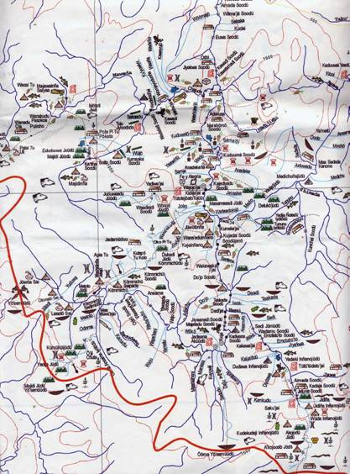
10c project : Swedbio, DGIS, Hivos
Venezuela: Sanema/ Ye’kwana
Guyana : Wapishana
Suriname : Karinya
Cameroon: Baka
Thailand: Karen and Hmong
Bangladesh: fisherfolk, mangrove dwellers in Sunderbans
FPIC in practice: 4 countries Guyana, Indonesia, Philippines, Peru
Will Conservation partner?

