Slide 1
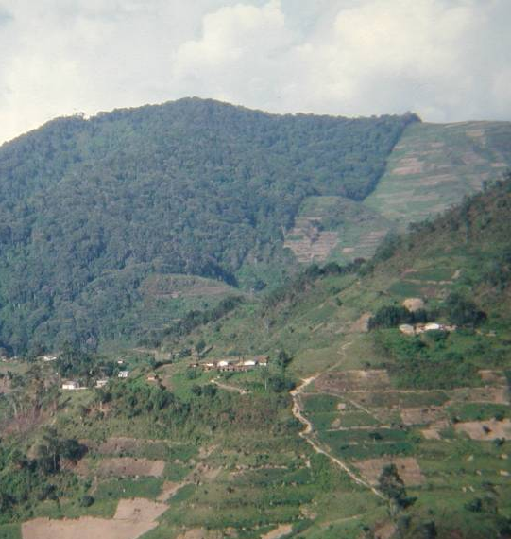
Poverty-Conservation Programming in CARE
A global programme:
  More than 130 agriculture and natural resource management projects world-wide
  30 of these in 20 countries address the management and conservation of natural forests and woodlands, mostly in areas of high biodiversity

Slide 2
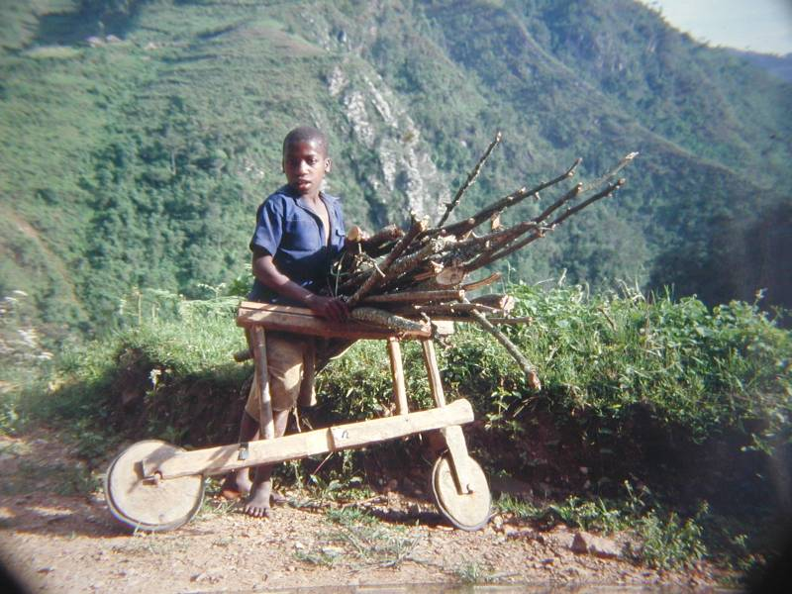
CARE’s Interest
CARE’s interest in NRM is to enhance the livelihoods of poor men, women and children by promoting social justice and equity in the use and sustainable management of natural resources. At the heart of this approach lies the reconciliation of national and international interests with the aspirations of local people

Slide 3
CARE’s Approach
Key principles:
  Increasing local community control over resources
  Fair reward for environmental stewardship
Key elements:
  Co-management/community-based management
  Strengthening grass roots civil society
  Pro-poor PES/conservation financing
  Rights-based approach

Slide 4
Global Level P-C Initiatives
CARE ICD Network
  20 countries
  To enhance the impact of CARE’s NRM programming in terms of promoting social justice and equity in the use, sustainable management and conservation of natural resources
Promoting Biodiversity Conservation with Social Equity
  Uganda, Kenya, Thailand, Philippines
  To characterise and demonstrate approaches to governance and financing of protected areas that achieve equitable sharing of costs and benefits of biodiversity conservation at local level, and between local, national and global levels.

Slide 5
Global Level P-C Initiatives
Action Research into Poverty Impacts of PFM
  Nepal, Vietnam, Kenya, Uganda
  To determine the extent to which Participatory Forest Management provides sustainable benefits to the poorest rural households, and to identify ways of making PFM approaches more “pro-poor”
Equitable Payments for Watershed Services
  Philippines, Indonesia, Tanzania, Guatemala, Peru
  To demonstrate and promote approaches to payments for watershed services that are able to deliver poverty reduction as well as environmental objectives

