Slide 1

Conservation Incentives and Equity
COP8: Purpose of positive incentives: Positive incentive measures can influence decision-making by recognizing and rewarding – through monetary and non-monetary means – activities that are carried out for conservation and sustainable use.
COP7 (PAs POW): Identify and establish positive incentives that support the integrity and maintenance of protected areas and the involvement of indigenous and local communities and stakeholders in conservation.

Slide 2
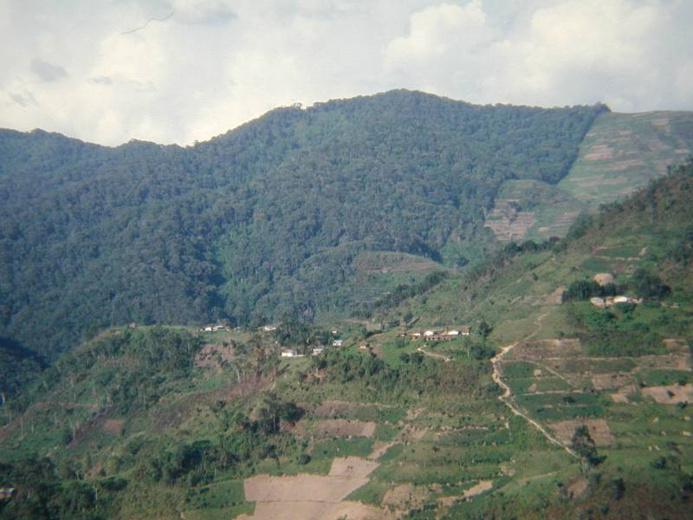
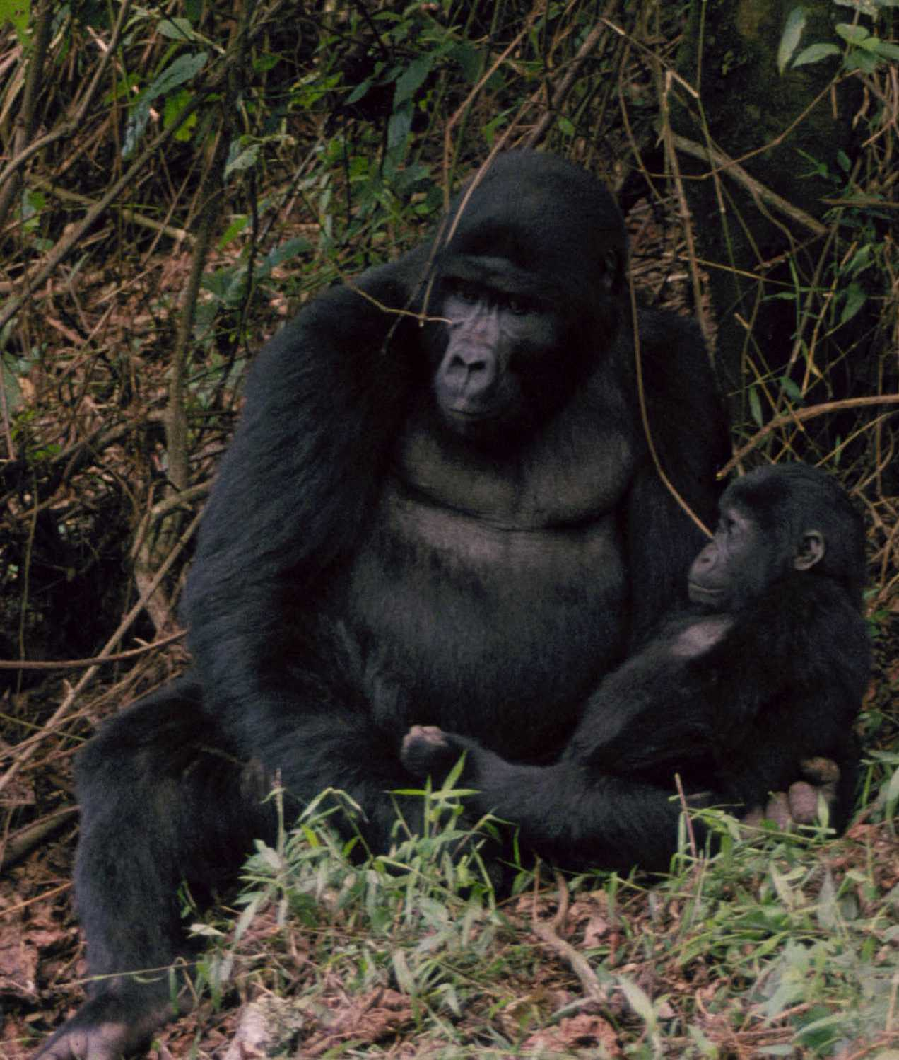
Case Study: Mountain Gorilla Protected Areas

Slide 3
Local Costs
Reduced/lost access to forest resources
Reduced/lost access to cultural sites
Crop damage by wildlife
Restrictions on road development
Labour inputs to assist PA management
Lost opportunity to convert to agriculture

Slide 4
Local Benefits
Water availability
NTFP availability
Employment
Tourism-based enterprise
PA-related projects supporting agricultural production and income generation

Slide 5
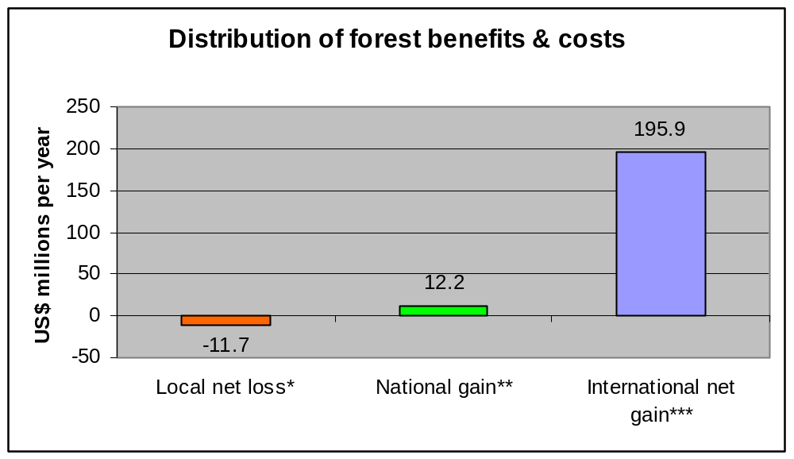
Mountain Gorilla Protected Areas

Slide 6
Costs to Local Communities versus PA Authorities: Lake Mburo NP
Management cost to Uganda Wildlife Authority $370,000
Total benefits to Local Community $230,000/year
Total costs to communities $700,000/year
Net cost to communities $470,000/year
Cost to communities > cost to the PA Authority
  also likely to be the case in Bwindi and Mgahinga NPs
Adapted from: Sustainable Financing of Protected Areas (IUCN, 2005)r

Slide 7
Local Benefits - Uganda
Water availability
NTFP availability
Employment
Tourism-based enterprise
PA-related projects supporting agricultural production and income generation
Tourism revenue sharing
Conservation Trust Fund – MBIFCT

Slide 8
Tourism Revenue Sharing:
1996-2000
Funds derived from tourism revenue
Funded 19 community projects up to 5km from PA – schools, health centres, roads
Total funds disbursed: $76,000 (average of $4000 per project)
Implemented by the PA authority with INGO support

Slide 9
MBIFCT:
1996-2000
An endowment fund supported by World Bank – GEF and USAID
Funded c 50 community projects up to 15km from the PA, mostly schools & health centres
Total funds disbursed c$250,000
Implemented by an independent Trust

Slide 10
Percentage of people citing factors causing decrease in illegal activities:
0
10
20
30
40
50
60
70
80
Law enforcement
Agricultural improvement programmes
Trust support for community projects
Tree & Bamboo Planting
Community benefits from tourism
Access to forest resources
Revenue sharing
Conservation education/awareness
Gravity water scheme (Mgahinga)
Batwa resettlement
Problem animal control
Park-related employment
Other reasons
Don't know

Slide 11
Percentage of people citing each factors causing improved attitudes
0
10
20
30
40
50
60
Agricultural improvement programmes
TRUST support for community projects
Revenue sharing
Community benefits from tourism
Access to forest resources
Tree & Bamboo Planting (i.e. substitution)
Park-related employment
Conservation education/awareness
Problem animal control
Law enforcement
Batwa resettlement
Gravity water scheme (Mgahinga)
Reduced illegal activities
Rangers allow resource access
Park improved security
Access to micro-funds
Other reasons

Slide 12
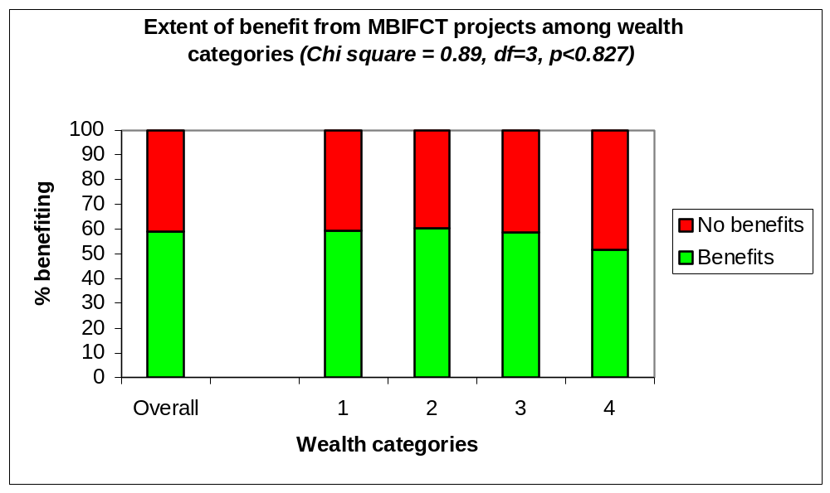
Distribution of Costs and Benefits within Communities
Poorer households are more dependent on PA resources and more impacted by restrictions on access
Benefits from MBIFCT relatively evenly distributed relative to other ICD interventions

Slide 13
Conservation Incentives:
Some Lessons
Investment in social infrastructure proved successful in terms of conservation (contrary to ICD experience).
Revenue sharing initially more cost effective (more conservation per $) because of stronger linkage to PA
BUT has run into problems as linkage to conservation weakened by increasing role of local government
MBIFCT would have more conservation impact if more focused on people most affected by the PA
Despite small funding levels these incentive mechanisms can make a substantial contribution to conservation and equity if carefully targeted.

Slide 14
Why address Equity?
Practical argument: Modern democracies will find it difficult to sustain conservation approaches that disadvantage indigenous and local communities who increasingly have a political voice.
Moral argument: It is unacceptable that the cost of conserving globally important biodiversity should continue to fall disproportionately on the shoulders of the poorest of the poor.
BUT can we afford to address equity in a time of conservation crisis & funding constraints?

Slide 15
Incentives, Equity and the CBD: Back-sliding on the concept
COP1: “priorities of the financial mechanism: i) innovative measures, including …economic incentives…., including those which assist developing countries to address situations where opportunity costs are incurred by local communities and to identify … means by which these can be compensated, in accordance with article 11”
COP6: “any conservation measure has some impact on stakeholders; incentive measures should take into account those who benefit and those who assume the cost of that measure”.
COP8:
  no longer any reference to compensation for local costs
  Purpose of monetary incentives “to create a differential in favour of desirable activities where it is not feasible to discourage the undesirable alternatives through other measures” (ie a last resort)

Slide 16
Incentives, Equity and the CBD: Back-sliding on financing
CBD 1992: “The developed country Parties shall provide new and additional financial resources to enable developing country Parties to meet the agreed full incremental costs to them of implementing measures which fulfill the obligations of this Convention”
Where global conservation goals require more restrictions on the use of biodiversity resources by indigenous and local communities than might otherwise be the case, these opportunity costs are genuinely incremental costs.
Financial obligations of developed countries weakened by weak accountability mechanisms and conditionalities e.g.
  Recurrent costs excluded, thus start-up cost only (i.e. projects)
  Opportunity costs excluded (though in theory acceptable)
to the point where a right has become a privilege??

