Slide 1
Poverty Environment Partnership (PEP)
Steve Bass, IIED 13.12.05
www.povertyenvironment.net/pep

Slide 2
What is the PEP?
Informal network: bilateral dev agencies, multilateral dev banks, UN agencies, INGOs
Goal: to improve coordination of work on poverty reduction and environment
Scope: all env assets/hazards linked to poverty (green/brown/blue), low-income countries
Policy space: DAC/aid, recipient countries
Established: September 2001
Funding: self-funding (donors are secure)
Revolving host: + part-time facilitator, no rules!

Slide 3
Objectives of PEP
Build consensus on links between poverty and envt – esp that better envt management is essential for lasting poverty reduction
Review activities of devt agencies
Generate and promote knowledge, building on common themes and addressing key knowledge gaps

Slide 4
Four areas of collaboration
Knowledge management and exchange of expertise/info on mainstreaming env
Conceptual and analytical work on the links between poverty and env
Joint communication, advocacy, policy dialogue and alliances to influence decisions
Facilitate coordinated work with partner countries and regions

Slide 5
The continuing PEP ‘roadshow’
London September 2001
Washington DC March 2002
New York December 2002
Brussels May 2003
Netherlands February 2004
Berlin November 2004
Stockholm March 2005
Ottawa October 2006
Washington DC June 2006?
Nairobi late 2006?

Slide 6
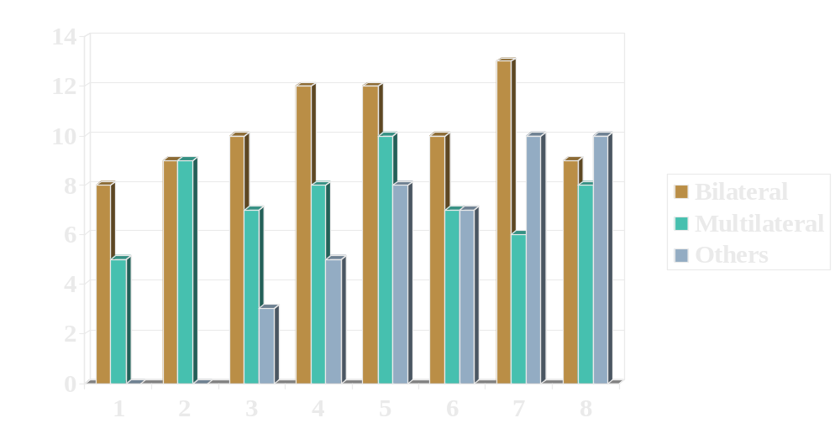
Membership/Participation
Notes:
Attention à l’échelle

Slide 7

Products of PEP
Policy papers – reviews/guidance :
  Poverty-environment links and indicators
  Climate change adaptation
  Environment in PRSs – experiences
  Env fiscal reform – esp forests, fisheries
  Water management for poverty reduction
  Env investment to achieve the MDGs
Policy dialogue:
  Env for MDGs – Millennium Summit
  Pov-env links and indicators – WSSD

Slide 8
Upcoming PEP work
NRs for pro-poor growth (DGIS lead)
Environmental health (WB)
Strengthening economic case for env investments (UN, IIED, IUCN, WRI)
Integrating env in budget support/SWAps (DFID, DCI, CIDA)
Country-level joint work on e.g. national MDG plans, PRSs, PEI countries… ?

Slide 9
Summary of PEP strengths
Informal = flexible, inclusive, inquiring
Multiple agencies = financial and political clout, jointly signed products
Research + consensus = credible products and positions
No secretariat/central budget = encourages volunteers, not competition

Slide 10
Challenges
‘Env’ desks dominate PEP
Internal low profile of env in bilaterals
WSSD + 2005 UN Summit = only ‘profile’
Multiple papers/guidelines – less action
Failure to move from policy coordination to joint funding/implementation
No PEP action in developing countries
Developing country PEP ‘membership’ or counterpart to PEP?
Notes:
Participation in meetings welcome:
particularly when contribution to specific agenda item
Link with the work at country level (to be discussed later)

Slide 11
www.povertyenvironment.net/pep

