Slide 1
Cyclone
By :
Shubhajit Saha, Shamsher Alam, Debu Mahato, Sandeep Tamang, Braja Gopal Dey, Samiruddin Mallick, Arijit Malik

Slide 2
In meteorology, a cyclone is an area of closed, circular fluid motion rotating in the same direction as the Earth. This is usually characterized by inward spiraling winds that rotate counter clockwise in the Northern Hemisphere and clockwise in the Southern Hemisphere of the Earth.

Slide 3
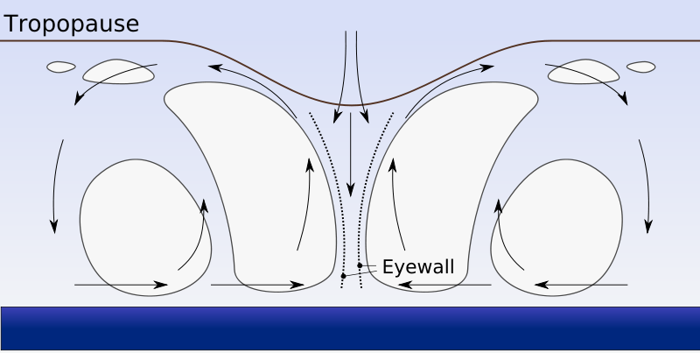
Cyclogenesis: Cyclogenesis refers to the process of a cyclone forming, maturing, occluding, and then disappearing completely. A small cyclone, once formed, evolves through a 4-stage process as it moves, taking several days from start to finish.

Slide 4
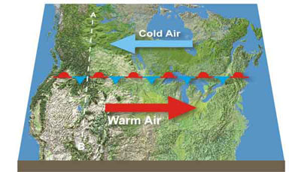
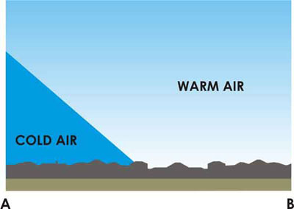
STAGE 1: Stationary Front

Slide 5
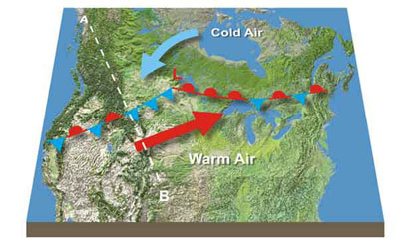
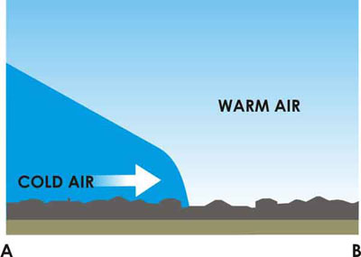
STAGE 2: Formation of a cyclone

Slide 6
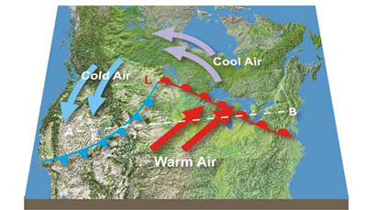
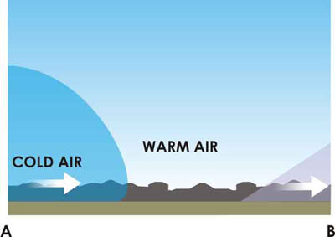
STAGE 3: Maturing depression

Slide 7
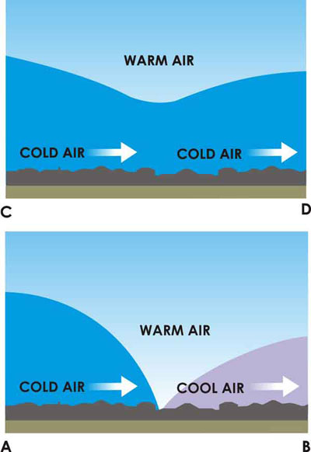
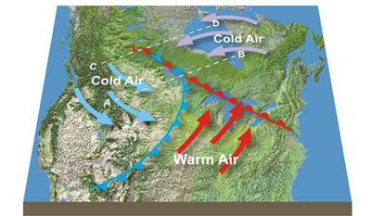
STAGE 4: Occlusion

Slide 8
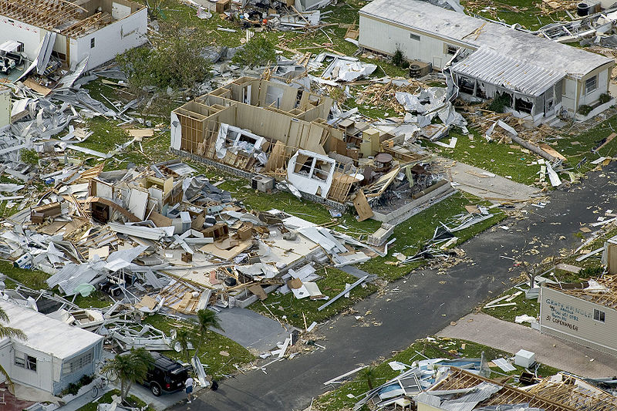
Destruction caused by Cyclones
There are three elements associated with a cyclone, which cause destruction.

Slide 9
1. High-pressure gradients
’
Damage caused by very severe cyclonic storm ‘Nargis

Slide 10
2. Very strong winds
Damage caused by very severe cyclonic storm ‘Nargis’

Slide 11
3. Heavy and prolonged rains
Flood cause by Orissa Super Cyclone

Slide 12
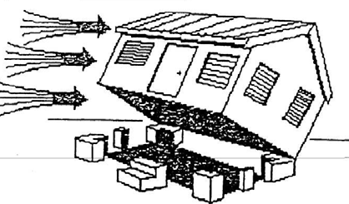
Damaging Effects of Cyclone on Houses
1. Due to the high wind pressure and improper connection of the house to the footings it can be blown away.

Slide 13
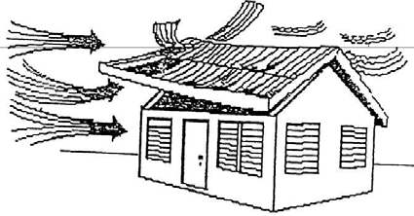
2. Roofing materials not anchored can be blown away.

Slide 14
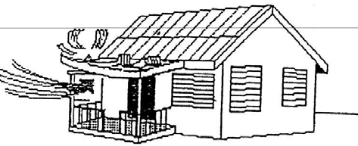
3. Light weight verandah roofs are more susceptible to damage due to high wind speed.

Slide 15
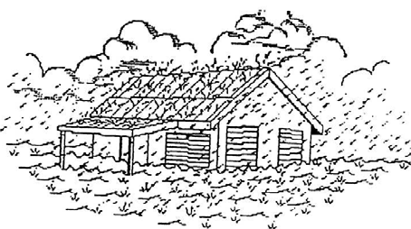
4. When cyclones are accompanied with heavy rain for a long duration, the buildings can be damaged due to flooding also. Building contents are spoiled due to rain when roofing sheets fly away.

Slide 16
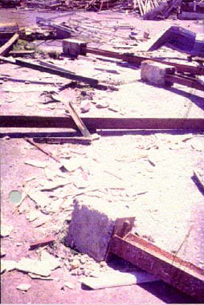
Catastrophic Failures
1. Foundations - The uplift forces
from cyclone winds can
sometimes pull buildings
completely
out of the ground

Slide 17
2. Steel Frames
A common misconception is that the loss of cladding relieves the loads from building frameworks. There are several circumstances where the opposite is the case and where the wind loads on the structural frame increases substantially with the loss of cladding.

Slide 18
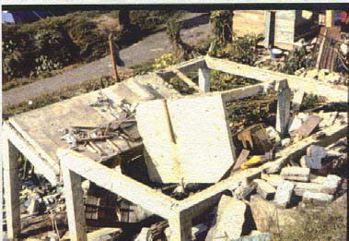
3. Masonry Houses
These are usually regarded as being safe in cyclones. There are countless examples where the loss of roofs has triggered the total destruction of un-reinforced masonry walls.
Total loss of unreinforced concrete block
walls and destruction of reinforced
concrete supports

Slide 19
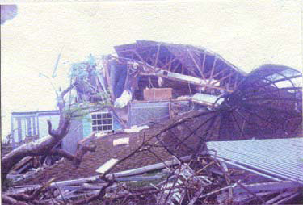
4. Timber Houses
The key to safe construction of timber houses is the connection details. The inherent vulnerability of light-weight timber houses coupled with poor connections is a dangerous combination which has often led to disaster.
Destruction of expensive timber framed
residence (Bahamas)

Slide 20
5. Reinforced Concrete Frames
The design of reinforced concrete frames is usually controlled by the seismic hazard. In countries where this is not an issue care still needs to be exercised to ensure that the concrete frames can accommodate the wind forces. There have been a few isolated examples where, ignoring this, has led to disaster.

Slide 21
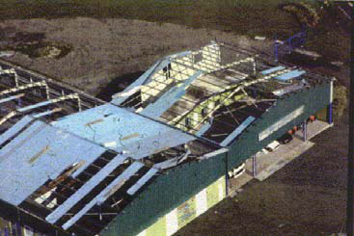
Component Failures
1. Roof Sheeting
This is perhaps the commonest area of failure in cyclones. The causes are usually inadequate fastening devices, inadequate sheet thickness and insufficient frequencies of fasteners in the known areas of greater wind suction.
Loss of corrugated, metal, roof sheets

Slide 22
2. Roof Tiles
These were thought to have low vulnerability in storms but past cyclones have exposed the problem of unsatisfactory installation practices.

Slide 23
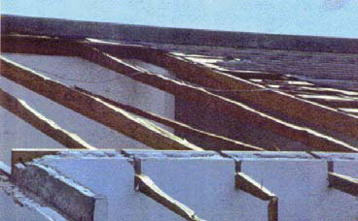
3. Rafters
Of particular interest in recent cyclones was the longitudinal splitting of rafters with the top halves disappearing and leaving the bottom halves in place. The splitting would propagate from holes drilled horizontally through the rafters to receive holding-down straps.
Longitudinal splitting of
timber rafters

Slide 24
4. Windows and Doors
After roof sheeting, these are the components most frequently damaged in cyclones. Of course, glass would always be vulnerable to flying objects. The other area of vulnerability for windows and doors is the hardware-latches, bolts and hinges.

Slide 25
5. Walls
It is not uncommon for un-reinforced masonry to fail in severe cyclones. Cantilevered parapets are most at risk. But so are walls braced by ring beams and columns have remained safe.

Slide 26
Mitigation
A reduction in loss of life and property is possible by taking appropriate measures. People living in the coastal areas are exposed to high risk.
Pre hazard - early warning, exposure and vulnerability
Post hazard – relief, evacuation of people, shelters and rehabilitation intended to reduce consequential loss

Slide 27
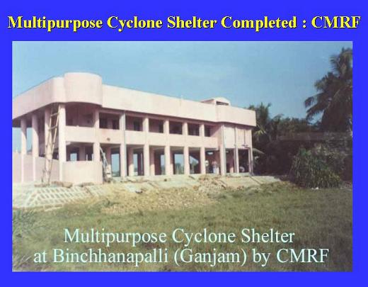
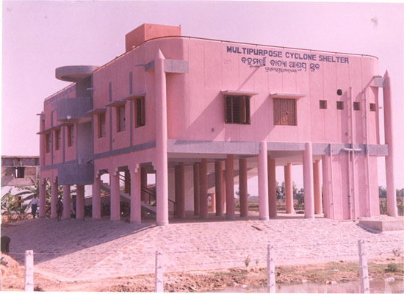

Slide 28
Key Objectives of Mitigation
Reduction in vulnerability of coastal states through creation of appropriate infrastructure which can help mitigate the adverse impacts of cyclones, while preserving the ecological balance of a coastal region.
Strengthening of cyclone warning systems enabling quick and effective dissemination of warning and advisories from source/district/sub-district level to the relevant communities.

Slide 29
Thank you

