Slide 1
Application of GIS in Rural Road and Habitation Mapping
By,
SHAMSHER ALAM (I.D. 110407062)
SHUBHAJIT SAHA (I.D. 110407060)
Under guidance of
Prof. SUJATA BISWAS

Slide 2
General
Infrastructural Facilities.
Good Road Infrastructure.
Highway Network in the Country is Inadequate and Insufficient.
Bitumen-based Macadamized Roads.

Slide 3
Condition of road network of India
Table 1 Indian road network
Almost 80% of passenger traffic and about 65% of freight movement is handled by this vast network.
Class | Length (km)
Access Controlled Expressways | 200 km (120 mi)
4-6 lane Divided Highways (with service rd in crowded areas) | 10,000 km (6,200 mi)
National Highways | 66,590 km (41,380 mi)
State Highways | 131,899 km (81,958 mi)
Major district roads | 467,763 km (290,654 mi)
Rural & other roads | 2,650,000 km (1,650,000 mi)
Total (approx) | 3,300,000 km (2,050,000 mi)

Slide 4
Transport in West Bengal
The total length of surface road in West Bengal is over 92,023 km (57,180 mi)
National Highways 2,377 Km (1,477 mi)
State highways 2,393 km (1,487 mi)

Slide 5
Pradhan Mantri Gram Sadak Yojana (PMGSY)
OBJECTIVE
Provide Connectivity
Upgradation of the Existing Roads.
In Upgradation works, priority should be given to Through Routes of the Rural Core Network, which carry more traffic.

Slide 6
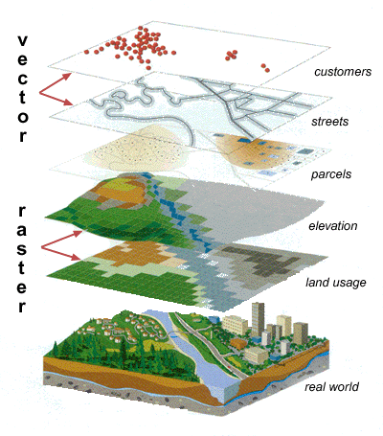
Geographic Information Systems (GIS)
Geographic Information Systems (GIS) or Geospatial Information Systems is a set of tools that captures, stores, analyzes, manages, and presents data that are linked to location(s).
Figure 1 Raster and Vector data

Slide 7
Geographic Information Systems (GIS)
Raster data
a raster graphics image or bitmap is a data structure representing a generally rectangular grid of pixels.
Vector data
Vector graphics is the use of geometrical primitives such as points, lines, curves, and shapes or polygon(s), which are all based on mathematical equations
Different kinds of Vector data
Points
Lines
Polygons
Figure 2 Point example
Figure 3 Line example
Figure 4 Polygon example

Slide 8
GIS in the field of transportation
Using GIS in the field of transportation opens up a wide range of possible applications, as diverse as the field of transportation itself
A GIS can provide a valuable tool for managing these objects in a spatially referenced context, viewing the paths as a transportation network.
Planning and design
Routing
Navigation
Tracking
Traffic control
Evaluation

Slide 9
Objective
To develop habitation database and rural road network database in block level.
To identify the unconnected habitation in the block
To identify the growth centre in block level based on socio-economic parameters.

Slide 10
Scope of the work
The database development is very much useful for problem identification of rural road network planning and management.
It directly helps the villagers to upgrade living quality in terms of livelihood, medical, educational facilities as well as other socio-economical parameters.

Slide 11
Present Study: Data collection
Study Area
Geography: Arambagh is located at 22.88°N 87.78°E. It has an average elevation of 15 meters (118 feet).
Geographical area of Arambagh being: 322.53 km² (32253.47 hectares)
Perimeter = 133.99 km
Economics: This is a rice and potato agricultural area with several cold storages.

Slide 12
Data collection
Various data items required for the development of the comprehensive rural road planning and development can be broadly categorized under three categories
Village Data
Rural Road Data
Map Data

Slide 13
Flowchart for Rural Road Inventory
Village Level Data
V & RIS
Map Data
Habitation Level
Rural Road Inventory
PMGSY Map
Road Reference
Road Geometric Details
Road pavement condition
Terrain & soil type & traffic
CD
Serial no.
Name of the road
Road code
Length
Carriage Width
Surface type
CBR
Total traffic per day
Commercial vehicle per day
Total length
Width

Slide 14
Data collection: Village Data
The block has 242 villages with a total population of 233094. The block has 11 Gram Panchayat headquarters.
A habitation can be defined as a cluster of population, living in an area, the location of which change over time
Table 2 Habitation Facilities
Facilities | Number
School and education centre | 115
Health centre | 103
Market centre | 17
Gram Panchayat Headquater | 11
District Headquater | 0
Block Headquater | 1

Slide 15
Data collection: Road Data
The road inventory data is essential for planning, management of the road system and planning of rural connectivity.
The total existing road length is 282.15 Km.
Table 3 Road Facilities
Type | Number | Length
T- Through Routes | 14 | 50.5 km
L- Link Routes | 47 | 131.65 km

Slide 16
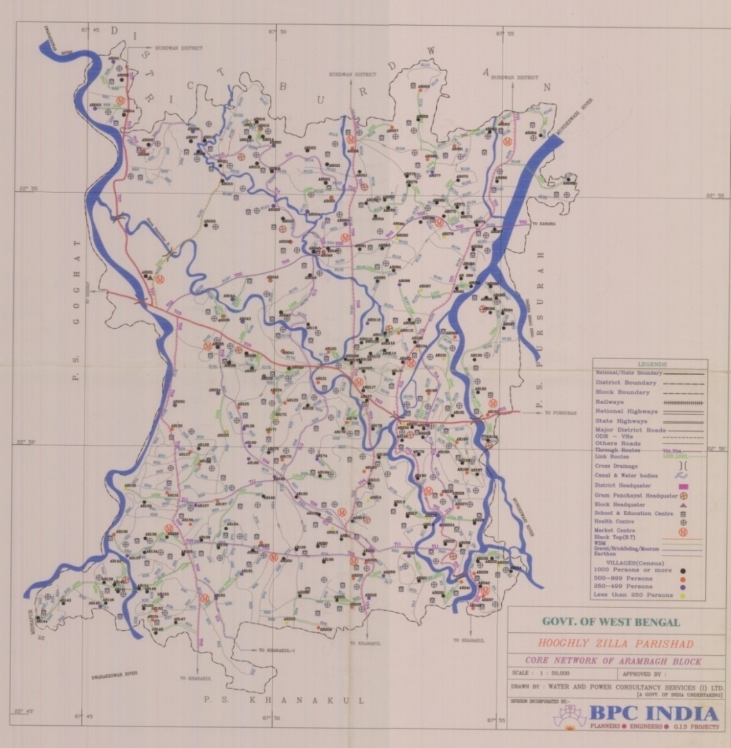
Data collection: Map Data
Figure 5 Map of Arambagh Block (Scale 1:50,000)

Slide 17
Procedure of Work
Geo Referencing using ERDAS Imagine
Application of Arc View GIS
Calculating Length, Area of different theme layers
Table 4 Different Themes used in the block
Theme type | Category
Point | Habitation Health centre School Market place Gram panchyat Block head quarter
Line | Through route Link route
Polygon | Block boundary

Slide 18
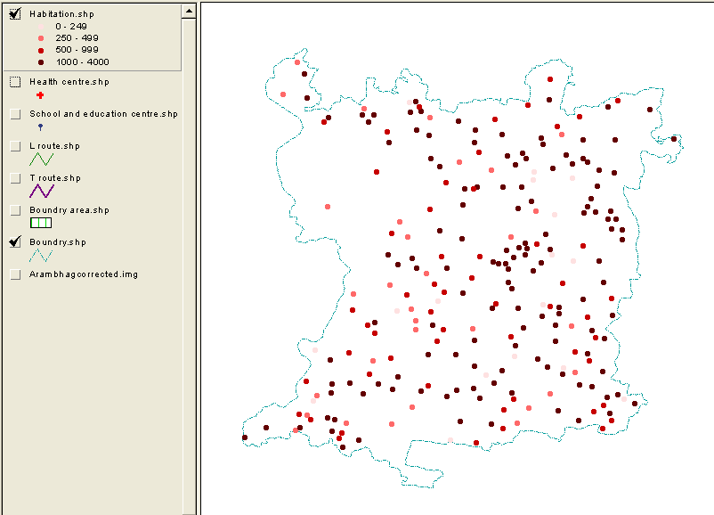
Point: Habitation
Figure 6 Habitation mapping as per population

Slide 19
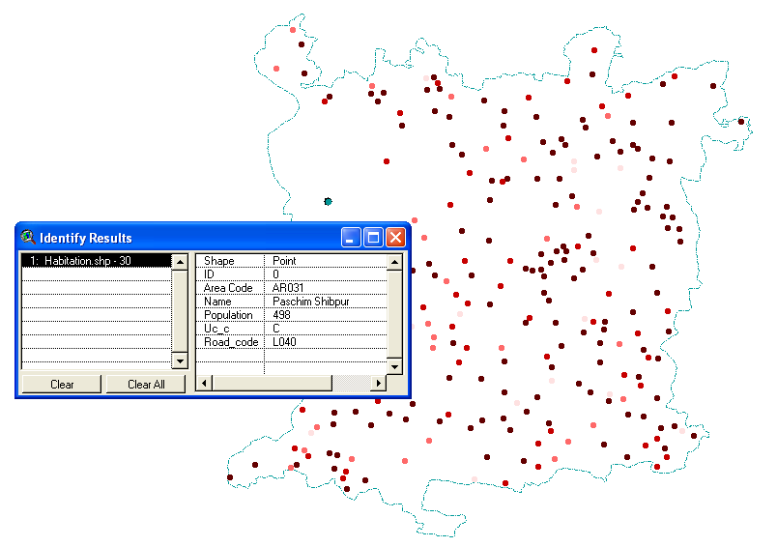
Point: Habitation Data of a selected point
Figure 7 Habitation Data of a selected point (shown in Green)

Slide 20
Point: Habitation Attribute Table
Table 5 Sample Attribute Table of Habitation
AREA_CODE | NAME | POPULATION | UC_C | ROAD_CODE
AR001 | Bhabapur | 253 | UC | L042
AR002 | Maminpur | 2037 | C | T07
AR003 | Paradra | 329 | UC | L041
AR004 | Krithchandrapur | 1154 | C | T07
AR005 | Manodra | 1062 | UC | T10
Table 6 Habitation Intensity
Srl No. | Name of Block | Total No of Habitations | Category
 |  |  | 1000+ | 500-999 | 250-249 | <250 | Total
1 | Arambagh | 242 | 139 | 55 | 31 | 17 | 242

Slide 21
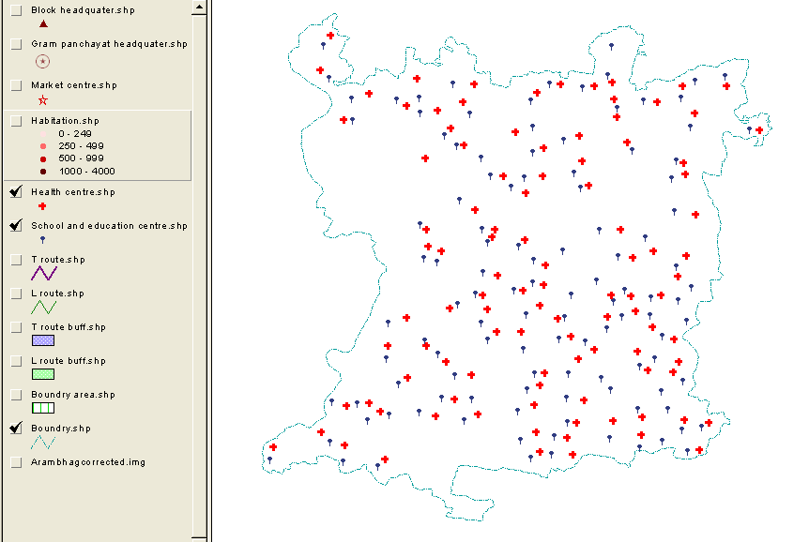
Point: Health centre and School
Figure 8 Schools and Health Centre

Slide 22
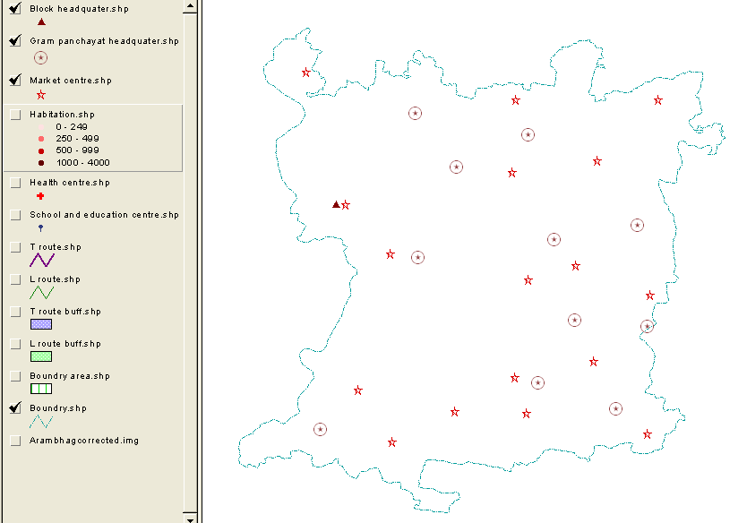
Point: Market place, Gram panchyat and Block head quarter
Figure 9 Block Head Quarter, Gram Panchayat and Market Centre

Slide 23
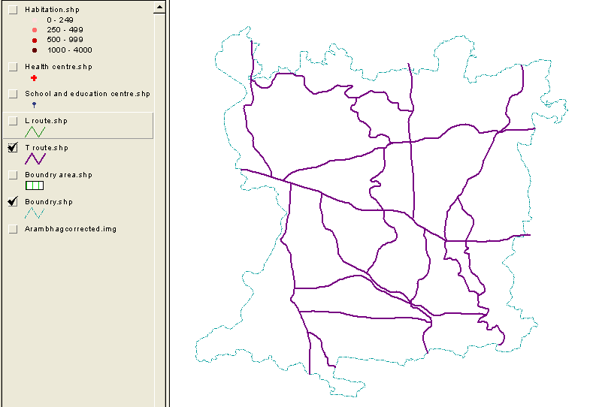
Line: Through route
Figure 10 Through routes in the block

Slide 24
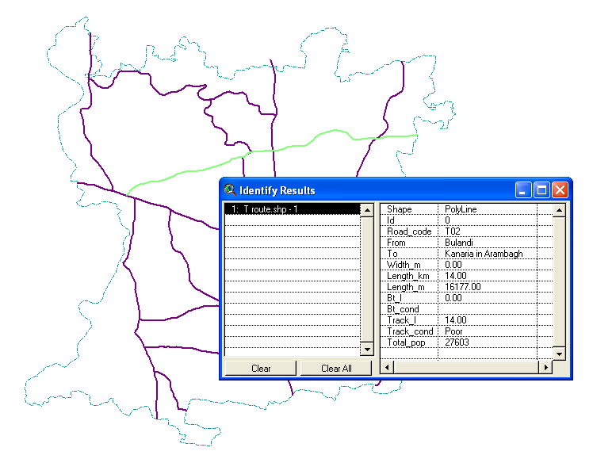
Line: Through route data of a selected route
Figure 11 Road data of selected through route (shown in Green)

Slide 25
Line: Through route data
Table 7 Road data of Through routes
ROAD_CODE | FROM | TO | LENGTH_KM | CAL_LENGTH_M | BT_L | BT_COND | TRACK_L | TRACK_COND | TOTAL_POP
T01 | Fatepur | Tilakchak | 20.00 | 23876.00 | 20.00 | Poor | 0.00 |  | 37783
T02 | Bulandi | Kanaria in Arambagh | 14.00 | 16177.00 | 0.00 |  | 14.00 | Poor | 27603
T03 | Pallishree (Arambag) | Amgram (Continuation of Goghat) | 8.50 | 18369.00 | 8.50 | Good | 0.00 |  | 39417
T04 | Mayapur | Bhanderhati (to Garerghat) | 9.00 | 9396.30 | 9.00 | Poor | 0.00 |  | 18609
T05 | Kapshit | Samta | 7.50 | 7942.00 | 0.00 |  | 7.50 | Poor | 12038

Slide 26
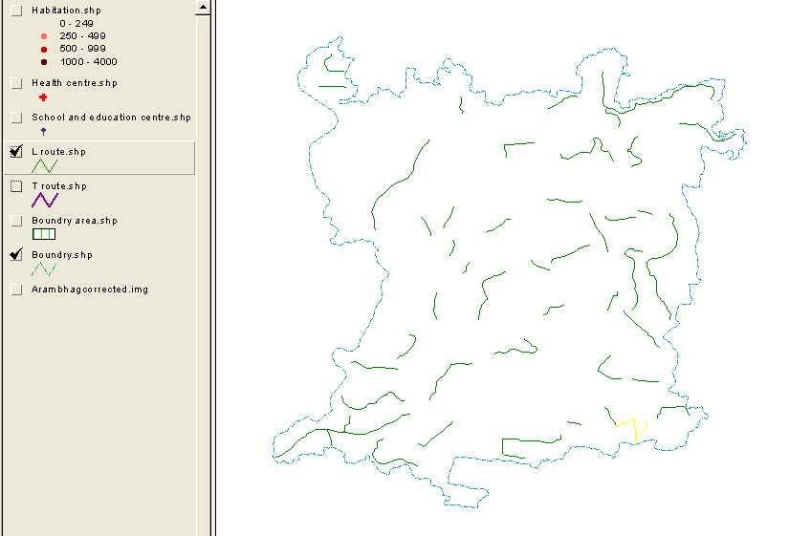
Line: Link route
Figure 12 Link routes in the block

Slide 27
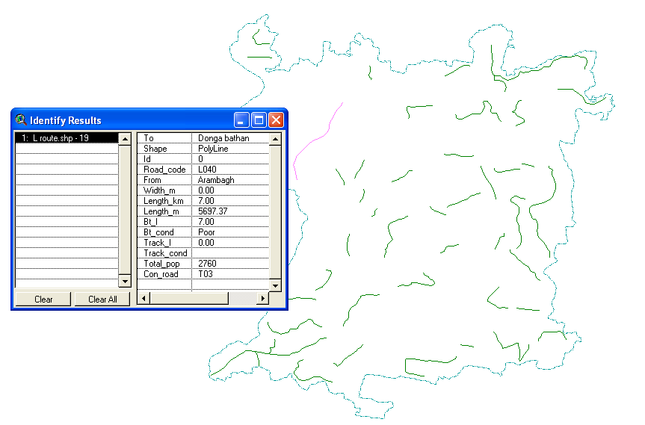
Line: Link route data of a selected route
Figure 13 Road data of selected link route (shown in Pink)

Slide 28
Line: Link route data
Table 8 Road data of Link routes
ROAD_CODE | FROM | TO | LENGTH_KM | CAL_LENGTH_M | BT_L | BT_COND | TRACK_L | TRACK_COND | TOTAL_POP | CON_ROAD
L021 | Fatepur | Purba Haripur | 1.50 | 1943.69 | 0.00 |  | 1.50 | Poor | 1481 | T01
L022 | Balia Road | Bank of Mundeswari rivers (upto Ghargohal) | 3.00 | 3168.22 | 0.00 |  | 3.00 | Poor | 1769 | T01
L023 | Kesabpur Bush Road | Moyrapara | 1.00 | 720.22 | 0.00 |  | 1.00 | Poor | 2373 | T01
L024 | Harinkhola | Purba Kesabchawk | 8.00 | 6082.56 | 0.00 |  | 8.00 | Poor | 11126 | T03
L025 | SH Road | Amgram | 1.00 | 698.02 | 0.00 |  | 1.00 | Poor | 1343 | T03

Slide 29
Analyzing Data
Identification of unconnected habitation
Identification of Growth Center

Slide 30
Analyzing Data: Identification of unconnected habitation
Routes are buffered to 500m range.
All the habitations that lie between the buffered routes are considered as connected

Slide 31
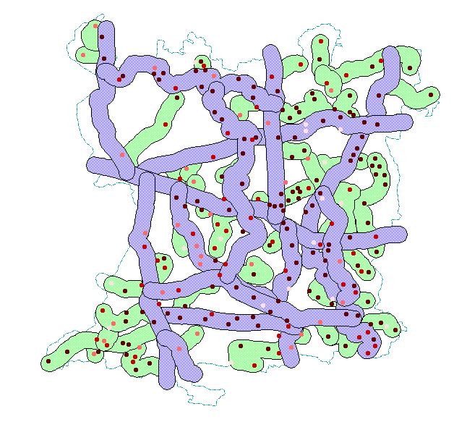
Analyzing Data: Identification of unconnected habitation
From the analysis it is seen that no habitation lies outside the buffered area. So, no habitation can be considered as unconnected.
Figure 14 Buffering of all existing routes to a specified width of 500m

Slide 32
Analyzing Data: Identification of Growth Center
Habitation Under:
1km buffering of health centre
1km buffering of school
2km buffering of market centre

Slide 33
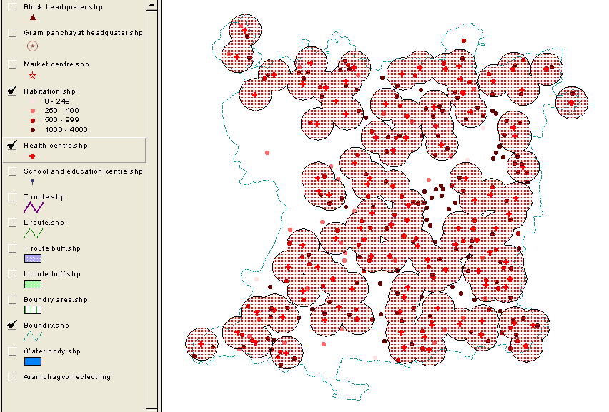
Analyzing Data: Identification of Growth Center
Figure 15 Health center buffered 1 km

Slide 34
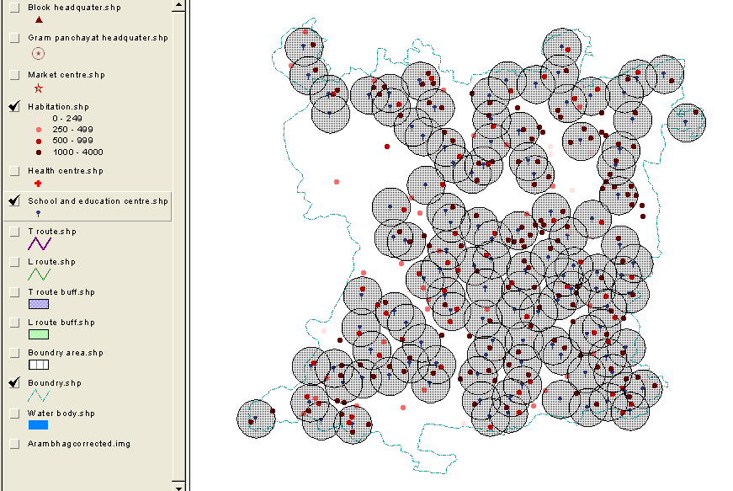
Analyzing Data: Identification of Growth Center
Figure 16 School buffered 1 km

Slide 35
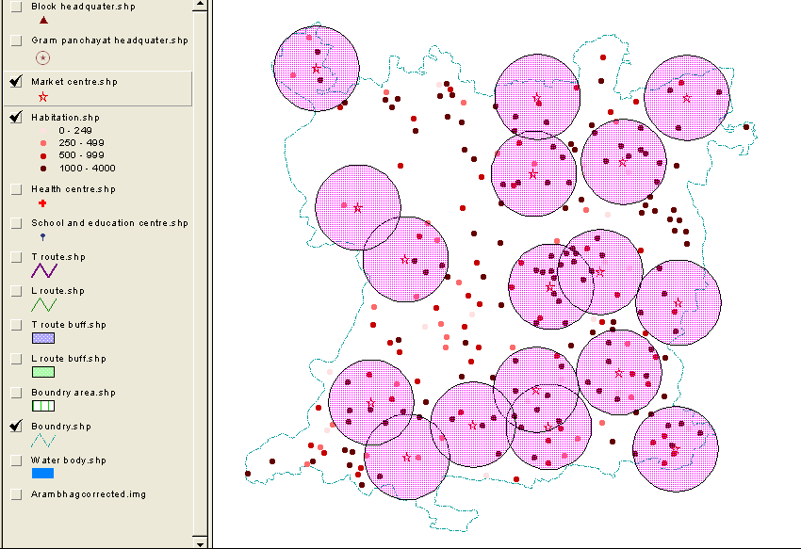
Analyzing Data: Identification of Growth Center
Figure 17 Market centre buffered 2 km

Slide 36
Analyzing Data: Identification of Growth Center
HINDEX
The Utility value for the habitation should consider a set of demographic, socio-economic. Infrastructure and level of development data.
This composite measure of development may be called as HINDEX (Habitation Index) of the habitation

Slide 37

Analyzing Data: Identification of Growth Center
Calculation of HINDEX
The HINDEX for habitation i may be computed as shown in the equation:
HINDEX_{i} = Habitation index for habitation i
F_{xyi} = Number of facility of x^{th} type with y^{th} intensity in habitation i
W_{xyi} = Weight for x^{th} facility of y^{th} intensity

Slide 38
Analyzing Data: Identification of Growth Center
Sample calculation of HINDEX for Pal para habitation
Habitation Pal para (AR201) having population 1015. The habitation has one health centre, two schools and one market place. Then from table 10 we get their weightage value.
HINDEX = 6 + 6 + (2 x 4) + 0 = 20
Table 9 Weightage table
Sl No | Facility Variables of the Habitation | Weightage of Variables
 |  | 0 | 2 | 4 | 6 | 8 | Max Weightage
1 | Habitation | Below 250 | 251 -500 | 501 -1000 | 1001 -2000 | Above 2000 | 8
2 | School | No | 1 | >1 |  |  | 4
3 | Health Centre | No |  |  | Yes |  | 6
4 | Market place | 1 | >1 |  |  |  | 2

Slide 39
Analyzing Data: Identification of Growth Center
Maximum habitation of 45.04 % falls in the HINDEX range of 11 – 16.
Table 10 Percentage Habitation in HINDEX range
HINDEX range | No. of Habitation | % of Habitation
2 - 6 | 18 | 7.44
7 - 10 | 55 | 22.73
11 - 16 | 109 | 45.04
17 - 22 | 60 | 24.79
 | Total = 242 | Total = 100

Slide 40
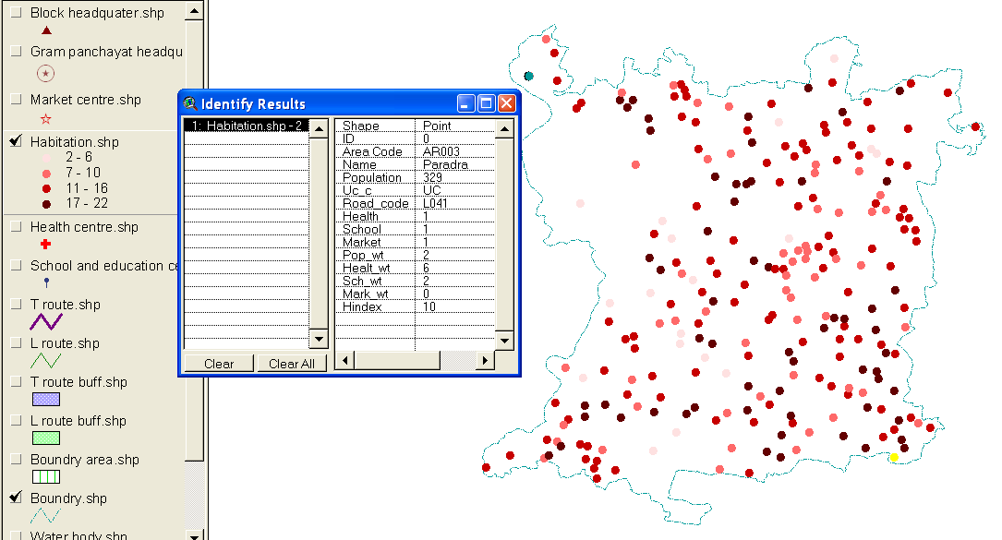
Analyzing Data: Identification of Growth Center
Figure 18 Habitation mapping according to HINDEX value

Slide 41
Analyzing Data: Identification of Growth Center
Table 11 Attribute table of Habitation along with HINDEX
AREA_CODE | NAME | POPULATION | UC_C | ROAD_CODE | HEALTH | SCHOOL | MARKET | POP_WT | HEALT_WT | SCH_WT | MARK_WT | HINDEX
AR001 | Bhabapur | 253 | C | L042 | 1 | 1 | 1 | 2 | 6 | 2 | 0 | 10
AR002 | Maminpur | 2037 | C | T07 | 1 | 1 | 1 | 8 | 6 | 2 | 0 | 16
AR003 | Paradra | 329 | C | L041 | 1 | 1 | 1 | 2 | 6 | 2 | 0 | 10
AR004 | Krithchandrapur | 1154 | C | T07 | 1 | 1 | 1 | 6 | 6 | 2 | 0 | 14
AR005 | Manodra | 1062 | C | T10 | 1 | 1 | 0 | 6 | 6 | 2 | 0 | 14

Slide 42
Thank you ☺

