Slide 1
Application of GIS in Road Network Inventory
BY,
SHAMSHER ALAM (I.D.110407062)
SHUBHAJIT SAHA (I.D. 110407060)
Under guidance of Prof. Sujata Biswas

Slide 2
INTRODUCTION
General
The development of any country depends on the infrastructural facilities available therein. Good road network facilities plays major role here.
Over the last few decades, lack of transportation infrastructure has affected the economic growth and development of India.

Slide 3
Realizing this fact an ambitious and biggest ever infrastructure development project in India (expected cost of $26 billion) named as Pradhan Mantri Gram Sadak Yojna (PMGSY) under ministry of Rural Development was conceptualized and launched on 25th December, 2000. to provide connectivity to unconnected rural habitations as part of a poverty eradication measure.

Slide 4
In the present study, an attempt is being made to develop an information system for road network planning using GIS for a particular block in rural area under PMGSY program.

Slide 5
Condition of road network of India
Indian Road Network
Class Length (km)
Major district roads 470,000
National Highways/Expressways 66,754
Rural & other roads 2,650,000
State Highways 128,000
Total (approx) 3,314,754

Slide 6
By acting as the link between the rural and urban areas, the State Highways and Major District Roads contribute significantly to the development of the rural economy and industrial growth of the country. It is estimated that the secondary system carries about 40 per cent of the total road traffic and comprises about 20% of the total road length

Slide 7
Pradhan Mantri Gram Sadak Yojana (PMGSY)
The primary objective of the PMGSY is to provide Connectivity, by way of an All-weather Road
The PMGSY will permit the Upgradation.

Slide 8
*Attempt made to study the road network of Arambagh block using GIS

Slide 9
GEOGRAPHIC INFORMATION SYSTEMS (GIS)
Geographic information systems (GIS) or geospatial information systems is a set of tools that captures, stores, analyzes, manages, and presents data that are linked to location(s).
Raster and vector are the two basic data structures for storing and manipulating images and graphics data on a computer. All of the major GIS (Geographic Information Systems) and software packages available today are primarily based on one of the two structures.

Slide 10
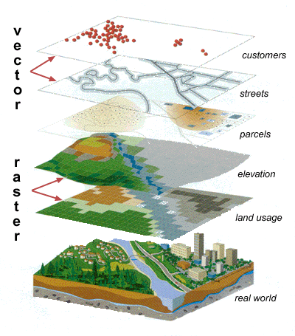

Slide 11
OBJECTIVE
To study the existing core network from the district rural plan (DRRP) map preprared by the authority.
To develop rural road network inventory in block level.

Slide 12
PRESENT STUDY
Study Area
The study area taken is Arambagh block in Hooghly district in the state of West Bengal. Arambagh lies between latitude 22’53’00” N and longitude 87’47’00” E

Slide 13
Data Collection
V & RIS
Map Data
Rural Road Inventory
PMGSY Map
Road Reference
Road Geometric Details
Road pavement condition
Terrain & soil type & traffic
CD
Serial no.
Name of the road
Road code
Length
Carriage Width
Surface type
CBR
Total traffic per day
Commercial vechicle perday
Total length
Width

Slide 14
Sr.No. | Name of District | Name of Block | Road Name | Pavement | Design |  |  |  | Traffic Intensity | CBR Value
 |  |  |  | Length (in Kms) | Carriage Way Width | Proposed Surface | Curve Type | Related Road in Core Network
1 | 2 | 3 | 6 | 11 | 31 | 32 | 33 | 34 | 36 | 37
3 | Hooghly | Arambag | Duttapur - Monirampur upto Acharjapara | 5.55 | 3.75 | Sealed Surface | B | T05 | 2008,93,24 | 4,5,3.61
4 | Hooghly | Arambag | Bais Mile - Batanal | 10.18 | 3.75 | Unsealed | B | T01 | 2004,105,49 | 4.5,9.5,3.12
5 | Hooghly | Arambag | Harinkhola - Purba Keshabpur | 5.73 | 3.75 | Unsealed | B | T01 | ##### | 3.5,5.7,3.53
6 | Hooghly | Arambag | Charmile - Dakshinnarayanpur | 12.64 | 3.75 | Sealed Surface | B | T11 | 2007,305,18 | 11.349,12.258,3.21
7 | Hooghly | Arambag | GoghatMetalRoad - Bijalkona | 17.92 | 3.75 | Sealed Surface | B | T14 | 2007,233,15 | 16.395,17.915,3.98

Slide 15
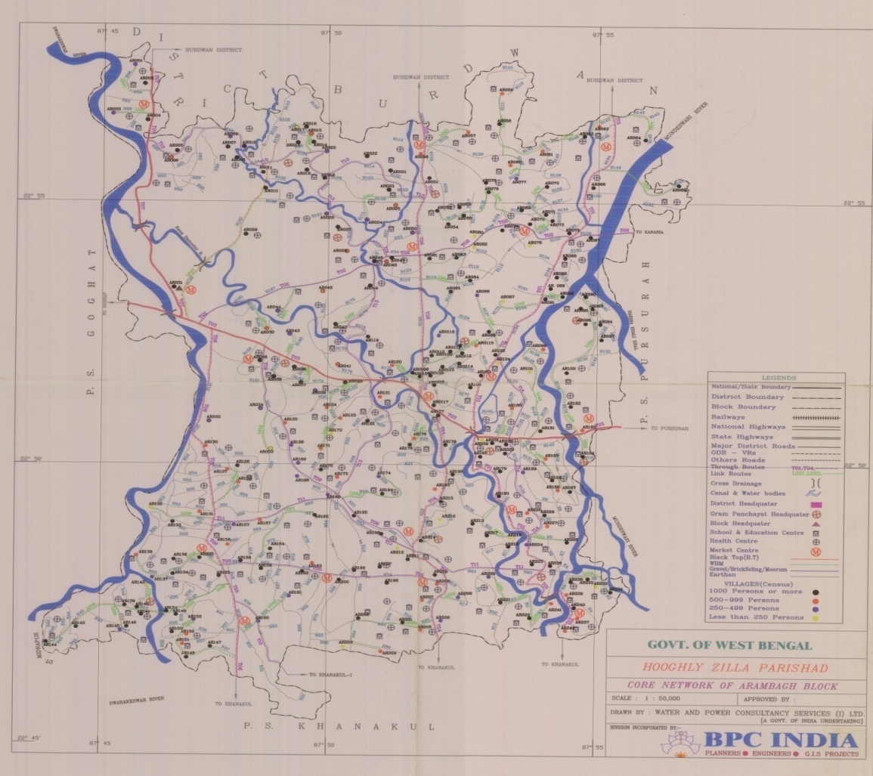
Map Data
Map of Arambagh Block (Scale 1:50,000)

Slide 16
APPLICATION OF ARC VIEW IN GIS
Arc View is a useful software or desktop GIS and mapping. It is a product of Environmental System Research Institute (ESRI). Arc view GIS is a powerful software that provides for visualizing, querying, exploring, and analyzing data geographically. Arc view is a powerful GIS tool that can display information (which resides locally or over a distributed network), read spatial and tabular information from a variety of data formats, access external databases, produced thematic maps (use colors and symbols to represent features based upon their attributes), perform spatial queries, connect spatial information to data attributes, provides several analytical tools and allows for a high degree of customization using Avenue. Using Arc View, we can understand the geographical context of our data, allowing us to see relationship and identify patterns in new ways

Slide 17
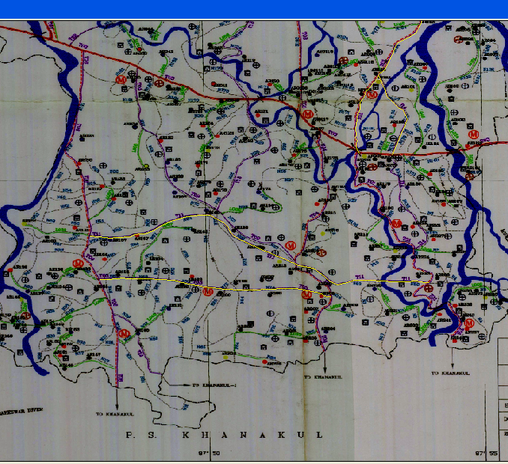
RESULTS
Roads in the Block

Slide 18
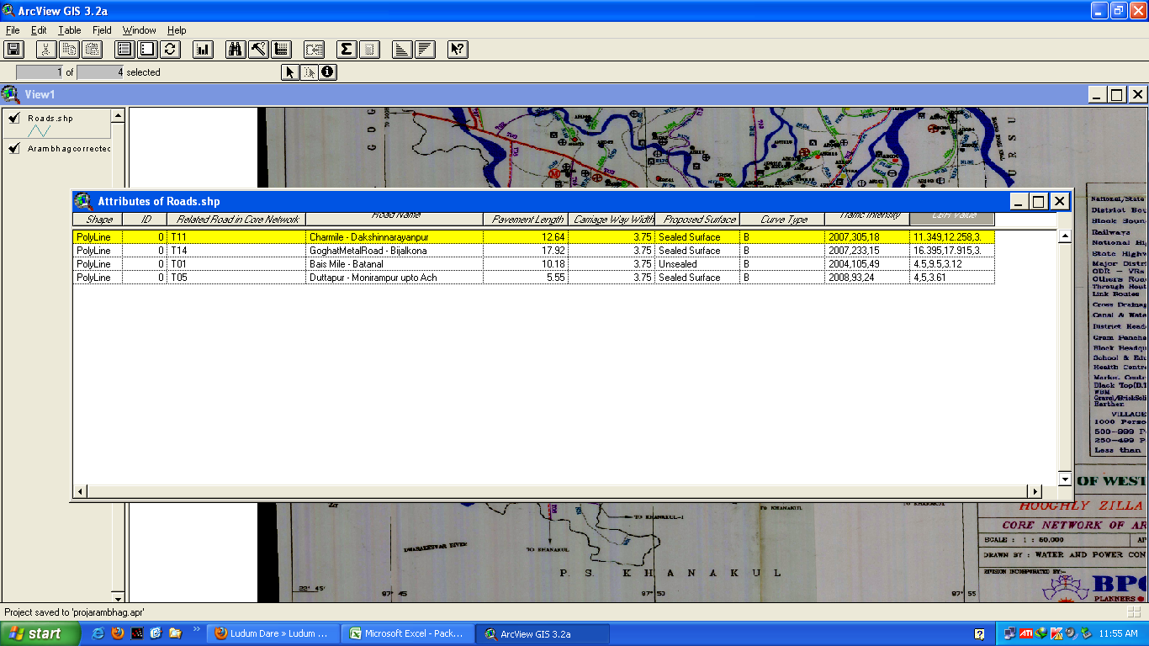
Attribute table

Slide 19
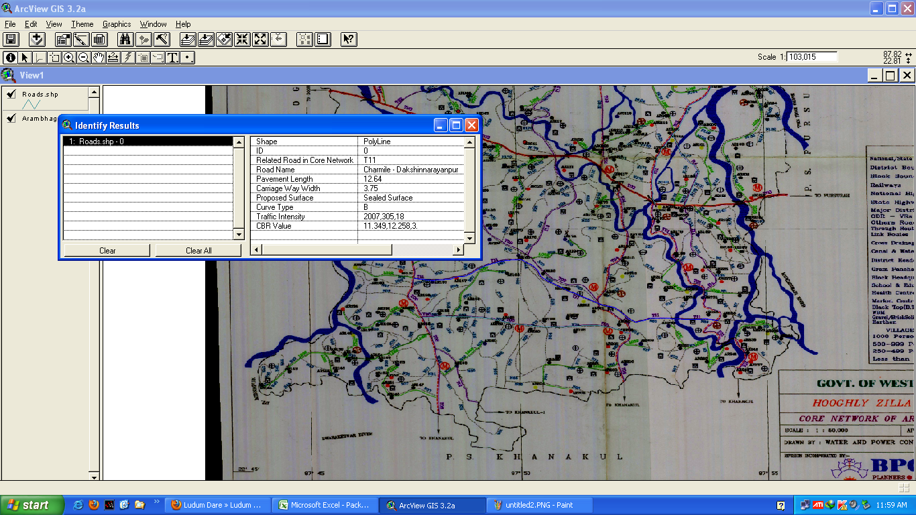
Inventory Data of road T11

