Slide 1

POE Final
PROG6212
ST10454185
Sheldon Naidoo

Slide 2
GitHub Repository Link
IIEWFL/prog6212-poe-ST10454185-Sheldon-Naidoo: prog6212-poe-ST10454185-Sheldon-Naidoo created by GitHub Classroom

Slide 3
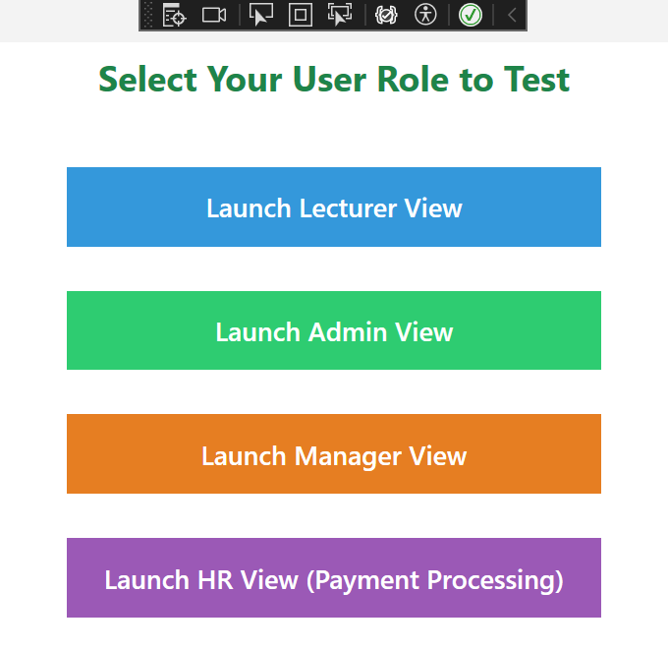
Main Window View
The Main Window View acts as the starting point of the Contract Monthly Claim System. Users can launch and access any of the suggested views and utilize their functionalities.

Slide 4
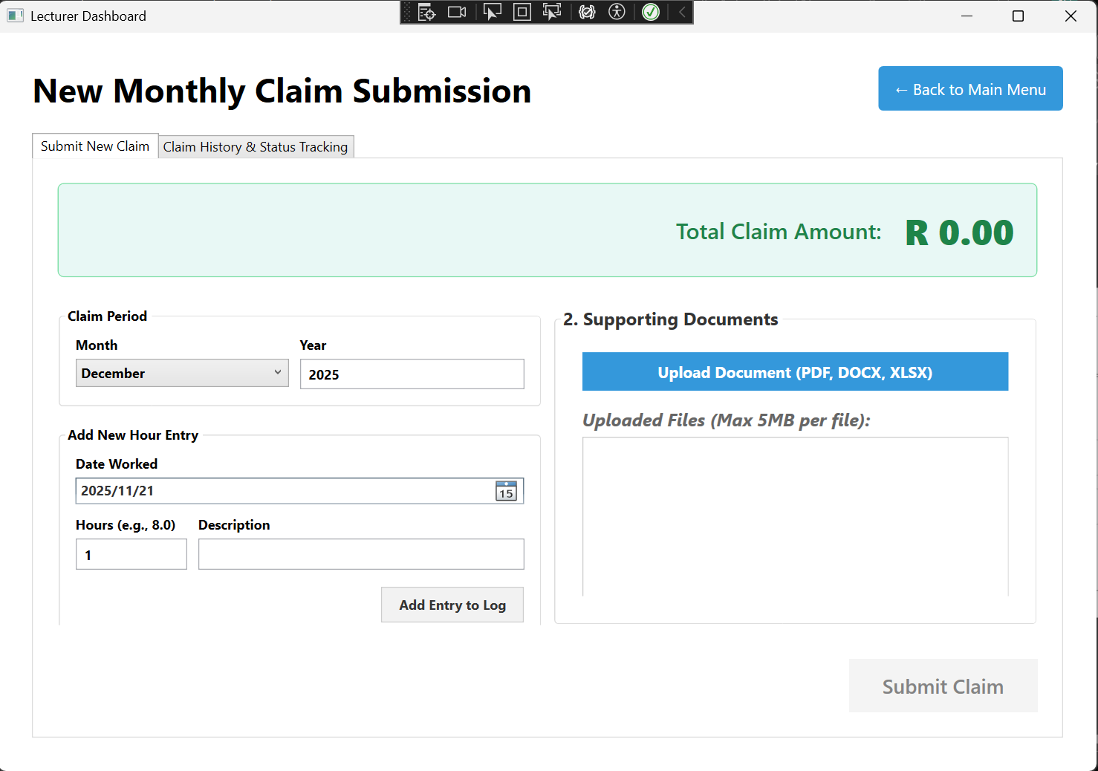
Lecturer View
When the user selects the Lecturer View, the user will be brought to this view page shown on the right.
Users can select a Claim Period under the “Claim Period” tab and choose the month and year for the claim period.
Users can also use the “Add New Hour Entry” tab to add hour entries by selecting the date the user worked, the hours the user worked for and the reason for the worked hours.
Users can also upload supporting documents with their entry.

Slide 5
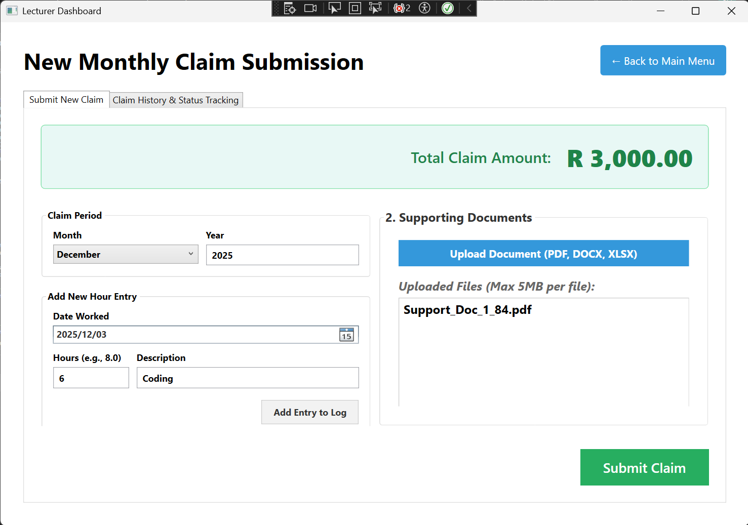
Lecturer View
The example shows the added entries of each section for the claim submission. The claim gets calculated according the number of hours at a rate of R500.00; hence, the total claim amount is R3000.00.

Slide 6
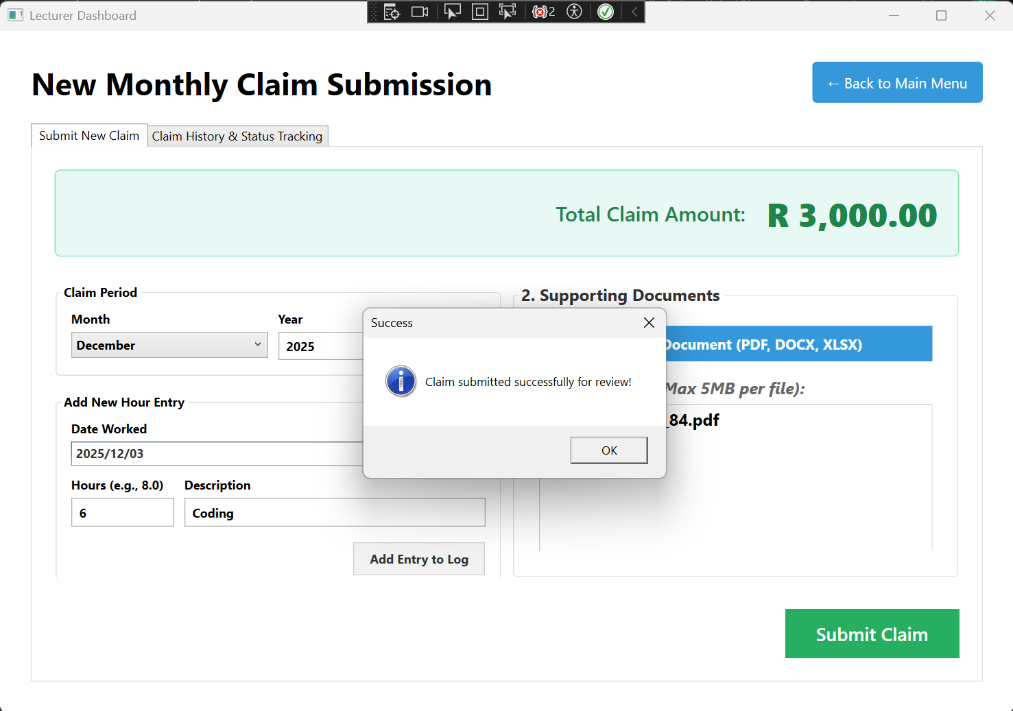
Lecturer View
A success message will display when the claim is submitted.

Slide 7
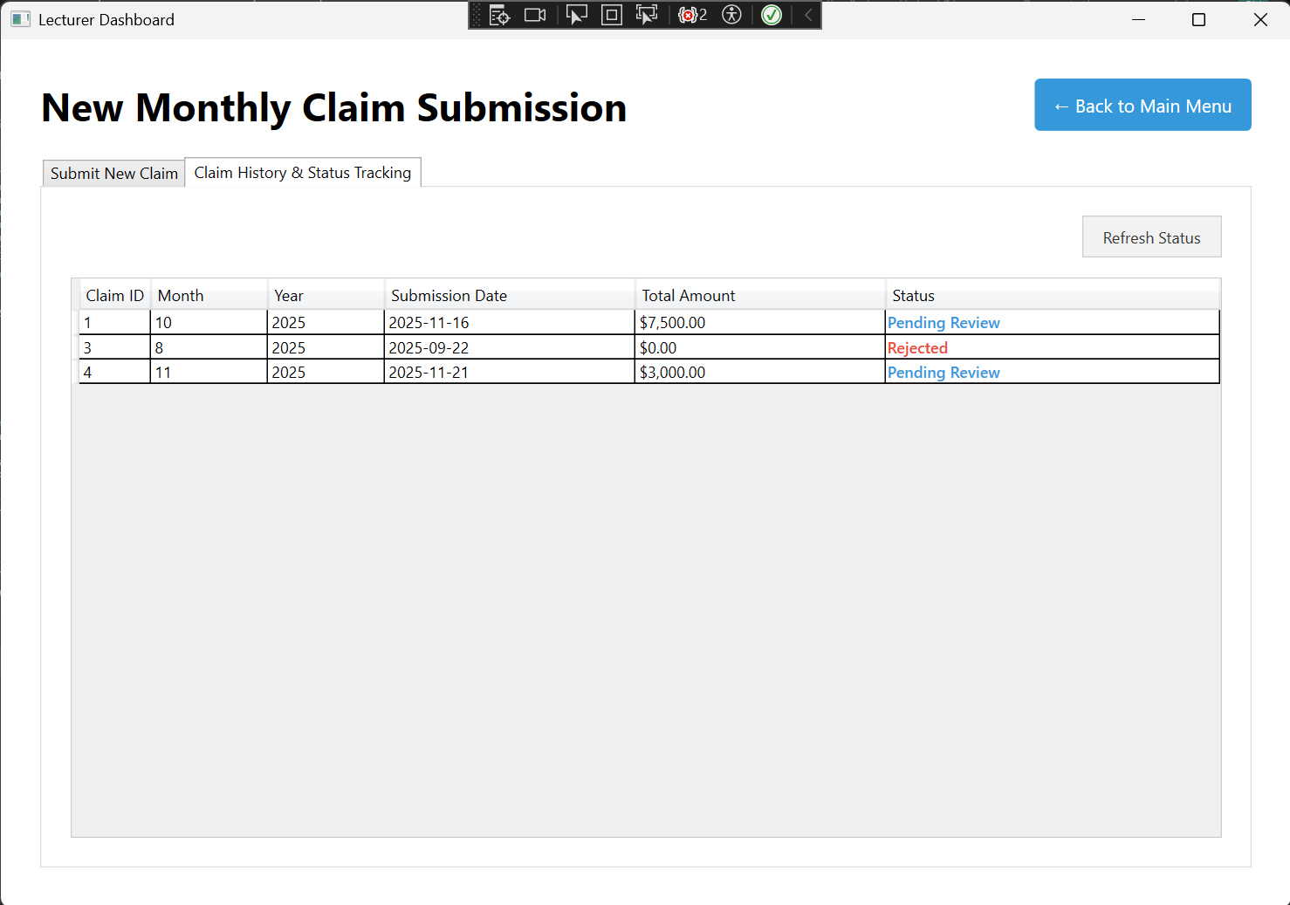
Lecturer View
The submitted claims will be displayed in the “Claim History & Status Tracking” tab and displays all the relevant claims that are pending for review, which also includes the newly submitted claim provided by the user.

Slide 8
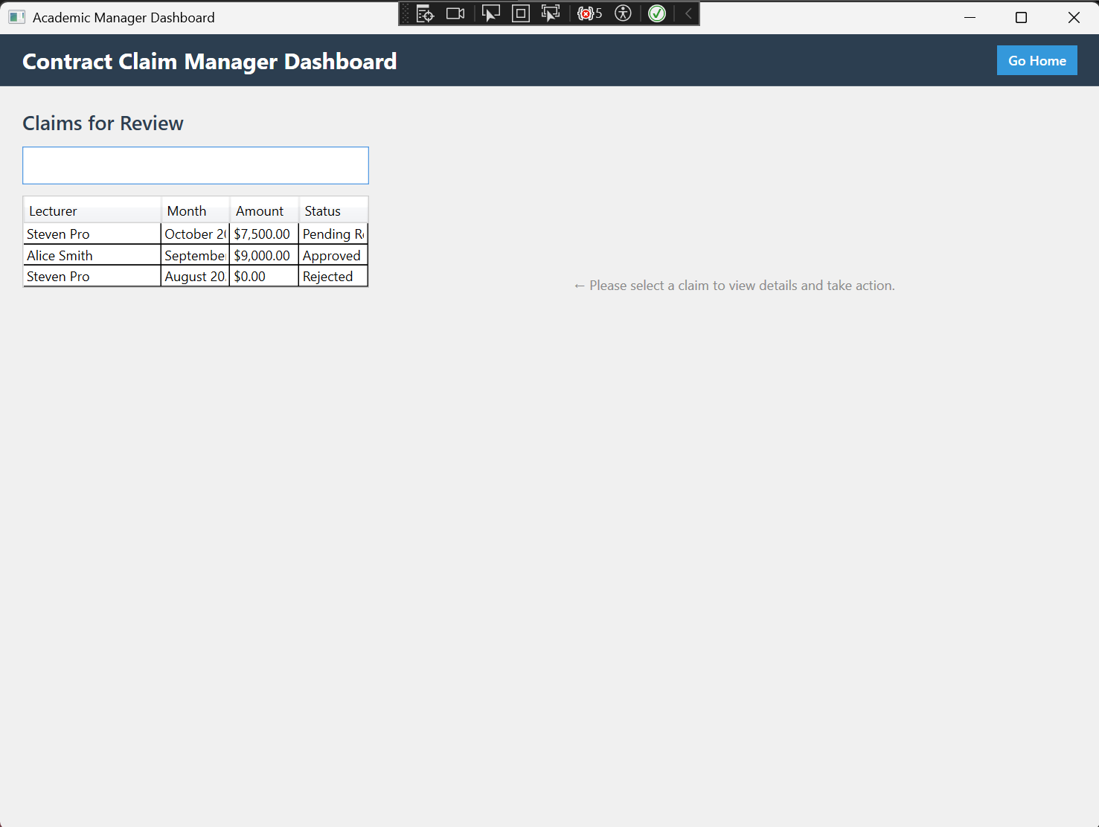
Coordinator and Manager View
When the user selects the Manager View, the user will be brought to this view page shown on the right.
The view shows a few pre-defined claims that can be clicked on to show the claim details.

Slide 9
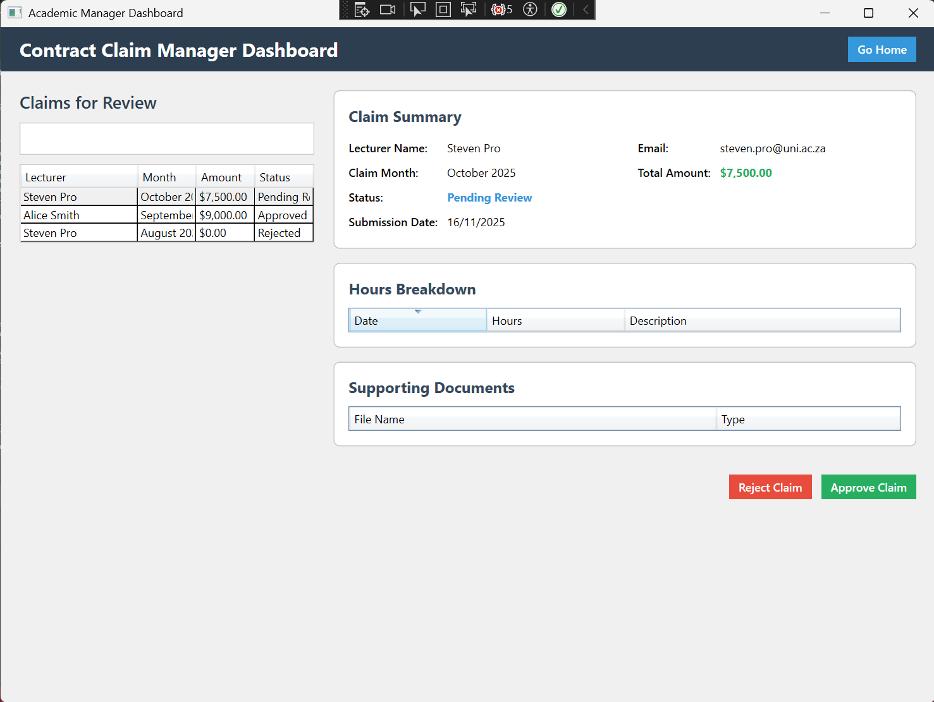
Coordinator and Manager View
The “Claim Summary” pane showcase the claim details correspondent to each lecturer that submitted a claim.
Claims with the “Pending Review” status can be approved or rejected depending on the manager’s reasoning for the claim and will be accordingly.

Slide 10
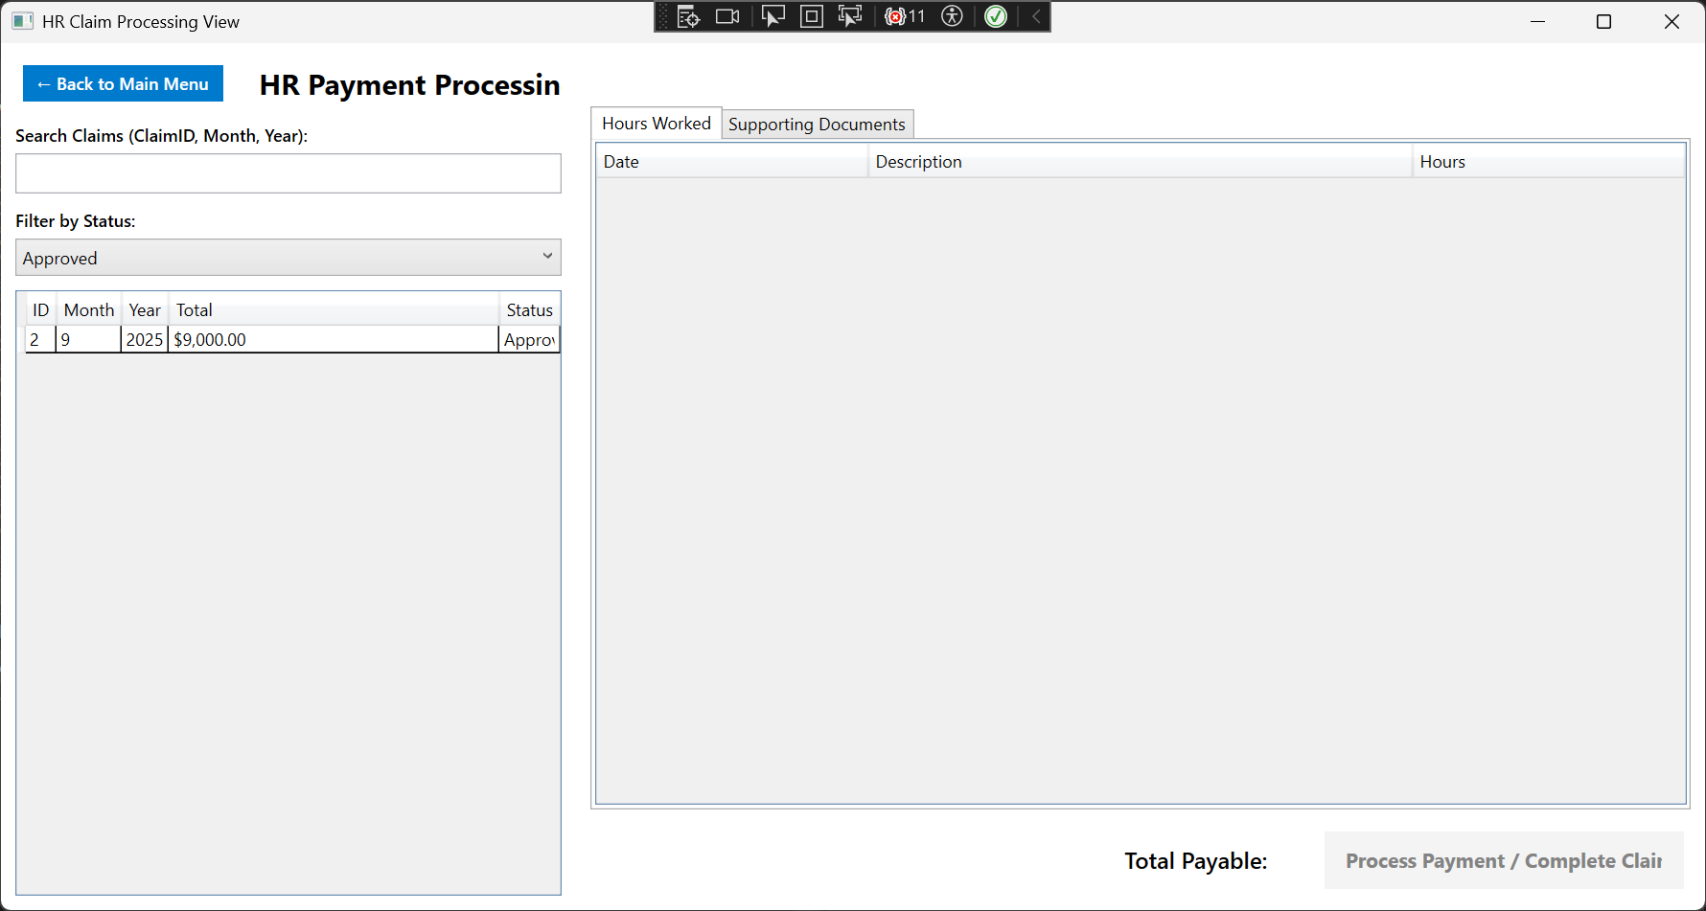
HR View
When the user selects the HR View, the user will be brought to this view page shown on the right.
Users can search for the desired claim using the “Search Claims” search bar to search for ClaimID, month of the claim or the year of the claim.
Users can also use the “Filter by Status” tab to search for claims related to the relevant claim status.

Slide 11
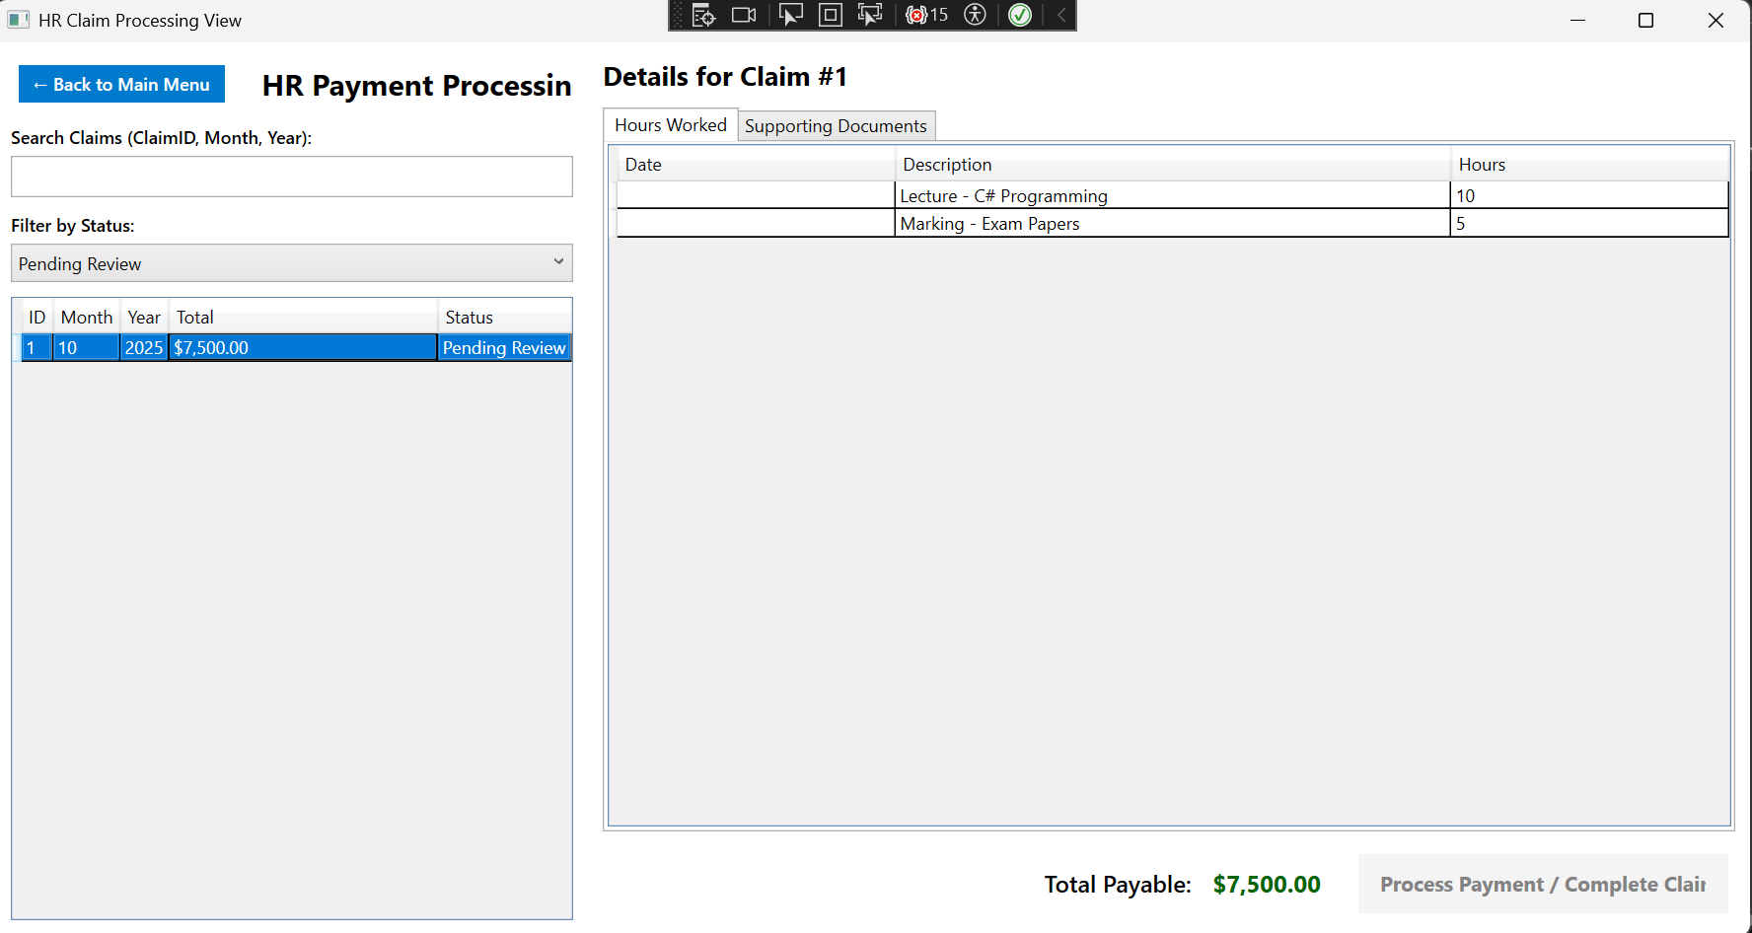
HR View
The first claim is shown in the picture for a pending review claim. The details of the claim are shown along with the hours worked by the person who submitted the claim.
This claim however is not approved; hence, the “Process Payment” button is inaccessible until the claim is approved. The same goes for other claim statuses that are not “Approved” statuses.

Slide 12
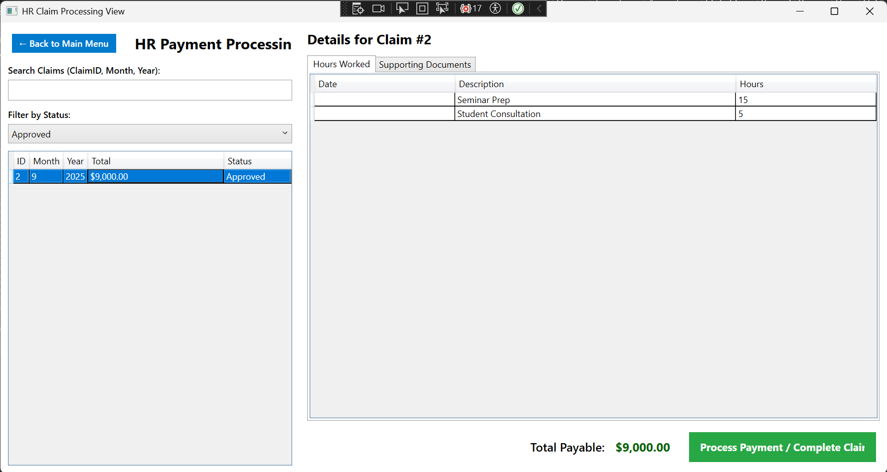
HR View
The second claim has an “Approved” claim status with the relevant claim details.
Since this claim is approved by the Coordinator and Manager View, the claim can be completed since the “Process Payment/Complete Claim” button is available.

Slide 13
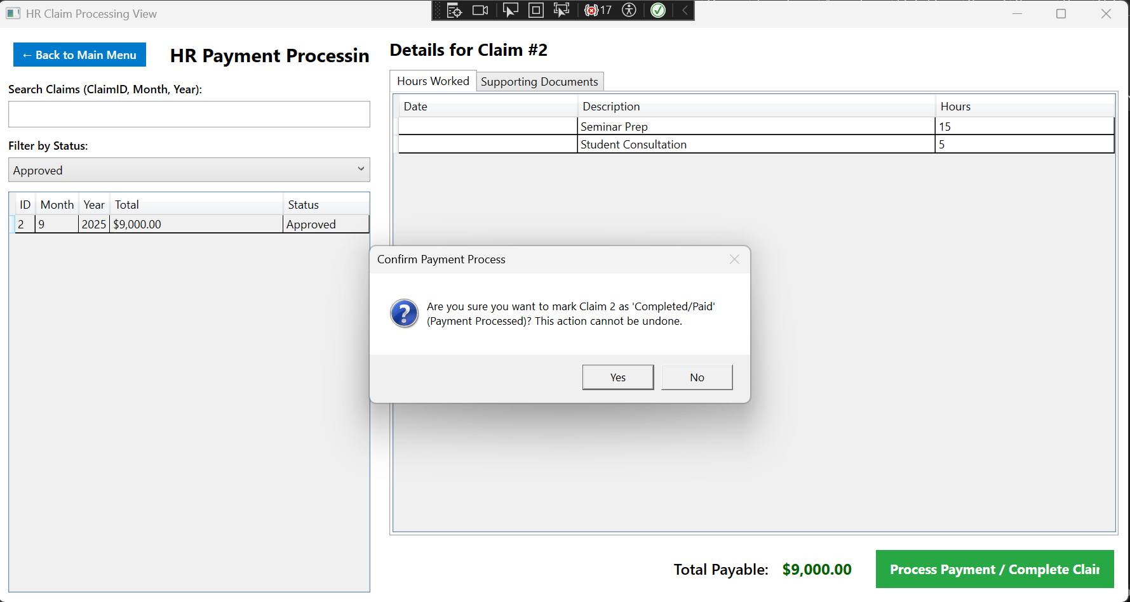
HR View
The user will then be prompted with a confirmation message on whether the claim payment process is to be completed or the user can reconsider and check if there are any errors in the claim details for the claim to then be completed.

Slide 14
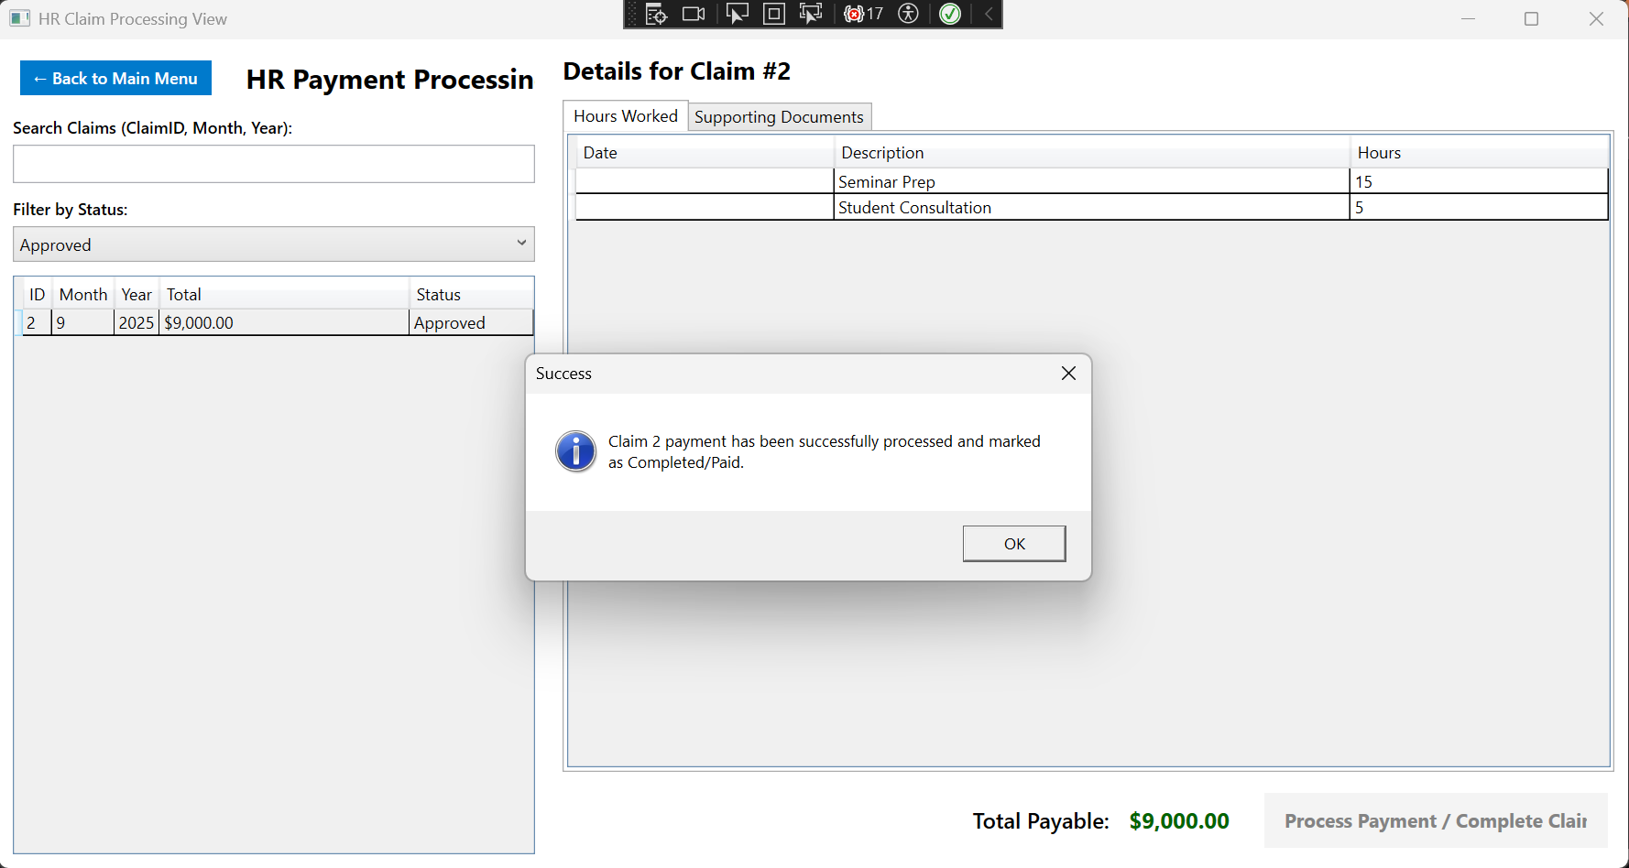
HR View
A success message will display if the user decided to proceed with the payment process of the claim

Slide 15
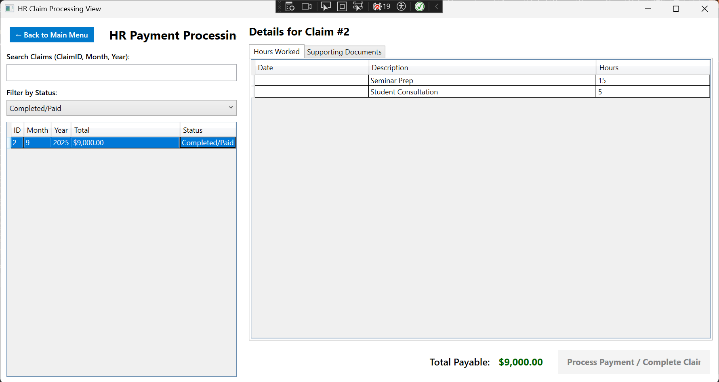
HR View
The completed claim will then have a “Completed/Paid” claim status and be displayed under the “Completed/Paid” claim status filter inclusive of all the relevant claim details.

