Slide 1

Quarterly Forecasting Forum
1pm-5pm, 6 December 2021

Slide 2
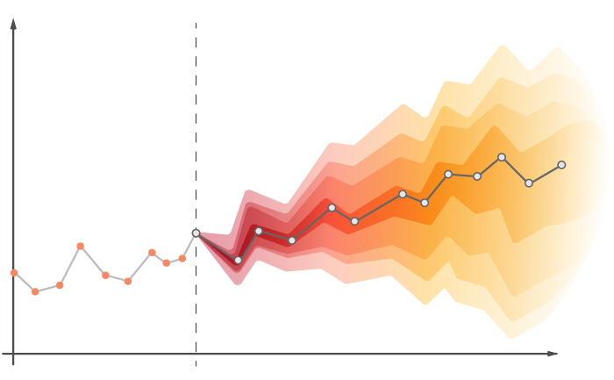
Agenda
13:00 | Welcome
13:10 | Short-term forecasting of extreme and non-extreme wind speeds: an INLA-based approach Daniela Castro Camilo, University of Glasgow
13:50 | Recent advances in the application and utility of subseasonal-to-seasonal predictions Chris White, University of Strathclyde
14:30 | Break
14:50 | Inertia forecasting: An emerging topic in field of energy forecasting Jemima Graham, Imperial College London
15:30 | Key learnings form the QGAM short-term forecasting of electrical demand, including extremes and multivariate analysis Gruffudd Edwards, TNIE Services Ltd
16:10 | Open discussion, IIF UK updates, and future QFFs

Slide 3

About QFF
Quarterly Foresting Forms are intended to facilitate cross-disciplinary and industry-academic discussion and knowledge exchange
Coordinated by the UK Chapter of the International Institute of Forecasters, but anyone can host
Aim to meet four times per year, including at the International Symposium on Forecasting (next: Oxford 2022)
More than talk: we’ve run some small hackathon type events and would like to do more of this in the future, let us know if you’d like to be involved!
Slides and data from past QFFs can be found on GitHub at https://github.com/IIF-UK

Slide 4
Break – back at 14:50
13:00 | Welcome
13:10 | Short-term forecasting of extreme and non-extreme wind speeds: an INLA-based approach Daniela Castro Camilo, University of Glasgow
13:50 | Recent advances in the application and utility of subseasonal-to-seasonal predictions Chris White, University of Strathclyde
14:30 | Break
14:50 | Inertia forecasting: An emerging topic in field of energy forecasting Jemima Graham, Imperial College London
15:30 | Key learnings form the QGAM short-term forecasting of electrical demand, including extremes and multivariate analysis Gruffudd Edwards, TNIE Services Ltd
16:10 | Open discussion, IIF UK updates, and future QFFs

Slide 5
IIF UK updates and future QFFs
IIF UK Chapter Updates
Call for invited sessions at ISF2022, deadline 4th March
Opportunities to join IIF UK Chapter Committee in 2022
Stay connected:
LinkedIn
Mailing list
Future QFFs
February 2022: Tesco, hosted by Trevor Sidery
Tesco HQ: Welwyn Garden City
Doodle in New Year to find date
Spring 2022: Cardiff, hosted by Bahman Rostami-Tabar
If you’d like to present at or host a future QFF, please get in touch

Slide 6



See you next time!
www.jethrobrowell.com
@jethrobrowell

