Slide 1
XY G-Code Pen Plotter
An AVR-based system that turns a digital image into a physical pen drawing
Inuka Indipa Gamage | 17237 | August 10, 2026
Notes:
Hello everyone — today I'm presenting my final project: an XY G-code pen plotter. It's a two-axis drawing machine that takes a digital image and reproduces it as pen strokes on paper, fully automatically. (~20 seconds)

Slide 2
MOTIVATION
Why Build an Image-to-Drawing Plotter?
Goal
AVR-class CNC plotter that goes straight from an ordinary image to a finished pen drawing — no manual path work and learn about CNC machine and how they work
Use cases
Reproducing artwork and line drawings
Tracing PCB layouts and blueprints for documentation
One system, three engineering layers
Computer vision — image → traced outlines (Python / OpenCV)
Motion control firmware — G-code → coordinated stepper motion
Embedded communication — reliable PC ↔ microcontroller serial streaming
2 / 10
Notes:
The motivation was to bring together computer vision, motion control, and embedded firmware into a single, low-cost desktop CNC plotter — you load a picture, and the machine draws it. (~30 seconds)

Slide 3
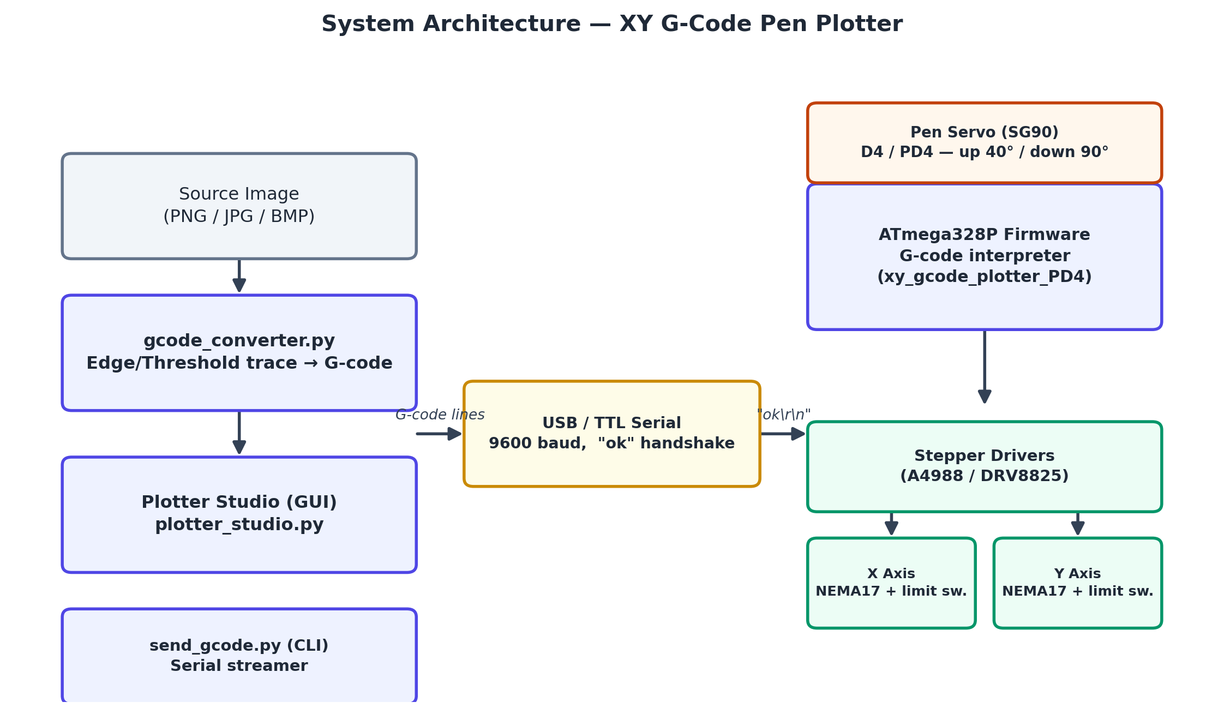
SYSTEM OVERVIEW
End-to-End Architecture
3 / 10
Notes:
Here's the full system. On the PC side, Plotter Studio or the command-line tool sends G-code over a 9600-baud serial link. The Arduino-class board interprets it, drives two stepper motors through A4988 drivers, and actuates a servo to lift and lower the pen. (~35 seconds)

Slide 4
HARDWARE
Mechanical & Electrical Design
• ATmega328P microcontroller16 MHz external oscilator
• 2 × NEMA17 stepper motors + A4988/DRV8825 drivers, 1/16 microstepping → 80 steps/mm
• 275 mm × 190 mm drawing bed
• 2 × limit switches for automatic homing on power-up
• SG90 servo lifts/lowers the pen (angles tuned per linkage: 40° up / 90° down)
4 / 10
Notes:
The hardware is a standard belt-driven XY gantry: two NEMA17 steppers give 80 steps per millimetre of precision, limit switches handle automatic homing, and a small servo lifts and lowers the pen. One design fix worth mentioning: I moved the servo signal off pin D11 onto D4, because D11 is also the SPI programming pin. (~40 seconds)

Slide 5
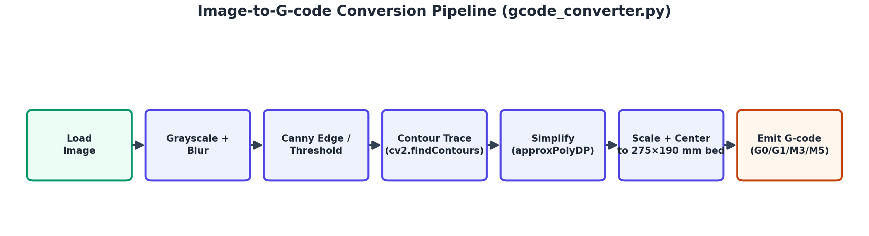
SOFTWARE
Image-to-G-code Pipeline
• OpenCV traces the image into contours, which are simplified and scaled to fit the bed exactly.
5 / 10
Notes:
On the software side, gcode_converter.py takes any image, runs it through grayscale, blur, and Canny edge detection, traces the resulting contours with OpenCV, simplifies them, and scales them to fit the physical bed — then emits standard G-code: travel moves, pen down, draw moves, pen up. (~35 seconds)

Slide 6
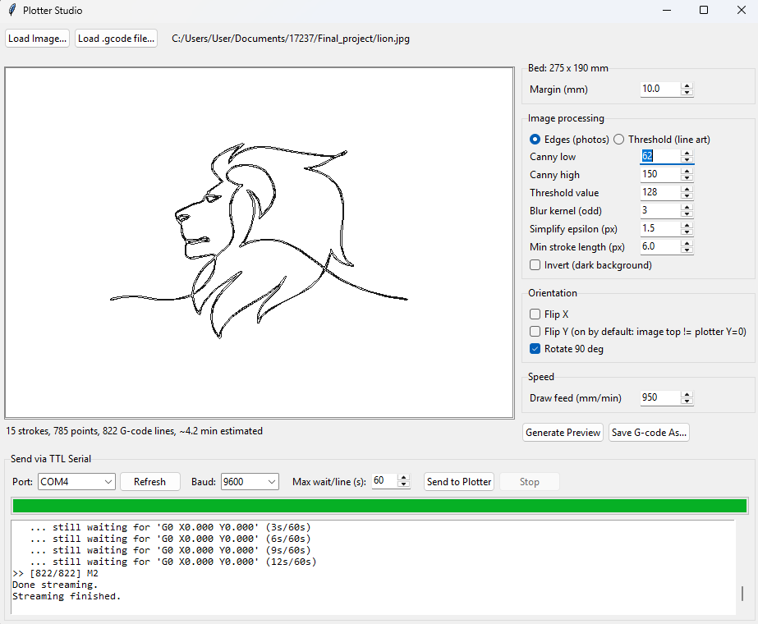
APPLICATION
Plotter Studio — The Desktop App
• Load an image or an existing .gcode file
• Tune tracing parameters live: edge/threshold mode, sensitivity, blur, simplification
• Fix mirrored/upside-down output with Flip X / Flip Y / Rotate 90°
• Preview the exact toolpath before committing to a physical draw
• Send directly to the plotter over serial, with live progress and a log — or export the G-code to a file
6 / 10
Notes:
All of this is wrapped in a single Tkinter desktop app called Plotter Studio: load an image, tune the tracing, preview the path on a virtual bed, fix orientation issues if needed, and either save the G-code or send it straight to the plotter with live progress feedback. (~30 seconds)

Slide 7
FIRMWARE
G-code Interpreter & Flow Control
• Supports standard commands: G0/G1 moves, G28 homing, G90/G91, M3/M4/M5 pen control, G20/G21 units
• Coordinated X/Y stepping keeps diagonal lines straight
• Two-stage homing: fast approach to the limit switch, back off, then a slow, repeatable re-approach
• Every line gets an "ok" reply — this handshake is what lets the host safely stream thousands of lines without overflowing the microcontroller's tiny 64-byte serial buffer
7 / 10
Notes:
On the firmware side, a compact G-code interpreter supports the standard move and pen commands, homes each axis precisely using a two-stage approach, and — critically — replies 'ok' after every single line. That handshake is what makes it possible to reliably stream a huge G-code file without ever overrunning the microcontroller's small serial buffer. (~35 seconds)

Slide 8
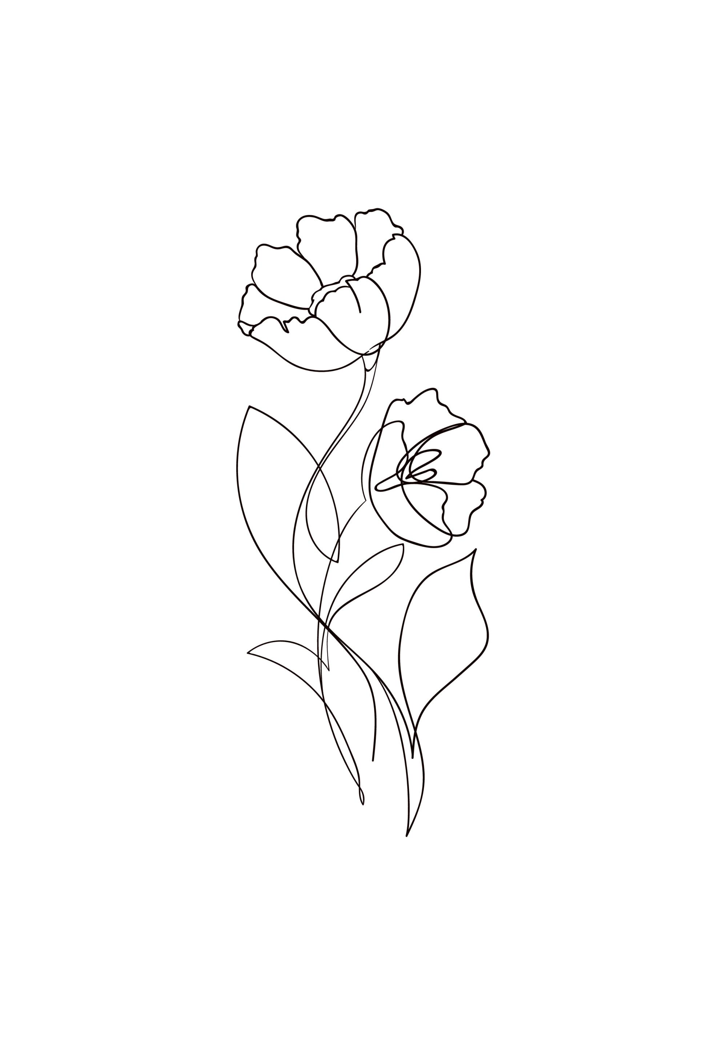
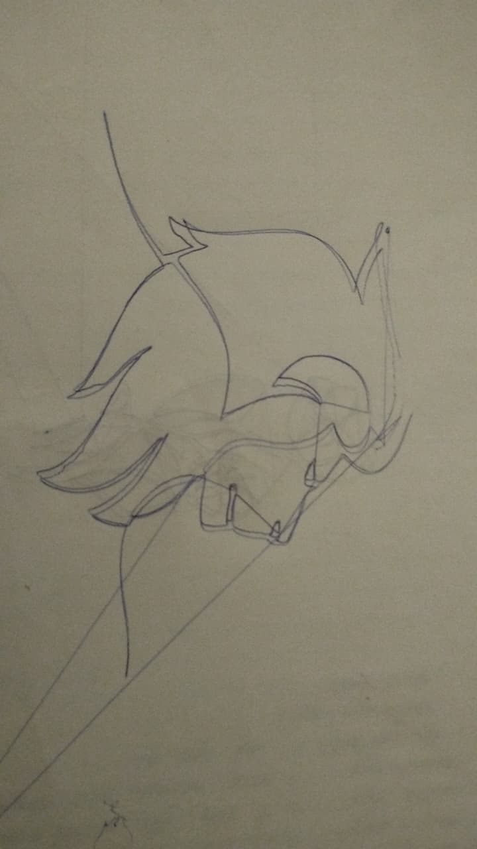
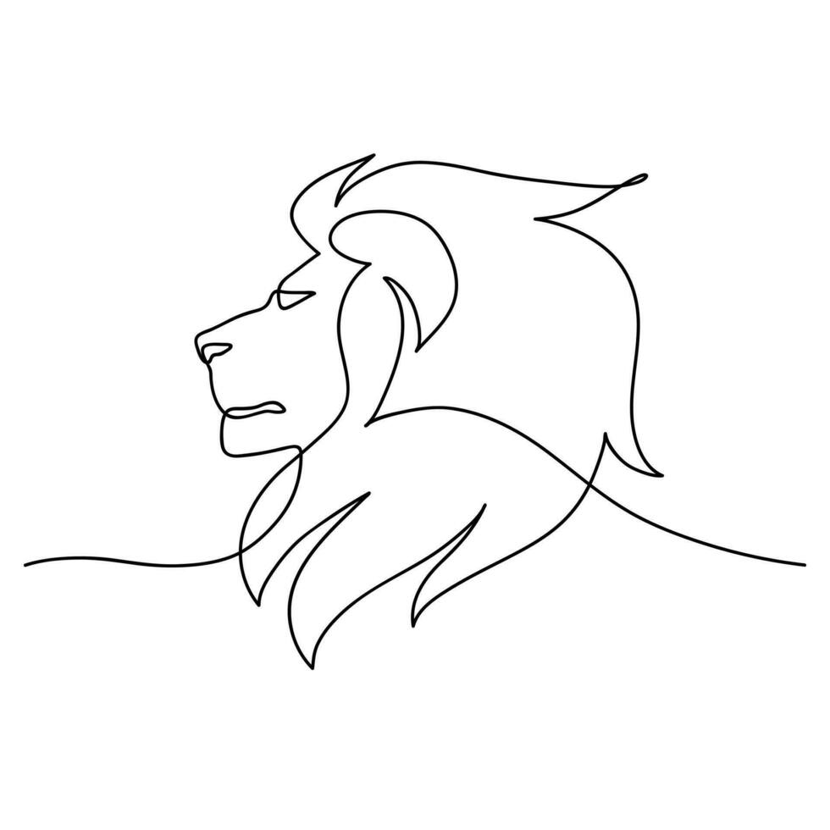
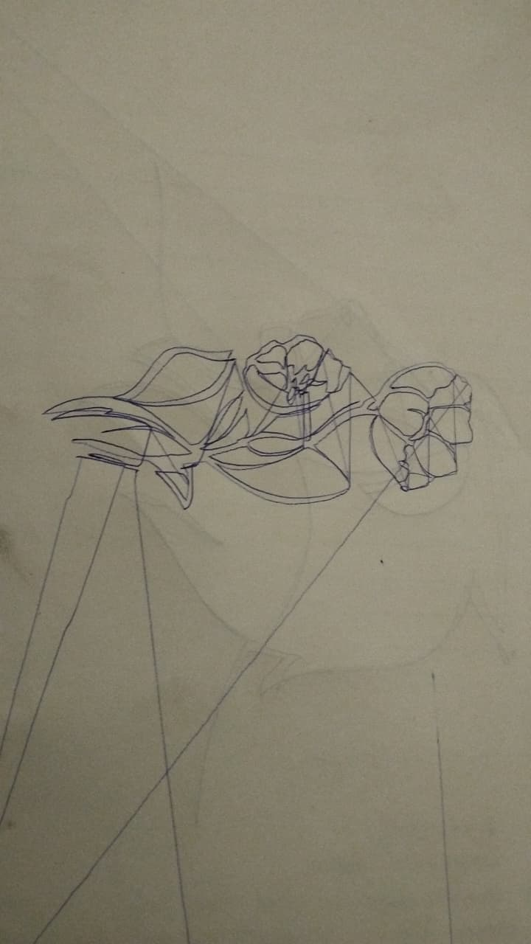
VALIDATION
Results — Tested on Real Hardware
8 / 10
Notes:
This isn't just simulated — it was validated on the real machine. A 1,310-line G-code file generated from an actual photo streamed over COM7 with zero timeouts or dropped responses, and completed the full drawing in about 18.7 minutes. Every stage of the workflow — image load, preview, save, reload, and send — was confirmed working end to end on physical hardware. (~35 seconds)

Slide 9
CHALLENGES & NEXT STEPS
What I Solved, and What's Next
• Future work: acceleration/velocity ramping for smoother, faster moves
• Future work: larger bed size and multi-pen / multi-color support
Make PCB engraving machine
9 / 10
Notes:
Two real engineering problems came up during development: a pin conflict between the servo and the SPI programming line, solved by relocating the servo signal; and mirrored or upside-down drawings, solved by adding orientation controls in the app. Looking ahead, I'd like to add acceleration ramping for smoother motion, and support for a larger bed or multiple pen colors. (~35 seconds)

Slide 10
Thank You
Notes:
Thank you — happy to answer any questions about the hardware, the firmware, or the software. (~10-15 seconds, remainder of time for Q&A)

