Slide 1
Blockchain Essentials & DApps

Slide 2
Course Outcomes
Student will be able to illustrate the Blockchain terminologies with its applications.- L2
Student will be able to analyze the working principles of Blockchain -L2
Student will be Able to comprehend the principles and methodologies used in Bitcoin –L2
Student will be Able to create Ethereum Network, Wallets, Nodes, Smart contract & DApps –L4
Student will be Able to develop Blockchain Based Application Architecture using Hyperledger –L3

Slide 3
CO-PO Mapping
PO | 1 | 2 | 3 | 4 | 5 | 6 | 7 | 8 | 9 | 10 | 11 | 12 | PSO1 | PSO2
CO1 | 3 |  |  |  |  |  |  |  |  |  |  |  |  | 3
CO2 | 3 | 2 |  |  |  |  |  |  |  |  |  |  |  | 3
CO3 | 3 | 2 |  |  |  |  |  |  |  |  |  |  |  | 3
CO4 | 2 | 2 | 3 |  | 2 |  | 2 |  | 2 | 2 |  | 2 |  | 3
CO5 | 2 | 2 | 3 |  | 2 |  | 2 |  | 2 | 2 |  | 2 |  | 3
14IS71 | 3 | 2 | 3 |  | 2 |  | 2 |  | 2 | 2 |  | 2 |  | 3

Slide 4
Teaching Methodology:
Black board teaching/Power Point Presentations
Hands-on Training/Assignemnet
Case Study.

Slide 5
Assessment Methods
Three internals, 30Marks each will be conducted and the Average of best of two will be taken.
Rubrics evaluation for the Programming Assignment will be conducted for 10 marks.
Rubrics evaluation for the Case Studywill be conducted for 10 marks.
Final examination, of 100 Marks will be conducted and will be evaluated for 50 Marks.

Slide 6
Course Contents: UNIT-1
Distributed systems, CAP theorem, Byzantine Generals problem, Consensus. The history of blockchain, Introduction to blockchain, Various technical definitions of blockchains, Generic elements of a blockchain, Features of a blockchain, Applications of blockchain technology, Tiers of blockchain technology, Consensus in blockchain, CAP theorem and blockchain, Benefits and limitations of blockchain

Slide 7
Course Contents: UNIT-2
Decentralization using blockchain, Methods of decentralization, Blockchain and full ecosystem decentralization, Smart contract, Decentralized organizations, Decentralized autonomous organizations, Decentralized autonomous corporations, Decentralized autonomous societies Decentralized applications, Platforms for decentralization,
Hash functions: Compression of arbitrary messages into fixed length digest,Easy to compute, Pre-image resistance, Second pre-image resistance,Collision resistance,Message Digest (MD),Secure Hash Algorithms (SHAs), Merkle trees, Patricia trees, Distributed hash tables (DHTs), Digital signatures

Slide 8
Course Contents: UNIT-3
Bitcoin, Bitcoin definition, Transactions, The transaction life cycle, The transaction structure, Types of transaction, The structure of a block , The structure of a block header, The genesis block, The bitcoin network, Wallets, Smart Contracts-History, Definition, Ricardian contracts, Smart contract templates, Oracles, Smart Oracles, Deploying smart contracts on a blockchain, The DAO

Slide 9
Course Contents: UNIT-4
Ethereum 101, Introduction, Ethereum clients and releases, The Ethereum stack, Ethereum blockchain, Currency (ETH and ETC), Forks, Gas, The consensus mechanism, The world state, Transactions, Contract creation transaction, Message call transaction, Elements of the Ethereum blockchain , Ethereum virtual machine (EVM), Accounts, Block, Ether, Messages, Mining, The Ethereum network
Hands-on: Clients and wallets -Geth

Slide 10
Course Contents: UNIT-5
Hyperledger, Hyperledger as a protocol, Fabric, Hyperledger Fabric, Sawtooth lake, Corda

Slide 11
TEXTBOOK
Imran Bashir. “Mastring BlockChain”, Packt
REFERENCEBOOKS
Mastering Bitcoin: Programming the Open Blockchain Paperback – 2017 by Andreas M. O’rielly

Slide 12
Definition of a Distributed System
A distributed system is
a collection of independent computers
that appears to its users
as a single coherent system.
... or ...
as a single system.

Slide 13
Resource Sharing and the Web
Hardware resources (reduce costs)
Data resources (shared usage of information)
Service resources
search engines
computer-supported cooperative working 
Service vs. server (node or process )

Slide 14
Distributed application
one single “system”
one or several autonomous subsystems
a collection of processors
parallel processing
Increased performance, reliability, fault tolerance
partitioned or replicated data
increased performance, reliability, fault tolerance
Dependable systems, grid systems, enterprise systems

Slide 15
Why Distribution?
Sharing of information and services
Possibility to add components improves
availability
Reliability
fault tolerance
performance
scalability

Slide 16
Goals of DS
Making resources accessible
Distribution transparency
Openness
Scalability
Security
System design requirements

Slide 17
Challenges for Making Resources Accessible
Naming
Access control
Security
Availability
Performance
Mutual exclusion of users, fairness
Consistency in some cases

Slide 18
Transparencies
Access : Hide differences in data representation and how a resource is accessed
Location: Hide where a resource is located
Migration :Hide that a resource may move to another location
Relocation :Hide that a resource may be moved to another location while in use (the others don’t notice)
Replication :Hide that a resource is replicated
Concurrency :Hide that a resource may be shared by several competitive users
Failure :Hide the failure and recovery of a resource
Persistence: Hide whether a (software) resource is in memory or on disk

Slide 19
Omission and arbitrary failures
Fail-stop :Process halts and remains halted. Other processes may detect this state.
Crash :Process halts and remains halted. Other processes may not be able to detect this state.
Omission :A message inserted in an outgoing message buffer never arrives at the other end’s incoming message buffer.
Send-omission:A process completes send, but the message is not put in its outgoing message buffer.
Receive-omission : A message is put in a process’s incoming message buffer, but that process does not receive it.
Arbitrary(Byzantine) :Process/channel exhibits arbitrary behaviour: it may send/transmit arbitrary messages at arbitrary times, commit omissions; a process may stop or take an incorrect step.

Slide 20
Timing failures
Clock :Process’s local clock exceeds the bounds on its rate of drift from real time.
Performance : Process exceeds the bounds on the interval between two steps.
Performance : A message’s transmission takes longer than the stated bound.

Slide 21
Failure Handling
More components
increased fault rate
Increased possibilities
more redundancy => more possibilities for fault tolerance
no centralized control => no fatal failure
Issues
Detecting failures
Masking failures
Recovery from failures
Tolerating failures
Redundancy
partial failures

Slide 22
Concurrency
Concurrency:
Several simultaneous users => integrity of data
mutual exclusion
synchronization
transaction processing in data bases
Replicated data: consistency of information?
Partitioned data: how to determine the state of the system?
Order of messages?
There is no global clock!

Slide 23
Challenges for Scalability
The system will remain effective when there is a significant increase in
number of resources
number of users
The architecture and the implementation must allow it
The algorithms must be efficient under the circumstances to be expected

Slide 24
Challenges for Security
Security: confidentiality, integrity, availability
Vulnerable components
channels (links <–> end-to-end paths)
processes (clients, servers, outsiders)
Threats
information leakage
integrity violation
denial of service
illegitimate usage
Current issues:
Denial-of-service attacks, security of mobile code, information flow;
open wireless ad-hoc environments

Slide 25
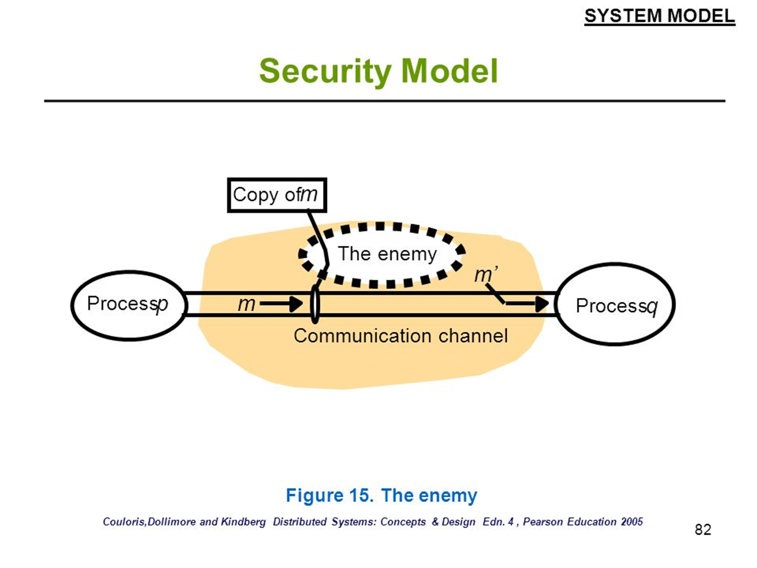

Slide 26
Threats to channels
eavesdropping (data, traffic)
tampering, replaying
masquerading
denial of service
Threats to processes
server: client’s identity;
client: server’s identity
unauthorized access (insecure access model)
unauthorized information flow (insecure flow model)

Slide 27
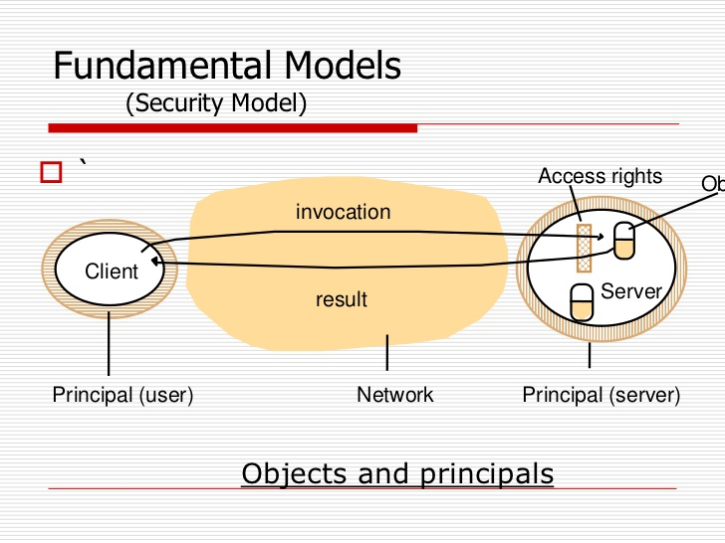

Slide 28
Defeating Security Threats
Techniques
cryptography
authentication
access control techniques
intranet: firewalls
services, objects: access control lists, capabilities
Policies
access control models
lattice models
information flow models
Leads to: secure channels, secure processes, controlled access, controlled flows

Slide 29
Distributed systems
Distributed systems are a computing paradigm whereby two or more nodes work with each other in a coordinated fashion in order to achieve a common outcome
DS modeled in such a way that end users see it as a single logical platform.
Node can be defined as an individual player in a distributed system and have their own memory and processor.
All nodes are capable of sending and receiving messages to and from each other.
Nodes can be honest, faulty, or malicious

Slide 30
A node that can exhibit arbitrary behavior is also known as a Byzantine node.
This arbitrary behavior can be intentionally malicious, which is detrimental to the operation of the network.
Generally, any unexpected behavior of a node on the network can be categorized as Byzantine.

Slide 31
Challenge in distributed system Design
Coordination between nodes
Fault tolerance.
Even if some of the nodes become faulty or network links break, the distributed system should tolerate
D S should continue to work flawlessly in order to achieve the desired result.
Several algorithms and mechanisms has been proposed to overcome these issues.
Distributed systems are so challenging to design that a theorem known as the CAP theorem has been proved and states that a distributed system cannot have all much desired properties simultaneously.

Slide 32
CAP theorem (Brewer's theorem)
Introduced originally by Eric Brewer in 1998;
In 2002 it was proved as a theorem by Seth Gilbert and Nancy Lynch.
The theorem states that any distributed system cannot have Consistency, Availability, and Partition tolerance simultaneously
Somehow blockchain manages to achieve all these properties

Slide 33
CAP theorem
Consistency is a property that ensures that all nodes in a distributed system have a single latest copy of data
Availability means that the system is up, accessible for use, and is accepting incoming requests and responding with data without any failures as and when required
Partition tolerance ensures that if a group of nodes fails the distributed system still continues to operate correctly

Slide 34
In order to achieve fault tolerance, replication is used.
Consistency is achieved using consensus algorithms to ensure that all nodes have the same copy of data. This is also called state machine replication.
Blockchain is basically a method to achieve state machine replication.

Slide 35
Types of fault
Faulty node has simply crashed
Faulty node can exhibit malicious or inconsistent behavior arbitrarily.
Difficult to deal with since it can cause confusion due to misleading information.

Slide 36

Byzantine Generals problem
Generals = Computer Components
The abstract problem…
Each division of Byzantine army is directed by its own general.
There are n Generals, some of which are traitors.
All armies are camped outside enemy castle, observing enemy.
Communicate with each other by messengers.
Requirements:
G1: All loyal generals decide upon the same plan of action
G2: A small number of traitors cannot cause the loyal generals to adopt a bad plan
Note: We do not have to identify the traitors.

Slide 37
Motivation
Coping with failures in computer systems
Failed component sends conflicting information to different parts of system.
Agreement in the presence of faults.
P2P Networks?
Good nodes have to “agree to do the same thing”.
Faulty nodes generate corrupted and misleading messages.
Non-malicious: Software bugs, hardware failures, power failures
Malicious reasons: Machine compromised.

Slide 38
Byzantine Generals problem
In September 1962, Paul Baran introduced the idea of cryptographic signatures with his paper On distributed communications networks.
This is the paper where the concept of decentralized networks was also introduced for the very first time.
Then in 1982 a thought experiment was proposed by Lamport et al. whereby a group of army generals who are leading different parts of the Byzantine army are planning to attack or retreat from a city.
The only way of communication between them is a messenger and they need to agree to attack at the same time in order to win.
The issue is that one or more generals can be traitors and can communicate a misleading message.

Slide 39
Need for a viable mechanism that allows agreement between generals even in the presence of treacherous generals so that the attack can still take place at the same time.
In distributed systems, generals can be considered as nodes, traitors can be considered Byzantine (malicious) nodes, and the messenger can be thought of as a channel of communication between the generals.
In 1999,Castro and Liskov presented the Practical Byzantine Fault Tolerance (PBFT) algorithm.
In2009, the first practical implementation was made with the invention of bitcoin where the Proof of Work (PoW) algorithm was developed as a mechanism to achieve consensus.

Slide 40
Consensus
Consensus is a process of agreement between distrusting nodes on a final state of data.
It is easy to reach an agreement between two nodes
But when multiple nodes are participating in a distributed system and they need to agree on a single value – Difficult Task
Distributed consensus: Achieving consensus between multiple nodes

Slide 41
Consensus mechanisms
A consensus mechanism is a set of steps that are taken by all, or most, nodes in order to agree on a proposed state or value.
Consensus mechanisms have recently come into the limelight and gained much popularity with the advent of bitcoin and blockchain.

Slide 42
Requirements which must be met in order to provide the desired results in a consensus mechanism.
Agreement: All honest nodes decide on the same value.
Termination: All honest nodes terminate execution of the consensus process and eventually reach a decision.
Validity: The value agreed upon by all honest nodes must be the same as the initial value proposed by at least one honest node.
Fault tolerant: The consensus algorithm should be able to run in the presence of faulty or malicious nodes (Byzantine nodes).
Integrity: The nodes make decisions only once in a single consensus cycle. No node makes the decision more than once.

Slide 43
Types of consensus mechanism
Byzantine fault tolerance-based:
This method relies on a simple scheme of nodes that are publishing signed messages.
When a certain number of messages are received, then an agreement is reached.
Leader-based consensus mechanisms:
This type of mechanism requires nodes to compete for the leader-election lottery
The node that wins it proposes a final value

Slide 44
Practical implementations
Paxos, the most famous protocol introduced by Leslie Lamport in 1989.
In Paxos nodes are assigned various roles such as
Proposer
Acceptor
Learner.
Nodes or processes are named replicas and consensus is achieved in the presence of faulty nodes by agreement among a majority of nodes.

Slide 45
Paxos Terms
Proposer
Suggests values for consideration by Acceptors.
Advocates for a client.
Acceptor
Considers the values proposed by proposers.
Renders an accept/reject decision.
Learner
Learns the chosen value.
In practice, each node will usually play all three roles.
Proposal
An alternative proposed by a proposer.
Consists of a unique number and a proposed value.
( 42, B )
We say a value is chosen when consensus is reached on that value.
Notes:
Three different roles that a node might play. The different roles correspond to different responsibilities in the consensus algorithm.
Proposer
Advocates for a client.
Suggest different proposals for consideration by the Acceptors.
Proposal is a (N,V) pair.
Acceptor
Responsible for reaching consensus.
Accept proposals which meet certain constraints.
Learner
Determines when consensus is reached.

Slide 46
1
1
1
1
1
2
2
2
(“prepare”,1)
(“accept”,1 ,v₁)
.
.
.
.
.
.
.
.
.
(“ack”,1, ⊥, ⊥)
n
n
n
(“accept”,1 ,v₁)
decide v₁

Slide 47
Practical implementations
Another alternative to Paxos is RAFT, which works by assigning any of three states, that is,
Follower
Candidate
Leader.
A Leader is elected after a candidate node receives enough votes
All changes now have to go through the Leader, who commits the proposed changes once replication on the majority of follower nodes is completed.

Slide 48
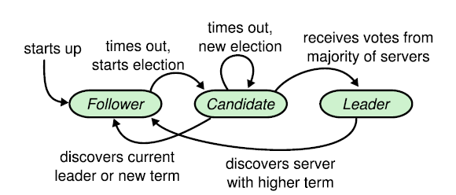

Slide 49
The history of blockchain
Blockchain was introduced with the invention of bitcoin in 2008 and then with its practical implementation in 2009.
The concept of electronic cash or digital currency is not new.
Since the 1980s, e-cash protocols have existed that are based on a model proposed by David Chaum.

Slide 50
Electronic cash
The idea of electronic cash is also essential to appreciate the first and astonishingly successful application of blockchain:
the bitcoin, or broadly cryptocurrencies.
Theoretical concepts in distributed systems such as consensus algorithms provided the basis of the practical implementation of Proof of Work algorithms in bitcoin;
Ideas from different electronic cash schemes also paved the way for the invention of cryptocurrencies, specifically bitcoin

Slide 51
The concept of electronic cash
Fundamental issues that need to be addressed in e-cash systems are
Accountability
Anonymity.
David Chaum addressed both of these issues in his seminal paper in 1984 by introducing two cryptographic operations,
Blind signatures
Secret sharing.
Blind signatures allow signing a document without actually seeing it
Secret sharing is a concept that allows the detection of using the same e-cash token twice (double spending).
Chaum, Fiat, and Naor (CFN) Protocol : e-cash schemes that introduced anonymity and double spending detection.

Slide 52
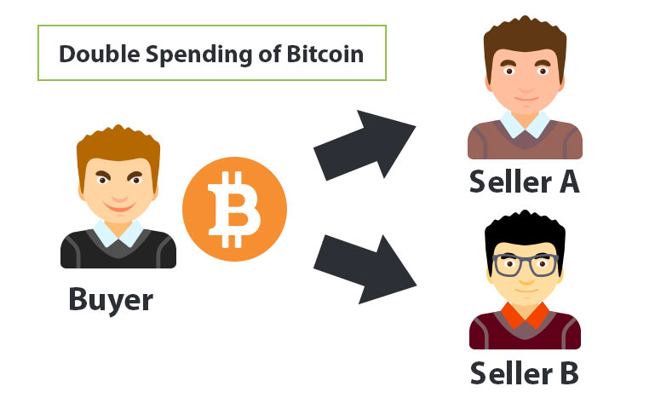

Slide 53
Brand's e-cash
Brand's e-cash is another system that improved on CFN, made it more efficient, and introduced the concept of security reduction to prove statements about the e-cash scheme.
Security reduction is a technique used in cryptography to prove that a certain algorithm is secure by using another problem as a comparison.
cryptographic security algorithm is as hard to break as some other hard problem; thus by comparison it can be deduced that the cryptographic security algorithm is secure too.

Slide 54
hashcash
A different but relevant concept called hashcash was introduced by Adam Back in 1997 as a PoW system to control e-mail spam.
if legitimate users want to send e-mails then they are required to compute a hash as a proof that they have spent a reasonable amount of computing resources before sending the e-mail.
Generating hashcash is a compute intensive process but does not inhibit a legitimate user from sending the e-mail
because the usual number
e-mails required to be sent by a legitimate user is presumably quite low.
If a spammer wants to send e-mails, usually thousands in number, then it becomes infeasible to compute hashcash for all e-mails, thus making the spamming effort expensive;

Slide 55
Hashcash is popularized by its use in the bitcoin mining process.
This idea of using computational puzzles or pricing functions to prevent e-mail spam was introduced originally in 1992 by Cynthia Dwork and Moni Naor.
Pricing function was the name given to the hard functions that are required to be computed before access to a resource can be granted.
Adam Back invented hashcash independently in 1997, which introduced the usage of computing hash functions as PoW.

Slide 56
b-money
In 1998 b-money was introduced by Wei Dai and proposed the idea of creating money via solving computational puzzles such as hashcash.
It's based on a peer-to-peer network where each node maintains its own list of transactions.

Slide 57
BitGold
Another similar idea by Nick Szabo called BitGold was introduced in 2005 and also proposed solving computational puzzles to mint digital currency.
In 2005 Hal Finney introduced the concept of cryptographic currency by combining ideas from b-money and hashcash puzzles
but it still relied on a centralized trusted authority.

Slide 58
bitcoin
In 2009 the first practical implementation of a cryptocurrency named bitcoin was introduced;
For the very first time it solved the problem of distributed consensus in a trustless network.
It uses public key cryptography with hashcash as PoW to provide a secure, controlled, and decentralized method of minting digital currency.
The key innovation is the idea of an ordered list of blocks composed of transactions and cryptographically secured by the PoW mechanism

Slide 59
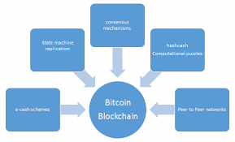
Ideas and concepts from electronic cash schemes and distributed systems were combined together to invent bitcoin
Now it is known as blockchain.

Slide 60
Introduction to blockchain
Blockchain at its core is a peer-to-peer distributed ledger that is
cryptographically secure
append-only
immutable (extremely hard to change)
updateable only via consensus or agreement among peers.
Blockchain can be thought of as a layer of a distributed peer-to-peer network running on top of the Internet

Slide 61
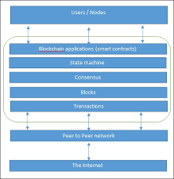
The network view of a blockchain

Slide 62
Introduction to blockchain
From a business point of view a blockchain can be defined as a platform whereby peers can exchange values using transactions without the need for a central trusted arbitrator.
This allows blockchain to be a decentralized consensus mechanism where no single authority is in charge of the database

Slide 63
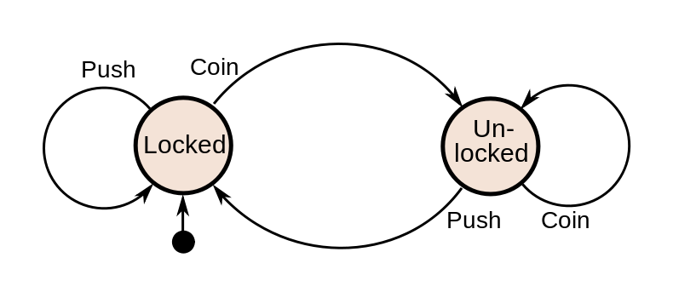
State Machines
State Variables
Deterministic Commands

Slide 64
Consensus
Termination
Validity
Integrity
Agreement
Ensures procedures are called in same order across all machines

Slide 65
Fault Tolerant State Machines
Implement the state machine on multiple processors.
State Machine Replication
Each starts in the same initial state
Executes the same requests
Requires consensus to execute in same order
Deterministic, each will do the exact same thing
Produce the same output.

Slide 66
state machine replication
state machine replication or state machine approach is a general method for implementing a fault-tolerant service by replicating servers and coordinating client interactions with server replicas
Make server deterministic (state machine)
Replicate server
Ensure correct replicas step through the same sequence of state transitions
Vote on replica outputs for fault-tolerance

Slide 67
Replica Coordination
All non-faulty state machines receive all commands in the same order
Every non-faulty state machine processes the commands it receives in the same order

Slide 68
Block
A block is simply a selection of transactions bundled together in order to organize them logically.
It is made up of transactions and its size is variable depending on the type and design of the blockchain in use.
A reference to a previous block is also included in the block unless it's a genesis block.
A genesis block is the first block in the blockchain that was hardcoded at the time the blockchain was started.
The structure of a block is also dependent on the type and design of a blockchain

Slide 69
Block
Generally there are a few attributes that are essential to the functionality of a block
Block header
Pointers to previous` blocks
Time stamp
Nonce
Transaction counter
Transactions
Other attributes.

Slide 70
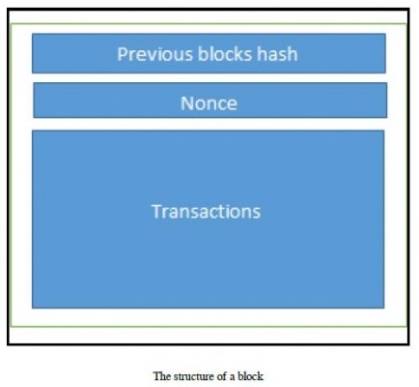
The structure of a block

Slide 71
Various technical definitions of blockchains – Definition 1
Blockchain is a decentralized consensus mechanism.
In a blockchain, all peers eventually come to an agreement regarding the state of a transaction.

Slide 72
Definition 2
Blockchain is a distributed shared ledger.
Blockchain can be considered as a shared ledger of transactions.
The transaction are ordered and grouped into blocks.
Real-world model is based on private databases that each organization maintains whereas the distributed ledger can serve as a single source of truth for all member organizations that are using the blockchain.

Slide 73
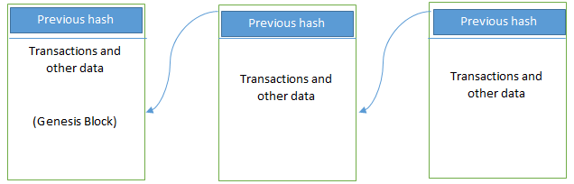
Definition 3
Blockchain is a data structure;
it is basically a linked list that uses hash pointers instead of normal pointers.
Hash pointers are used to point to the previous block.

Slide 74
Generic elements of a blockchain - Addresses
Addresses are unique identifiers that are used in a transaction on the blockchain to denote senders and recipients.
An address is usually a public key or derived from a public key.
Addresses can be reused by the same user, addresses themselves are unique.
In practice, single user may not use the same address again and generate a new one for each transaction.

Slide 75
Addresses
Bitcoin is in fact a pseudonymous(false) system.
End users are usually not directly identifiable
But some research in de-anonymizing bitcoin users have shown that users can be identified successfully.
As a good practice it is suggested that users generate a new address for each transaction
In order to avoid linking transactions to the common owner, thus avoiding identification.

Slide 76
Transaction
A transaction is the fundamental unit of a blockchain.
A transaction represents a transfer of value from one address to another.

Slide 77
Block
A block is composed of multiple transactions and some other elements such as the previous
block hash (hash pointer)
Timestamp
Nonce.
A nonce ("number only used once") is a number added to a hashed block that, when rehashed, meets the difficulty level restrictions.
The nonce is the number that blockchain miners are solving for.

Slide 78
Block
The nonce can be found as a 4-byte field in a block header,
Its value adjusted by miners so that the hash of the block will be less than or equal to the current target hash value set by the network.
Miners will hash slight variations of the input data, which for the mining process will be the nonce,
Finding such a hash value during the mining process is known as a golden nonce.

Slide 79
Peer-to-peer network
Network topology whereby all peers can communicate with each other and send and receive messages.

Slide 80
Scripting or programming language
This element performs various operations on a transaction.
Transaction scripts are predefined sets of commands for nodes to transfer tokens from one address to another and perform various other functions.
Turing complete programming language is a desirable feature of blockchains;

Slide 81
Virtual machine
A virtual machine allows Turing complete code to be run on a blockchain (as smart contracts)
Virtual machines are not available on all blockchains;
Various blockchains use virtual machines to run programs
Ethereum Virtual Machine (EVM)
Chain Virtual Machine (CVM).

Slide 82
State machine
A blockchain can be viewed as a state transition mechanism
whereby a state is modified from its initial form to the next and eventually to a final form as a result of a transaction execution and validation process by nodes.

Slide 83
Nodes
A node in a blockchain network performs various functions depending on the role it takes.
A node can propose and validate transactions and perform mining to facilitate consensus and secure the blockchain.
Nodes can also perform other functions such as
simple payment verification (lightweight nodes)
validators,
many others functions.

Slide 84
Smart contracts
Programs run on top of the blockchain
Encapsulate the business logic to be executed when certain conditions are met.
The smart contract feature is not available in all blockchains
It is becoming a very desirable feature due to the flexibility and power it provides to the blockchain applications.
Self-automated computer programs that can carry out the terms of any contract
Mostly based on objective conditions precedent
“If, then” criteria

Slide 85
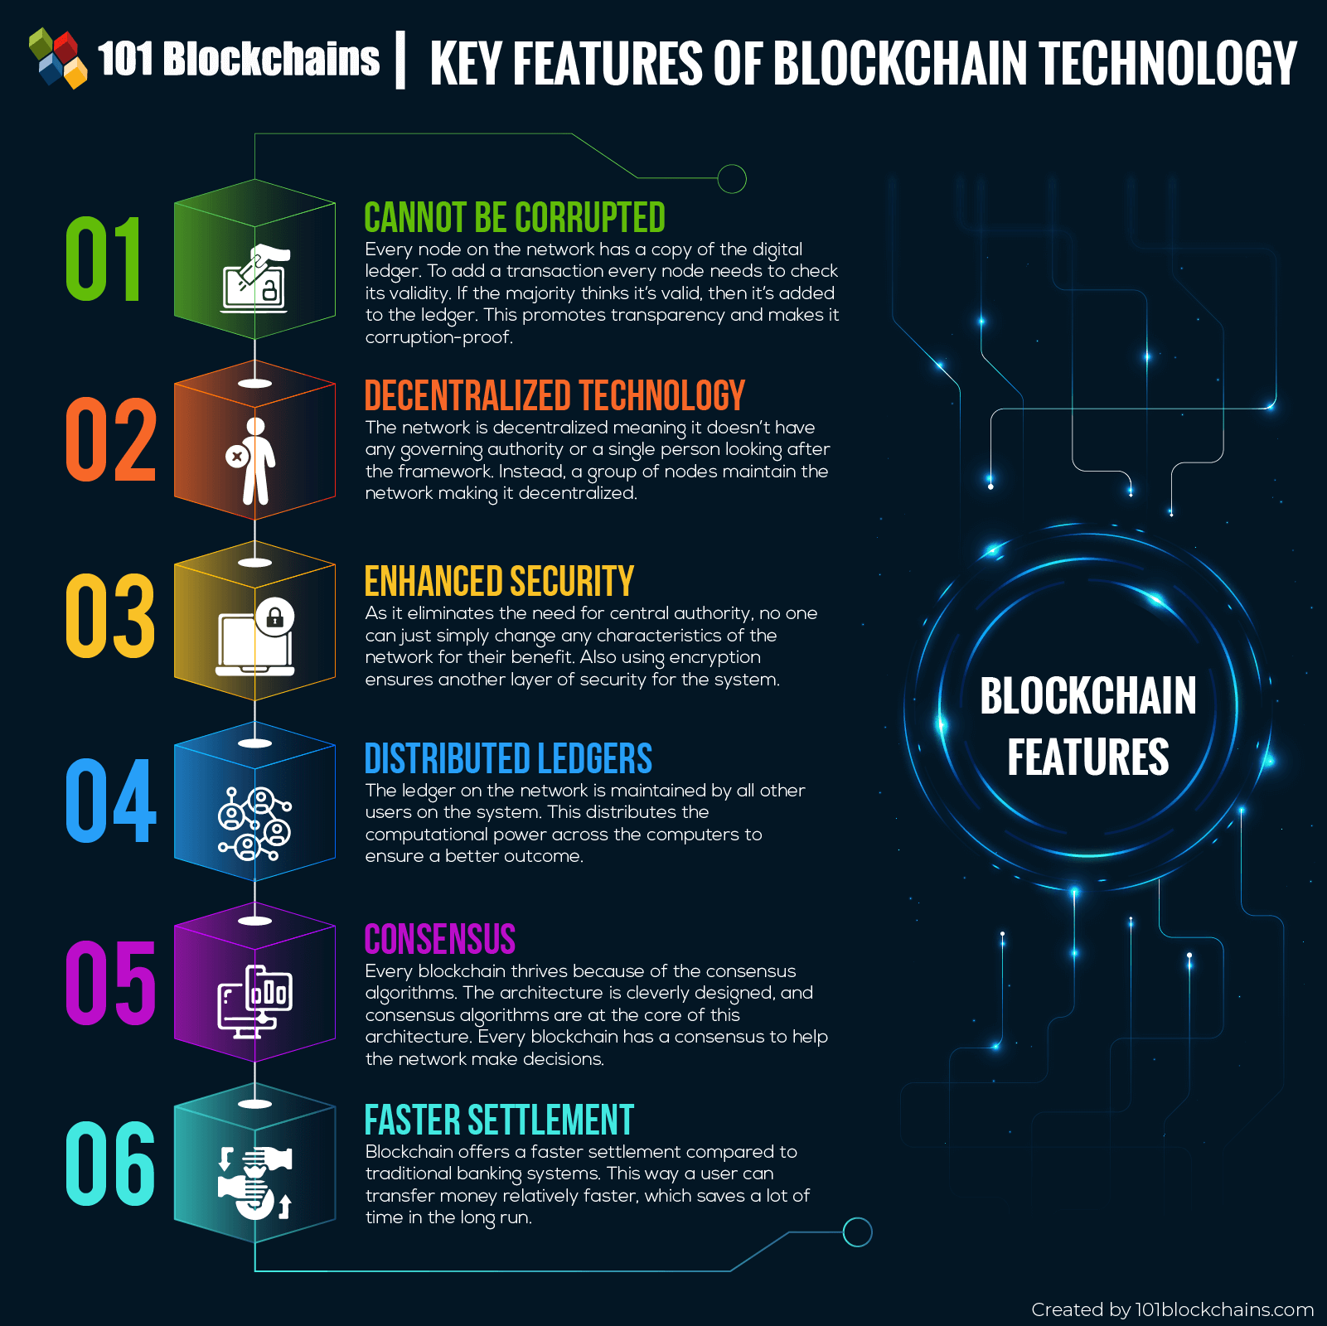
Features of a blockchain

Slide 86
Features of a blockchain
Distributed consensus
Enables a blockchain to present a single version of truth that is agreed upon by all parties
Transaction verification
Any transactions posted from nodes on the blockchain are verified based on a predetermined set of rules
Only valid transactions are selected for inclusion in a block
Platforms for smart contracts
A blockchain is a platform where programs can run that execute business logic on behalf of the users

Slide 87
Transferring value between peers
Blockchain enables the transfer of value between its users via tokens.
Generating cryptocurrency
A blockchain can generate cryptocurrency as an incentive to its miners who validate the transactions and spend resources in order to secure the blockchain.
Smart property
Linking a digital or physical asset to the blockchain in an irrevocable manner such that it cannot be claimed by anyone else;
Full control on your asset and it cannot be double spent or double owned

Slide 88
Provider of security
Blockchain is based on proven cryptographic technology that ensures the integrity and availability of data
Confidentiality is not provided due to the requirements of transparency
Other security services such as nonrepudiation and authentication are also provided by blockchain as all actions are secured by using private keys and digital signatures.
Immutability
Records once added onto the blockchain are immutable.
There is the possibility of rolling back the changes but this is considered almost impossible to do as it will require an unaffordable amount of computing resources

Slide 89
Uniqueness
Ensures that every transaction is unique and has not been spent already.
Especially relevant in cryptocurrencies
Smart contracts
Revolutionary feature of blockchain as it allows flexibility, programmability, and much desirable control of actions that users of blockchain need to perform according to their specific business requirements.

Slide 90
Applications of blockchain technology
Blockchain technology has a multitude of applications in various sectors including but not limited to finance, government, media, law, and arts.
Almost all industries have already realized the potential and promise of blockchain and have already embarked, or soon will embark

Slide 91
How blockchains accumulate blocks
A node starts a transaction by signing it with its private key.
The transaction is propagated (flooded) by using much desirable Gossip protocol to peers
Peers validates the transaction based on pre-set criteria.
Usually, more than one node is required to validate the transactions.
Once the transaction is validated, it is included in a block, which is then propagated on to the network.
At this point, the transaction is considered confirmed.

Slide 92
How blockchains accumulate blocks
The newly created block now becomes part of the ledger and the next block links itself cryptographically back to this block.
This link is a hash pointer.
At this stage, the transaction gets its second confirmation and the block gets its first.
Transactions are then reconfirmed every time a new block is created.
Usually, six confirmations in the bitcoin network are required to consider the transaction final.
To be secure against double spending, a transaction should not be considered as confirmed until it is a certain number of blocks deep.

Slide 93
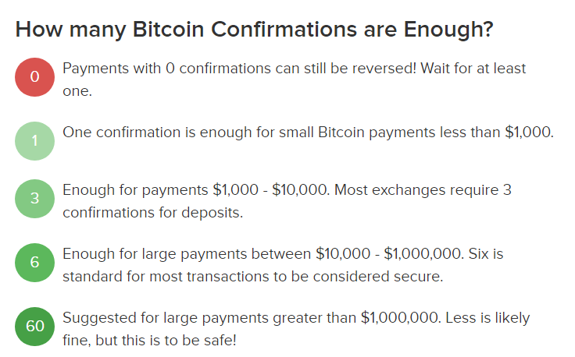

Slide 94
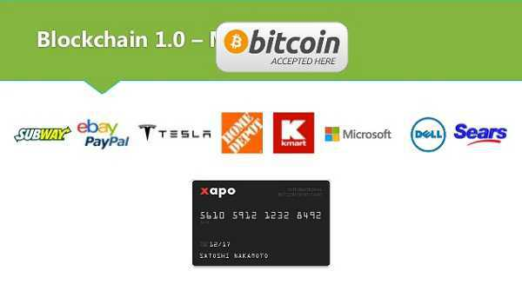
Tiers of blockchain technology
Blockchain 1.0
Introduced with the invention of bitcoin and is basically used for cryptocurrencies.
Categorize Generation 1 of blockchain technology to only include cryptographic currencies.
All alternative coins and bitcoin fall into this category.
This includes core applications such as payments and applications.
This generation started in 2009 when Bitcoin was released and ended in early 2010.

Slide 95
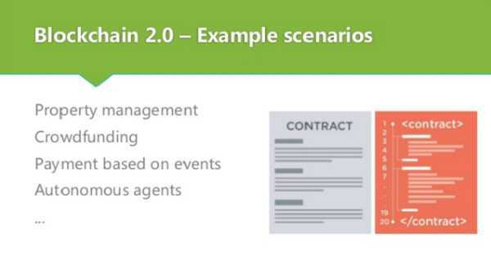
Tiers of blockchain technology
Blockchain 2.0
Generation 2.0 blockchains are used by financial services and contracts are introduced in this generation.
This includes various financial assets, for example derivatives, options, swaps, and bonds.
Applications that are beyond currency, finance, and markets are included at this tier.
Ethereum, Hyperledger, and other newer blockchain platforms are considered part of Blockchain 2.0.
This generation started when ideas related to using blockchain for other purposes started to emerge in 2010.

Slide 96

Tiers of blockchain technology
Blockchain 3.0
Generation 3 blockchains are used to implement applications beyond the financial services industry
Used in more general-purpose industries such as government, health, media, the arts, and justice.
Again, as in Blockchain 2.0, Ethereum, Hyperledger, and newer blockchains with the ability to code smart contracts are considered part of this blockchain technology tier.
This generation of blockchain emerged around 2012 when multiple applications of blockchain technology in different industries were researched.

Slide 97
Tiers of blockchain technology
Generation X (Blockchain X)
This is a vision of blockchain singularity where one day we will have a public blockchain service available that anyone can use just like the Google search engine
It will provide services in all realms of society.
This is a public open distributed ledger with general purpose rational agents (Machina Economicus) running on blockchain, making decisions and interacting with other intelligent autonomous agents on behalf of humans and regulated by code instead of law or paper contracts.
Machina Economicus is a concept which comes from the field of Artificial Intelligence (AI) and computational economics. It can be defined as a machine that makes logical and perfect decisions.

Slide 98
Types of blockchain-Public blockchains
Blockchains are open to the public
Anyone can participate as a node in the decision-making process.
Users may or may not be rewarded for their participation.
Ledgers are not owned by anyone and are publicly open for anyone to participate in.
All users of the permission-less ledger maintain a copy of the ledger on their local nodes and use a distributed consensus mechanism in order to reach a decision about the eventual state of the ledger.
Public blockchains are also known as permission-less ledgers.

Slide 99
Types of blockchain-Private blockchains
Private blockchains as the name implies are private
Open only to a consortium or group of individuals or organizations that has decided to share the ledger among themselves

Slide 100
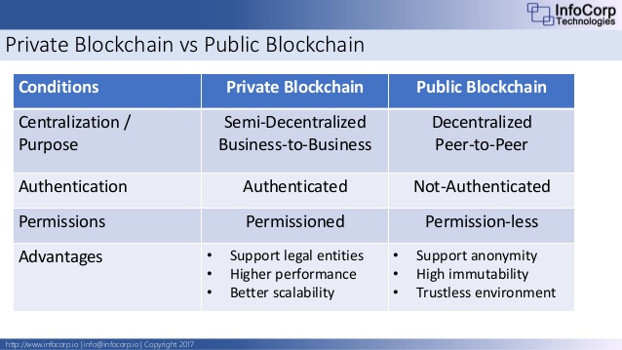

Slide 101
Types of blockchain-Semi-private blockchains
Part of the blockchain is private and part of it is public.
The private part is controlled by a group of individuals
whereas the public part is open for participation by anyone

Slide 102
Types of blockchain-Sidechains
More precisely known as pegged sidechains,
This is a concept whereby coins can be moved from one blockchain to another and moved back.
Common uses include the creation of new altcoins (alternative cryptocurrencies) whereby coins are burnt as a proof of adequate stake.
There are two types of sidechain.
The example provided above for burning coins is applicable to a one-way pegged sidechain.
The second type is called a two-way pegged sidechain, which allows the movement of coins from the main chain to the sidechain and back to the main chain when required.

Slide 103
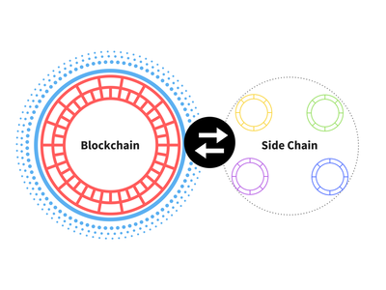

Slide 104
Types of blockchain-Permissioned ledger
A permissioned ledger is a blockchain whereby the participants of the network are known and already trusted.
Permissioned ledgers do not need to use a distributed consensus mechanism
instead an agreement protocol can be used to maintain a shared version of truth about the state of the records on the blockchain.
There is also no requirement for a permissioned blockchain to be private as it can be a public blockchain but with regulated access control.

Slide 105
Types of blockchain-Distributed ledger
This ledger is distributed among its participants and spread across multiple sites or organizations.
This type can either be private or public.
The key idea is that, unlike many other blockchains, the records are stored contiguously instead of sorted into blocks.
This concept is used in Ripple.

Slide 106
Types of blockchain
Shared ledger
This is generic term that is used to describe any application or database that is shared by the public or a consortium.
Fully private and proprietary blockchains
These blockchains perhaps have no mainstream application as they deviate from the core idea of decentralization in blockchain technology.
Nonetheless in specific private settings within an organization there might be a need to share data and provide some level of guarantee of the authenticity of the data.
For example, for collaboration and sharing data between various government departments.

Slide 107
Types of blockchain
Tokenized blockchains
These blockchains are standard blockchains that generate cryptocurrency as a result of a consensus process via mining or via initial distribution
Tokenless blockchains
These are probably not real blockchains because they lack the basic unit of transfer of value
These are still valuable in situations where there is no need to transfer value between nodes and only sharing some data among various already trusted parties is required.

Slide 108
Consensus in blockchain
Consensus is basically a distributed computing concept that has been used in blockchain in order to provide a means of agreeing to a single version of truth by all peers on the blockchain network.
Two categories of consensus mechanism exist:
Proof-based, leader-based, or the Nakamoto consensus whereby a leader is elected and proposes a final value
Byzantine fault tolerance-based, which is a more traditional approach based on rounds of votes

Slide 109
Proof of Work
This type of consensus mechanism relies on proof that enough computational resources have been spent before proposing a value for acceptance by the network.
Used in bitcoin and other cryptocurrencies.
Currently, this is the only algorithm that has proven astonishingly successful against Sybil attacks.
Sybil Attack : node in the network operates multiple identities actively at the same time and undermines the authority/power in reputation systems.

Slide 110
Proof of Stake
This algorithm works on the idea that a node or user has enough stake in the system;
Example the user has invested enough in the system so that any malicious attempt would outweigh the benefits of performing an attack on the system.
This idea was first introduced by Peercoin and is going to be used in the Ethereum blockchain.
Another important concept in Proof of Stake (PoS) is coin age, which is a derived from the amount of time and the number of coins that have not been spent.
In this model, the chances of proposing and signing the next block increase with the coin age.

Slide 111
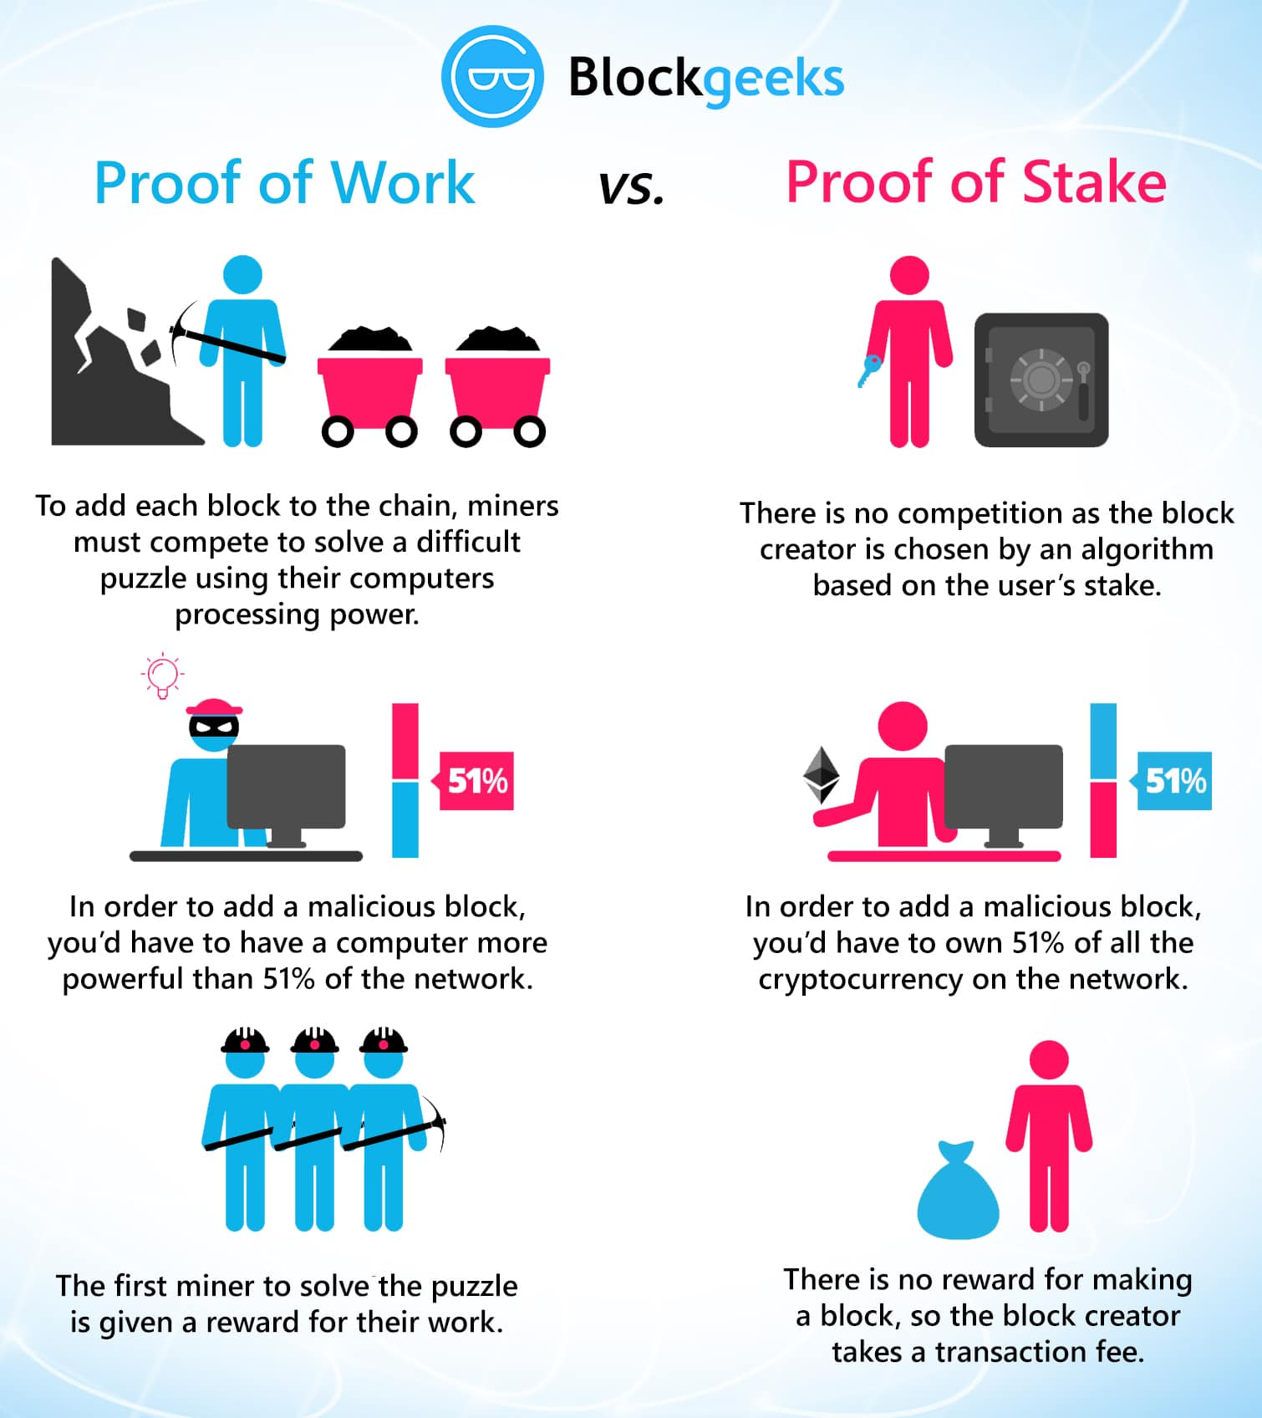

Slide 112
Delegated Proof of Stake
Delegated Proof of Stake (DPOS) is an innovation over standard PoS
Each node that has stake in the system can delegate the validation of a transaction to other nodes by voting.
This is used in the bitshares blockchain

Slide 113
Proof of Elapsed Time
Introduced by Intel
Proof of elapsed time (POET) is a blockchain network consensus mechanism algorithm that prevents high resource utilization and high energy consumption
Uses Trusted Execution Environment (TEE) to provide randomness and safety in the leader election process via a guaranteed wait time.
Each participating node in the network is required to wait for a randomly chosen time period,
first one to complete the designated waiting time wins the new block.
Each node in the blockchain network generates a random wait time and goes to sleep for that specified duration.
The one to wake up first – that is, the one with the shortest wait time – wakes up and commits a new block to the blockchain, broadcasting the necessary information to the whole peer network .
It requires the Intel SGX (Software Guard Extensions) processor in order to provide the security guarantee and for it to be secure.
Hyperledger in the context of the Intel Sawtooth Lake blockchain project.

Slide 114
Deposit-based consensus
Nodes that wish to participate on the network have to put in a security deposit before they can propose a block.
The protocol governs through the controlling of these security deposits, which implicitly governs the incentives of validators.

Slide 115
Proof of importance
Proof of importance not only relies on how much stake a user has in the system but it also monitors the usage and movement of tokens by the user to establish a level of trust and importance.
This is used in Nemcoin.
Proof importance uses other various metrics in order to evaluate nodes.
net transfers
amount of vested currency,
activity clusters

Slide 116
Federated consensus or federated Byzantine consensus
Used in the stellar consensus protocol
Nodes in this protocol keep a group of publicly trusted peers
Propagates only those transactions that have been validated by the majority of trusted nodes.

Slide 117
Reputation-based mechanisms
Leader is elected on the basis of the reputation it has built over time on the network.
This can be based on the voting from other members.

Slide 118
Practical Byzantine Fault Tolerance
Practical Byzantine Fault Tolerance (PBFT) achieves state machine replication
which provides tolerance against Byzantine nodes.
PBFT, PAXOS, RAFT, and Federated Byzantine Agreement (FBA), are also being used or have been proposed for use in many different implementations of distributed systems and blockchains.

Slide 119
CAP theorem and blockchain
CAP theorem is violated in blockchain,
bitcoin,
In blockchains consistency is sacrificed in favor of availability and partition tolerance.
In this scenario, Consistency (C) on the blockchain is not achieved simultaneously with Partition tolerance (P) and Availability (A), but it is achieved over time.
This is called eventual consistency, where consistency is achieved as a result of validation from multiple nodes over time.

Slide 120
CAP theorem and blockchain
For this purpose, the concept of mining was introduced in bitcoin;
This is a process that facilitates the achievement of consensus by using a consensus algorithm called PoW.
Mining can be defined as a process that is used to add more blocks to the blockchain.

Slide 121
Benefits of blockchain
Decentralization
no need for a trusted third party or intermediary to validate transactions
Transparency and trust
blockchains are shared and everyone can see what is on the blockchain
Immutability
Once the data has been written to the blockchain, it is extremely difficult to change it back

Slide 122
Benefits of blockchain
High availability
data is replicated and updated on each and every node
Highly secure
All transactions on a blockchain are cryptographically secured and provide integrity
Simplification of current paradigms
Blockchain can serve as a single shared ledger among interested parties

Slide 123
Benefits of blockchain
Faster dealings
Blockchain does not require a lengthy process of verification, reconciliation, and clearance
Because a single version of agreed upon data is already available on a shared ledger
Cost saving
No third party or clearing houses are required in the blockchain model

Slide 124
Challenges and limitations of blockchain technology
Scalability
Adaptability
Regulation
Relatively immature technology
Privacy

Slide 125
References
Imran Bashir. “Mastring BlockChain”, Packt
Web Materials

