Slide 1
Decentralization
-Dr. Sanjay H A

Slide 2
Decentralization using blockchain
Decentralization is a core benefit and service provided by the blockchain technology.
Blockchain does not need any intermediaries and can function with many different leaders chosen via consensus mechanisms.
This model allows anyone to compete to become the decision-making authority.
This competition is governed by a consensus mechanism and Proof of Work (PoW).

Slide 3
Decentralization using blockchain
Decentralization is applied in varying degrees from semi-decentralized to fully decentralized depending on the requirements and circumstances.
Example
Information and communication technology (ICT) has conventionally been based on a centralized paradigm
With bitcoin and the advent of the blockchain technology, this model has changed and now the technology that allows anyone to start a decentralized system

Slide 4
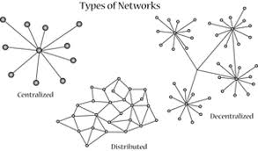

Slide 5
Centralized systems
Conventional (client–server) IT systems whereby there is a single authority that controls the system and is solely in-charge of all operations on the system.
Online service providers, such as eBay, Google, Amazon, Apple's App Store, and the majority of other providers, use this model of delivering services.

Slide 6
Distributed system
Data and computation are spread across multiple nodes in the network.
Parallel computing v/s Distributed system.
Both of these models are used with variations in order to achieve failure tolerance and speed.
In this model, there is still a central authority that has control over all nodes and governs processing.
This means that the system is still centralized in nature.

Slide 7
Decentralized system
key difference between a decentralized system and distributed system
In a distributed system, there still exists a central authority that governs the entire system
In a decentralized system, no such authority exists.
A decentralized system is a type of network whereby nodes are not dependent on a single master node;
instead, control is distributed among many nodes.
User to agree on something via a consensus algorithm without the need for a central trusted third party, intermediary, or service provider
For example,
Each department in an organization has its own database server
Taking away the power from the central server and distributing it to the sub-departments that manage their own databases.

Slide 8
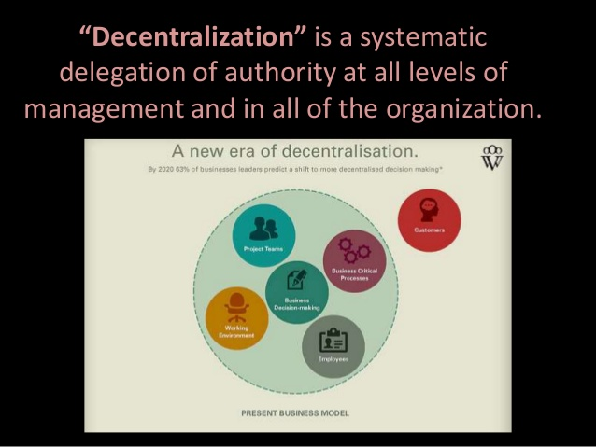

Slide 11
Methods of decentralization
Disintermediation
Through competition

Slide 12
Disintermediation
Example: Imagine you want to send money to your friend in another country.
You go to a bank that will transfer your money to the bank for a fee.
Bank keeps a central database that is updated, confirming that you have sent the money.
With blockchain technology, it is possible to send this money directly to your friend without the need for a bank.
This way, the intermediary is no longer required and decentralization is achieved by disintermediation.
This model can be used not only in finance but also in many other different industries.

Slide 13
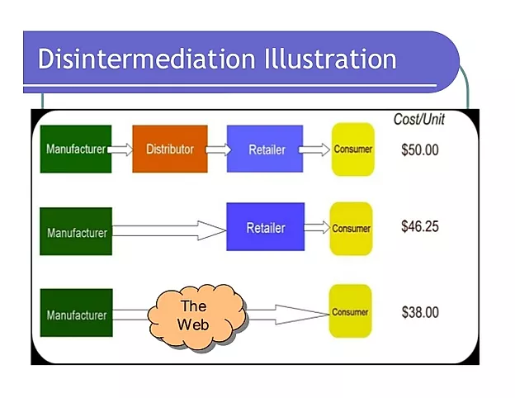

Slide 14
Through competition
Group of service providers compete with each other in order to be selected for the provision of services by the system.
This paradigm does not achieve complete decentralization, but to a certain degree ensures that an intermediary or service provider is not monopolizing the service.
In the context of blockchain technology
Smart contracts can choose an external data provider from a large number of providers based on their reputation, previous score, reviews, and quality of service.
This will not result in full decentralization, but it allows smart contracts to make a free choice based on the criteria mentioned earlier.
This way, an environment of competition is cultivated among service providers, whereby they compete with each other to become the data provider of choice.

Slide 16
Benefits of decentralization
Transparency
Efficiency
Cost saving
Development of trusted ecosystems
Privacy
Anonymity

Slide 17
Challenges
Security requirements
Software bugs
Human errors
For example
In a decentralized system such as bitcoin or Ethereum, where security is usually provided by private keys
How can it be ensured that a smart property associated with these private keys cannot be rendered
Useless if, due to a human error, the private keys are lost or if, due to a bug in the smart contract code
Decentralized application is vulnerable to attack by adversaries

Slide 18
How to decentralize
A framework has been proposed by Arvind Narayanan and others that can be used to evaluate the decentralization requirements of a variety of things in the context of blockchain technology.
The framework basically proposes four questions that, once answered, provide a clear idea as to how a system can be decentralized.
What is being decentralized?
What level of decentralization is required?
What blockchain is used?
What security mechanism is used?

Slide 19
How to decentralize
The first question simply asks what system is being decentralized.
Any system, for example an Identity system or trading.
The next question can be answered by specifying the level of decentralization required by looking at the scale of decentralization.
full disintermediation / partial disintermediation.

Slide 20
How to decentralize
Third question is quite straightforward, where developers can make a choice as to which blockchain is suitable for a particular application.
Bitcoin / Ethereum blockchain or any other blockchain
key question needs to be answered about the security mechanism as to how the security of a decentralized system can be guaranteed.
Atomicity, for example, whereby either the transaction executes in full or does not execute at all. This ensures the integrity of the system.
Other mechanisms can include reputation, which allows varying degrees of trust in a system.

Slide 21
Examples
Money transfer system -which is required to be decentralized
Answer 1:
Money transfer system.
Answer 2:
Disintermediation.
Answer 3:
Bitcoin.
Answer 4:
Atomicity.

Slide 22
Blockchain and full ecosystem decentralization
In order to achieve complete decentralization, it is necessary that the environment around the blockchain is also decentralized
Storage
Communication
Computation

Slide 23
Storage
Data can be stored directly in a blockchain, and with this, it does achieve decentralization,
Major disadvantage of this approach is that blockchain is not suitable for storing large amounts of data by design
It can store simple transactions and some arbitrary data but is certainly not suitable for storing images or large blobs of data, as is the case in traditional database systems
Alternative is to use distributed hash tables (DHTs).
DHTs were originally used in peer-to-peer file sharing software, such as BitTorrent, Napster, Kazaa, and Gnutella.
BitTorrent turns out to be the most scalable and fast network, but the issue is that there is no incentive for users to keep the files indefinitely

Slide 24
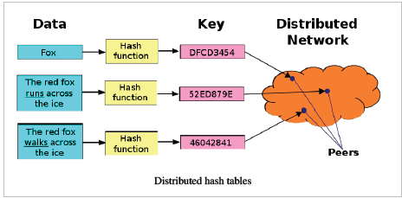

Slide 25
Storage
Users do not usually keep files permanentl
If nodes leave the network that has data required by someone there is no way to retrieve it except having the required nodes rejoin the network again so that the files become available once more.
Two main requirements are high availability and link stability
Data should be available when required and network links should also always be accessible.

Slide 26
Storage
Inter Planetary File System (IPFS) by Juan Benet possesses both properties and the vision is to provide a decentralized World Wide Web by replacing the HTTP protocol.
IPFS uses Kademlia DHT and merkle DAG (Directed Acyclic Graph) to provide the storage and searching functionality, respectively
The incentive mechanism is based on a protocol known as Filecoin that pays incentives to nodes that store data using the BitSwap mechanism.
The BitSwap mechanism allows nodes to keep a simple ledger of bytes sent or bytes received under a one-to-one relationship.
Git-based version control mechanism is used in IPFS to provide structure and control over the versioning of data.

Slide 27
Storage
Ethereum has its own decentralized and distributed ecosystem that uses Swarm for storage and the whisper protocol for communication.
Maidsafe is aiming to provide a decentralized World Wide Web.
BigChainDB is another storage layer decentralization project aimed at providing a scalable, fast, and linearly scalable decentralized database as opposed to a traditional filesystem.
BigChainDB complements decentralized processing platforms and file systems such as Ethereum and IPFS.

Slide 28
Communication
Services such as e-mail and online storage are all now based on a paradigm where the service provider is in control and users trust them to give them access to the service when required.
This model is based on the trust of the central authority (the service provider)
Users are not in control of their data; even passwords are stored on trusted third-party systems.
Access to user data is guaranteed and is not dependent on a single third party.

Slide 29
Communication
Access to the Internet is based on Internet service providers (ISPs) that act as a central hub for Internet users.
If the ISP is shut down for any other reasons, then no communication is possible
An alternative is to use mesh networks
Limited in functionality as compared to the Internet
Provide a decentralized alternative where nodes can talk directly to each other without a central hub such as an ISP.

Slide 30
Communication
Original vision of the Internet was to build a decentralized network;
Over the years, with the advent of large-scale service providers such as Google, Amazon, and eBay, the control is shifting toward the big players.
For example, email is a decentralized system at its core; anyone can run an e-mail server with minimal effort and can start sending and receiving e-mails,
But there is a better alternative available that is already providing a managed service for end users,
There is a natural inclination toward selecting a centralized service as it is more convenient and free
Blockchain has once again given this vision of decentralization to the world

Slide 31
Computation
Decentralization of computing or processing is achieved by a blockchain technology such as Ethereum
where smart contracts with embedded business logic can run on the network.
Other blockchain technologies also provide similar processing layer platforms where business logic can run over the network in a decentralized manner.

Slide 32
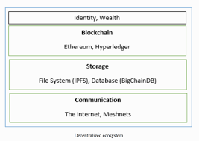

Slide 33
Decentralized Ecosystem
On the bottom layer, Internet or Meshnets provides a decentralized communication layer
Storage layer uses technologies such as IPFS and BigChainDB to enable decentralization
Blockchain that serves as a decentralized processing layer.

Slide 34
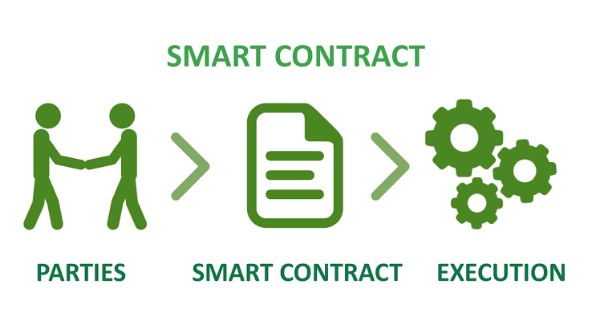
Smart contract
A smart contract can be thought of as a small decentralized program.
Smart contracts do not necessarily need a blockchain to run;
However, due to the security benefits that the blockchain technology provides, it is now becoming almost a standard to use blockchain as a decentralized execution platform for smart contracts.

Slide 35
Smart contract
A smart contract usually contains some business logic and a limited amount of data.
Actors or participants in the blockchain use these smart contracts or they run autonomously on behalf of the network participants.
Small programs reside on the blockchain and execute business logic if some specific criteria are met

Slide 36
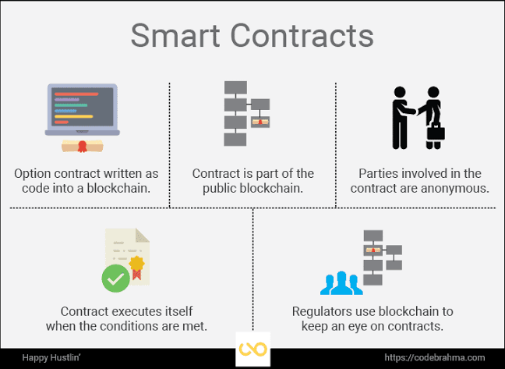

Slide 37
Decentralized organizations
Decentralized organization (DOs)
Software programs that run on a blockchain
Based on the idea of real human organizations with people and protocols.
DO, in the form of a smart contract or a set of smart contracts, is added to the blockchain,
It becomes decentralized and parties interact with each other based on the code defined within the DO software.

Slide 38
Decentralized autonomous organizations
Just like DOs, a Decentralized autonomous organization (DAO) is also a computer program than runs on top of a blockchain and embedded within it are governance and business logic rules.
DAO and DO are basically the same thing, but the main difference is
DAOs are autonomous, which means that they are fully automated and contain artificially intelligent logic
DOs lack this feature and rely on human input in order to execute business logic.

Slide 39
Decentralized autonomous organizations
Ethereum blockchain led the way with the introduction of DAOs for the first time.
In DAO, the code is considered the governing entity rather than humans or paper contracts.
Curator,, is a human entity that participates as someone who maintains this code and acts as a proposal evaluator for the community
DAOs are capable of hiring external Contractors if enough input is received from the token holders (participants).

Slide 40
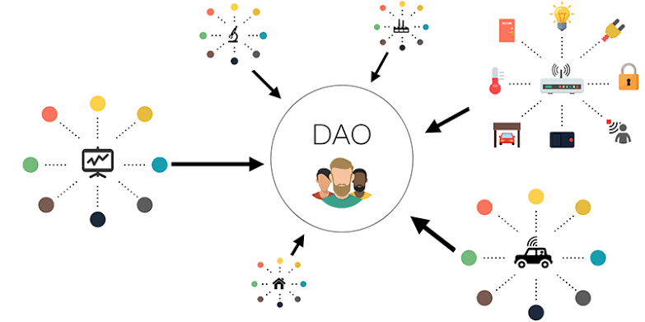

Slide 41
Decentralized autonomous organizations
The most famous DAO project is The DAO (h t t p s ://d a o h u b . o r g ) as it raised 168 million US dollars in its crowd-funding phase.
Venture capital fund which was aimed at providing a decentralized business model with no single entity as an owner.
Hacked due to a bug in the DAO code and millions of dollars' worth of Ether currency (ETH) were siphoned out of the DAO into a child DAO created by the hackers.
It required a hard fork on the Ethereum blockchain to reverse the impact of the hack and initiate the recovery of the funds.
hard fork: is a radical change to the protocol that makes previously invalid blocks/transactions valid (or vice-versa).
A hard fork requires all nodes or users to upgrade to the latest version

Slide 42
Decentralized autonomous organizations
DAOs do not have any legal status even though they may contain some intelligent code that enforces some protocols and conditions,
But these rules have no value in the current real-world legal system
An Autonomous Agent (AA) is a piece of code that runs without human intervention.
The fact that DAOs are purely decentralized entities makes it possible to run them in any physical jurisdiction.
Issue is how a current legal system would work with such a varied mix of different jurisdictions and geographies.

Slide 43
Decentralized autonomous corporations
DAOs and Decentralized autonomous corporations (DACs) are a similar concept but are considered a smaller subset of DAOs.
General difference is
DAOs are usually considered to be nonprofit,
DACs can make money via shares offered to the participants and by paying dividends.
These corporations can run a business automatically without human intervention based on the logic programmed within them.

Slide 44
Decentralized autonomous societies
Decentralized autonomous societies (DASs) are a concept whereby entire societies can function on a blockchain with the help of
multiple complex smart contracts
combination of DAOs and Decentralized applications (DAPPs)
Many services that a government offers can be delivered via blockchain,
Government Identity Card systems, passport issuance, ,records of deeds, marriages, and births.
if a government is corrupt and central systems do not provide the satisfactory levels of trust that a society needs
Society can start its own virtual blockchain that is driven by decentralized consensus and is transparent.

Slide 45
Decentralized applications
All DAOs, DACs, and DOs are basically decentralized applications that run on top of a blockchain in a peer-to-peer network.
Decentralized applications or DAPPs are software programs that can
Run on their own blockchain
Use another already existing established blockchain,
Use only protocols of an existing blockchain solution.
These are called Type I, Type II, and Type III DAPPs.

Slide 46
Requirements of a decentralized application
The DAPP should be fully open source and autonomous and no single entity should be in control of a majority of its tokens.
All changes to the application must be consensus-driven based on the feedback given by the community.
Data and records of operations of the application must be cryptographically secured and stored on a public, decentralized blockchain in order to avoid any central points of failure.
A cryptographic token must be used by the application in order to provide access and rewards to those who contribute value to the applications, for example, miners in bitcoin.
The tokens must be generated by the decentralized application according to a standard cryptographic algorithm.

Slide 47
Operations of a DAPP
Establishment of consensus by a DAPP can be achieved using consensus algorithms such as Proof of Work and Proof of Stake.
PoW has been found to be incredibly resistant to 51% attacks, as is evident from bitcoin.
DAPP can distribute tokens (coins) via mining, fundraising, and development.

Slide 48
Examples -Decentralized applications
KYC-Chain
Application to manage Know Your Customer (KYC) data in a secure and convenient way based on smart contracts.
OpenBazaar
Decentralized peer-to-peer network that allows commercial activities directly between sellers and buyers instead of relying on a central party
as opposed to conventional providers such as eBay and Amazon.
It should be noted that this system is not built on top of a blockchain; instead, distributed hash tables are used in a peer-to-peer network in order to enable direct communication and data sharing between peers.
It makes use of bitcoin as a payment network

Slide 49
Examples -Decentralized applications
Lazooz
Decentralized equivalent of Uber.
It allows peer-to-peer ride sharing
Users can be incentivized by proof of movement and can earn Zooz coins.

Slide 50
Platforms for decentralization-Ethereum
Ethereum tops the list as being the first blockchain that introduced a Turing-complete language and the concept of a virtual machine.
With the availability of Turing complete language called Solidity, endless possibilities have opened for the development of decentralized applications.
Ethereum proposed in 2013 by Vitalik Buterin and provides a public blockchain to develop smart contracts and decentralized applications.
Currency tokens on Ethereum are called Ethers.

Slide 51
Platforms for decentralization-Maidsafe
Maidsafe provides a SAFE (Secure Access for Everyone) network that is made up of unused computing resources, such as storage, processing power, and the data connections of its users.
The files on the network are divided into small chunks of data that are encrypted and distributed throughout the network randomly.
This data can only be retrieved by its respective owner.
One key innovation is that duplicate files are automatically rejected on the network, which helps reduce the need for additional computing resources to manage the load.
It uses Safecoin as a token to incentivize its contributors.

Slide 52
Platforms for decentralization-Lisk
Lisk is a blockchain application development and cryptocurrency platform.
It allows developers to use JavaScript to build decentralized applications and host them in their own respective sidechains.
Lisk uses the Delegated Proof of Stake (DPOS) mechanism for consensus whereby 101 nodes can be elected to secure the network and propose blocks.
It uses the Node.js and JavaScript backend whereas the frontend allows the use of standard technologies, such as CSS3, HTML5, and JavaScript.
Lisk uses LSK coin as a currency on the blockchain.
Another derivative of Lisk is Rise, which is a Lisk-based decentralized application and digital currency platform.
It has more focus on the security of the system.

Slide 53
References
Imran Bashir. “Mastring BlockChain”, Packt
Web Materials

