Slide 1
Olive Ledger
Smart Expense Manager
A clearer picture of student spending
COE203 · Advanced Python · Project 1
Mohannad Turkman 220911358
Rahaf Elnazier Ali 2305025319
Abdullah Al Shawaf 2309116128
Amr Khaled Mostafa Kamal 220901707
Abdulaziz Alzomi 2509111076
OLIVE LEDGER
01
Notes:
Olive Ledger helps students understand where their allowance goes and notice overspending early. It combines a white and olive interface with a Python backend, and also works through the command line.
Sources: User-provided team names and IDs. README.md.

Slide 2
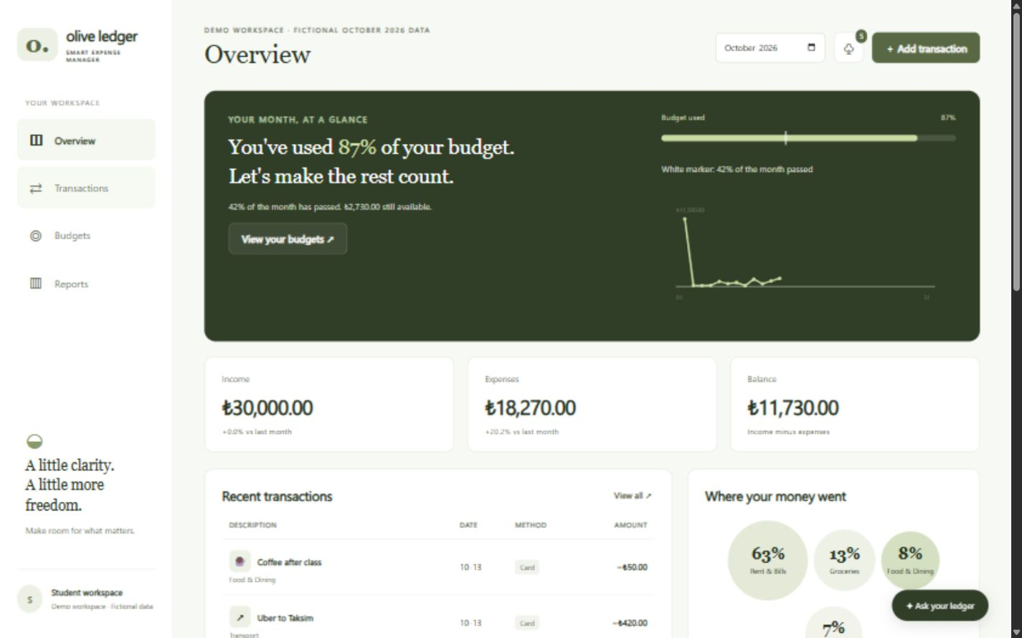
The student spending workflow
Record
Income and expenses
with dates and methods
Plan
Monthly and
category budgets
Understand
Reports and alerts
with clear reasons
OLIVE LEDGER
02
Notes:
Users record income and expenses, choose payment methods, and set monthly or category budgets. The dashboard shows remaining money, spending patterns, and explained alerts. These screenshots use clearly labelled fictional demo data.
Sources: Actual local application screenshot; fictional October 2026 data created by launch.py. UI-UX_Design.pdf, pages 2–3.

Slide 3
One service, two entry points
Frontend
FastAPI
Service
Repository
argparse CLI
SQLite
CLI entry point excerpt
args = vars(parser().parse_args(argv))
service = ExpenseService(db)
result = service.add_transaction(**args)
OLIVE LEDGER
03
Notes:
Our architecture separates the interface, business rules, and storage. FastAPI and the argparse CLI call the same service functions, so validation and calculations behave consistently. This connects our project to functions, modules, dictionaries, and professional script structure from class.
Sources: backend/main.py; backend/routes.py; backend/services.py; cli.py. Course Week 3: functions, dictionaries, argparse and main guard. Diagram simplifies the repository/Database split.

Slide 4
Exact money and validated storage
Decimal input becomes integer cents
amount = Decimal(str(value))
if amount != amount.quantize(Decimal("0.01")):
raise ValidationError("At most two decimals.")
return int(amount * 100)
0.10 + 0.20 = 30 cents
Bound SQL parameters
Foreign keys and CHECK constraints
Atomic record and alert saves
OLIVE LEDGER
04
Notes:
We convert validated decimal amounts into integer cents, so adding point one and point two gives exactly thirty cents. SQL parameters keep user input separate from queries. A transaction saves the record and its alerts together, and database constraints reject invalid relationships.
Sources: backend/validation.py money(): shortened error message for slide readability. backend/database.py; backend/repository.py; backend/services.py. Decimal snippet is an excerpt and omits additional validation checks.

Slide 5
Explainable alerts
A transparent category-based rule
if count >= 3 and item["amount_cents"] * count > total * 2:
... # save an explained alert
Previous expenses only. The new expense is excluded.
Budget warnings at 80% and 100%, once per threshold
30 automated tests
CLI, setup instructions and public repository
github.com/IIICROWIII/smart-expense-manager
OLIVE LEDGER
05
Notes:
An unusual expense must exceed twice its category average, using at least three previous expenses. The current expense never enters its own baseline. Budget alerts fire once at eighty and one hundred percent. Thirty automated tests cover invalid inputs, persistence, concurrency, and reports. The repository includes the CLI and setup instructions.
Sources: backend/services.py _unusual(): pseudocode renames item["amount_cents"] to amount_cents and shows the flagging action as a named helper for readability. _budget_alerts(). tests/test_backend.py: 30 tests passed before slide authoring. Repository URL supplied by user; latest local changes require a push.

