Slide 1

RESEARCH PRESENTATION
MERGE: Multimodal Emotion-Driven Rhythmic Lyric Generation Engine
Authors: Abhay Sharma, Ankit Kumar, Hritik Ranjan, Vikash Kumar Institute: Indian Institute of Information Technology, Hyderabad Date: April 2026

Slide 2
ABSTRACT
1-Slide Summary
Problem: Existing systems focus on either emotion OR structure of lyrics, rarely both in a multimodal context.
Solution: Proposed MERGE, a framework for rhythm-aware lyrics conditioned on facial expressions.
Method: Infers emotional state via FER (Facial Emotion Recognition) to guide GPT-2 generation.
Evaluation: Introduced PHREM, a comprehensive research-level metric for quality assessment.

Slide 3





PROBLEM STATEMENT
Structural Focus
Emotional Control
Integration Gap
Prior systems primarily emphasize rhyme at the cost of emotional depth.
Limited research on using external modalities (visual/face) for linguistic creative steering.
Absence of frameworks combining facial emotion vectors with rhythm-constrained text decoding.
Goal: Generate emotion-aware and rhythm-consistent lyrics through a unified multimodal pipeline.

Slide 4
MOTIVATION
Why Lyrics?
Complexity: Direct music synthesis faces data scarcity and high audio dimensionality.
.
NLP Scope: Lyric generation allows sophisticated semantic and structural study within text domains.
Expressivity: Lyrics serve as the primary emotional carrier in modern musical compositions.

Slide 5



RESEARCH QUESTIONS
RQ1: Control Signal Efficacy
Can facial emotion signals effectively serve as control inputs for fine-grained lyric generation?
RQ2: Constraint Interaction
Can rhythmic constraints be enforced during decoding without significantly degrading emotional alignment or linguistic fluency?

Slide 6



CORE CONTRIBUTIONS
MERGE Framework
Annotation Pipeline
PHREM Metric
First end-to-end framework connecting FER with rhythmic lyric generation.
Scalable method to map GoEmotions to FER classes for large-scale labeling.
Advanced evaluation metric capturing phonetic flow, rhythm, and coherence.

Slide 7

I. Background & Literature
Current state of Facial Emotion Recognition and Controlled Text Generation

Slide 8
RELATED WORK: FER
Facial Emotion Recognition
Evolution from ResNet/MobileNet to Transformer-based architectures.
Benchmark datasets: FER-2013 (35k images) and RAF-DB.
Focus on 7-class classification (Angry, Disgust, Fear, Happy, Sad, Surprise, Neutral).

Slide 9
RELATED WORK: TEXT GEN
Controlled Text Generation
Attribute-guided generation using control tokens (Radford et al., 2019).
Poetry systems using CMU Dictionary for phonetic rules (Ghazvininejad et al., 2016).
Missing: Systems that merge multimodal visual cues with multi-attribute text steering.

Slide 10
II. Dataset Details
Large-scale lyric corpora and multi-dataset FER unification

Slide 11


DATA SOURCES
Lyrics: Genius Corpus
Vision: FER Unified
~3.2 Million English-language songs.
FER-2013: Grayscale baseline.
Multi-genre diversity for robust training.
RAF-DB: Real-world images.
Filtered for high-quality metadata.
AffectNet: High-scale annotation (30k used).

Slide 12



EMOTION TAXONOMY
To ensure cross-modal compatibility, we utilized a 6-class mapping:
Angry
Fear
Happy
Sad
Surprise
Neutral
Exclusion of Disgust: Removed due to severe class imbalance in FER datasets and significant linguistic overlap with 'Sadness' in lyrics.

Slide 13
EMOTION MAPPING PIPELINE
GoEmotions to FER
Raw lyrics lack explicit emotion labels.
Step 1: 28 GoEmotions categories predicted line-by-line.
Step 2: Line probabilities grouped into 6 parent FER sets.
Step 3: Weighted aggregation for song-level sentiment.

Slide 14

MATHEMATICAL FORMULATION
Probability vector aggregation for a song with $n$ lines:
Where $w_i = 1 - q_{neutral}$ represents emotional intensity. The dominant emotion $e^*$ is selected via $\arg\max$.

Slide 15
III. Methodology
The MERGE System Architecture & Constrained Decoding

Slide 16
SYSTEM OVERVIEW
The Pipeline
1.
Input: User Face Image.
2.
FER Module: Predicts emotion (e.g., Happy).
3.
Control Token: Prepends to GPT-2.
4.
Transformer: Generates next-token probability.
5.
Constraint Decoder: Filters tokens for rhythm/rhyme.

Slide 17

FACIAL EMOTION RECOGNITION
Model Specs
Training Strategy: Phase V utilized an ensemble (EfficientNet-B3 + DenseNet-121) for superior robustness across multi-dataset variance.
CNN-based Feature Extractor.
Softmax layer for probability output across 6 classes.
Progressive unfreezing to prevent overfitting on FER-2013 benchmarks.

Slide 18
EMOTION CONDITIONING
[User Image] → FER → → GPT-2 → "Sunshine in my pocket..."
Emotion control is implemented via explicit control tokens. The model learns associations between high-level tags and thematic clusters (e.g., Happy → Imagery of celebration/light).

Slide 19

LANGUAGE MODEL: GPT-2
Lyric generation is a conditional probability task:
Optimizer: AdamW with linear warmup.
Sequence Length: 512 tokens.
Finetuning: Guided by mapped emotional Genius dataset.

Slide 20

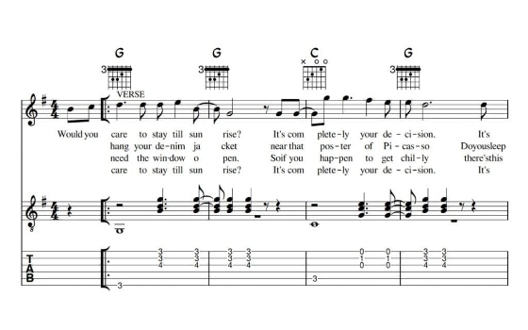
RHYTHM-CONSTRAINED DECODING
Constraint Enforcement
Syllable Count: Target counts maintained via candidate filtering.
Rhyme Schemes: CMU Dictionary lookup for AABB/ABAB patterns.
Soft Back-off: Strategy allows line regeneration if decoding becomes infeasible.

Slide 21
IV. The PHREM Metric
Phonetic Rhythm Emotion Metric: A Lyrical Evaluation Standard

Slide 22
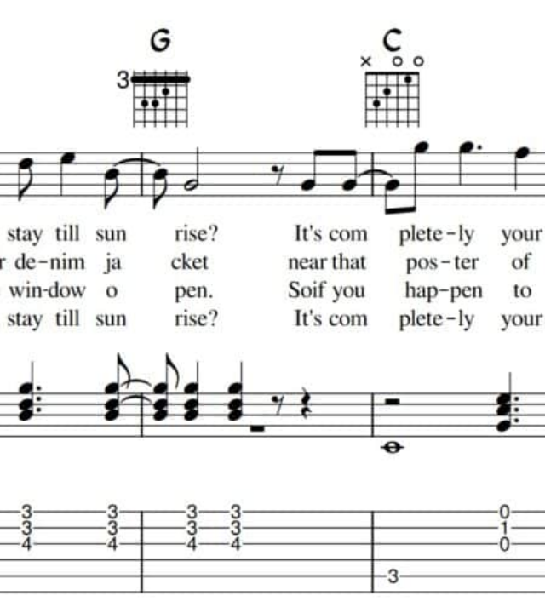
WHY PHREM?
Existing NLP metrics like BLEU or ROUGE fail for lyrics because they prioritize lexical overlap over musicality.
Lyrics require a holistic view of: • Phonetic flow • Rhythm/Meter • Emotional Arc • Semantic Coherence

Slide 23

PHREM CALCULATION
PHREM is a composite metric computed as a weighted sum of 7 dimensions:
Priority weights: **EAS (0.22)** for emotion and **MCS (0.20)** for coherence ensure thematic alignment remains primary.

Slide 24


FLOW & RHYTHM
PPFS: Phonetic Flow
RSFS: Rhythmic Structure
Smoothness of phoneme transitions. Penalizes jarring vowel-consonant shifts.
Measures syllable uniformity and stress pattern regularity across lines.

Slide 25
EMOTION & CATCHINESS
EAS: Emotion Arc Score
HQCS: Hook Quality
Measures emotional continuity across line transitions using JS divergence.
Identifies repeated n-gram patterns and rewards catchy refrains.

Slide 26
RHYME & COHERENCE
RCS: Rhyme Consistency
MCS: Motif Consistency
Evaluates rhyme quality of line-final words via phonetic pattern matching.
Topical coherence measured via sentence embeddings (Local vs. Global similarity).

Slide 27
DIVERSITY & LENGTH
DPS: Degeneracy Penalty
LPS: Length Penalty
Exponential penalty for excessive lexical repetition (word loop detection).
Discourages very short lyrics (sub-8 lines) to ensure narrative substance.

Slide 28
V. Experiments & Results
FER Training Phases and GPT-2 Performance Analysis

Slide 29
FER TRAINING PHASES
Phases I-II: Established ResNet18/34 baselines (Overfitting found).
Phase III: ResNet50 with linear warmup and label smoothing.
Phase IV: Reformulated to 6-class (Test Acc 67.43%).
Phase V: Multi-dataset ensemble with EfficientNet-B3 backbone.

Slide 30

GPT-2 CONFIGURATION
Prepended control tokens: e.g., , .
Optimizer: AdamW (lr = 5e-5).
Dataset split: 90% training / 10% validation for each emotion class.
Metrics used during training: Cross-entropy loss and Perplexity.

Slide 31
FER PERFORMANCE RESULTS
Phase | Backbone | Test Accuracy | Train-Test Gap
Phase I | ResNet18 | 0.620 | 8-12%
Phase IV | ResNet50 (6-cls) | 0.674 | <2%
Phase V | Ensemble + TTA | 0.751 | ~2%
The Phase V Ensemble showed significant generalization across unified datasets.

Slide 32


LYRIC GENERATION SAMPLES
Happy Condition
Sad Condition
"Sunlight dancing on the floor, Open up every single door, Laughter rising in the air, Joy is everywhere."
"Empty hallways, shadows cold, Stories left as yet untold, Rain against the window pane, Memories are all that remain."

Slide 33
ANALYSIS & DISCUSSION
Strengths
Weaknesses
Successful emotion conditioning.
Fear class: Consistent lowest F1 (0.448) due to subtle facial movements.
Scalable pipeline for million-scale song labeling.
Rhythm: Not fully enforced in all complex meter types.
Reduced overfitting via progressive unfreezing.

Slide 34

CONCLUSION & FUTURE WORK
MERGE effectively integrates **Visual Emotion** with **Rhythmic Language Modeling**. PHREM provides a robust quantitative baseline for creative lyric evaluation.
Future Horizons
Deeper Rhythm Enforcement: Improving multi-beat patterns.
Larger Models: Moving to GPT-3/LLaMA architectures.
Human-in-the-loop: Incorporating subjective evaluation to calibrate PHREM weights.

Slide 35





IMAGE SOURCES
https://miro.medium.com/v2/resize:fit:1400/1*KJMY3D-VqY80Cb651JEIIA.png
Source: pub.towardsai.net
https://www.frontiersin.org/files/Articles/1386937/xml-images/fpsyg-15-1386937-g001.webp
Source: www.frontiersin.org
https://blogger.googleusercontent.com/img/b/R29vZ2xl/AVvXsEjOaB5mFdwI2RffpXI5t5tqwclC884Vabrqk22UFxXeEV9bP3BaijKbV2u2iS-6GSJCHix3crLDDzHtE3GiCYpu-_Md_U7HeapXtd_aEaMMVzxfiwXFpGQlMcOdVve8-iLLLKQvNQrKR3_V2tB_NyCkVQHgBTWWBqorluHqnUs8GXJ62zVw86Si7nsdLULz/s16000/00%20Header.png
Source: www.flerlagetwins.com
https://dfzljdn9uc3pi.cloudfront.net/2025/cs-3335/1/fig-1-full.png
Source: peerj.com
https://majaroedenbeckmusic.com/wp-content/uploads/2024/11/Lady-With-A-Braid-Blogtitelbild-V3-1024x501.jpg
Source: majaroedenbeckmusic.com

