Slide 1

Indian Institute of Information Technology, Lucknow
भारतीय सूचना प्रौद्योगिकी संस्थान, लखनऊ
Blockchain Technology (Crypto Assets and Tokens)
(BT3400C)
BTech & MBA (Digital Business)
Topic:- AgriTrace Ledger(Food Supply Chain Transparency)
Submitted to : Vinaya Sathyanarayana

Slide 2
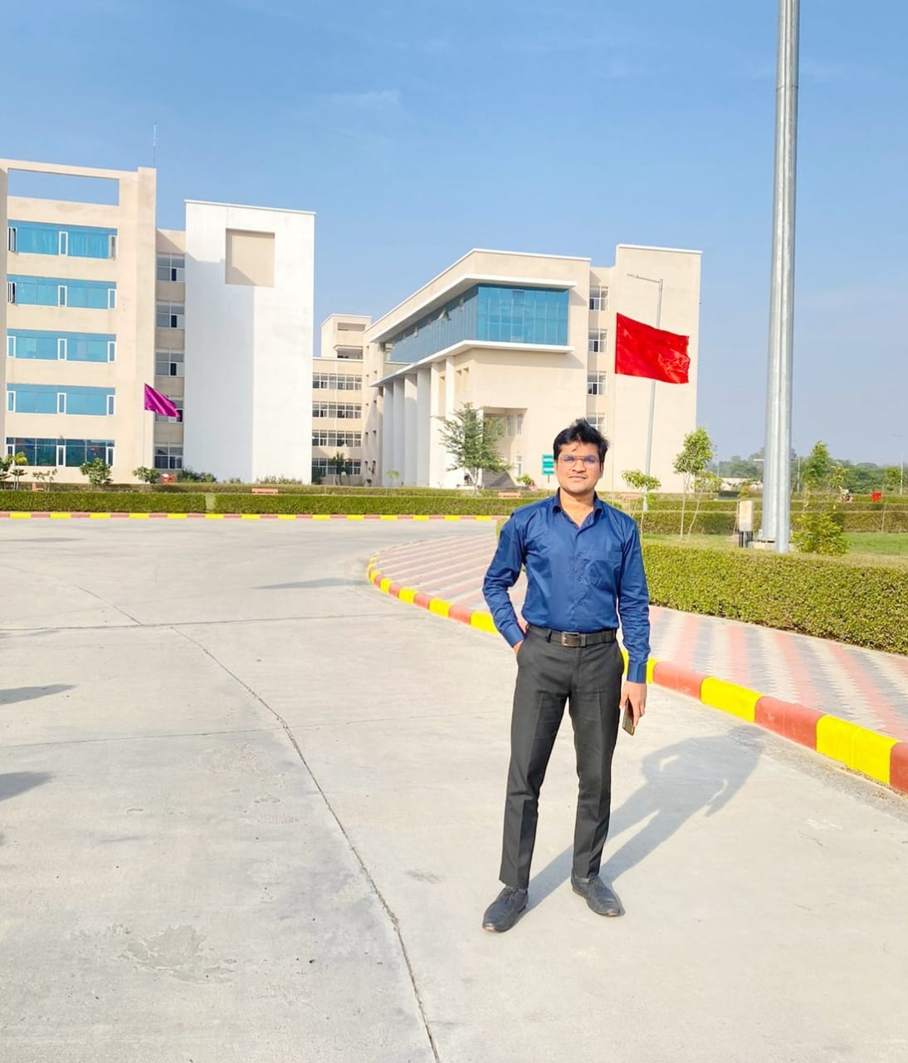
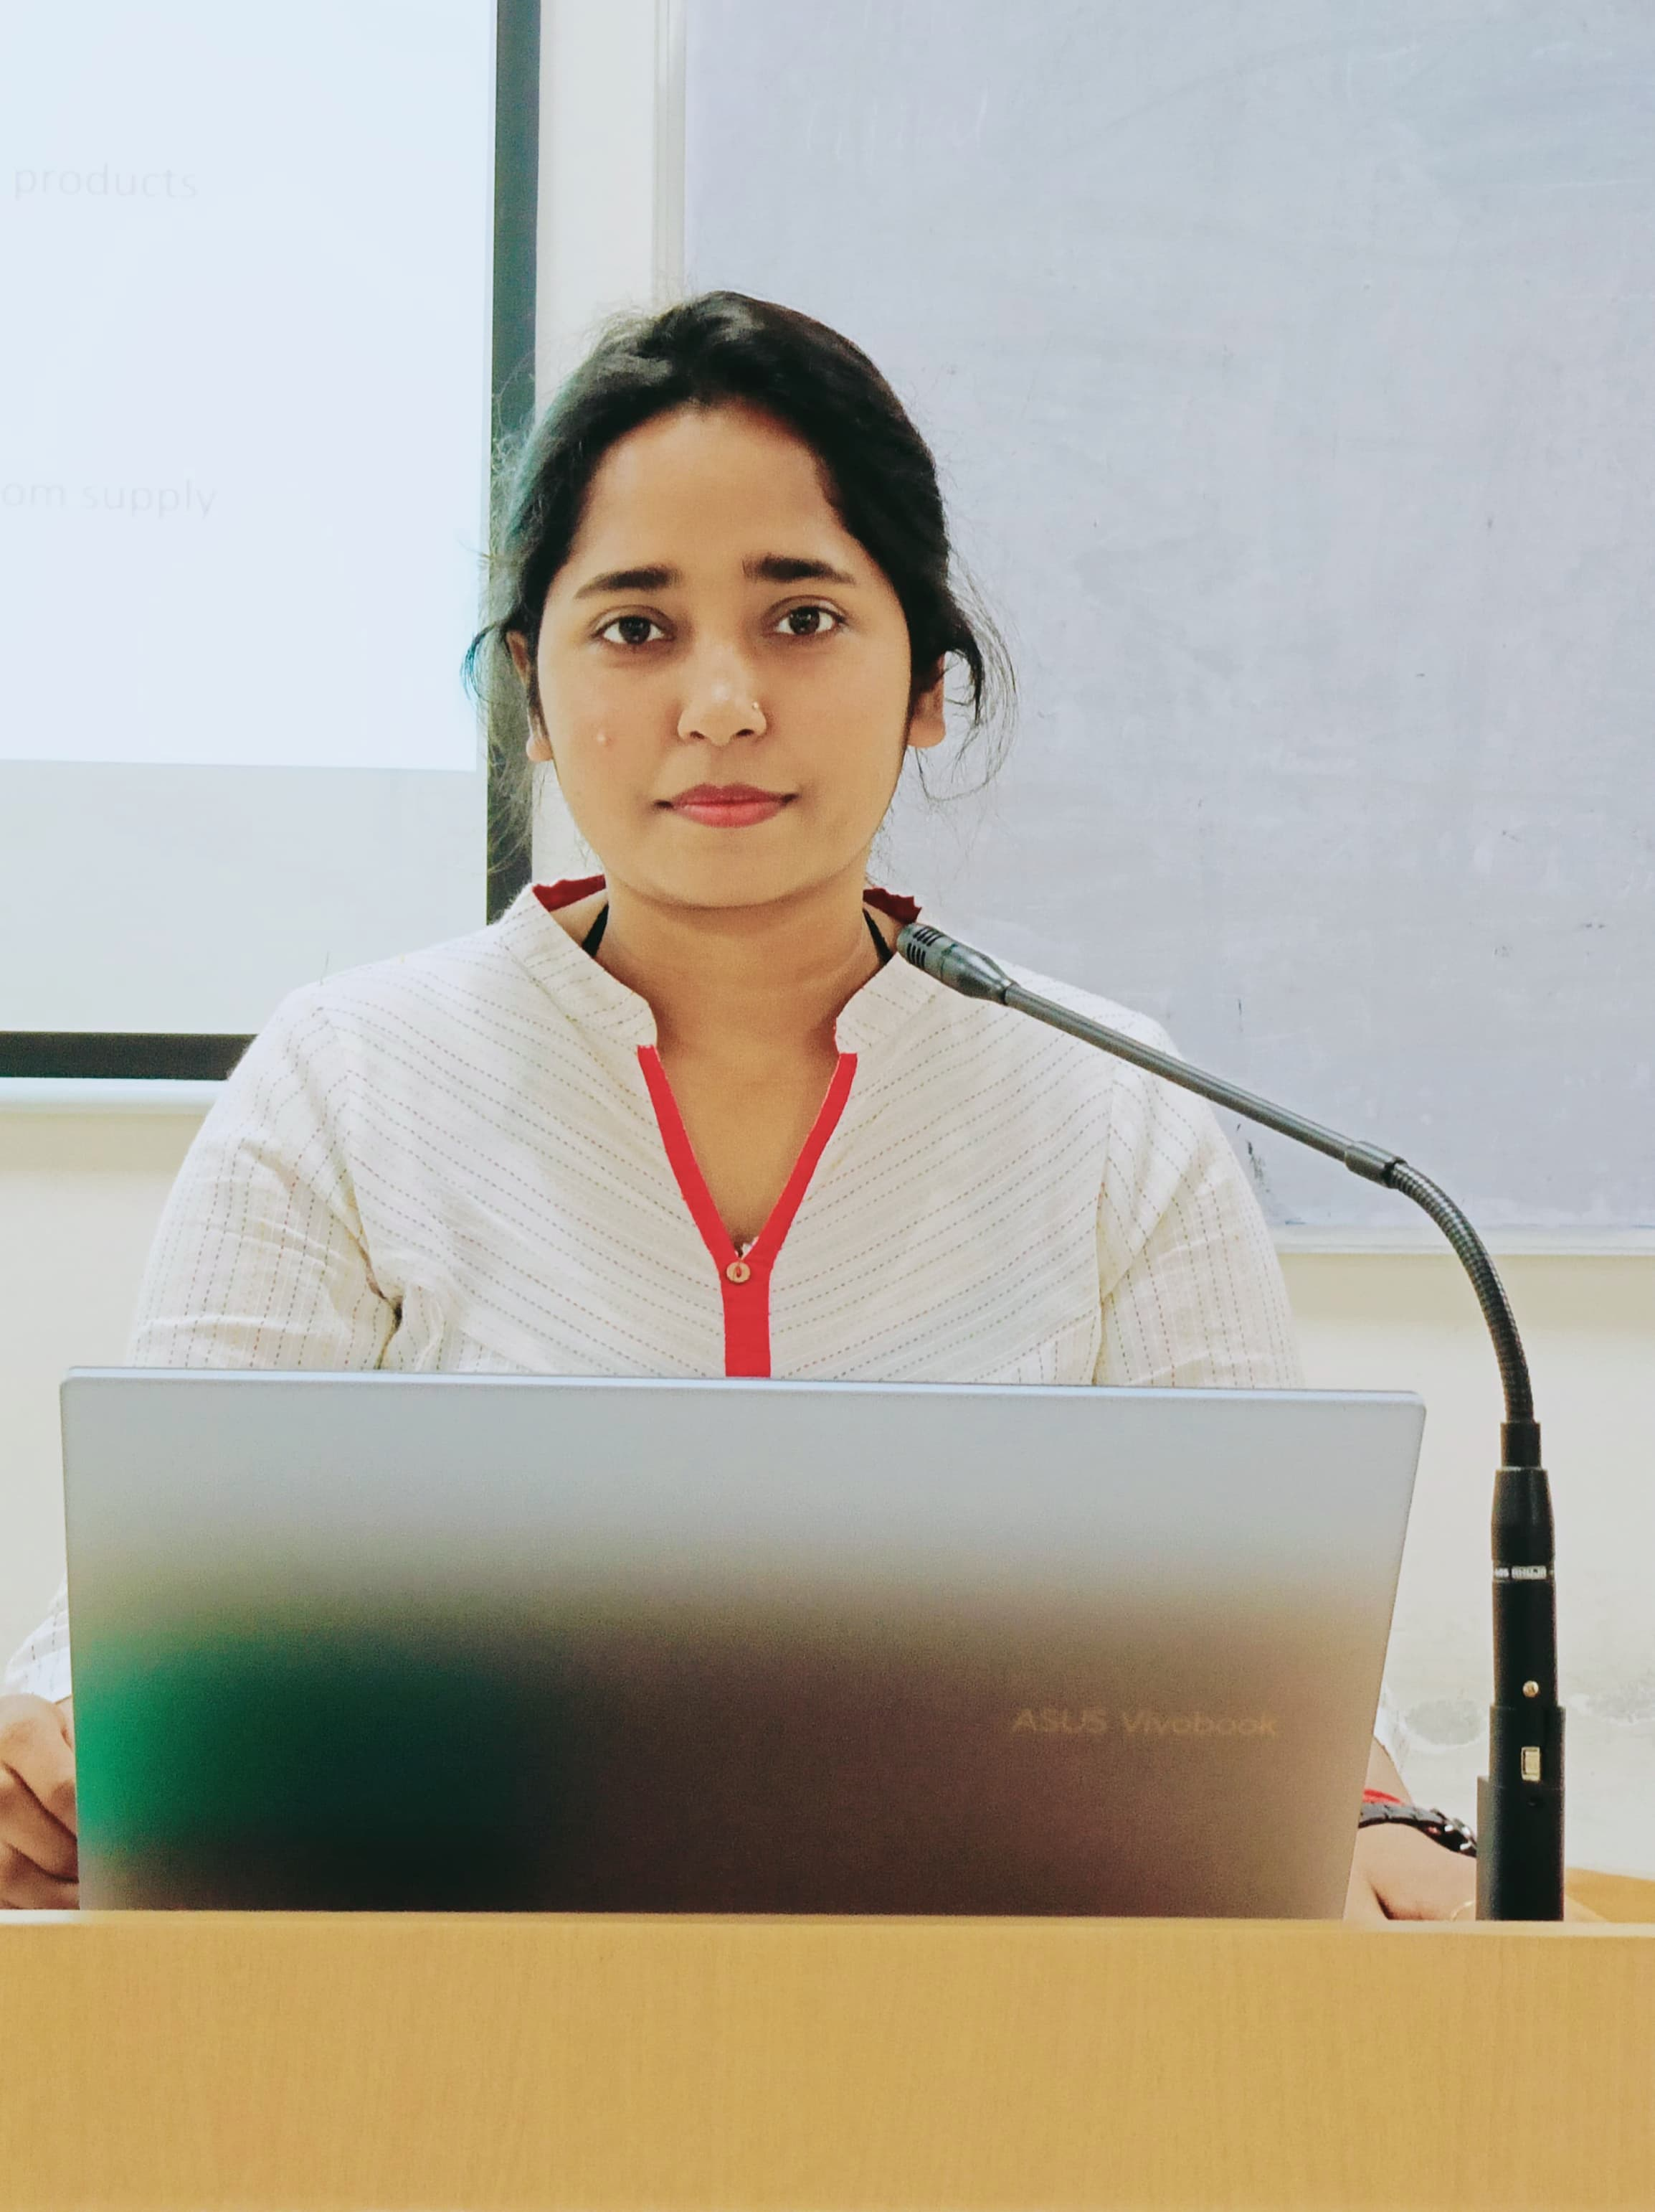




Project Title :- AgriTrace Ledger
Our Team
Abhishek Dubey
(MDB23027)
Anjali Kumari
(MDB23028)
Priyanshi Jain
(MDB23022)
Tridibesh Misra
(LCB2021002)
Ammu Kurien
(MDB23025)
Ayush Sharma
(LCB2021007)

Slide 3
Introduction
Areas of Focus
Idea Description
Understanding the Value Chain
Pain points in Existing System
Impact of AgriTrace on Value Chain
Technology behind the Idea
Target Users and Value Proposition
Market and Strategic Analysis
Next Steps: Launching AgriTrace
TABLE OF CONTENTS

Slide 4
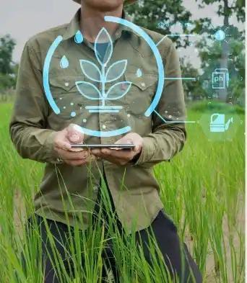
AgriTrace Ledger: A Blockchain-Based Solution for Food Supply Chains
Welcome we'll explore our blockchain solution for food supply chain transparency. We'll see how this innovative system can build trust, improve efficiency, and enhance the entire food journey from farm to table.

Slide 5

Area of Focus: Food Supply Chain Transparency
GOAL
To track and verify each step in the food journey from farm to consumer.
BENEFITS
Provides a trustworthy and tamper-proof record of food origin and handling.

Slide 6
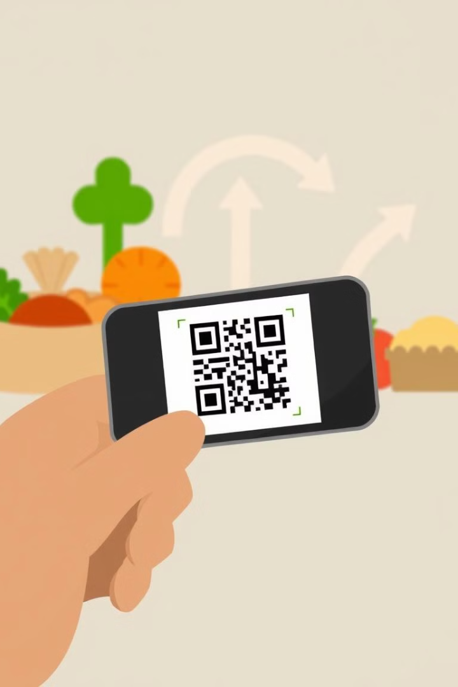
Idea Description: How AgriTrace Works
Farm to Harvest
Processing and Distribution
1
2
Farmers record harvest details directly on the blockchain platform.
Every step is documented, creating a complete and immutable record.
3
Consumer Transparency
Customers can scan a QR code to see the entire food journey.

Slide 7
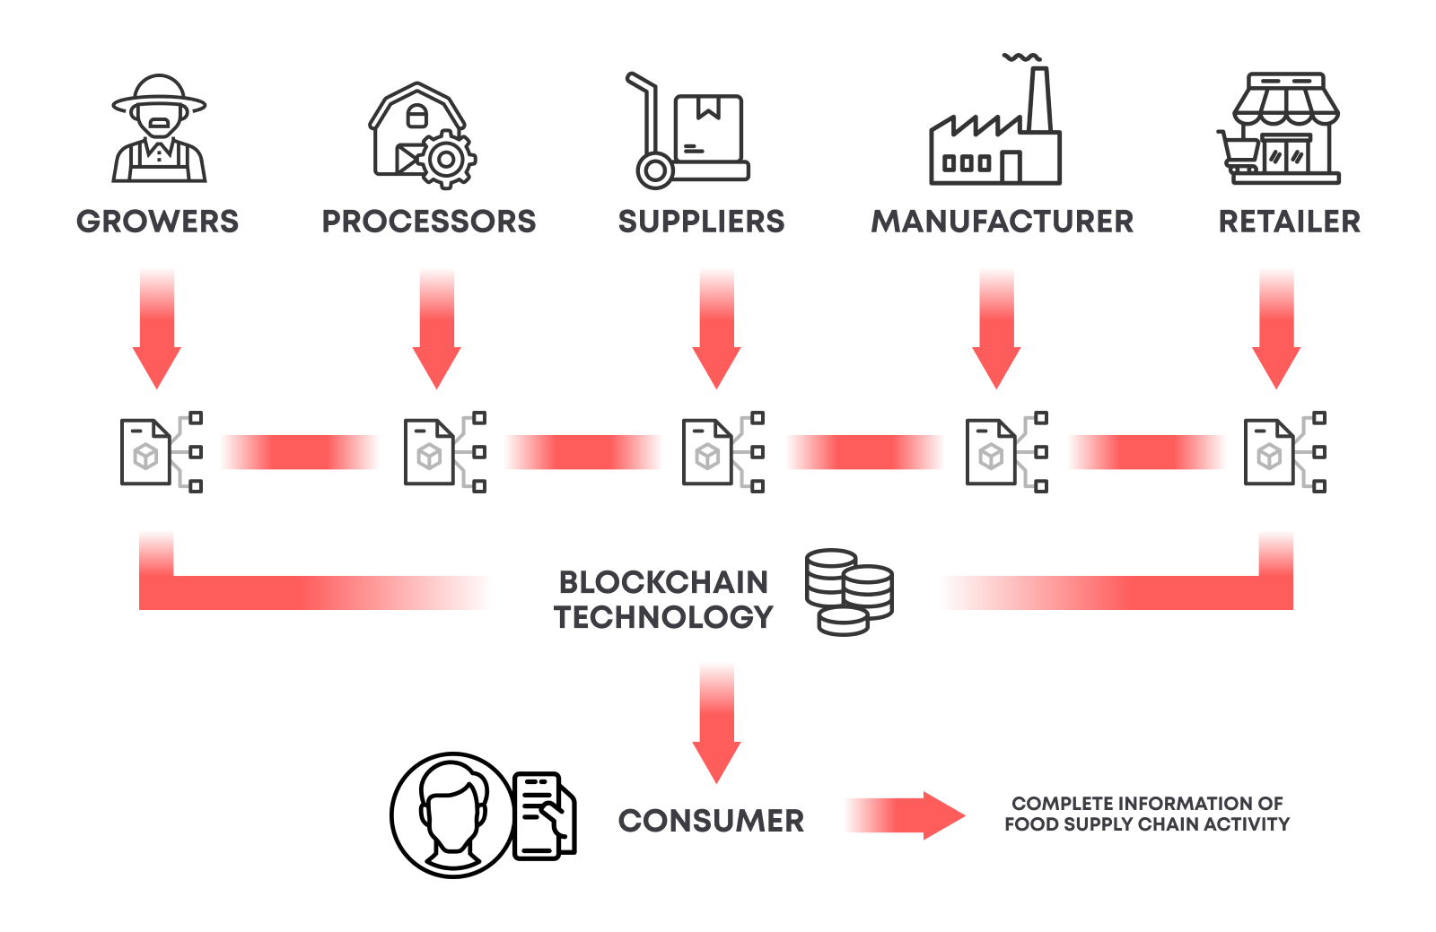
Understanding the Value Chain
1
Farmers
Grow and harvest crops or produce.
2
Processing/Packaging Plants
Clean, package, or process produce for transport.
3
Retailers
Sell final products to consumers.

Slide 8
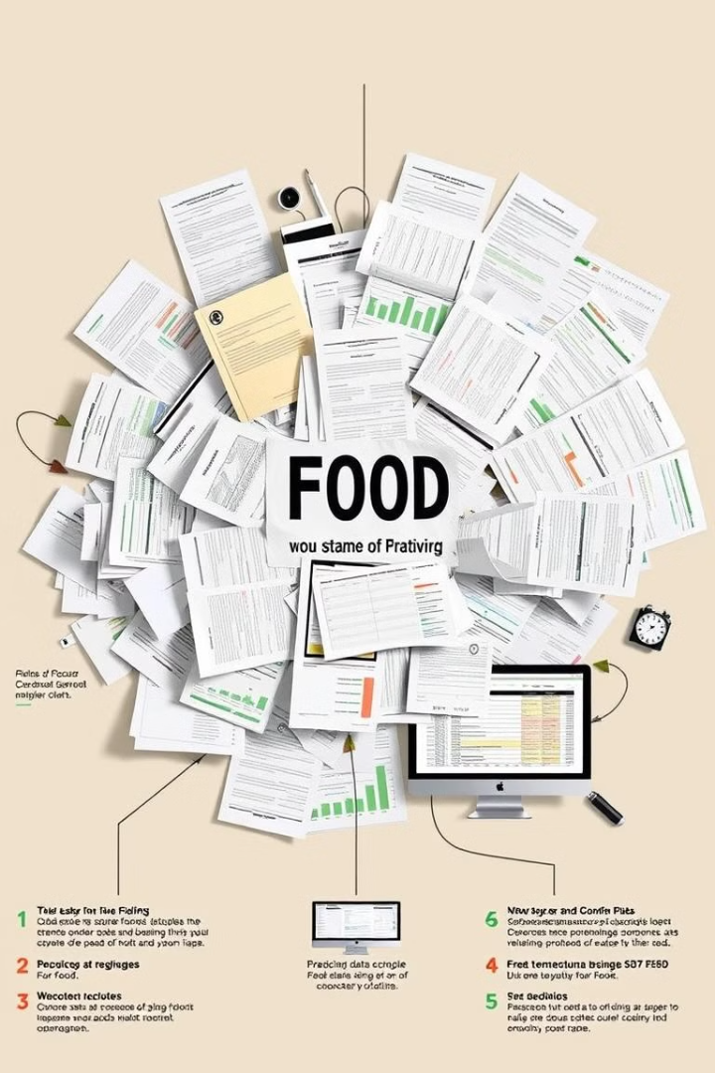
Pain Points in the Existing System
Lack of Trust
Inaccurate Records
It's difficult for buyers and consumers to verify claims about food origin and quality.
Paper documents can be lost or altered, and data sharing is inconsistent.
Slow Problem Response
Tracing issues like contamination or quality problems is time-consuming and challenging.

Slide 9
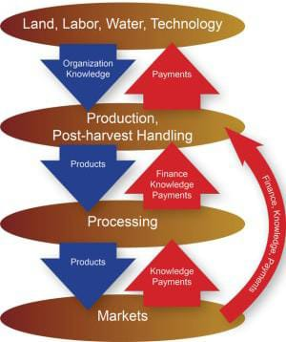




AgriTrace's Impact on the Value Chain
Farming Stage
Processing/Packaging Stage
Records origin and growing methods of produce.
Logs how produce is processed, packaged, and stored.
Distribution Stage
Retail Stage
Tracks shipping conditions and locations in real-time.
Allows retailers to show verified product history to consumers.

Slide 10




Technology: The Building Blocks of AgriTrace
Blockchain Platform
1
A permissioned blockchain ensures data security and transparency.
Smart Contracts
2
Automated rules ensure data accuracy and enforce processes.
User Interface
3
A user-friendly app for farmers, distributors, and retailers.
QR Codes
4
Enable consumers to scan and view product history easily.

Slide 11
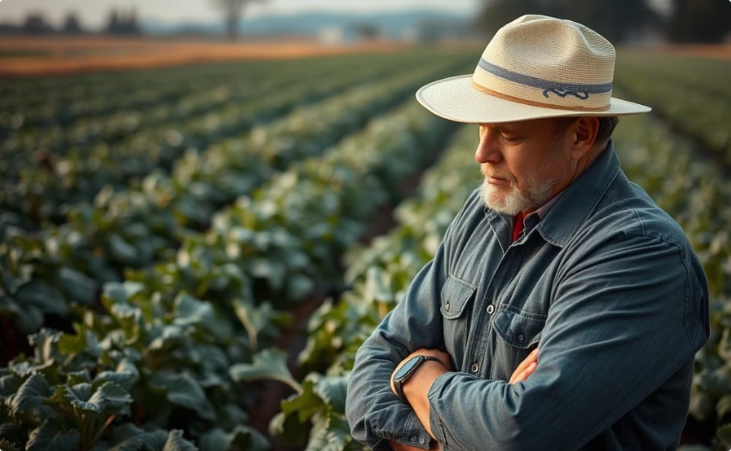
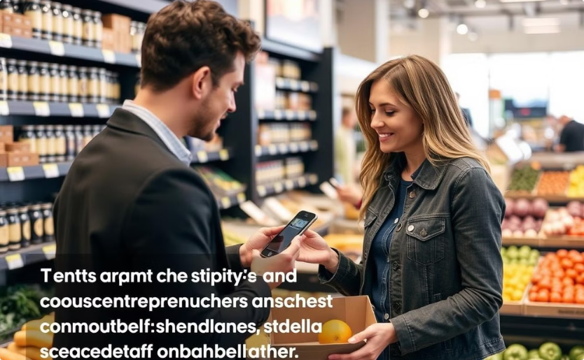
Target Users and Value Proposition
Farmers
Consumers
Gain recognition for quality and authenticity of their produce.
Build trust and confidence in the quality of their food purchases.

Slide 12
Market and Strategic Analysis
Competitors
1
IBM Food Trust, Provenance.org, and TE-Food offer similar traceability solutions.
Market Potential
2
The global food supply chain market is worth trillions of dollars.
Market Share
3
We aim to capture 3-5% market share by 2027.

Slide 13
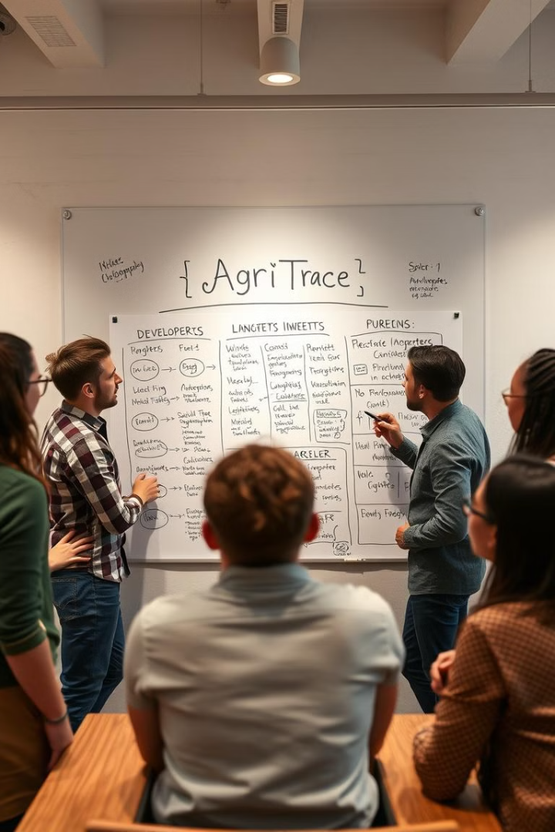
Next Steps: Launching AgriTrace
1
Pilot Program
Partner with local farms and a retailer for initial testing.
2
Public Launch
Expand to a wider market, including retailers and distributors.
3
Growth and Expansion
Integrate with more partners, expand features, and seek larger clients.

Slide 14
THANK YOU

