Slide 1
What Really Drives the Rupee?
Presenter: Ankit Singh - EMBAA25004
AS
A Data-Driven Intelligence System for Explaining and Predicting USD/INR Movements
₹45 → ₹95.51
IIM Kashipur · Executive MBA (Analytics) · Business Intelligence & Business Analytics, Term V
Faculty: Prof. Nitin Varma · Group Project, Sessions 19–20
USD/INR, 2010 average to Sep 2026 average (FRED EXINUS)
AS
Ankit Singh
EMBAA25004 · Data & dashboard
GS
Gopalakrishnan S
EMBAA25017 · Descriptive & inferential
MP
Murugan Perumal
EMBAA25020 · Regression & diagnostics
AG
Aswin G.
EMBAA25008 · Classification
AK
Atul Kumar Singh
EMBAA25009 · Clustering & scenarios
DP
Devanshu Priyam
EMBAA25014 · Live refresh & reporting
Ankit Singh - EMBAA25004 - ankit.embaa25004@iimkashipur.ac.in || Gopalakrishnan S - EMBAA25017 - gopalakrishnan.embaa25017@iimkashipur.ac.in || Murugan Perumal - EMBAA25020 - murugan.embaa25020@iimkashipur.ac.in
Aswin G. - EMBAA25008 - aswin.embaa25008@iimkashipur.ac.in || Atul Kumar Singh - EMBAA25009 - atul.embaa25009@iimkashipur.ac.in || Devanshu Priyam - EMBAA25014 - devanshu.embaa25014@iimkashipur.ac.in
Notes:
Ankit opens. Introduce the team and the question: is oil really what moves the rupee, or something else? We answer it with 175 months of official data and an R-based intelligence system.

Slide 2
Executive summary: oil is not the villain
Presenter: Ankit Singh - EMBAA25004
AS
FPI flows and the US dollar drive the rupee. Oil's effect disappears once they are counted.
0.03 → 0.43
−0.40
+0.32
−0.01
Adj. R²: oil alone vs six-factor model
FPI effect (std. β), significant
Broad dollar effect (std. β), significant
Oil effect (std. β), p = 0.86
Explain ≠ predict
On 2023–26 test data no model beats a naive average (RMSE 0.74). The drivers explain a month after it happens but cannot forecast the next one.
What managers should do
Watch FPI and the dollar index, not oil headlines. Hedge on scenarios: a 3% dollar rally or a US$5 bn outflow justifies hedging a US$10 mn payable.
Ankit Singh - EMBAA25004 - ankit.embaa25004@iimkashipur.ac.in || Gopalakrishnan S - EMBAA25017 - gopalakrishnan.embaa25017@iimkashipur.ac.in || Murugan Perumal - EMBAA25020 - murugan.embaa25020@iimkashipur.ac.in
Aswin G. - EMBAA25008 - aswin.embaa25008@iimkashipur.ac.in || Atul Kumar Singh - EMBAA25009 - atul.embaa25009@iimkashipur.ac.in || Devanshu Priyam - EMBAA25014 - devanshu.embaa25014@iimkashipur.ac.in
Notes:
The one-line answer: FPI flows and the broad dollar drive the rupee; oil does not. Walk the four numbers left to right. Then the honest caveat: these drivers explain a month after it happens but don't forecast the next one, so the business answer is scenario-based hedging.

Slide 3
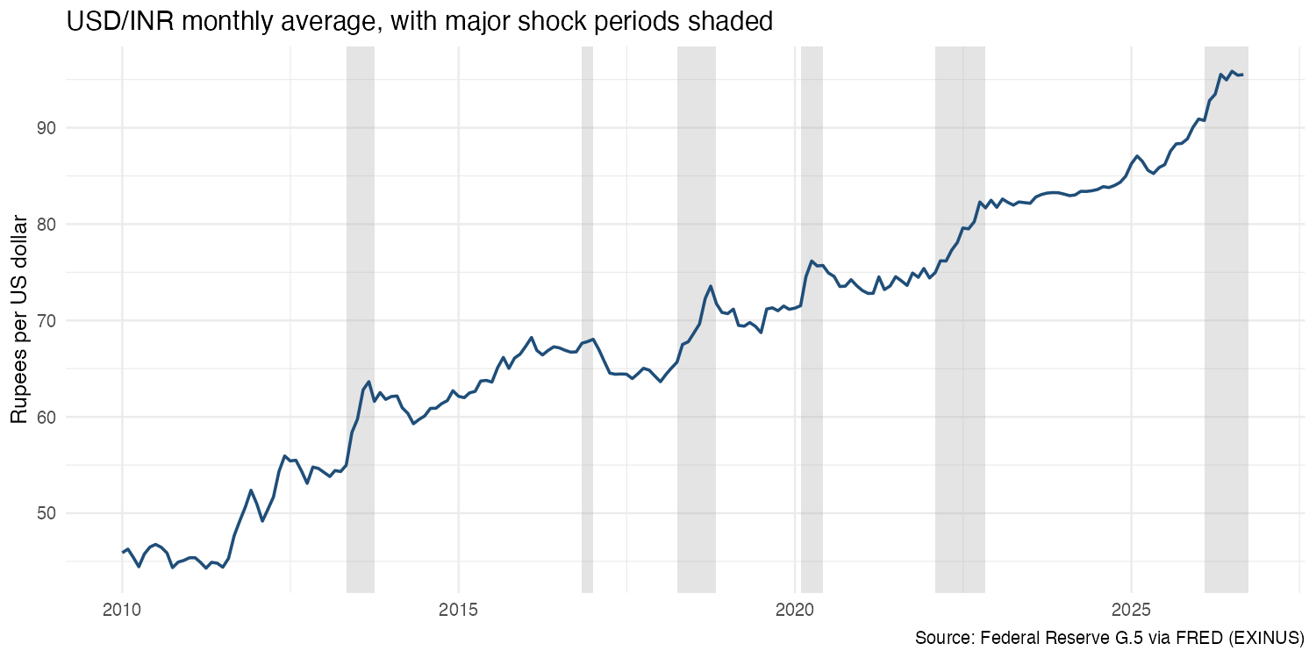
Business problem: a falling rupee, a single-cause story
Presenter: Ankit Singh - EMBAA25004
AS
USD/INR rose from ₹45 (2010) to ₹95.51 (Sep 2026)
The rupee weakened in 14 of 15 calendar years, 2011–2025
Every move hits import bills, export margins, foreign-debt servicing and imported inflation
Popular story: “oil went up, so the rupee fell”
Need: a ranked, evidence-based view of the drivers and a tool to stress-test exposure
Source: Federal Reserve G.5 via FRED (EXINUS); shaded = shock windows
Ankit Singh - EMBAA25004 - ankit.embaa25004@iimkashipur.ac.in || Gopalakrishnan S - EMBAA25017 - gopalakrishnan.embaa25017@iimkashipur.ac.in || Murugan Perumal - EMBAA25020 - murugan.embaa25020@iimkashipur.ac.in
Aswin G. - EMBAA25008 - aswin.embaa25008@iimkashipur.ac.in || Atul Kumar Singh - EMBAA25009 - atul.embaa25009@iimkashipur.ac.in || Devanshu Priyam - EMBAA25014 - devanshu.embaa25014@iimkashipur.ac.in
Notes:
The rupee has lost more than half its value against the dollar since 2010. Shaded bands are the six shock windows we study. Businesses hear 'oil went up, so the rupee fell'. Our job is to test that with data and give treasurers a better decision tool.

Slide 4
Six research questions span every analytics block
Presenter: Ankit Singh - EMBAA25004
AS
RQ | Research question | Technique | Sessions
RQ1 | Which factors move together with USD/INR? | Descriptive stats, correlation, t-tests, ANOVA | 6–9
RQ2 | Which factors matter most, holding others constant? | Multiple regression, standardised scorecard | 10–11
RQ3 | Is oil really the villain? | Nested Models A–D, lagged Model F, out-of-sample test | 10–11
RQ4 | Can we flag high-depreciation months? | Logistic, LDA, decision tree, SVM, confusion matrix | 12–14
RQ5 | What patterns appear in shocks and regimes? | Event windows, k-means, hierarchical, Apriori | 15–16
RQ6 | What should an importer do under stress? | What-if scenarios, hedge decision rule | 17–18
Target: INR_ret = monthly % change in USD/INR (positive = rupee weaker). Sessions 1–5 (BI, data integration, governance) are covered by the data pipeline.
Ankit Singh - EMBAA25004 - ankit.embaa25004@iimkashipur.ac.in || Gopalakrishnan S - EMBAA25017 - gopalakrishnan.embaa25017@iimkashipur.ac.in || Murugan Perumal - EMBAA25020 - murugan.embaa25020@iimkashipur.ac.in
Aswin G. - EMBAA25008 - aswin.embaa25008@iimkashipur.ac.in || Atul Kumar Singh - EMBAA25009 - atul.embaa25009@iimkashipur.ac.in || Devanshu Priyam - EMBAA25014 - devanshu.embaa25014@iimkashipur.ac.in
Notes:
Each research question maps to a block of the syllabus, sessions 6 to 18. This is how we cover the maximum concepts on one real business problem.

Slide 5
16 official series, downloaded by code, with full provenance
Presenter: Ankit Singh - EMBAA25004
AS
Publisher | Series used | Variables
FRED (Fed, EIA, BLS, OECD, IMF) | EXINUS, DEXINUS, DCOILBRENTEU, DTWEXBGS, VIXCLS, CPIAUCSL, FEDFUNDS, GS10, INDIR3TIB01STM, INDCPIALLMINMEI, XTEXVA/XTIMVA01INM667S, TRESEGINM052N | USD/INR, Brent, broad dollar, VIX, US CPI, US rates, India rate, India CPI, trade, reserves
World Bank Pink Sheet | Crude oil, Brent (monthly) | Cross-check for FRED Brent
NSDL | Monthly FPI net investments | FPI equity + debt (₹ crore → US$ bn)
MoSPI | CPI press releases, Apr 2025 onward | India CPI y/y (after OECD series ends)
Yahoo Finance | INR=X, BZ=F, DX-Y.NYB, ^VIX | Live quotes for the dashboard
Real-data rules
1
Nothing simulated or randomly generated
2
No interpolation: missing months are dropped and logged
3
provenance.csv: source, ID, URL, download time per column
4
Raw downloads kept apart from processed data
Model sample: Feb 2012 – Aug 2026, 175 complete months
Ankit Singh - EMBAA25004 - ankit.embaa25004@iimkashipur.ac.in || Gopalakrishnan S - EMBAA25017 - gopalakrishnan.embaa25017@iimkashipur.ac.in || Murugan Perumal - EMBAA25020 - murugan.embaa25020@iimkashipur.ac.in
Aswin G. - EMBAA25008 - aswin.embaa25008@iimkashipur.ac.in || Atul Kumar Singh - EMBAA25009 - atul.embaa25009@iimkashipur.ac.in || Devanshu Priyam - EMBAA25014 - devanshu.embaa25014@iimkashipur.ac.in
Notes:
All data comes from official publishers, pulled by R code. Two series, NSDL FPI and recent MoSPI CPI, are copied exactly from official tables because there's no API. Nothing is simulated or filled in, and every column has a provenance record.

Slide 6
A nine-script R pipeline from download to dashboard
Presenter: Ankit Singh - EMBAA25004
AS
01
02
03–07
app.R
08
Fetch
Build
Analyse
Dashboard
Refresh
16 series + provenance
monthly merge, features, QA
stats, models, scenarios
7 Shiny tabs
live quotes, nowcast
Feature engineering
Why returns, not levels? ADF test: USD/INR level p = 0.34, Brent p = 0.60 (non-stationary). Their returns: p ≤ 0.01 (stationary).
Daily → monthly: mean (oil, dollar, VIX), month-end and volatility (USD/INR)
Returns, India–US inflation gap and rate gap, trade balance, reserves change
One-month lags (L1_*) so forecasts use only data known in advance
High-pressure month = depreciation above 1.26% (train 75th percentile)
Chronological split, never random
Train: Feb 2012 – Dec 2022 (131 months)
Test: 2023–26 (43)
Ankit Singh - EMBAA25004 - ankit.embaa25004@iimkashipur.ac.in || Gopalakrishnan S - EMBAA25017 - gopalakrishnan.embaa25017@iimkashipur.ac.in || Murugan Perumal - EMBAA25020 - murugan.embaa25020@iimkashipur.ac.in
Aswin G. - EMBAA25008 - aswin.embaa25008@iimkashipur.ac.in || Atul Kumar Singh - EMBAA25009 - atul.embaa25009@iimkashipur.ac.in || Devanshu Priyam - EMBAA25014 - devanshu.embaa25014@iimkashipur.ac.in
Notes:
One command, source R/run_all.R, runs everything. Key design choices: we model monthly returns, not levels, because the ADF test shows levels trend; and we split train and test by date so no model sees the future.

Slide 7
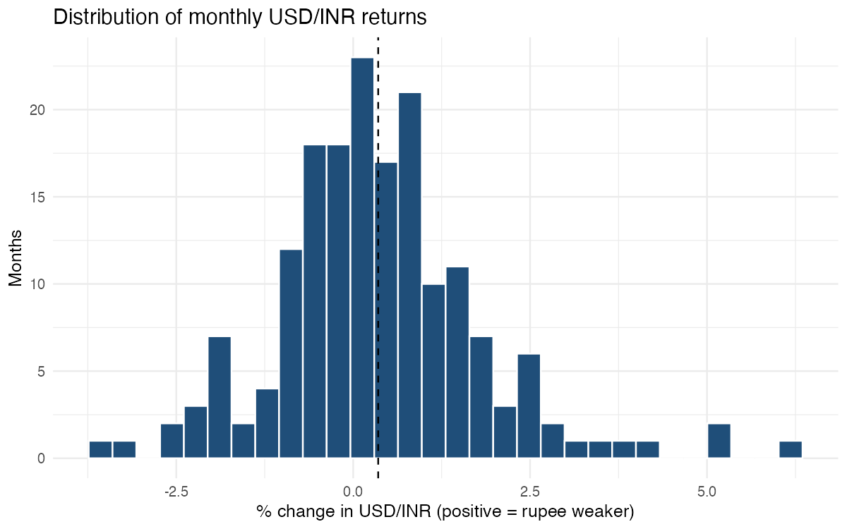
Descriptive analytics: depreciation is the most common month
Presenter: Gopalakrishnan S - EMBAA25017
GS
42%
14 / 15
of months: depreciation above 0.5% (the mode)
calendar years the rupee weakened, 2011–25
+0.35%
0.68
mean monthly change (SD 1.45%)
skew: sharp falls exceed sharp gains
Month types: 74 depreciated > 0.5%, 59 stable, 42 appreciated > 0.5% (175 months)
Distribution of monthly USD/INR returns (R, ggplot2)
Ankit Singh - EMBAA25004 - ankit.embaa25004@iimkashipur.ac.in || Gopalakrishnan S - EMBAA25017 - gopalakrishnan.embaa25017@iimkashipur.ac.in || Murugan Perumal - EMBAA25020 - murugan.embaa25020@iimkashipur.ac.in
Aswin G. - EMBAA25008 - aswin.embaa25008@iimkashipur.ac.in || Atul Kumar Singh - EMBAA25009 - atul.embaa25009@iimkashipur.ac.in || Devanshu Priyam - EMBAA25014 - devanshu.embaa25014@iimkashipur.ac.in
Notes:
Gopalakrishnan presents. The mode month type is a depreciation above half a percent. The distribution is right-skewed: big falls in the rupee are bigger than big gains.

Slide 8
Inferential analytics: flows and the dollar move the rupee
Presenter: Gopalakrishnan S - EMBAA25017
GS
Test | Result | Verdict
t-test: FPI outflow vs inflow months | +1.08% vs −0.11%, p < 0.001 | Significant
t-test: oil up vs oil down months | +0.26% vs +0.47%, p = 0.35 | No difference
t-test: volatility, shock vs normal | 0.46% vs 0.33%, p = 0.015 | Significant
ANOVA: 3 FPI regimes | F = 24.5, p < 0.001 | Significant
ANOVA: 3 oil regimes | F = 1.19, p = 0.31 | Not significant
Tukey / Levene / Kruskal–Wallis | All FPI pairs differ; Levene p = 0.22; KW p < 0.001 | Robust
Oil's correlation is small, has the “wrong” sign and is not significant (p = 0.08)
Ankit Singh - EMBAA25004 - ankit.embaa25004@iimkashipur.ac.in || Gopalakrishnan S - EMBAA25017 - gopalakrishnan.embaa25017@iimkashipur.ac.in || Murugan Perumal - EMBAA25020 - murugan.embaa25020@iimkashipur.ac.in
Aswin G. - EMBAA25008 - aswin.embaa25008@iimkashipur.ac.in || Atul Kumar Singh - EMBAA25009 - atul.embaa25009@iimkashipur.ac.in || Devanshu Priyam - EMBAA25014 - devanshu.embaa25014@iimkashipur.ac.in
Notes:
Correlations on the left: FPI and the dollar lead, oil is small and not significant. On the right, the tests confirm it: outflow months are much weaker, oil-up and oil-down months are no different, and ANOVA across FPI regimes is highly significant.

Slide 9
Is oil the villain? Alone 3%; six drivers explain 43%
Presenter: Murugan Perumal - EMBAA25020
MP
Answer: No
Holding the other drivers constant, oil's coefficient is −0.001 (p = 0.86). A 20% oil spike goes with a 0.03% move: effectively zero.
AIC falls from 497 (B) to 432 (C)
Model D adds VIX and lagged FPI but no fit
Model C chosen as the explanatory model
All five models fitted with lm() on 131 months
Ankit Singh - EMBAA25004 - ankit.embaa25004@iimkashipur.ac.in || Gopalakrishnan S - EMBAA25017 - gopalakrishnan.embaa25017@iimkashipur.ac.in || Murugan Perumal - EMBAA25020 - murugan.embaa25020@iimkashipur.ac.in
Aswin G. - EMBAA25008 - aswin.embaa25008@iimkashipur.ac.in || Atul Kumar Singh - EMBAA25009 - atul.embaa25009@iimkashipur.ac.in || Devanshu Priyam - EMBAA25014 - devanshu.embaa25014@iimkashipur.ac.in
Notes:
Murugan presents. The nested-model experiment. Model A uses oil only: adjusted R-squared 0.03. Model C adds inflation gap, rate gap, dollar, FPI and trade, and jumps to 0.43. Model D adds VIX and lagged FPI and gains nothing. Inside Model C oil's coefficient is essentially zero.

Slide 10
Driver scorecard: only FPI and the dollar are significant
Presenter: Murugan Perumal - EMBAA25020
MP
In real units
US$1 bn FPI inflow → rupee 0.18% stronger (p < 0.001)
1% broad-dollar rise → rupee 0.43% weaker (p < 0.001)
Diagnostic | Result | Reading
VIF | All < 1.5 | No multicollinearity
Breusch–Pagan | p = 0.19 | No heteroskedasticity
Durbin–Watson | 1.75, p = 0.06 | Mild; Newey–West SEs
Shapiro–Wilk | p = 0.44 | Residuals ~ normal
Overall F | 17.1, p < 0.001 | Jointly significant
Ankit Singh - EMBAA25004 - ankit.embaa25004@iimkashipur.ac.in || Gopalakrishnan S - EMBAA25017 - gopalakrishnan.embaa25017@iimkashipur.ac.in || Murugan Perumal - EMBAA25020 - murugan.embaa25020@iimkashipur.ac.in
Aswin G. - EMBAA25008 - aswin.embaa25008@iimkashipur.ac.in || Atul Kumar Singh - EMBAA25009 - atul.embaa25009@iimkashipur.ac.in || Devanshu Priyam - EMBAA25014 - devanshu.embaa25014@iimkashipur.ac.in
Notes:
Standardised betas put every driver on one scale. Only FPI and the broad dollar are significant with Newey-West robust errors. In real units, a US$1 bn inflow means a 0.18% stronger rupee; a 1% dollar rally means a 0.43% weaker rupee. Diagnostics are clean.

Slide 11
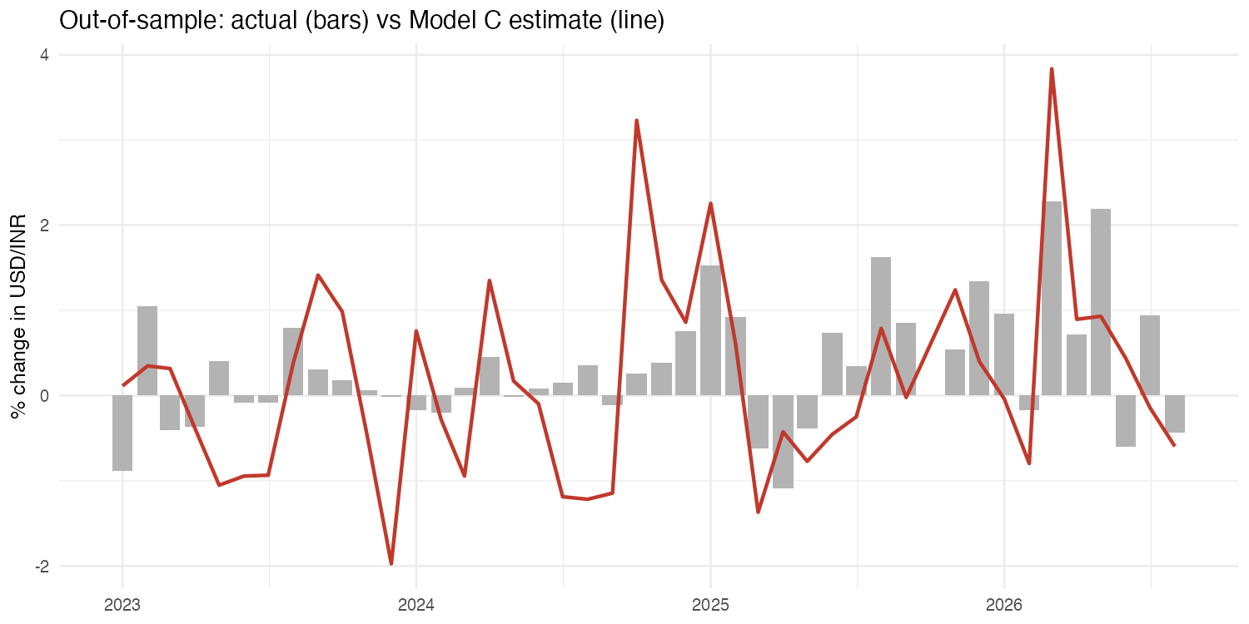
Honest test: the drivers explain, but they don't forecast
Presenter: Murugan Perumal - EMBAA25020
MP
Bars = actual monthly change; line = Model C estimate (test period)
A failure to beat the naive benchmark is a finding, not a failure: plan with scenarios, not point forecasts.
Ankit Singh - EMBAA25004 - ankit.embaa25004@iimkashipur.ac.in || Gopalakrishnan S - EMBAA25017 - gopalakrishnan.embaa25017@iimkashipur.ac.in || Murugan Perumal - EMBAA25020 - murugan.embaa25020@iimkashipur.ac.in
Aswin G. - EMBAA25008 - aswin.embaa25008@iimkashipur.ac.in || Atul Kumar Singh - EMBAA25009 - atul.embaa25009@iimkashipur.ac.in || Devanshu Priyam - EMBAA25014 - devanshu.embaa25014@iimkashipur.ac.in
Notes:
On 2023 to 2026 test months, the naive average has the lowest error. Model C explains in sample but its test RMSE is 1.01. We report this as a finding: same-month associations are real, next month is hard to predict. That shapes our managerial advice.

Slide 12
Rupee Stress Monitor: four classifiers, two honest set-ups
Presenter: Aswin G. - EMBAA25008
AG
Set-up | Model | Sensitivity | Specificity | Balanced acc. | AUC
Early warning | Logistic | 0.80 | 0.58 | 0.69 | 0.70
Early warning | LDA | 0.80 | 0.63 | 0.72 | 0.69
Early warning | Decision tree | 0.00 | 1.00 | 0.50 | 0.50
Early warning | SVM (radial) | 0.80 | 0.45 | 0.62 | 0.74
Nowcast | Logistic | 0.60 | 0.76 | 0.68 | 0.87
Nowcast | LDA | 0.80 | 0.76 | 0.78 | 0.86
Nowcast | Decision tree | 1.00 | 0.63 | 0.82 | 0.80
Nowcast | SVM (radial) | 0.60 | 0.84 | 0.72 | 0.84
Early warning
Last month's data only: a true forecast. Catches 4 of 5 stress months, with false alarms.
Nowcast
Same-month drivers: AUC up to 0.87. Explains a month once data is out; cannot forecast.
Test: 43 months (Jan 2023 – Aug 2026), 5 high-pressure. Cutoff = training share of high months (25%).
Ankit Singh - EMBAA25004 - ankit.embaa25004@iimkashipur.ac.in || Gopalakrishnan S - EMBAA25017 - gopalakrishnan.embaa25017@iimkashipur.ac.in || Murugan Perumal - EMBAA25020 - murugan.embaa25020@iimkashipur.ac.in
Aswin G. - EMBAA25008 - aswin.embaa25008@iimkashipur.ac.in || Atul Kumar Singh - EMBAA25009 - atul.embaa25009@iimkashipur.ac.in || Devanshu Priyam - EMBAA25014 - devanshu.embaa25014@iimkashipur.ac.in
Notes:
Aswin presents. A high-pressure month is depreciation above 1.26 percent. Early warning uses only last month's data, so it's a true forecast: LDA catches 4 of 5 stress months with balanced accuracy 0.72. Nowcast uses same-month data: AUC up to 0.87, but that's explanation, not prediction.

Slide 13
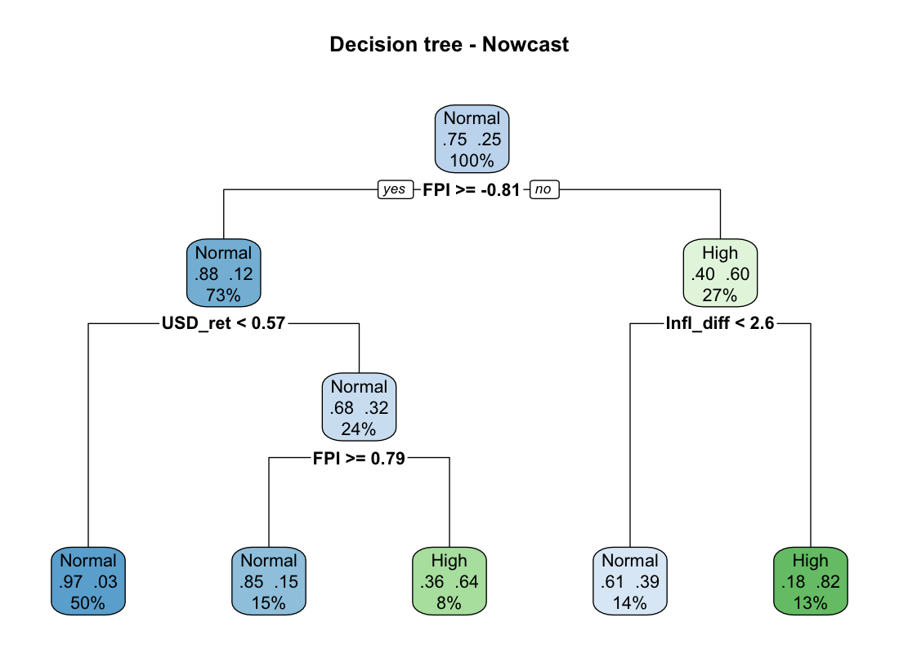
The accuracy trap, and what drives the odds of stress
Presenter: Aswin G. - EMBAA25008
AG
88% accuracy, 0 stress months caught
The early-warning tree predicts “Normal” every month. On unbalanced data, judge by sensitivity and balanced accuracy.
Logistic model | Driver | Odds ratio
Early warning | Last month's reserves change (+1%) | 0.62 (p = 0.006)
Nowcast | Broad dollar (+1%) | 3.59
Nowcast | FPI inflow (+US$1 bn) | 0.49
Nowcast | Inflation gap (+1 pp) | 1.40
Appendix: 3-class tree (Stable / Moderate / High) reaches 63% test accuracy.
Pruned nowcast decision tree (rpart): sensitivity 1.00 on test
Ankit Singh - EMBAA25004 - ankit.embaa25004@iimkashipur.ac.in || Gopalakrishnan S - EMBAA25017 - gopalakrishnan.embaa25017@iimkashipur.ac.in || Murugan Perumal - EMBAA25020 - murugan.embaa25020@iimkashipur.ac.in
Aswin G. - EMBAA25008 - aswin.embaa25008@iimkashipur.ac.in || Atul Kumar Singh - EMBAA25009 - atul.embaa25009@iimkashipur.ac.in || Devanshu Priyam - EMBAA25014 - devanshu.embaa25014@iimkashipur.ac.in
Notes:
The early-warning tree scored 88 percent accuracy by always saying Normal, and caught zero stress months. That's why we use the confusion matrix and balanced accuracy. Odds ratios: falling reserves last month warn of pressure; same month, a 1 percent dollar rise multiplies the odds by 3.6.

Slide 14
Every rupee shock came with heavy FPI outflows; oil did not
Presenter: Atul Kumar Singh - EMBAA25009
AK
Shock window | USD/INR | Rupee | Brent | Broad $ | Net FPI (US$ bn)
West Asia conflict (Feb–Sep 2026) | 90.9 → 95.5 | +5.1% | +71.4% | 0.0% | −18.8
Russia–Ukraine + Fed hikes (Feb–Oct 2022) | 74.4 → 82.3 | +10.6% | +7.9% | +10.8% | −19.4
COVID-19 (Feb–May 2020) | 71.3 → 75.7 | +6.1% | −53.8% | +6.4% | −17.5
2018 oil spike + EM sell-off (Apr–Oct) | 65.0 → 73.6 | +13.1% | +22.7% | +6.4% | −16.2
Demonetisation (Nov–Dec 2016) | 66.7 → 67.8 | +1.6% | +7.6% | +3.9% | −9.8
Taper tantrum (May–Sep 2013) | 54.3 → 63.6 | +17.2% | +9.1% | +1.5% | −6.8
COVID test: oil −54%, yet the rupee still fell 6% as US$17.5 bn of FPI left.
Volatility: 0.46% a day in shock months vs 0.33% in normal months (p = 0.015).
Ankit Singh - EMBAA25004 - ankit.embaa25004@iimkashipur.ac.in || Gopalakrishnan S - EMBAA25017 - gopalakrishnan.embaa25017@iimkashipur.ac.in || Murugan Perumal - EMBAA25020 - murugan.embaa25020@iimkashipur.ac.in
Aswin G. - EMBAA25008 - aswin.embaa25008@iimkashipur.ac.in || Atul Kumar Singh - EMBAA25009 - atul.embaa25009@iimkashipur.ac.in || Devanshu Priyam - EMBAA25014 - devanshu.embaa25014@iimkashipur.ac.in
Notes:
Atul presents. Six shock windows. Look at the FPI column: every shock saw billions of outflows. Oil rose in some and crashed in others. COVID is the clearest test: oil fell 54 percent and the rupee still weakened 6 percent.

Slide 15
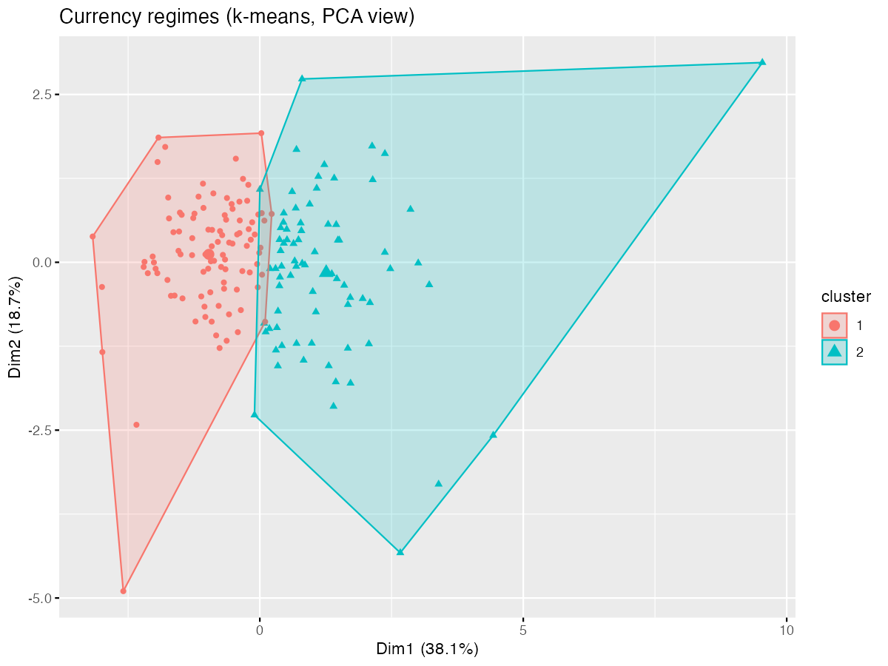
Unsupervised: two currency regimes, one recurring rule
Presenter: Atul Kumar Singh - EMBAA25009
AK
Calm / inflow
99 months · rupee −0.45%/mo · FPI +US$2.8 bn · dollar soft · VIX falling
Pressure / outflow
76 months · rupee +1.41%/mo · FPI −US$1.7 bn · dollar firm · VIX rising
Apriori rule → Rupee = Weak | Conf. | Lift
FPI Low + rate-gap chg High + trade-bal chg Mid | 100% | 3.02
FPI Low + trade-balance change Mid | 77% | 2.33
FPI Low + rate-gap change High | 73% | 2.20
Dollar High + FPI Low + VIX High | 71% | 2.16
k-means, k = 2 (silhouette 0.22); Ward agrees on 132 of 175 months
Baseline chance of a weak month: 33%. Top rule rests on 9 months: suggestive, not conclusive.
Ankit Singh - EMBAA25004 - ankit.embaa25004@iimkashipur.ac.in || Gopalakrishnan S - EMBAA25017 - gopalakrishnan.embaa25017@iimkashipur.ac.in || Murugan Perumal - EMBAA25020 - murugan.embaa25020@iimkashipur.ac.in
Aswin G. - EMBAA25008 - aswin.embaa25008@iimkashipur.ac.in || Atul Kumar Singh - EMBAA25009 - atul.embaa25009@iimkashipur.ac.in || Devanshu Priyam - EMBAA25014 - devanshu.embaa25014@iimkashipur.ac.in
Notes:
k-means on six features finds two regimes; the silhouette peaks at k equals 2 and hierarchical clustering agrees on 75 percent of months. The pressure regime is outflows, a firm dollar and rising VIX. Apriori market-basket rules: low FPI appears in almost every rule that ends in a weak rupee.

Slide 16
Prescriptive: hedge on dollar and FPI scenarios, not oil
Presenter: Atul Kumar Singh - EMBAA25009
AK
Scenario (from ₹95.51, Sep 2026) | Est. change | 80% range | Implied USD/INR | Worst-case extra cost | Recommendation
Neutral month | +0.26% | −1.21% to +1.74% | 95.76 | ₹1.66 cr | Partial hedge
Oil +20% | +0.10% | −1.39% to +1.59% | 95.61 | ₹1.52 cr | Partial hedge
Rate gap +50 bp | +0.63% | −0.85% to +2.11% | 96.12 | ₹2.02 cr | Hedge
FPI outflow US$5 bn | +1.06% | −0.42% to +2.54% | 96.52 | ₹2.43 cr | Hedge
Broad dollar +3% | +1.36% | −0.15% to +2.87% | 96.81 | ₹2.74 cr | Hedge
Combined: oil, dollar, outflow | +1.99% | +0.47% to +3.52% | 97.42 | ₹3.36 cr | Hedge
Decision rule (US$10 mn payable, hedge cost 0.40% = ₹0.38 cr): Hedge if both the expected and the 80% worst-case extra cost exceed the hedge cost; partial hedge if only the worst case does; otherwise stay unhedged. Estimates are model ranges under assumptions, not forecasts.
Ankit Singh - EMBAA25004 - ankit.embaa25004@iimkashipur.ac.in || Gopalakrishnan S - EMBAA25017 - gopalakrishnan.embaa25017@iimkashipur.ac.in || Murugan Perumal - EMBAA25020 - murugan.embaa25020@iimkashipur.ac.in
Aswin G. - EMBAA25008 - aswin.embaa25008@iimkashipur.ac.in || Atul Kumar Singh - EMBAA25009 - atul.embaa25009@iimkashipur.ac.in || Devanshu Priyam - EMBAA25014 - devanshu.embaa25014@iimkashipur.ac.in
Notes:
The prescriptive block replaces RFM, which doesn't fit currency data. We feed shocks into Model C from 95.51 and compare the extra cost of staying unhedged on a US$10 mn payable with a 0.40 percent hedge cost. A 3 percent dollar rally or a 5 billion outflow says Hedge; a 20 percent oil spike does not.

Slide 17
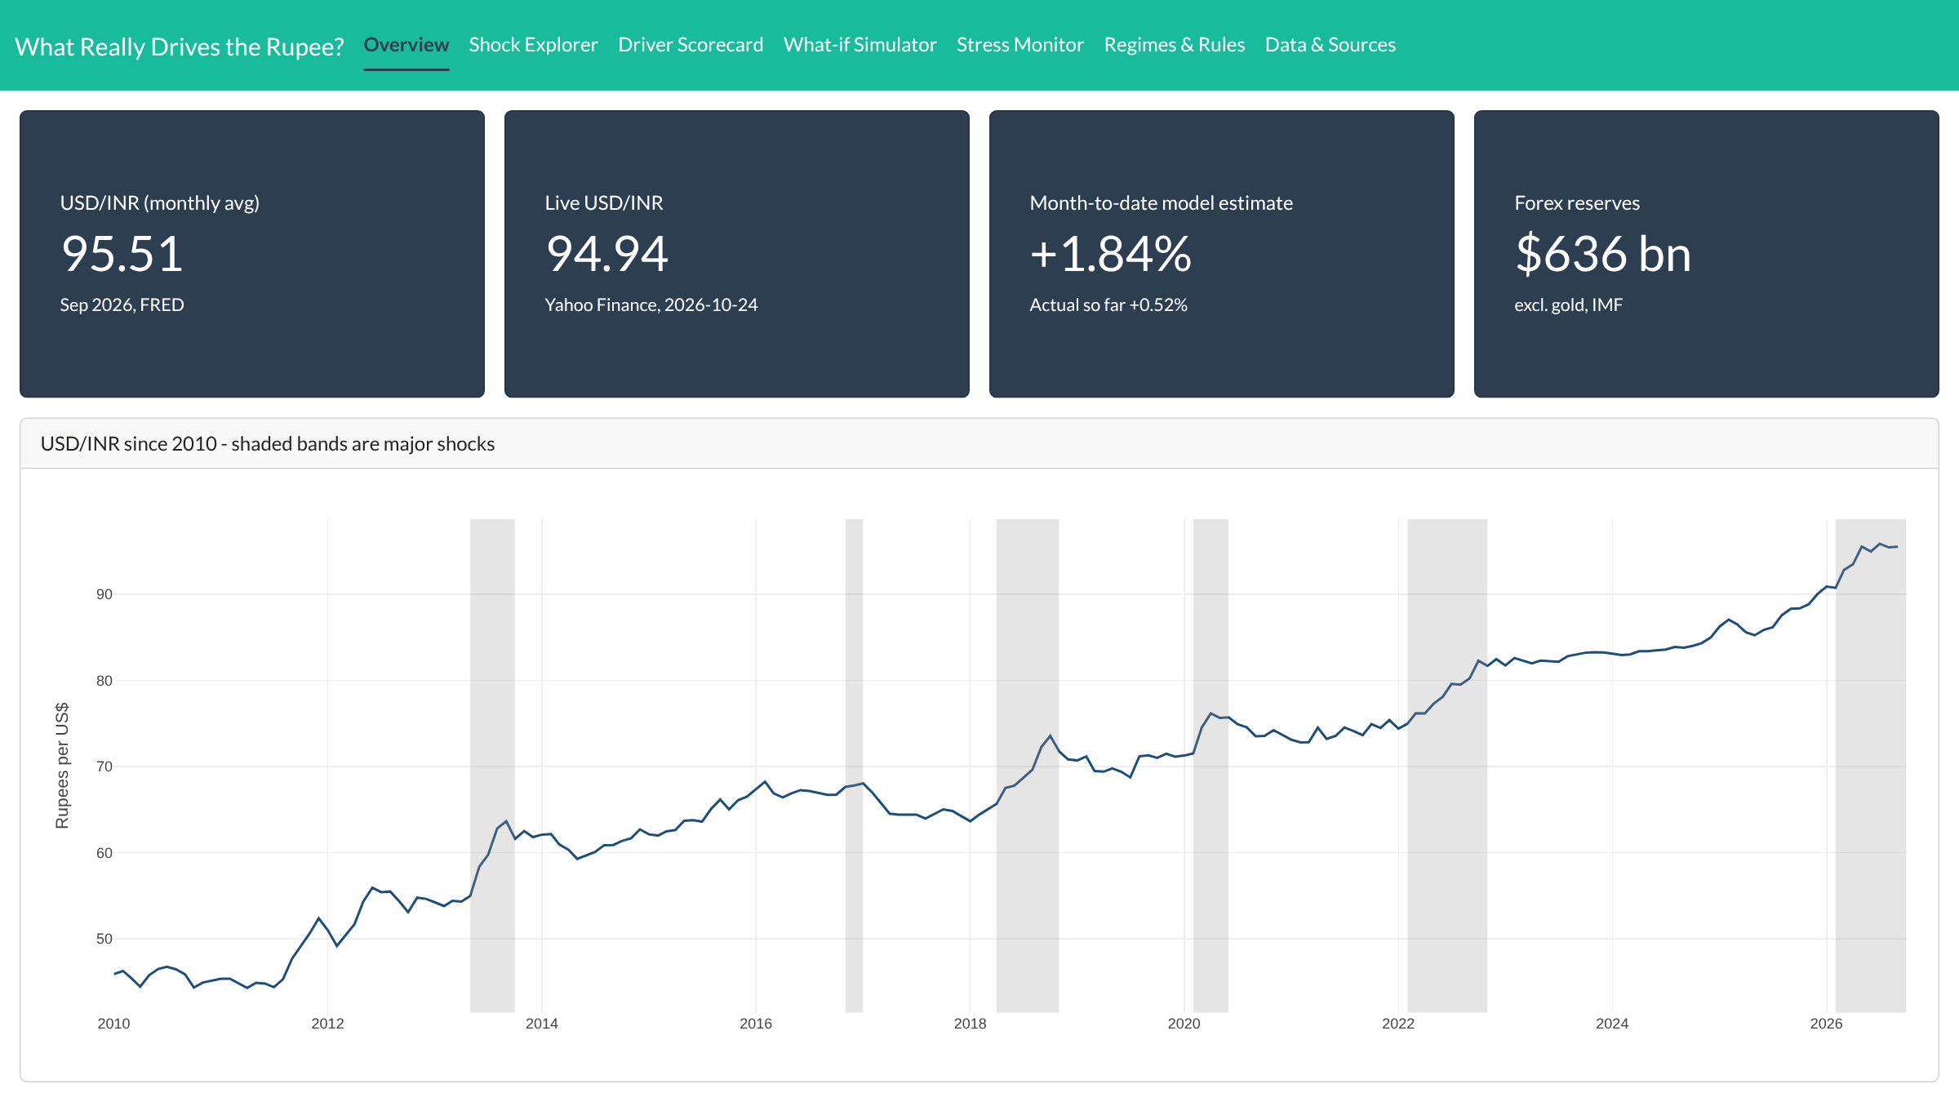
Live demo: the Rupee Intelligence Dashboard
Presenter: Ankit Singh - EMBAA25004
AS
What the treasurer sees in 5 seconds
₹95.51
Sep 2026 monthly average (FRED); live quote ₹94.94 (Yahoo)
+1.84%
October month-to-date model estimate; actual so far +0.52%
US$636 bn
Forex reserves excl. gold: the RBI's buffer
6 shocks
Shaded on the chart, from the 2013 taper tantrum to 2026
Overview tab, live from app.R (R Shiny + bslib + plotly), data as of 24 Oct 2026
Ankit Singh - EMBAA25004 - ankit.embaa25004@iimkashipur.ac.in || Gopalakrishnan S - EMBAA25017 - gopalakrishnan.embaa25017@iimkashipur.ac.in || Murugan Perumal - EMBAA25020 - murugan.embaa25020@iimkashipur.ac.in
Aswin G. - EMBAA25008 - aswin.embaa25008@iimkashipur.ac.in || Atul Kumar Singh - EMBAA25009 - atul.embaa25009@iimkashipur.ac.in || Devanshu Priyam - EMBAA25014 - devanshu.embaa25014@iimkashipur.ac.in
Notes:
ANKIT, about 90 seconds across this slide and the next.
[0:00-0:20, Overview] This is our Rupee Intelligence Dashboard, built in R Shiny. Everything you see is read from the pipeline's own output files, so every number traces back to an official source. The top row gives a treasurer the situation in five seconds: USD/INR averaged 95.51 in September, the live Yahoo quote is 94.94, our month-to-date model estimate for October is plus 1.84 percent, and reserves stand at 636 billion dollars.
[0:20-0:30, chart] The chart is the rupee since 2010. Grey bands are the six shocks we study, from the taper tantrum to the 2026 West Asia conflict.
[0:30] Let me show you the tabs that turn this into a decision. (next slide)

Slide 18
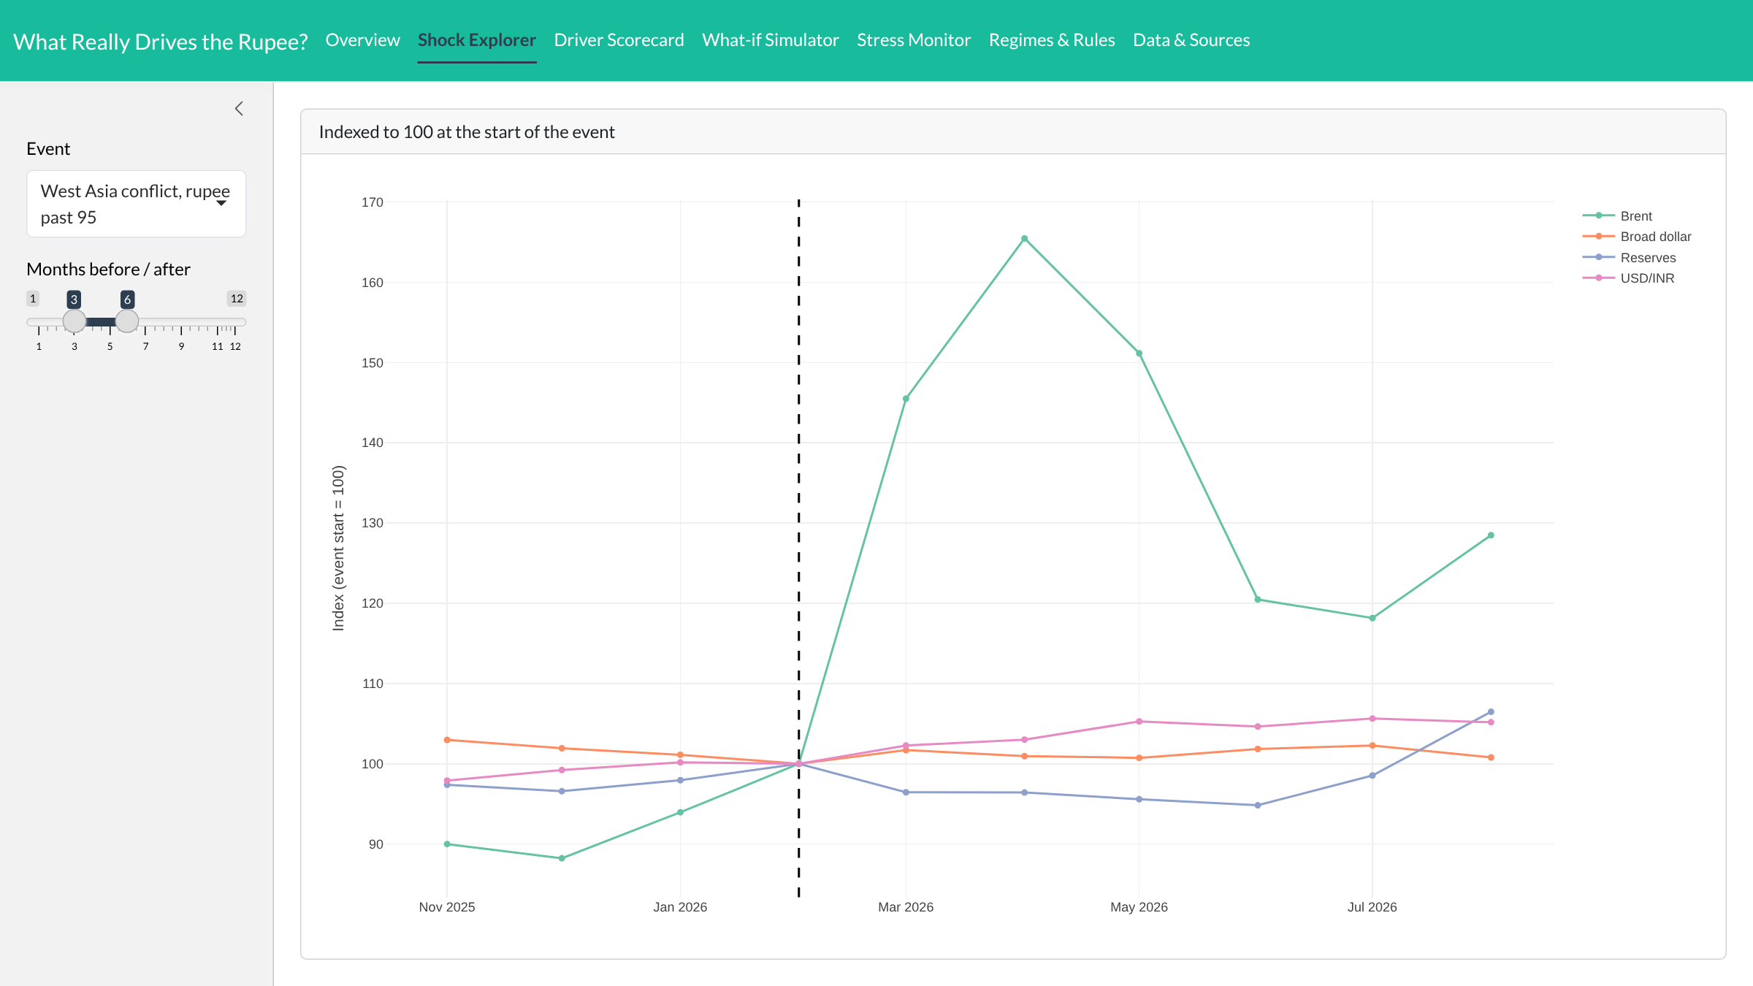
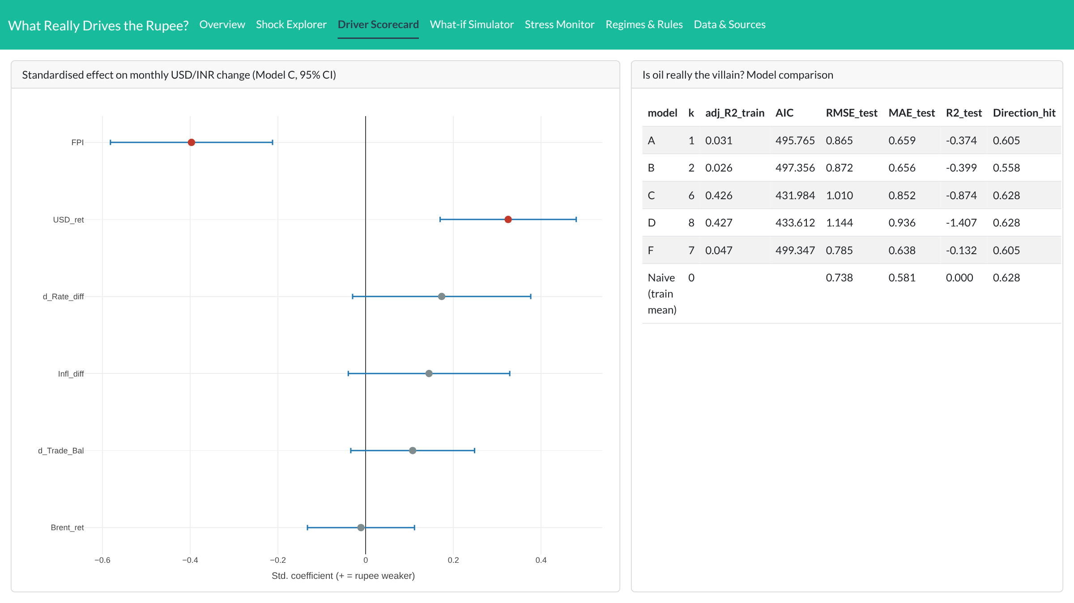
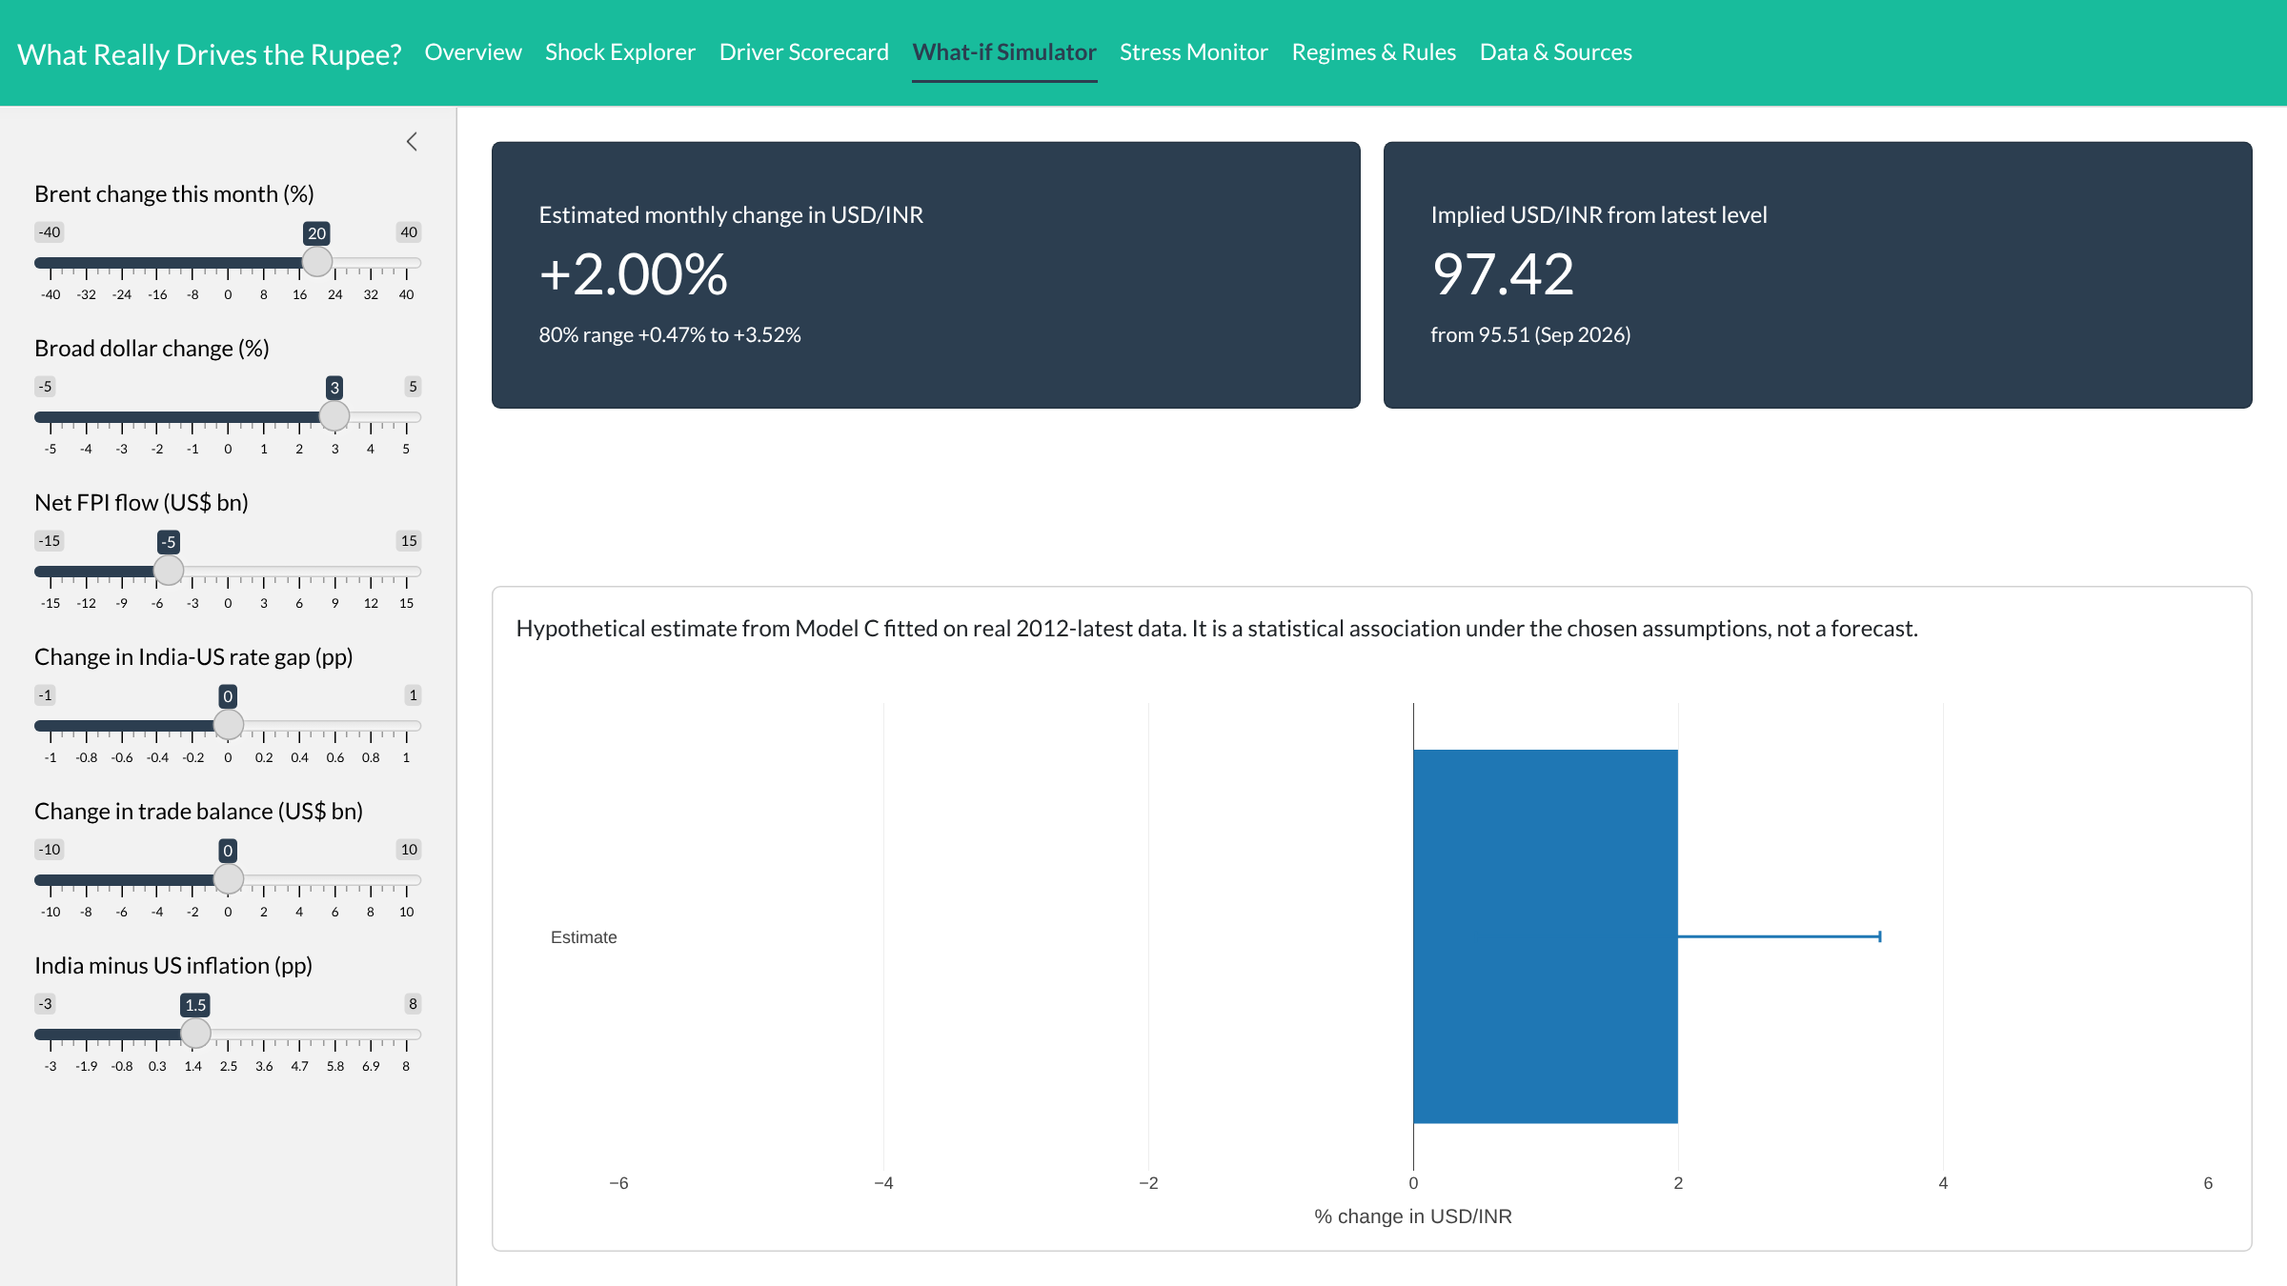
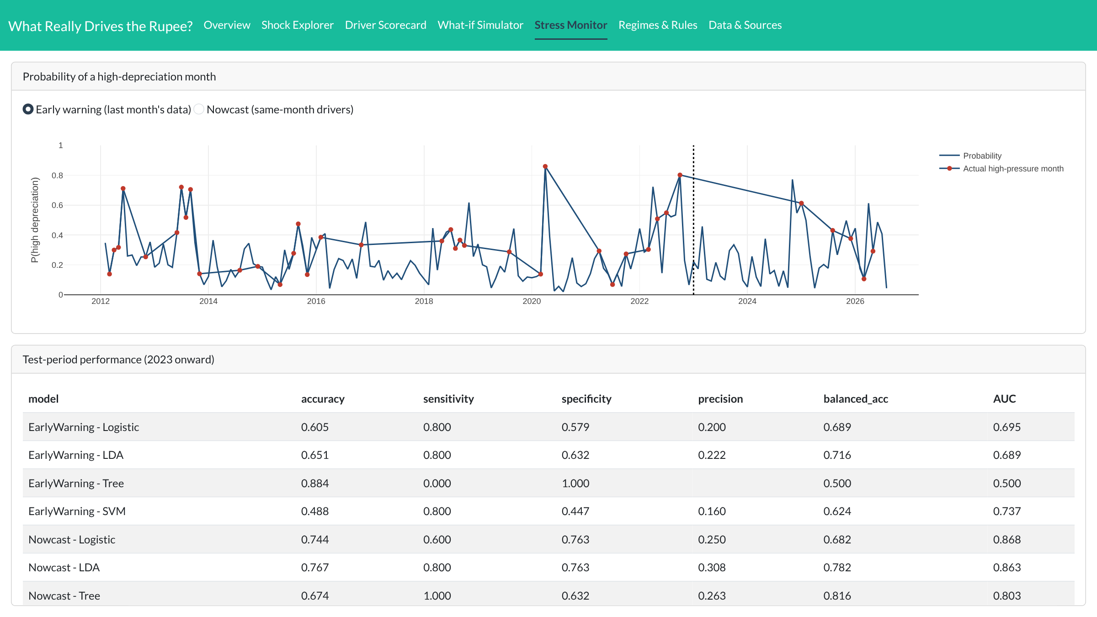
From insight to decision in four tabs
Presenter: Ankit Singh - EMBAA25004
AS
1
Shock Explorer
2
Driver Scorecard
2026 West Asia window: Brent up about two-thirds, rupee up only 5%
Only FPI and the broad dollar are significant; oil sits on zero
3
What-if Simulator
4
Stress Monitor
Oil +20%, dollar +3%, FPI −US$5 bn → +2.00%, ₹97.42 (80%: +0.47% to +3.52%)
Monthly P(high-pressure month), early warning or nowcast, plus test metrics
Also: Regimes & Rules (k-means + Apriori) · Data & Sources (provenance of every column) · daily refresh: Rscript R/08_realtime_refresh.R · run: shiny::runApp()
Ankit Singh - EMBAA25004 - ankit.embaa25004@iimkashipur.ac.in || Gopalakrishnan S - EMBAA25017 - gopalakrishnan.embaa25017@iimkashipur.ac.in || Murugan Perumal - EMBAA25020 - murugan.embaa25020@iimkashipur.ac.in
Aswin G. - EMBAA25008 - aswin.embaa25008@iimkashipur.ac.in || Atul Kumar Singh - EMBAA25009 - atul.embaa25009@iimkashipur.ac.in || Devanshu Priyam - EMBAA25014 - devanshu.embaa25014@iimkashipur.ac.in
Notes:
ANKIT, continued.
[0:30-0:45, Shock Explorer] Pick any shock. Here, the 2026 West Asia conflict: Brent jumped by about two-thirds, yet the rupee moved only about 5 percent. Oil is not the story.
[0:45-1:00, Driver Scorecard] This is why. Only FPI flows and the broad dollar are significant; oil sits on zero. The table beside it is our 'Is oil the villain?' model comparison.
[1:00-1:20, What-if Simulator] The heart of the app. A treasurer moves sliders: oil plus 20, dollar plus 3, FPI outflow of 5 billion. The model says plus 2 percent, about 97.4 rupees, with an 80 percent range of 0.5 to 3.5 percent. That range, not a point forecast, is what we hedge against.
[1:20-1:35, Stress Monitor] Finally, the monthly probability of a high-pressure month, early-warning or nowcast, with the test-period scorecard.
[1:35-1:45] Regimes and Rules shows the two currency regimes, and Data and Sources shows the provenance of every column. It refreshes daily with one script. Over to Devanshu.

Slide 19
Managerial implications for treasurers
Presenter: Devanshu Priyam - EMBAA25014
DP
1
Don't hedge because oil rose
Oil has no significant partial link to the rupee in monthly data.
2
Watch FPI and the dollar index
They carry most of the explained variation; track them daily.
3
Plan with scenarios, not forecasts
No model beat naive; set hedge-ratio policy and stress-test it.
4
Falling reserves = early warning
The one lagged signal that predicts next-month pressure.
5
Combined shocks are the real risk
Outflow + dollar + oil: +2%, range wholly above zero → hedge.
6
Govern the data
Provenance, no gap-filling and an unseen test set build CFO trust.
Ankit Singh - EMBAA25004 - ankit.embaa25004@iimkashipur.ac.in || Gopalakrishnan S - EMBAA25017 - gopalakrishnan.embaa25017@iimkashipur.ac.in || Murugan Perumal - EMBAA25020 - murugan.embaa25020@iimkashipur.ac.in
Aswin G. - EMBAA25008 - aswin.embaa25008@iimkashipur.ac.in || Atul Kumar Singh - EMBAA25009 - atul.embaa25009@iimkashipur.ac.in || Devanshu Priyam - EMBAA25014 - devanshu.embaa25014@iimkashipur.ac.in
Notes:
Devanshu presents. Six takeaways. The headline: don't hedge on oil headlines; watch FPI and the dollar; set hedging policy using scenarios because forecasts don't beat naive.

Slide 20
Limitations and future work
Presenter: Devanshu Priyam - EMBAA25014
DP
Limitations
Future work
Association, not causation: FPI and the rupee affect each other
Rate gap and trade balance show reverse-causation signs (defence of a falling rupee)
Structural breaks across taper, COVID and 2022–26
Proxies: interbank rate for RBI repo; reserves for intervention
Monthly data smooths daily shocks; only 5 stress months in test
Daily or weekly data and the RBI repo rate from DBIE
RBI forward book and intervention as direct drivers
Rolling-window or regime-switching models
Deploy on shinyapps.io with the daily refresh scheduled
Ankit Singh - EMBAA25004 - ankit.embaa25004@iimkashipur.ac.in || Gopalakrishnan S - EMBAA25017 - gopalakrishnan.embaa25017@iimkashipur.ac.in || Murugan Perumal - EMBAA25020 - murugan.embaa25020@iimkashipur.ac.in
Aswin G. - EMBAA25008 - aswin.embaa25008@iimkashipur.ac.in || Atul Kumar Singh - EMBAA25009 - atul.embaa25009@iimkashipur.ac.in || Devanshu Priyam - EMBAA25014 - devanshu.embaa25014@iimkashipur.ac.in
Notes:
Be upfront: these are associations. Two signs run against theory, likely reverse causation. Future work: daily data, RBI repo and intervention data, regime-switching models, and a hosted dashboard.

Slide 21
Conclusion: money flows and the dollar move the rupee, not oil
Presenter: Devanshu Priyam - EMBAA25014
DP
On 175 months of official data, FPI and the broad dollar are the only significant drivers of the rupee. They explain it but don't forecast it, so manage rupee risk with scenario-based hedging. The R pipeline and dashboard make that repeatable.
Member | IIM ID | Contribution
Ankit Singh | EMBAA25004 | Data pipeline, provenance, Shiny dashboard (01–02, app.R)
Gopalakrishnan S | EMBAA25017 | Descriptive & inferential analysis, ADF (03)
Murugan Perumal | EMBAA25020 | Regression A–F, diagnostics, scorecard (04)
Aswin G. | EMBAA25008 | Stress Monitor: 4 classifiers (05)
Atul Kumar Singh | EMBAA25009 | Clustering, Apriori, scenarios, hedge rule (06–07)
Devanshu Priyam | EMBAA25014 | Live refresh, report & deck (08)
Thank you
Questions?
Rscript R/run_all.R
shiny::runApp()
Ankit Singh - EMBAA25004 - ankit.embaa25004@iimkashipur.ac.in || Gopalakrishnan S - EMBAA25017 - gopalakrishnan.embaa25017@iimkashipur.ac.in || Murugan Perumal - EMBAA25020 - murugan.embaa25020@iimkashipur.ac.in
Aswin G. - EMBAA25008 - aswin.embaa25008@iimkashipur.ac.in || Atul Kumar Singh - EMBAA25009 - atul.embaa25009@iimkashipur.ac.in || Devanshu Priyam - EMBAA25014 - devanshu.embaa25014@iimkashipur.ac.in
Notes:
Close with the one sentence, the team contributions, and open for questions. Reproduce with Rscript R/run_all.R then shiny::runApp().

