Slide 1


JuckFava

Slide 2
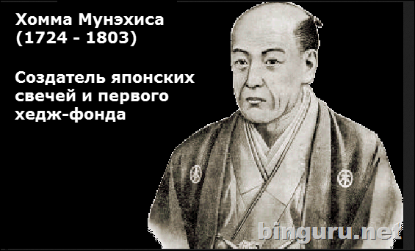
JuckFava

Slide 3
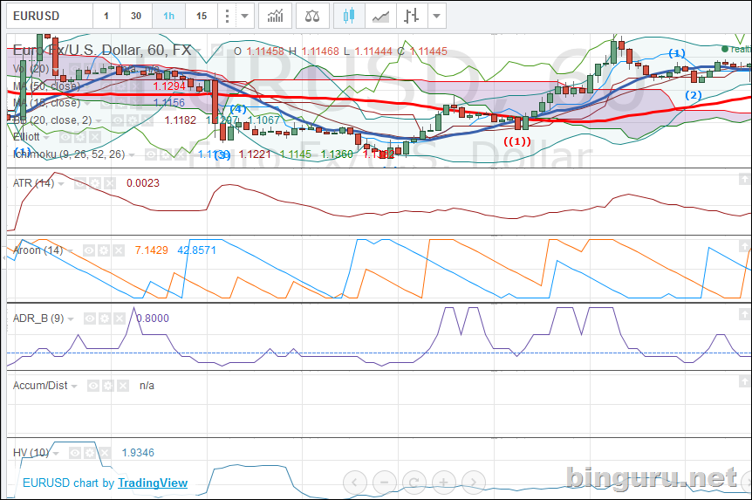
JuckFava

Slide 4
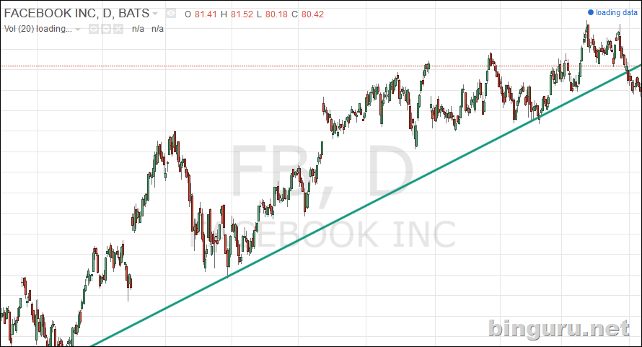
JuckFava

Slide 5

JuckFava

Slide 6
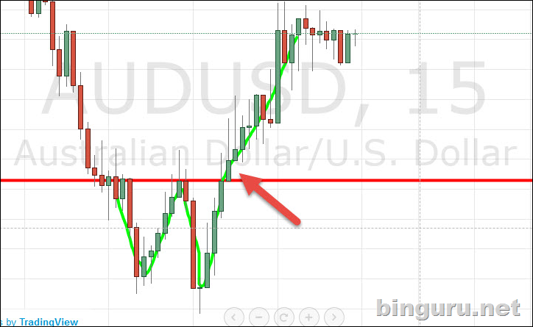
JuckFava

