Slide 1

Python for data analysis
MAQUET François-Xavier
MOSER Paul
NESSI Victor

Slide 2


I. Data pre-processing

Slide 3
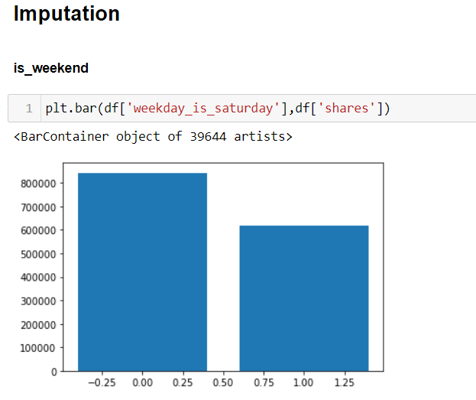
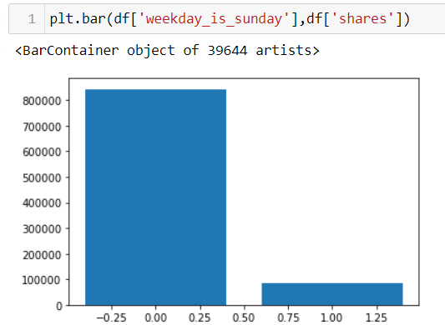
I. Data pre-processing

Slide 4


I. Data pre-processing

Slide 5


I. Data pre-processing

Slide 6
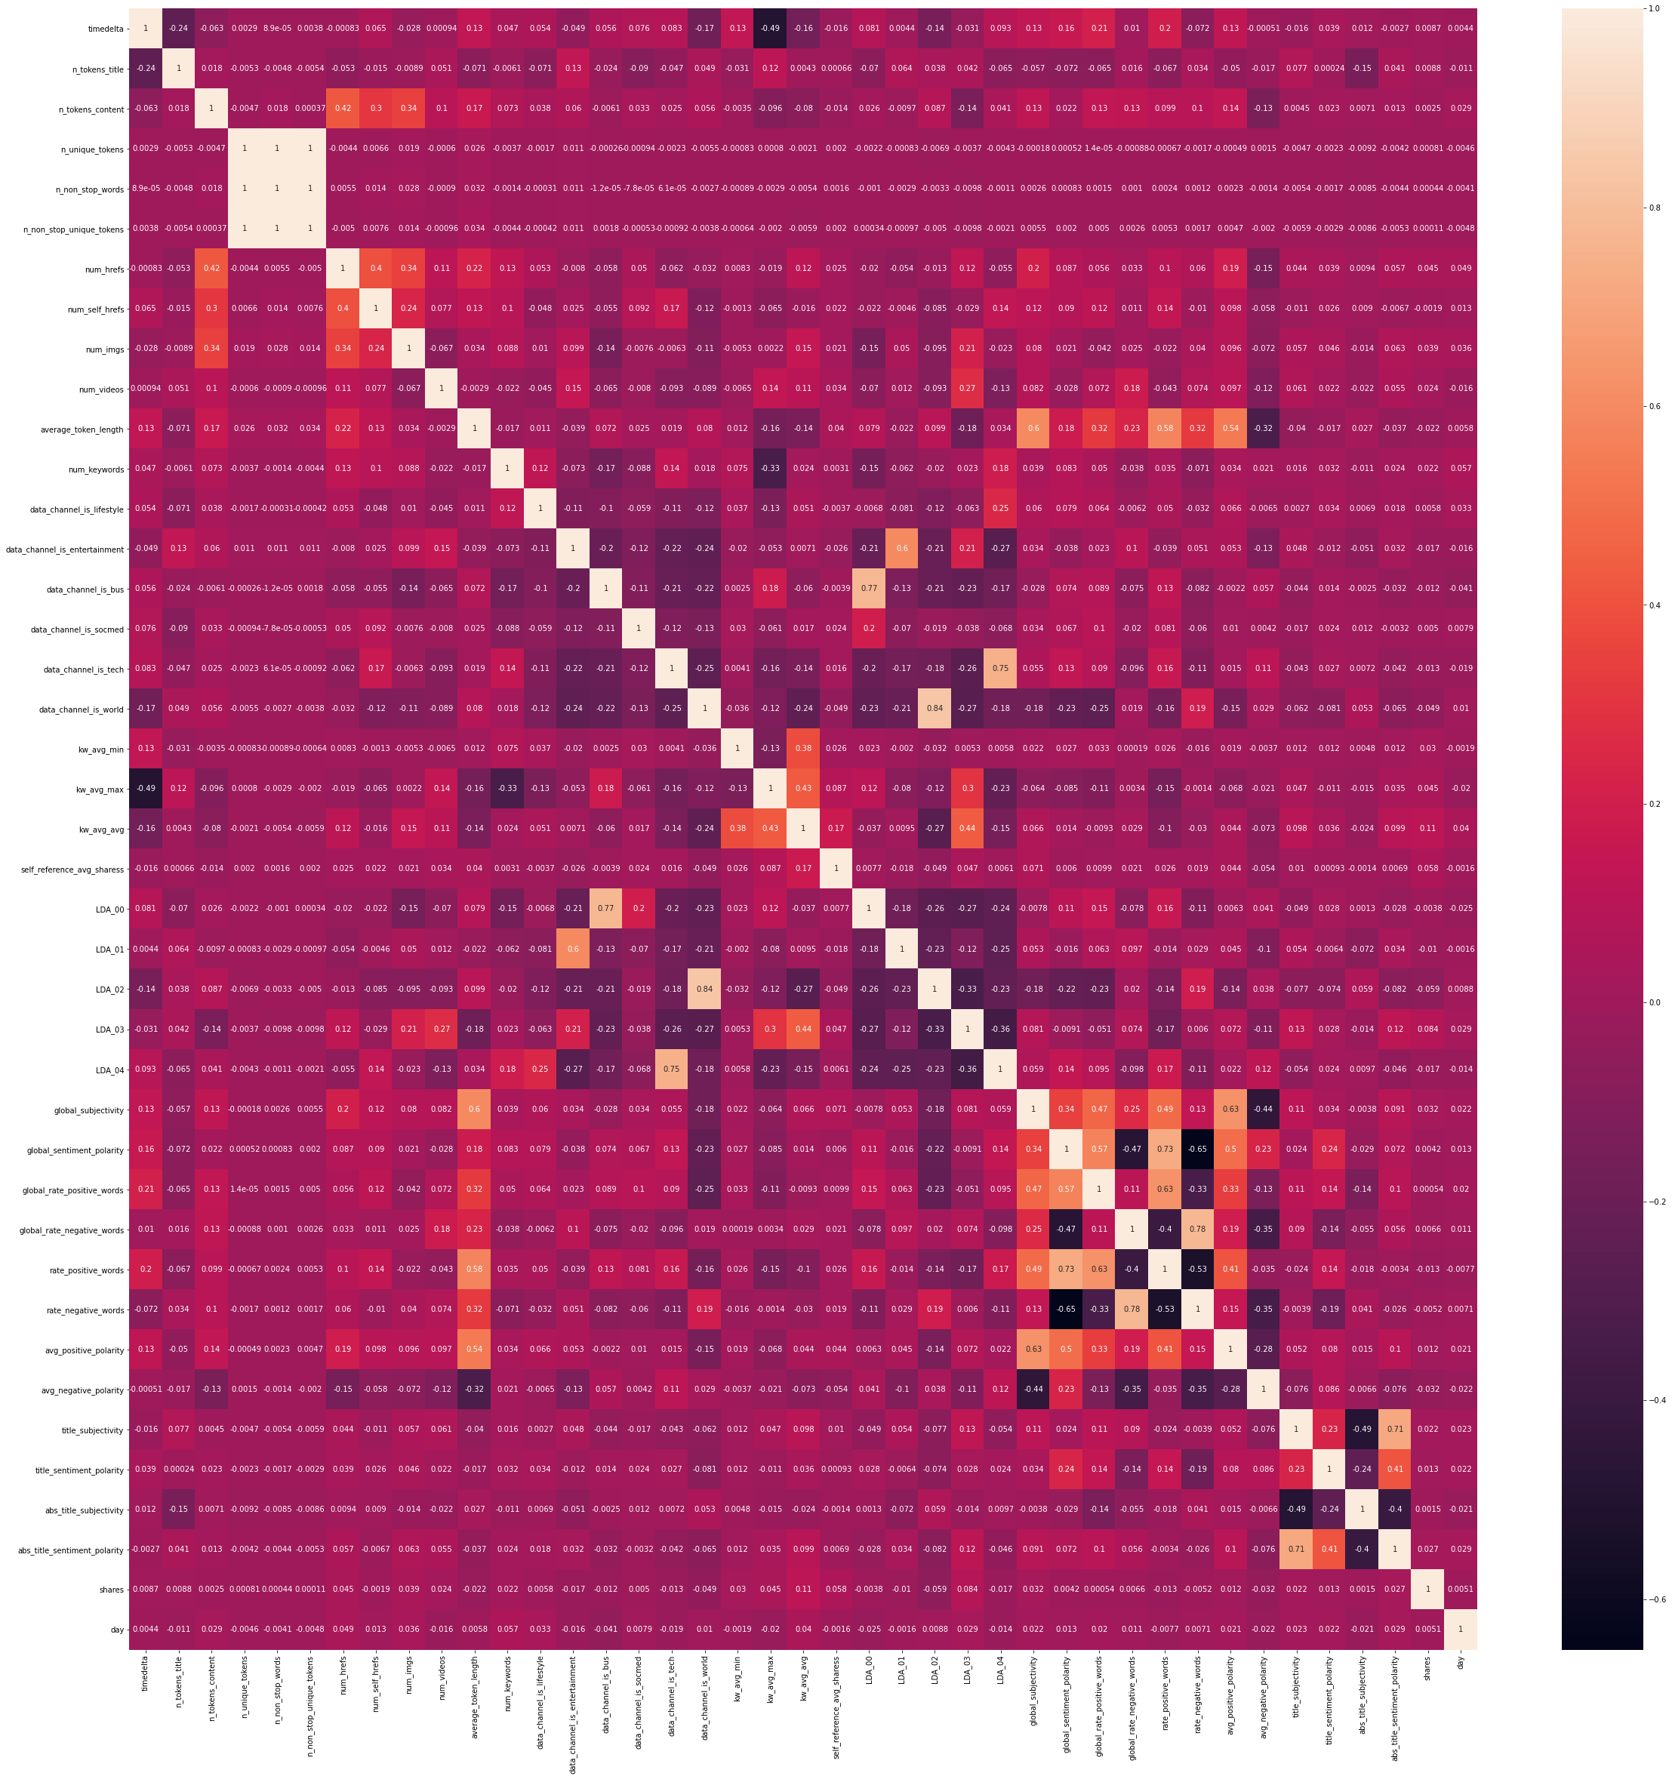

II. Visualization

Slide 7
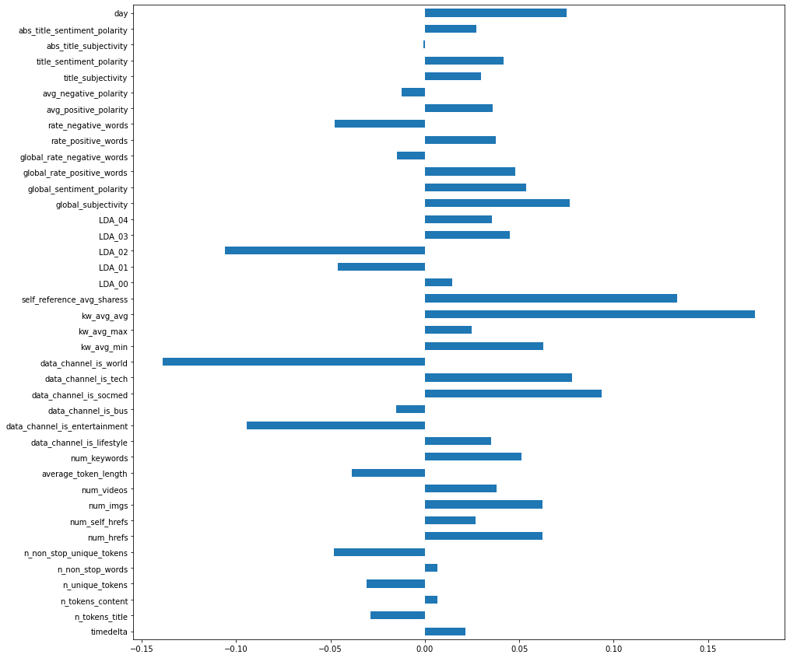

II. Visualization

Slide 8


II. Visualization
Amount of shares by day
Amount of shares by domain

Slide 9

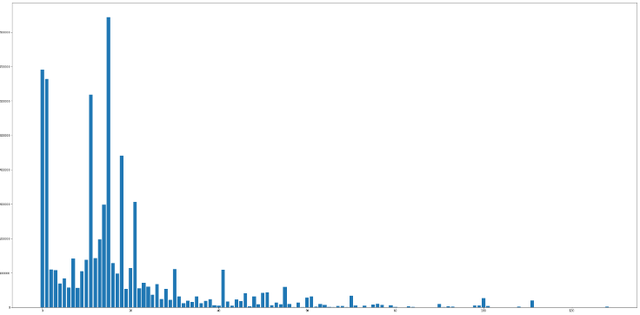
II. Visualization

Slide 10
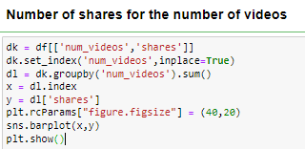
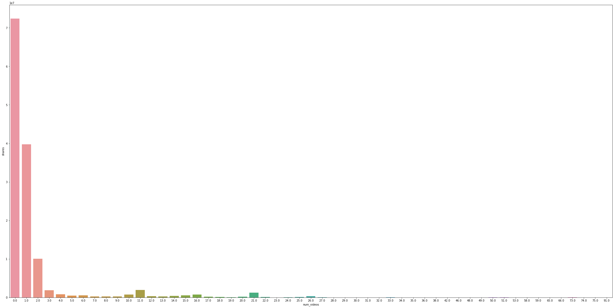
II. Visualization

Slide 11
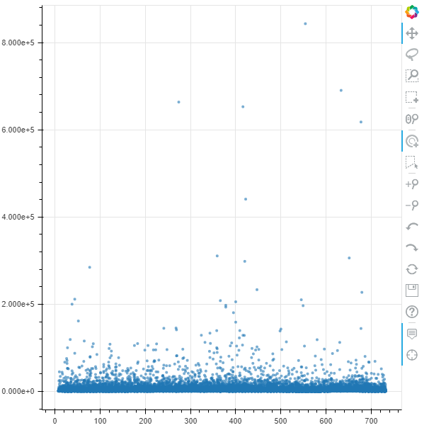
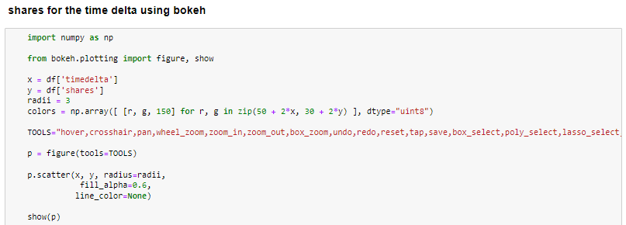
II. Visualization

Slide 12
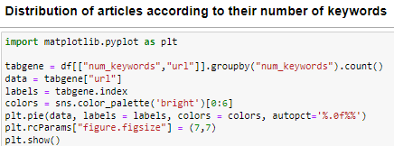
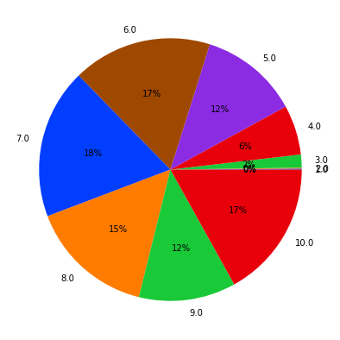
II. Visualization

Slide 13

III.Modeling
Regression
Splitting and fitting the dataset

Slide 14

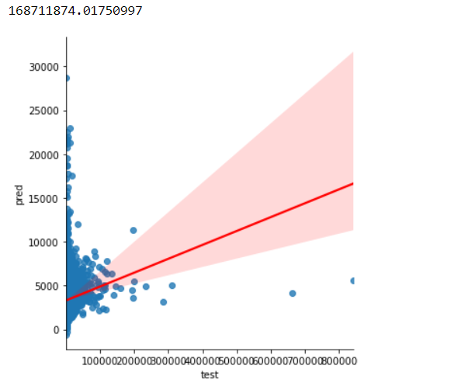
III.Modeling
Linear Regression

Slide 15

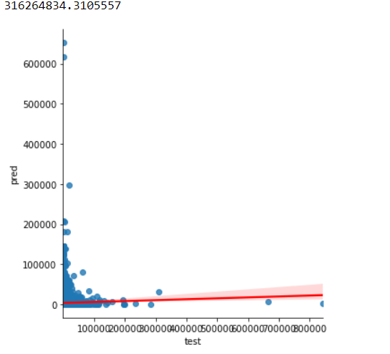
III.Modeling
Decision Tree

Slide 16

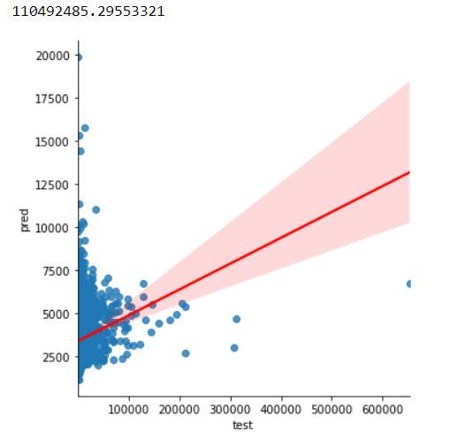
III.Modeling
Logic Regression

Slide 17

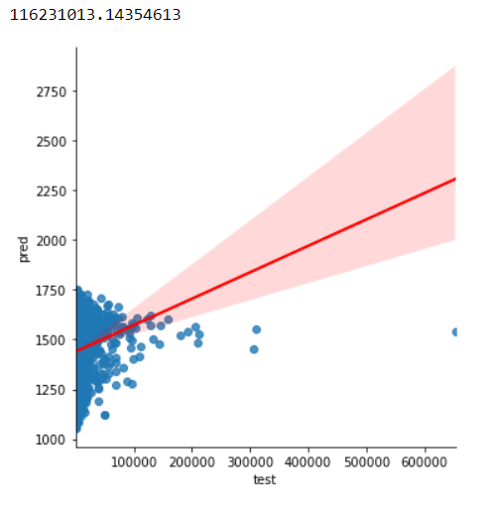
III.Modeling
SVM

Slide 18

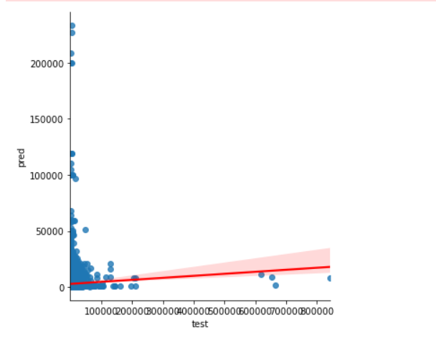
III.Modeling
Neural Network

Slide 19

III.Modeling
Classification

Slide 20
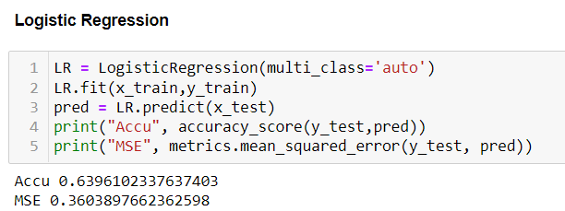
III.Modeling

Slide 21
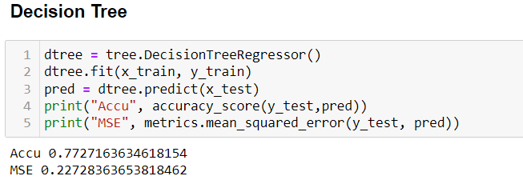
III.Modeling

Slide 22

III.Modeling

Slide 23
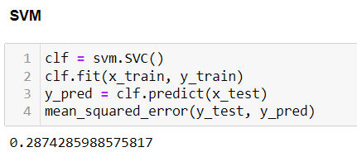
III.Modeling

Slide 24
III.Modeling
Model name | Logic Regression | Decision Tree | Random Forest
Accuracy | 0.6396102337637403 | 0.7727163634618154 | 0.8818221091537465
MSE | 0.3603897662362598 | 0.22728363653818462 | 0.11817789084625353

