Slide 1
Meiosis Formation of Gametes (Eggs & Sperm)

Slide 2
Facts About Meiosis
Preceded by interphase which includes chromosome replication
Two meiotic divisions --- Meiosis I and Meiosis II
Called Reduction- division
Original cell is diploid (2n)
Four daughter cells produced that are monoploid (1n)

Slide 3
Facts About Meiosis
Daughter cells contain half the number of chromosomes as the original cell
Produces gametes (eggs & sperm)
Occurs in the testes in males (Spermatogenesis)
Occurs in the ovaries in females (Oogenesis)

Slide 4
More Meiosis Facts
Start with 46 double stranded chromosomes (2n)
After 1 division - 23 double stranded chromosomes (n)
After 2nd division - 23 single stranded chromosomes (n)
Occurs in our germ cells that produce gametes

Slide 5
Why Do we Need Meiosis?
It is the fundamental basis of sexual reproduction
Two haploid (1n) gametes are brought together through fertilization to form a diploid (2n) zygote

Slide 6
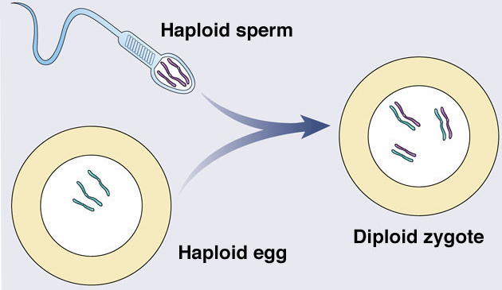
Fertilization – “Putting it all together”
2n = 6
1n =3

Slide 7
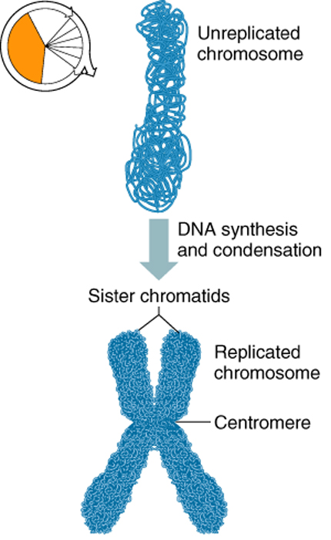
Replication of Chromosomes
Replication is the process of duplicating a chromosome
Occurs prior to division
Replicated copies are called sister chromatids
Held together at centromere
Occurs in Interphase
Notes:
Replication is the process of duplicating chromosome. The new copy of a chromosome is formed by DNA synthesis during S-phase. The chromosome copies are called sister chromatids. Sister chromatids are held together at the centromere.

Slide 8
A Replicated Chromosome
Gene X
Sister Chromatids
(same genes,
same alleles)
Homologs
(same genes, different alleles)
Homologs separate in meiosis I and therefore different alleles separate.

Slide 9
Meiosis Forms Haploid Gametes
Meiosis must reduce the chromosome number by half
Fertilization then restores the 2n number
from mom
from dad
child
too
much!
meiosis reduces
genetic content
The right number!

Slide 10
Meiosis: Two Part Cell Division
Sister
chromatids
separate
Homologs
separate
Meiosis I
Meiosis II
Diploid
Diploid
Haploid

Slide 11
Meiosis I: Reduction Division
Nucleus
Spindle
fibers
Nuclear
envelope
Early Prophase I
(Chromosome number doubled)
Late Prophase I
Metaphase I
Anaphase I
Telophase I (diploid)

Slide 12
Prophase I
Early prophase
Homologs pair.
Crossing over occurs.
Late prophase
Chromosomes condense.
Spindle forms.
Nuclear envelope fragments.

Slide 13

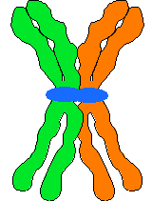

Tetrads Form in Prophase I
Homologous chromosomes (each with sister chromatids)
Join to form a TETRAD
Called Synapsis

Slide 14
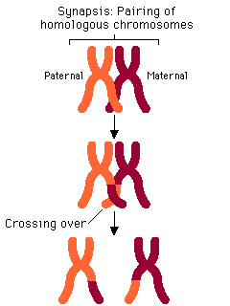
Crossing-Over
Homologous chromosomes in a tetrad cross over each other
Pieces of chromosomes or genes are exchanged
Produces Genetic recombination in the offspring

Slide 15
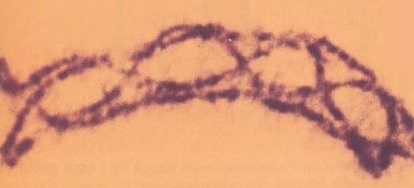
Homologous Chromosomes During Crossing-Over

Slide 16
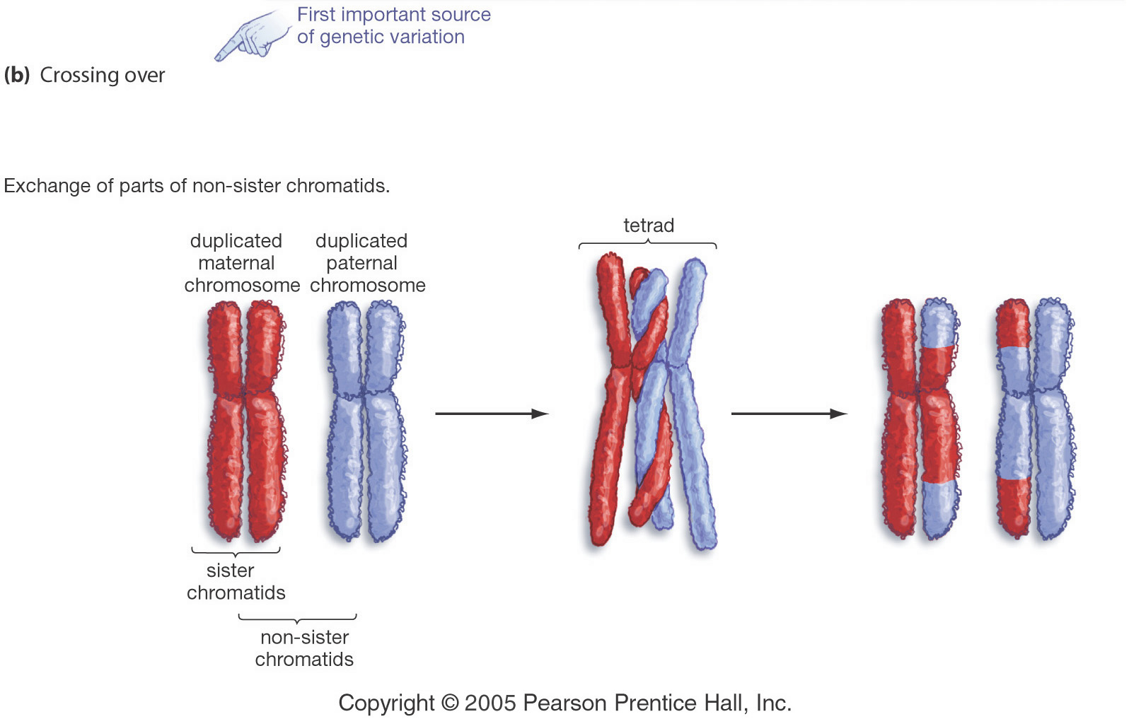
Crossing-Over
Crossing-over multiplies the already huge number of different gamete types produced by independent assortment

Slide 17
Metaphase I
Homologous pairs of chromosomes align along the equator of the cell

Slide 18
Anaphase I
Homologs separate and move to opposite poles.
Sister chromatids remain
attached at their centromeres.

Slide 19
Telophase I
Nuclear envelopes reassemble.
Spindle disappears.
Cytokinesis divides cell into two.

Slide 20
Meiosis II
Only one homolog of each chromosome is present in the cell.
Gene X
Sister chromatids carry
identical genetic
information.
Meiosis II produces gametes with
one copy of each chromosome and thus one copy of each gene.

Slide 21
Meiosis II: Reducing Chromosome Number
Prophase II
Metaphase II
Telophase II
Anaphase II
4 Identical haploid cells

Slide 22
Prophase II
Nuclear envelope fragments.
Spindle forms.

Slide 23
Metaphase II
Chromosomes align
along equator of cell.

Slide 24
Anaphase II
Equator
Pole
Sister chromatids separate and move to opposite poles.

Slide 25
Telophase II
Nuclear envelope assembles.
Chromosomes decondense.
Spindle disappears.
Cytokinesis divides cell into two.

Slide 26
Results of Meiosis
Gametes (egg & sperm) form
Four haploid cells with one copy of each chromosome
One allele of each gene
Different combinations of alleles for different genes along the chromosome

Slide 27
Gametogenesis
Oogenesis or Spermatogenesis

Slide 28
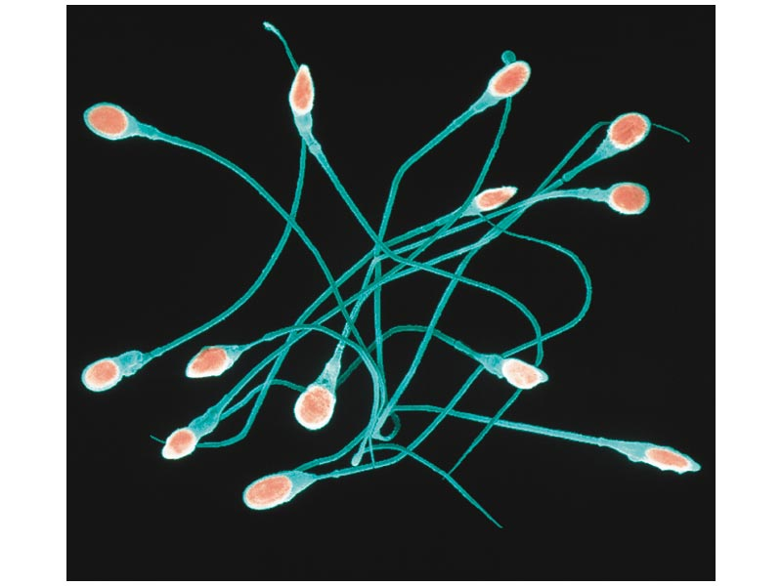
Spermatogenesis
Occurs in the testes
Two divisions produce 4 spermatids
Spermatids mature into sperm
Men produce about 250,000,000 sperm per day

Slide 29
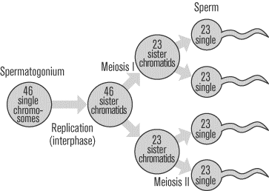
Spermatogenesis in the Testes
Spermatid

Slide 30
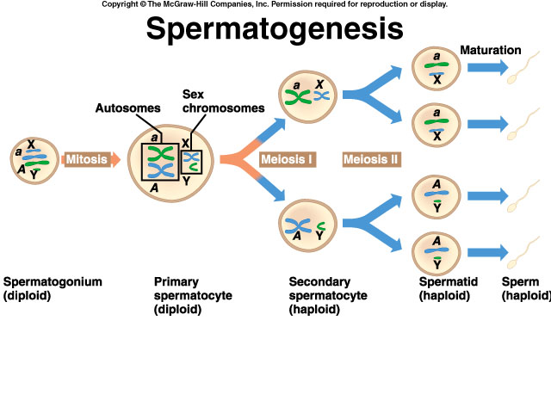

Slide 31
Oogenesis
Occurs in the ovaries
Two divisions produce 3 polar bodies that die and 1 egg
Polar bodies die because of unequal division of cytoplasm
Immature egg called oocyte
Starting at puberty, one oocyte matures into an ovum (egg) every 28 days

Slide 32
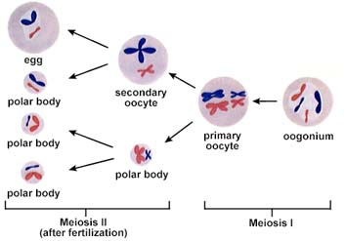
Oogenesis in the Ovaries

Slide 33
Oogenesis
First polar body
may divide
(haploid)
a
X
Polar
bodies
die
a
X
a
a
X
X
Mitosis
Meiosis I
Meiosis II
A
X
(if fertilization
occurs)
Oogonium
(diploid)
A
Primary
oocyte
(diploid)
X
A
X
Ovum (egg)
Mature
egg
Secondary
oocyte
(haploid)
A
X
Second
polar body
(haploid)

Slide 34
Comparing Mitosis and Meiosis

Slide 35
Comparison of Divisions
 | Mitosis | Meiosis
Number of divisions | 1 | 2
Number of daughter cells | 2 | 4
Genetically identical? | Yes | No
Chromosome # | Same as parent | Half of parent
Where | Somatic cells | Germ cells
When | Throughout life | At sexual maturity
Role | Growth and repair | Sexual reproduction

