Slide 1
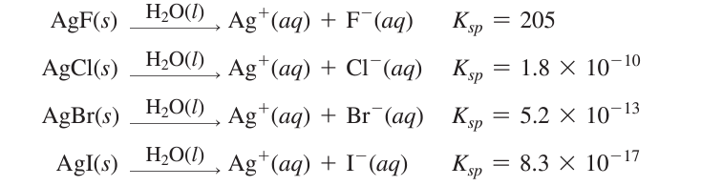

Slide 2
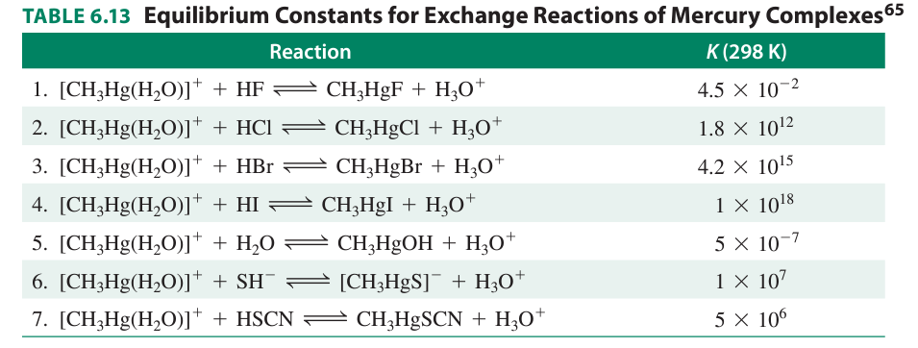

Slide 3
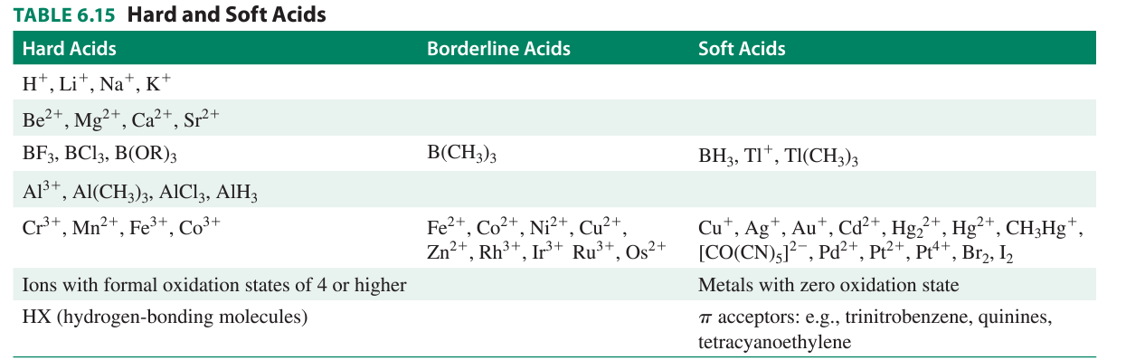

Slide 4
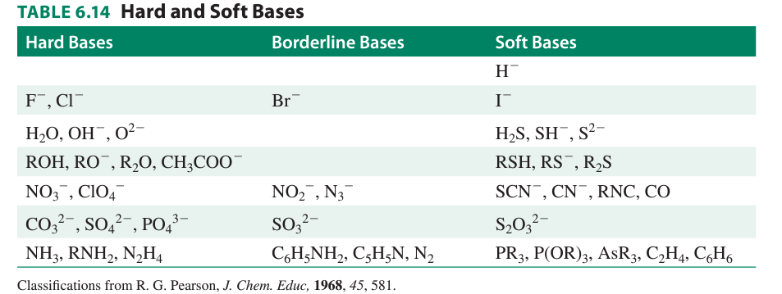
R₂SBF₃ + R₂O → R₂OBF₃ + R₂S
R₂OBH₃ + R₂S → R₂SBH₃ + R₂O
Hardness and softness of an acidic and basic site is not an inherent property of the particular atom at the site,
But can be influenced by the substituents atoms.

Slide 5
Acid-base strength and hardness and softness
SO₃²⁻ + HF ↔ HSO₃⁻ + F⁻
OH- + CH₃HgSO₃⁻ ↔ CH₃HgOH + SO₃ ²⁻
K = 10000
= 10
Stronger, yet softer base, the sulfite anion can displace the weak, hard base fluoride ion
from the hard acid proton.

