Slide 1
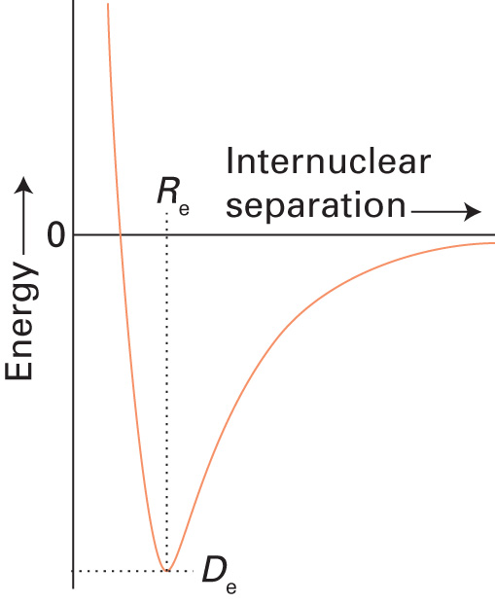
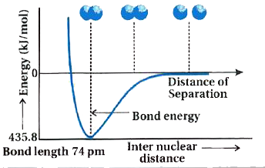
H₂ molecule

Slide 2
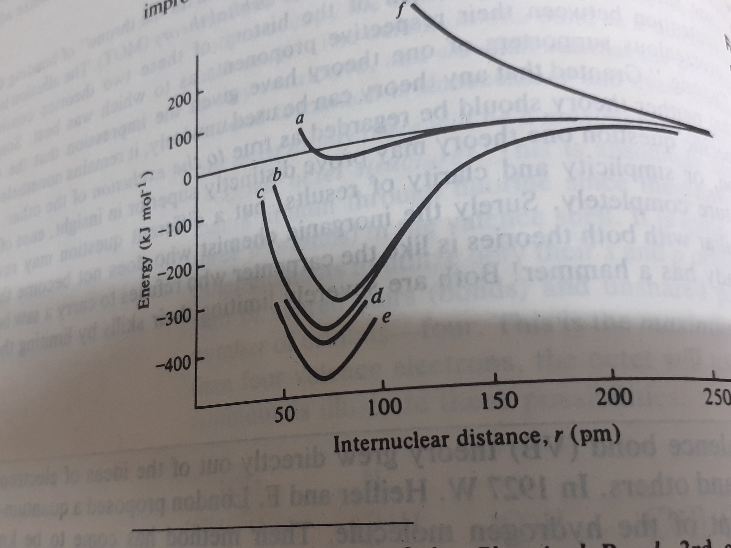
H₂ Molecule
Huheey, 4th Ed. Figure 5.1

Slide 3
Improvements
Type of wave Fubction | Energy (KJ mol-1) | Distance (pm)
Uncorrected | 24 | 90
Heitler-London | 303 | 86.9
Addition of shielding | 365 | 74.3
Add ionic contribution | 388 | 74.9
Observed value | 458 | 74.1

Slide 4
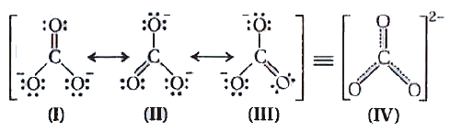
Carbonate Resonance

Slide 5
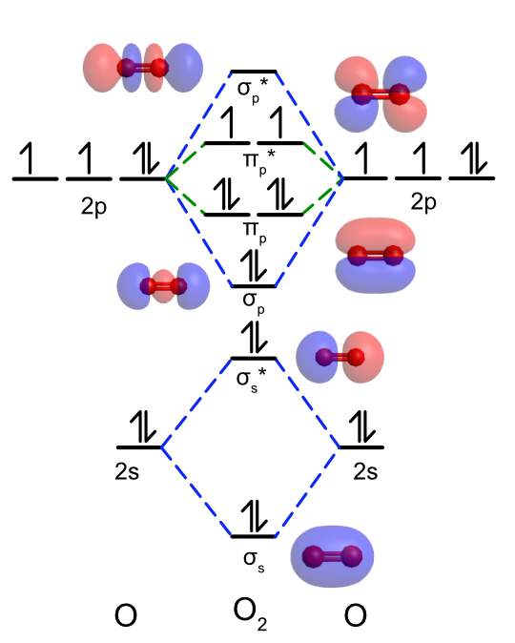
Source: Chem.libretext

Slide 6

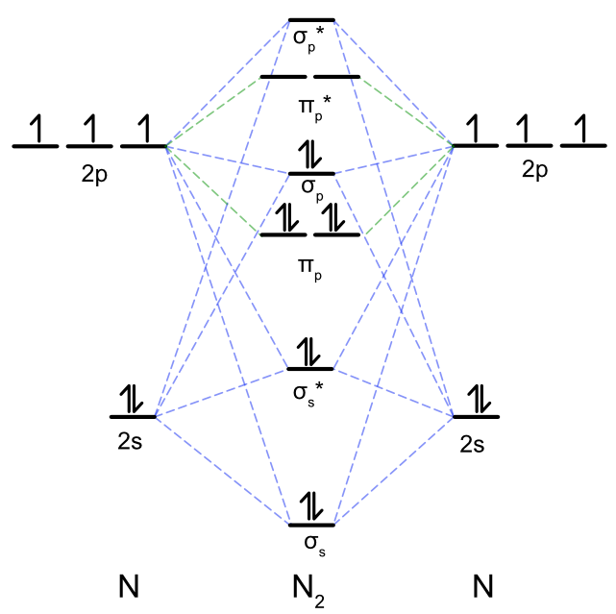
Source: Chem.libretext

Slide 7
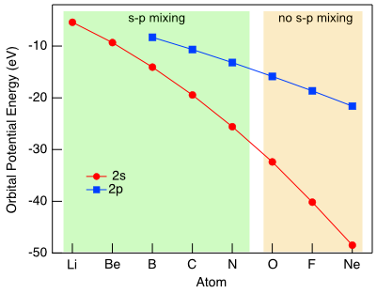

Slide 8
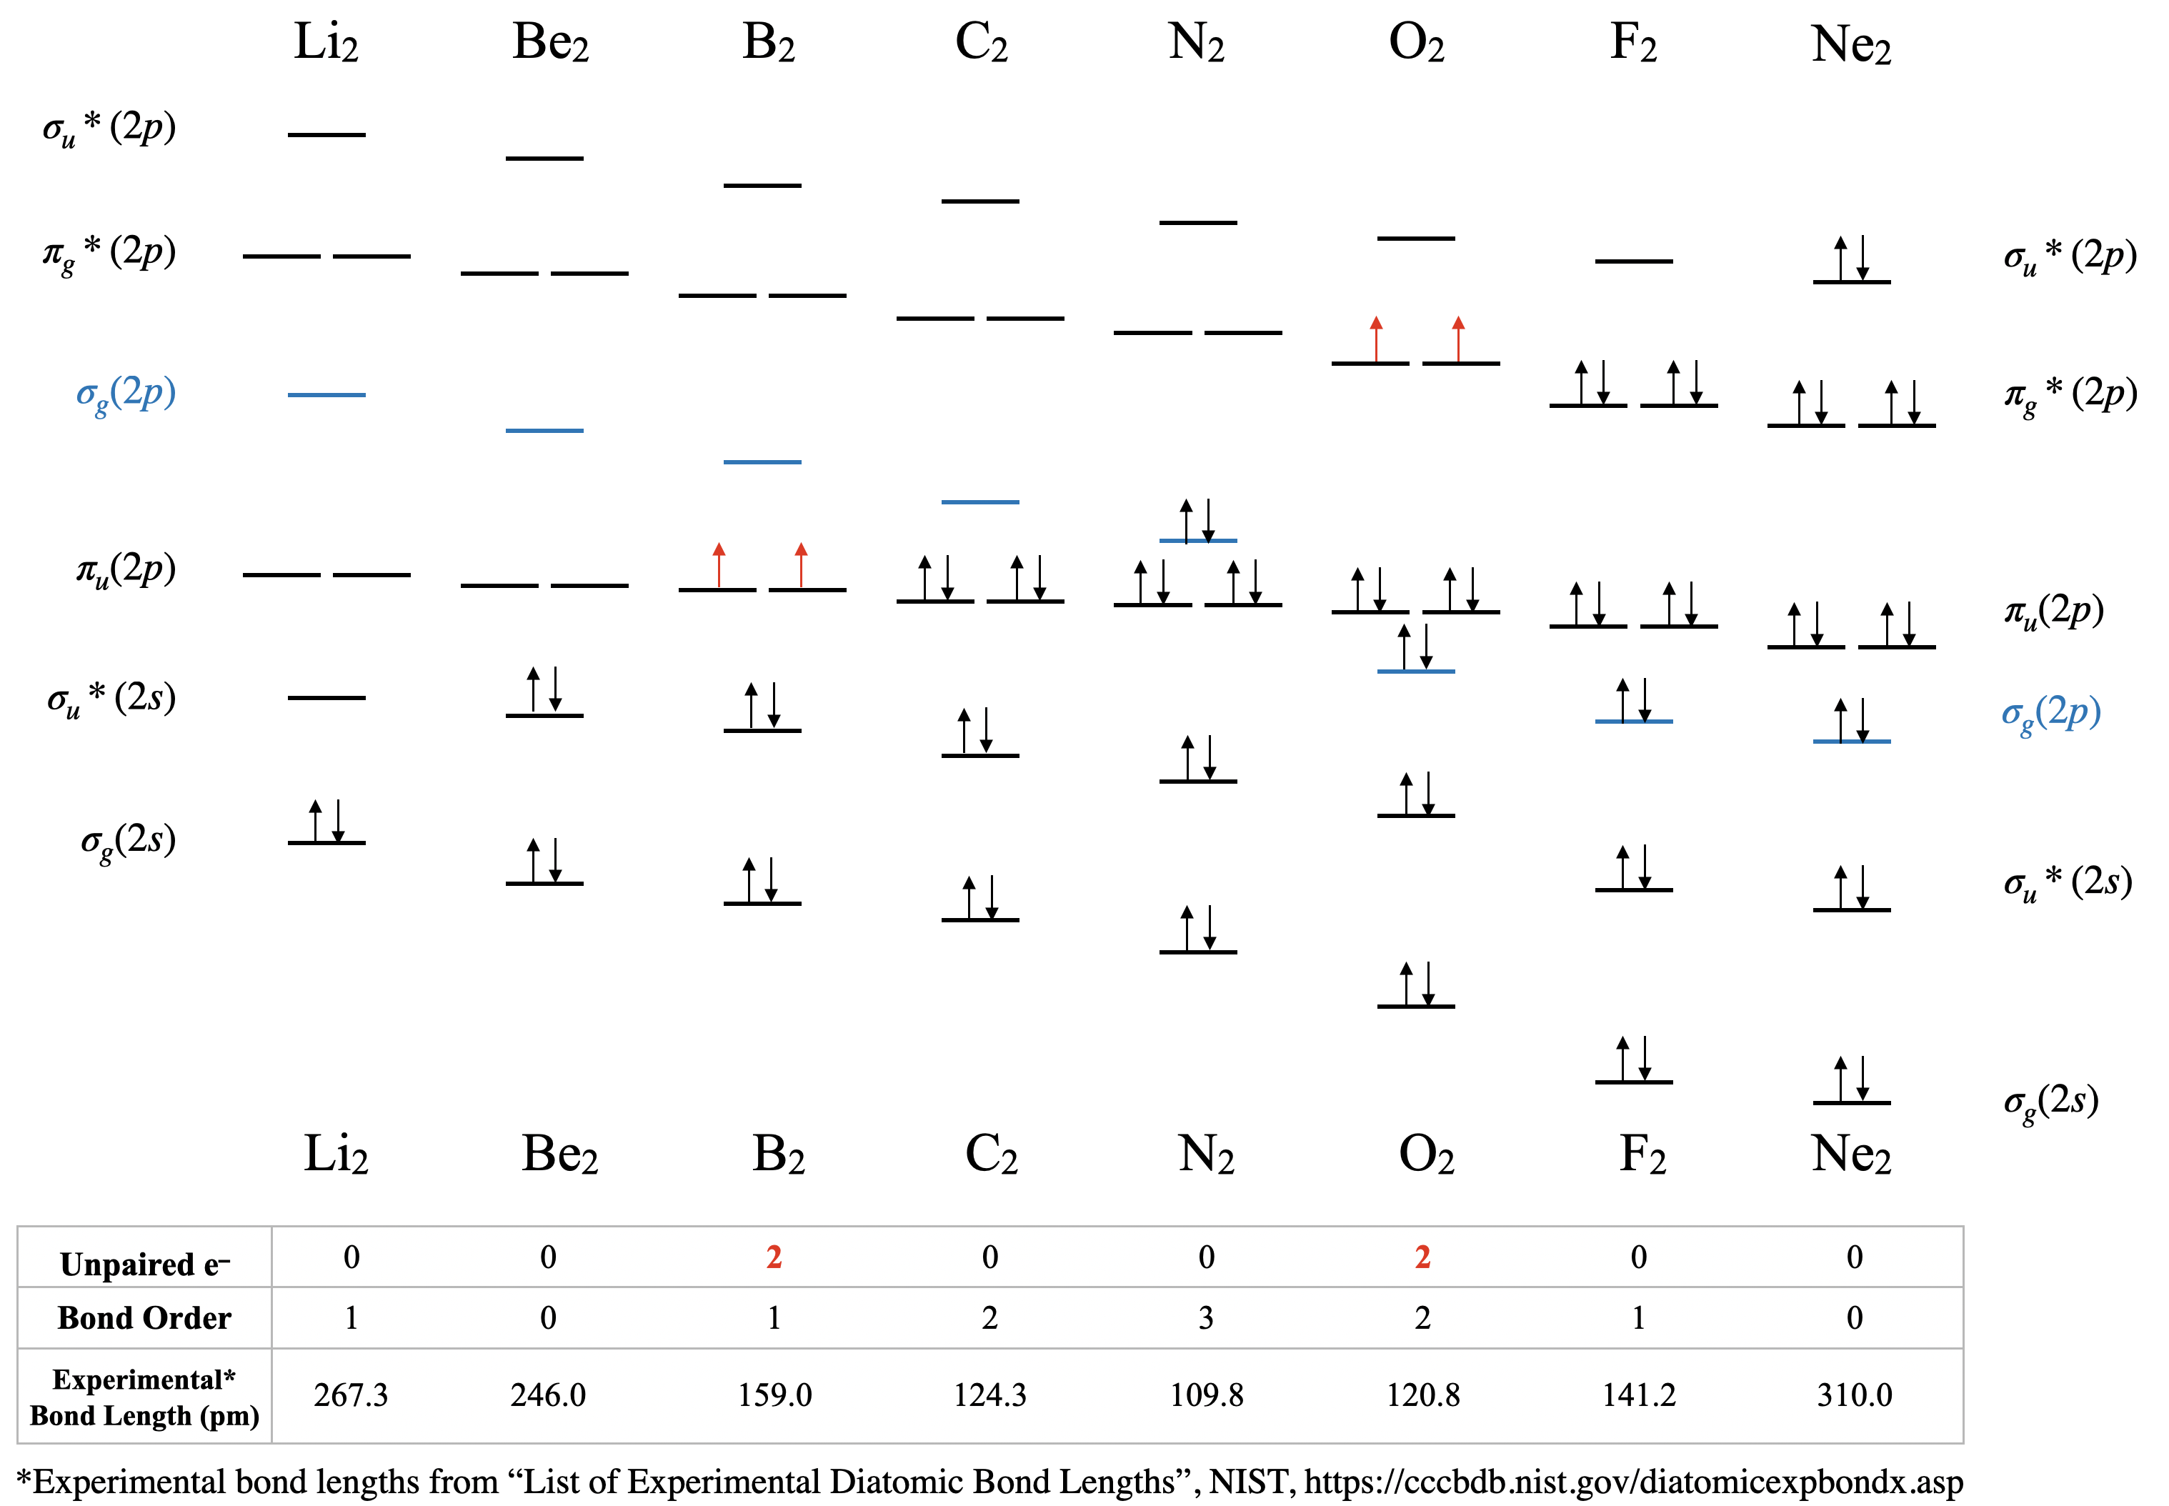
Source: Chem.libretext

Slide 9
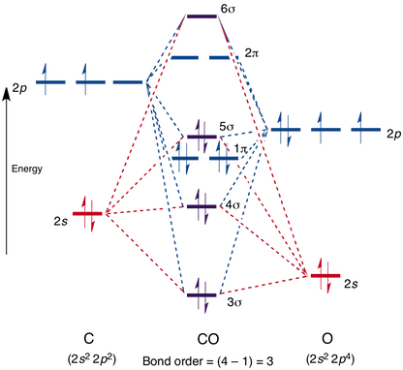
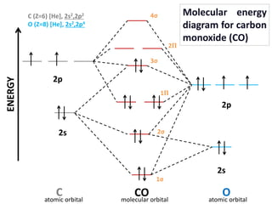
MO of Carbon Monoxide
Source: Chemtube3D

