Slide 1
Wireless Communications Seminar 04
Sungweon Hong
Information and Intelligent systems lab
Hanyang university
Department of Electronic Engineering

Slide 2
Contents
Review
Channel Capacity
AWGN Channel
Frequency-Flat/Fast-Fading Channel with Transmitter and Receiver CSI
Naïve Approach
Adaptive Power Control
Channel Inversion
Truncated Channel Inversion

Slide 3
Review

Slide 4
Channel Capacity
Channel Capacity
The maximum data rates that can be transmitted over the wireless channel with asymptotically small error probability
https://www.dictionary.com/browse/asymptotic

Slide 5

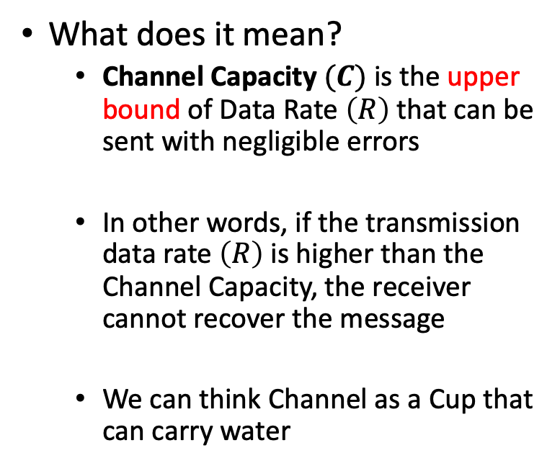
Channel Capacity
What does it mean?
Channel Capacity $(C)$ is the upper bound of Data Rate $\left(R\right)$ that can be sent with negligible errors
In other words, if the transmission data rate $\left(R\right)$ is higher than the Channel Capacity, the receiver cannot recover the message
We can think Channel as a Cup that can carry water

Slide 6
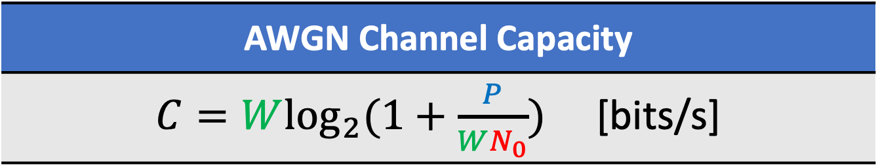
AWGN Channel Capacity
AWGN Channel Capacity
$C=W\log_{2}{(1+\frac{P}{WN_{0}})}$ [bits/s]

Slide 7
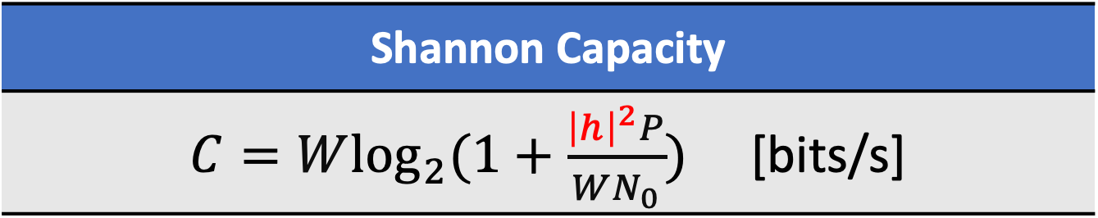
Frequency-Flat/Slow-Fading channel
Shannon Capacity
$C=W\log_{2}{(1+\frac{{\left|h\right|}^{2}P}{WN_{0}})}$ [bits/s]

Slide 8
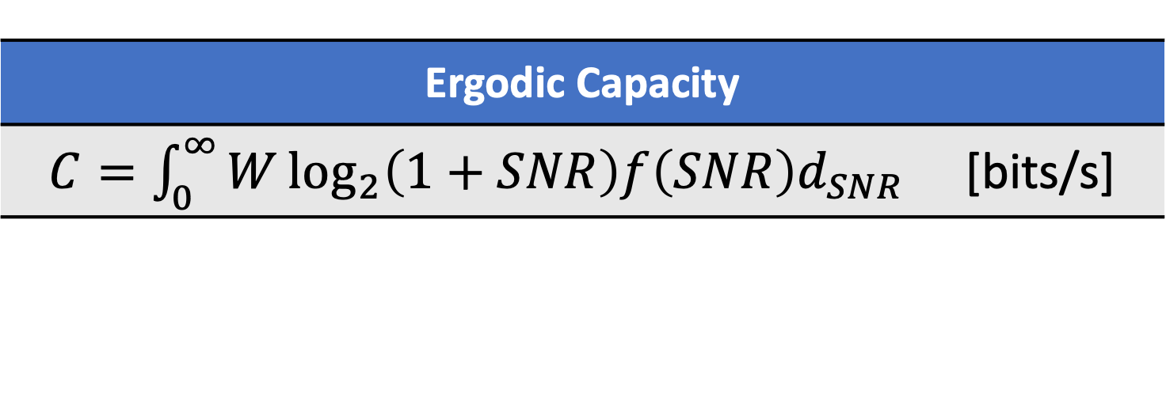
Frequency-Flat/Fast-Fading Channel
Ergodic Capacity
$C=\int_{0}^{∞}{W\log_{2}\left(1+SNR\right)f\left(SNR\right)d_{SNR}}$ [bits/s]

Slide 9
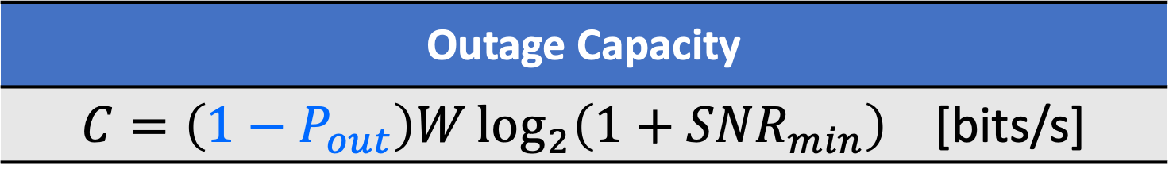
Outage Capacity
Outage Capacity
$C=\left(1−P_{out}\right)W\log_{2}\left(1+SNR_{min}\right)$ [bits/s]

Slide 10
case III:
Frequency-Flat/Fast Fading channel
Channel State Information (CSI) known at both Tx and RX

Slide 11
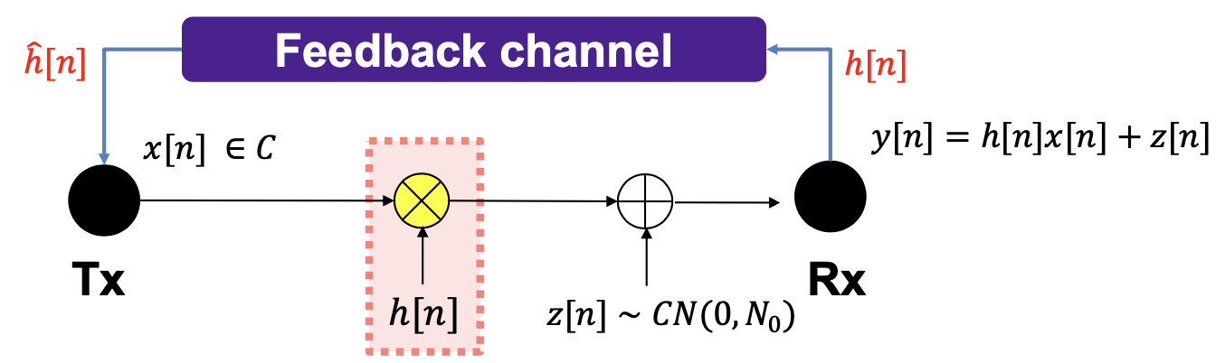

CSI at both Transmitter and Receiver
Receiver always estimates the channel $h\left[n\right]$
and sends back the signal $\hat{h}\left[n\right]$ to transmitter
Assumptions
No Estimation & Feedback error

Slide 12
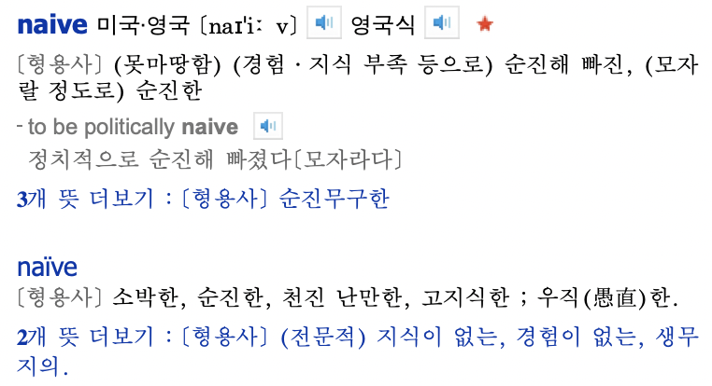
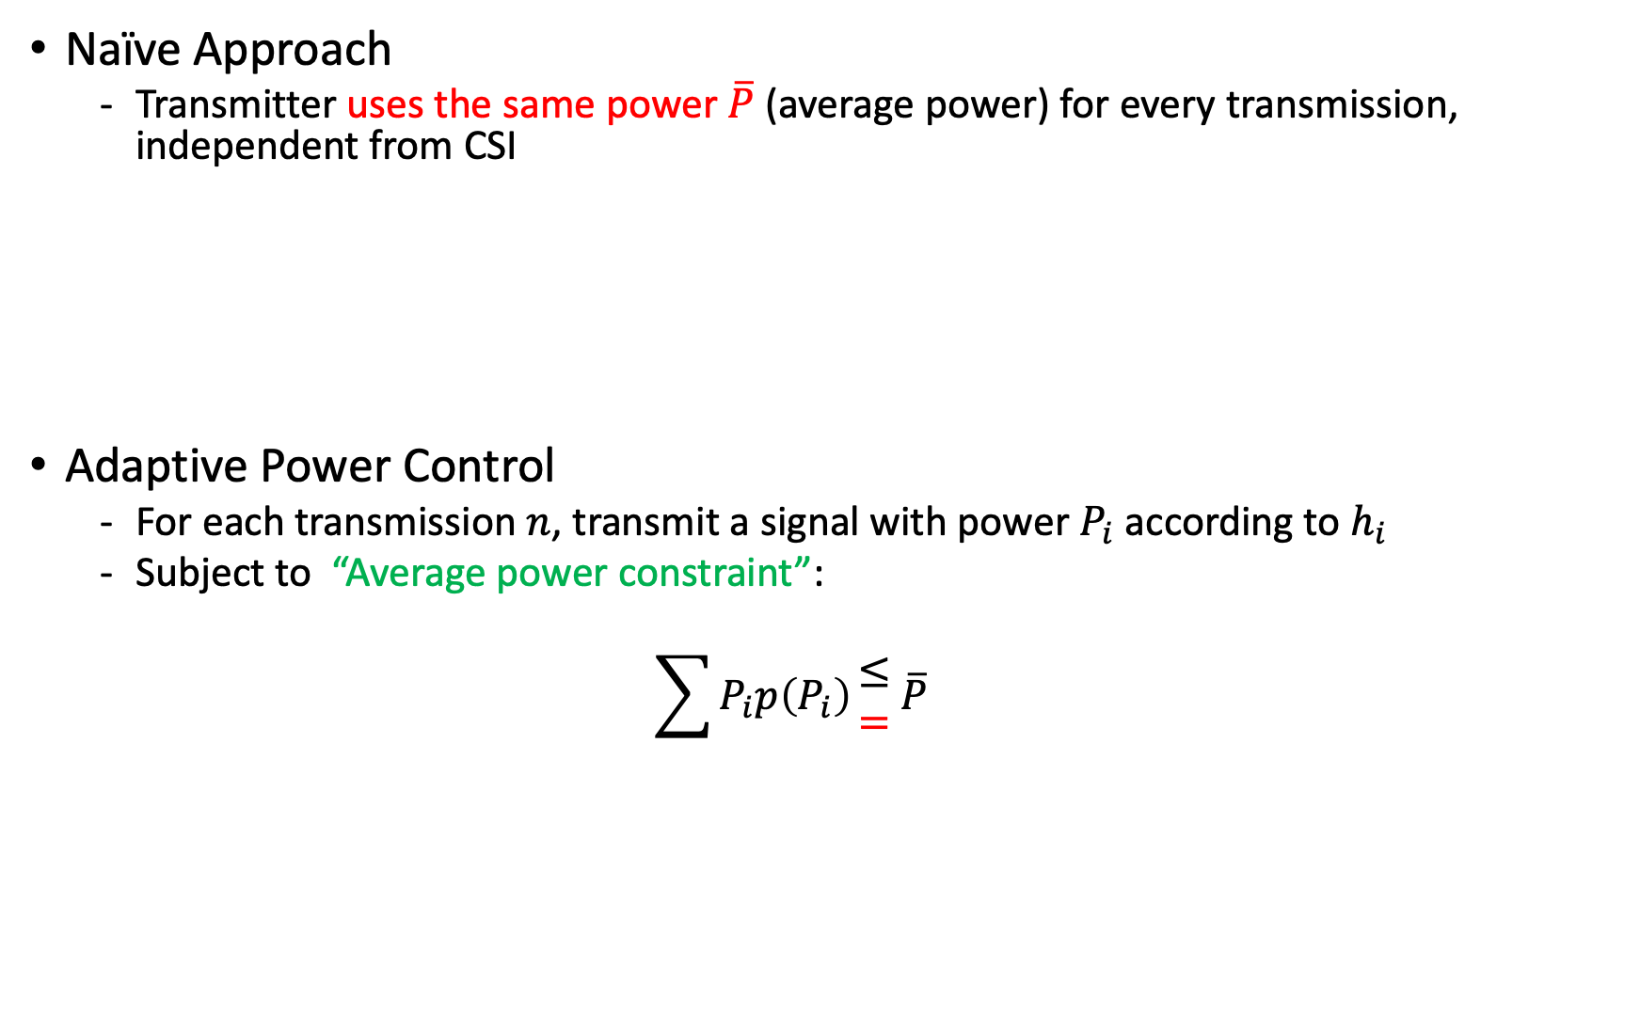
CSI at Both Transmitter and Receiver
Naïve Approach
Transmitter uses the same power $\overline{P}$ (average power) for every transmission, independent from CSI
Adaptive Power Control
For each transmission $n$, transmit a signal with power $P_{i}$ according to $h_{i}$
Subject to “Average power constraint”:
$$\sum{P_{i}p\left(P_{i}\right)}\begin{matrix}≤ \\ =\end{matrix} \overline{P}$$

Slide 13
CSI at Both Transmitter and Receiver
Naïve Approach vs. Adaptive Power Control
Both approaches emply SAME average power
How much GAIN with adaptive power control?
How to “ASSIGN A POWER” for transmission?

Slide 14
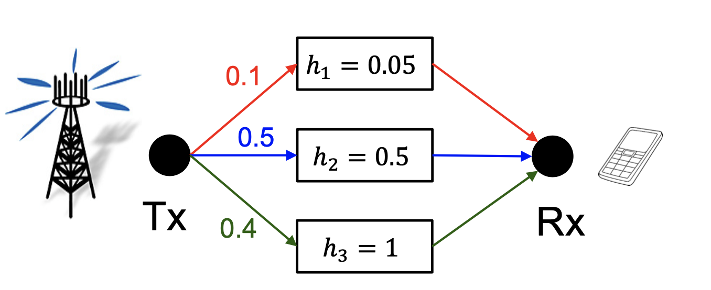

Naïve Approach
Regardless of channels, transmitter uses the same transmit power $\overline{P}$

Slide 15
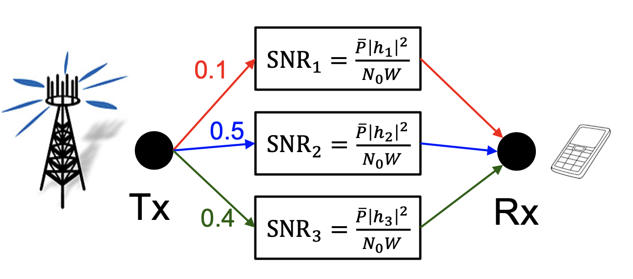
Naïve Approach
Regardless of channels, transmitter uses the same transmit power $\overline{P}$

Slide 16
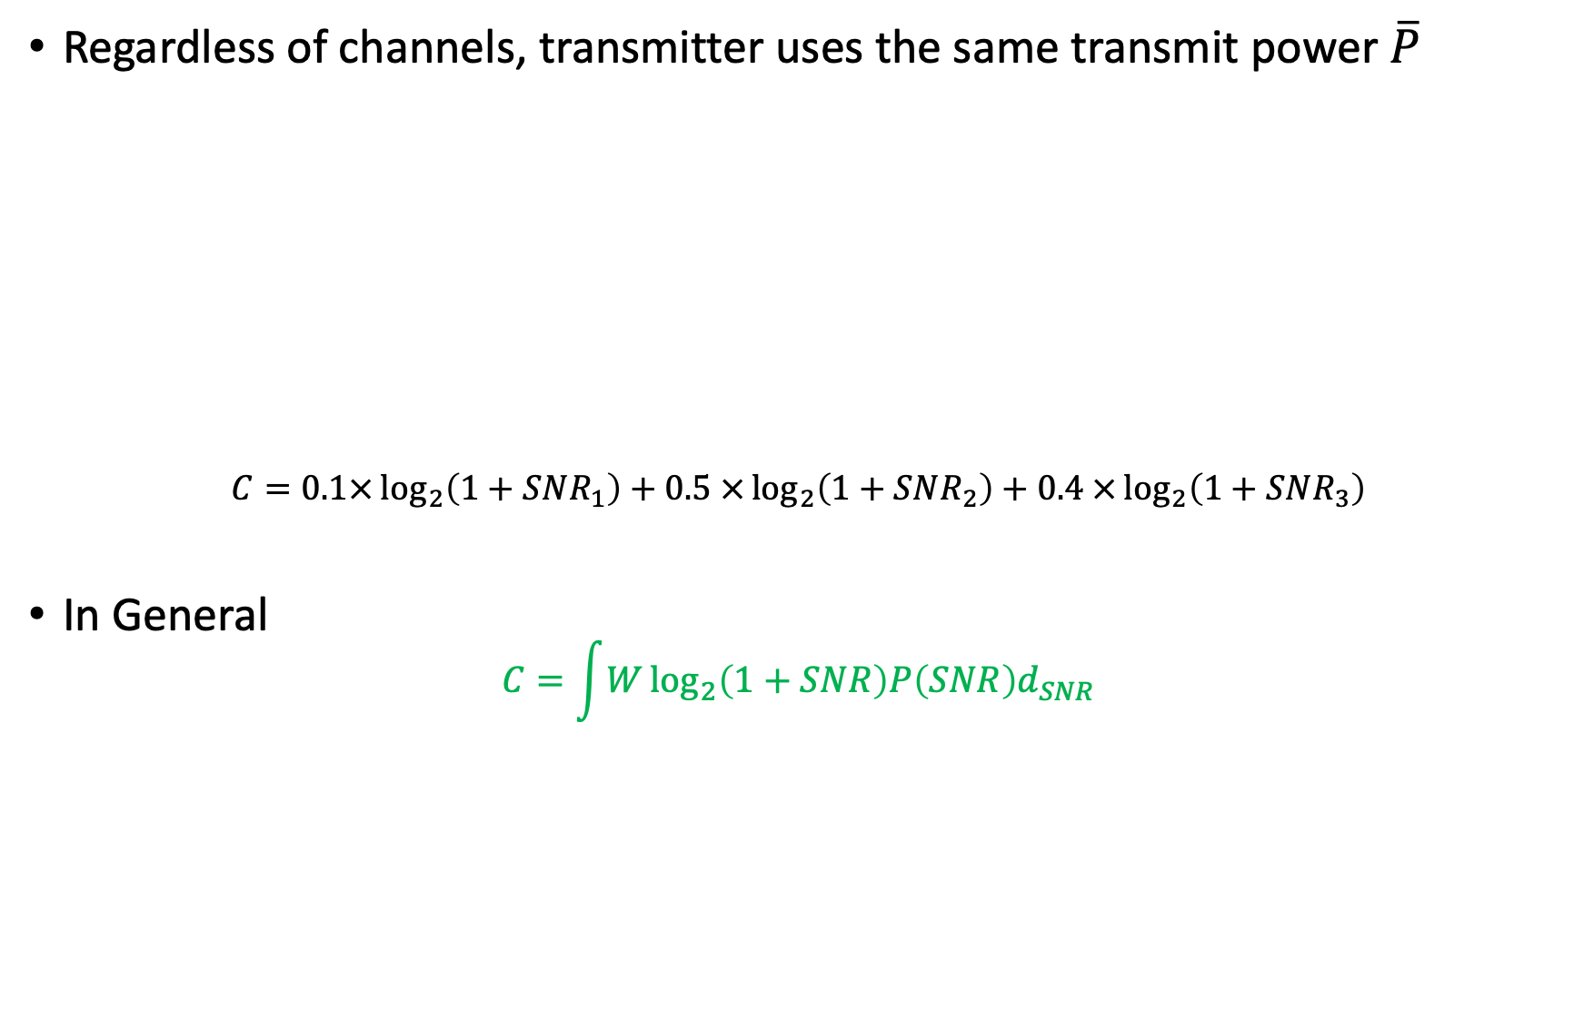
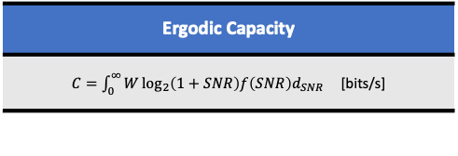
Naïve Approach
Regardless of channels, transmitter uses the same transmit power $\overline{P}$
$$C=0.1×\log_{2}\left(1+SNR_{1}\right)+0.5 ×\log_{2}\left(1+SNR_{2}\right)+0.4 ×\log_{2}\left(1+SNR_{3}\right)$$
In General
$$C=\int{W\log_{2}\left(1+SNR\right)P\left(SNR\right)d_{SNR}}$$
Ergodic Capacity
$C=\int_{0}^{∞}{W\log_{2}\left(1+SNR\right)f\left(SNR\right)d_{SNR}}$ [bits/s]

Slide 17
Naïve Approach
Naïve Approach has no advantage over ergodic capacity
As a result, We need to adapt transmission powers using the knowledge of the Channel Side Information (i.e., the channel loss of the time slot)

Slide 18

Adaptive Power Control
Tx can optimize a transmit power $P_{i}$ according to $h_{i}$ subject to average power constraint $\overline{P}$
Average Power Constraint
$$0.1×P_{1}+0.5×P_{2}+0.3×P_{3}=\overline{P}$$

Slide 19
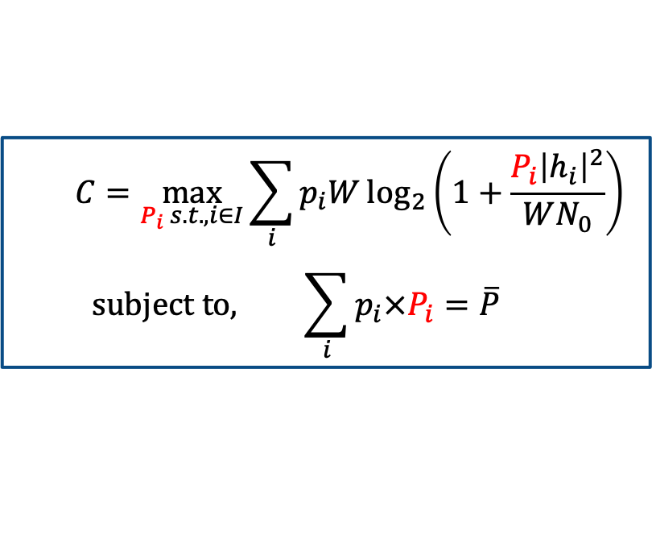
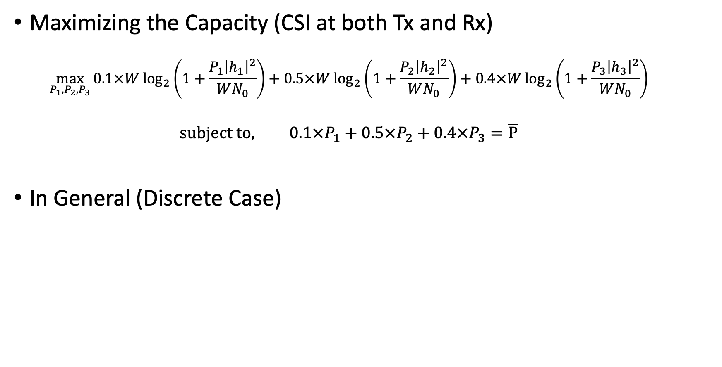

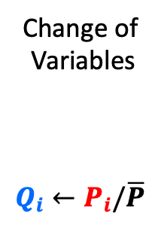

Adaptive Power Control
Maximizing the Capacity (CSI at both Tx and Rx)
$$\max_{P_{1},P_{2},P_{3}}{0.1×W\log_{2}\left(1+\frac{P_{1}{\left|h_{1}\right|}^{2}}{WN_{0}}\right)+0.5×W\log_{2}\left(1+\frac{P_{2}{\left|h_{2}\right|}^{2}}{WN_{0}}\right)+0.4×W\log_{2}\left(1+\frac{P_{3}{\left|h_{3}\right|}^{2}}{WN_{0}}\right)}$$
$$subject to, 0.1×P_{1}+0.5×P_{2}+0.4×P_{3}=\overline{P}$$
In General (Discrete Case)
$$P_{i}$$
$$C=\max_{P_{i} s.t., i∈I}{\sum_{i}{p_{i}W\log_{2}\left(1+\frac{P_{i}{\left|h_{i}\right|}^{2}}{WN_{0}}\right)}}$$
$$subject to, \sum_{i}{p_{i}×P_{i}=\overline{P}}$$
Change of
Variables
$$Q_{i}←P_{i}/\overline{P}$$
$$C=\max_{Q_{i} s.t., i∈I}{\sum_{i}{p_{i}W\log_{2}\left(1+\frac{Q_{i}\overline{P}{\left|h_{i}\right|}^{2}}{WN_{0}}\right)}}$$
$$subject to, \sum_{i}{p_{i}×Q_{i}=1}$$

Slide 20
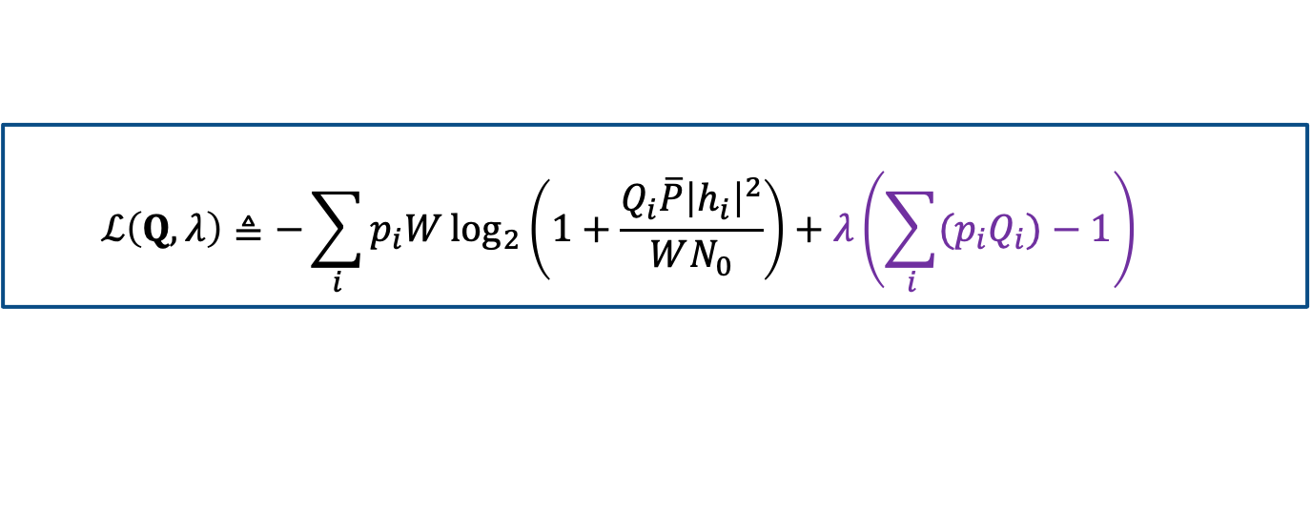
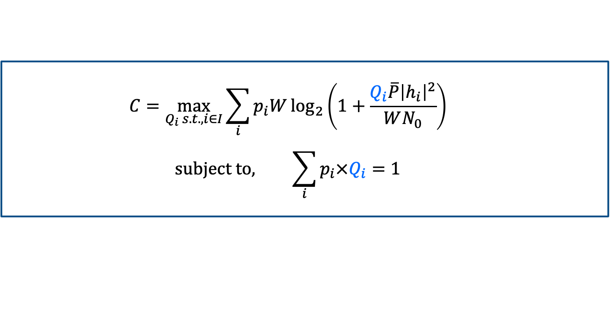
Adaptive Power Control
Capacity (CSI at both transmitter and receiver)
The Lagrangian Method
$$C=\max_{Q_{i} s.t., i∈I}{\sum_{i}{p_{i}W\log_{2}\left(1+\frac{Q_{i}\overline{P}{\left|h_{i}\right|}^{2}}{WN_{0}}\right)}}$$
$$subject to, \sum_{i}{p_{i}×Q_{i}=1}$$
$$ℒ\left(Q,λ\right)≜−\sum_{i}{p_{i}W\log_{2}\left(1+\frac{Q_{i}\overline{P}{\left|h_{i}\right|}^{2}}{WN_{0}}\right)}+λ\left(\sum_{i}{{(p}_{i}Q_{i})}−1\right)$$
Always convex

Slide 21

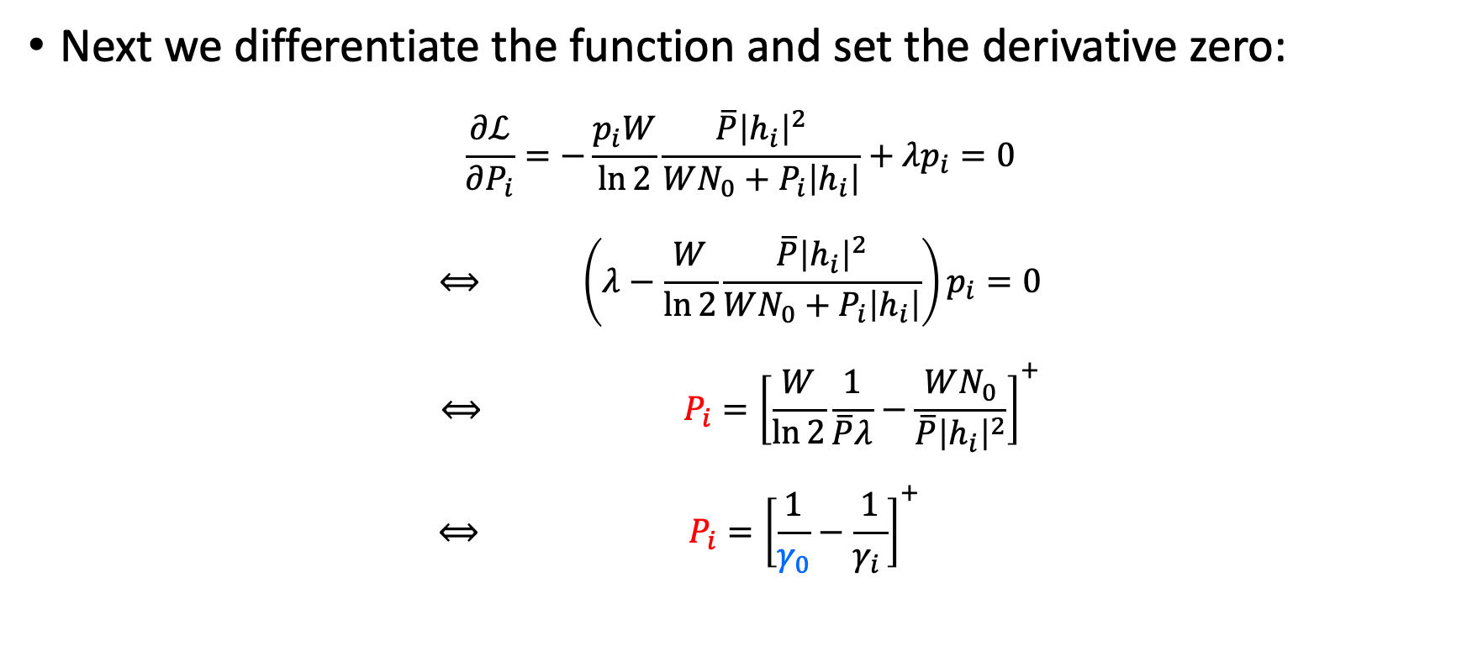
Adaptive Power Control
Next we differentiate the function and set the derivative zero:
$$\frac{∂ℒ}{∂P_{i}}=−\frac{p_{i}W}{\ln{2}}\frac{\overline{P}{\left|h_{i}\right|}^{2}}{WN_{0}+P_{i}\left|h_{i}\right|}+λp_{i}=0$$
$$⟺ \left(λ−\frac{W}{\ln{2}}\frac{\overline{P}{\left|h_{i}\right|}^{2}}{WN_{0}+P_{i}\left|h_{i}\right|}\right)p_{i}=0$$
$$⟺ P_{i}={\left[\frac{W}{\ln{2}}\frac{1}{\overline{P}λ}−\frac{WN_{0}}{\overline{P}{\left|h_{i}\right|}^{2}}\right]}^{+}$$
$$⟺ P_{i}={\left[\frac{1}{γ_{0}}−\frac{1}{γ_{i }}\right]}^{+}$$
$$\left(∵P_{i}≥0\right)$$

Slide 22


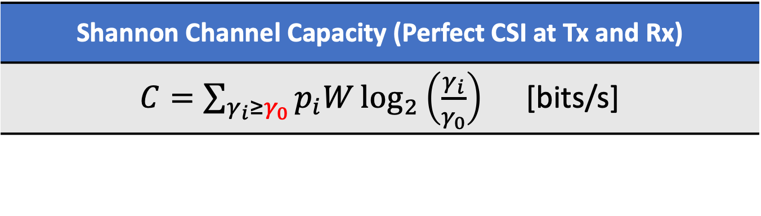
Adaptive Power Control
Finding the optimal transmit powers
Finding the cut-off SNR $γ_{0}$ to satisfy
$$\sum_{γ_{i}≥γ_{0}}{\left(\frac{1}{γ_{0}}−\frac{1}{γ_{i}}\right)p_{i}=1 }$$
GOOD Channel Condition
$→$More power and a higher data rate are sent over the channel
Shannon Channel Capacity (Perfect CSI at Tx and Rx)
$C=\sum_{γ_{i}≥γ_{0}}{p_{i}W\log_{2}\left(\frac{γ_{i}}{γ_{0}}\right)}$ [bits/s]

Slide 23
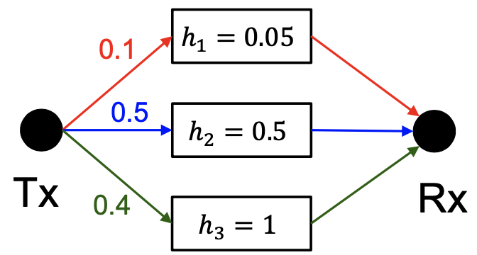

Adaptive Power Control
Example
$\overline{P}=0.01W, N_{0}={10}^{−9}W/Hz$, $W=30kHz$
What is the capacity when CSI is available at both transmitter and receiver?

Slide 24
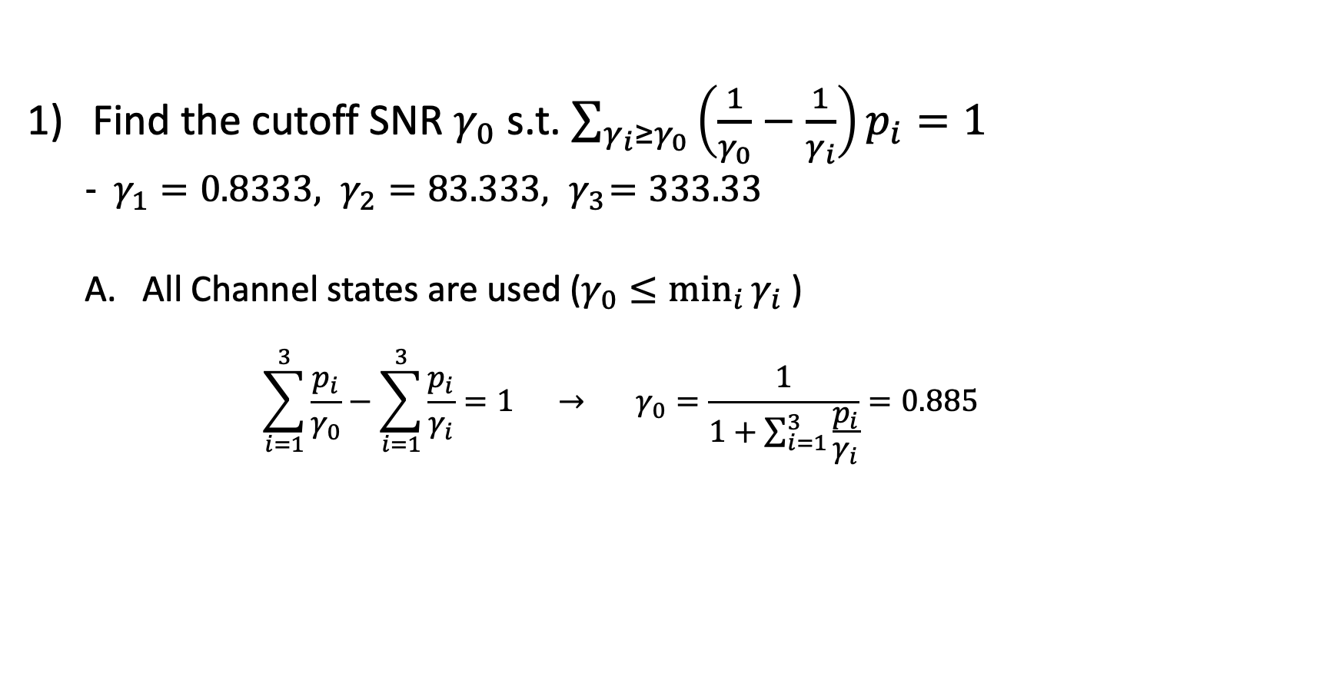
Adaptive Power Control
Find the cutoff SNR $γ_{0}$ s.t. $\sum_{γ_{i}≥γ_{0}}{\left(\frac{1}{γ_{0}}−\frac{1}{γ_{i}}\right)p_{i}=1}$
$γ_{1}=0.8333, γ_{2}=83.333, { γ}_{3}=333.33$
All Channel states are used ($γ_{0}≤\min_{i}{γ_{i} }$)
$$\sum_{i=1}^{3}{\frac{p_{i}}{γ_{0}}}−\sum_{i=1}^{3}{\frac{p_{i}}{γ_{i}}}=1 → γ_{0}=\frac{1}{1+\sum_{i=1}^{3}{\frac{p_{i}}{γ_{i}}}}=0.885$$

Slide 25
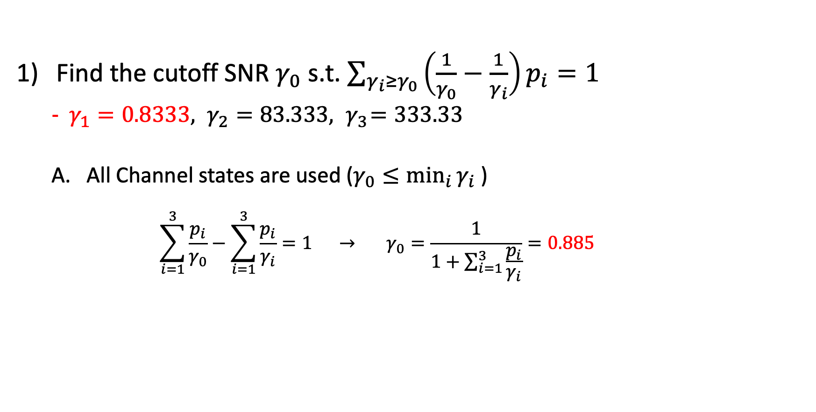
Adaptive Power Control
Find the cutoff SNR $γ_{0}$ s.t. $\sum_{γ_{i}≥γ_{0}}{\left(\frac{1}{γ_{0}}−\frac{1}{γ_{i}}\right)p_{i}=1}$
$γ_{1}=0.8333, γ_{2}=83.333, { γ}_{3}=333.33$
All Channel states are used ($γ_{0}≤\min_{i}{γ_{i} }$)
$$\sum_{i=1}^{3}{\frac{p_{i}}{γ_{0}}}−\sum_{i=1}^{3}{\frac{p_{i}}{γ_{i}}}=1 → γ_{0}=\frac{1}{1+\sum_{i=1}^{3}{\frac{p_{i}}{γ_{i}}}}=0.885$$

Slide 26

Adaptive Power Control
Find the cutoff SNR $γ_{0}$ s.t. $\sum_{γ_{i}≥γ_{0}}{\left(\frac{1}{γ_{0}}−\frac{1}{γ_{i}}\right)p_{i}=1}$
$γ_{1}=0.8333, γ_{2}=83.333, { γ}_{3}=333.33$
All Channel states are used ($γ_{0}≤\min_{i}{γ_{i} }$)
$$\sum_{i=1}^{3}{\frac{p_{i}}{γ_{0}}}−\sum_{i=1}^{3}{\frac{p_{i}}{γ_{i}}}=1 → γ_{0}=\frac{1}{1+\sum_{i=1}^{3}{\frac{p_{i}}{γ_{i}}}}=0.885$$
$$γ_{0}≤\min_{i}{γ_{i}}$$

Slide 27
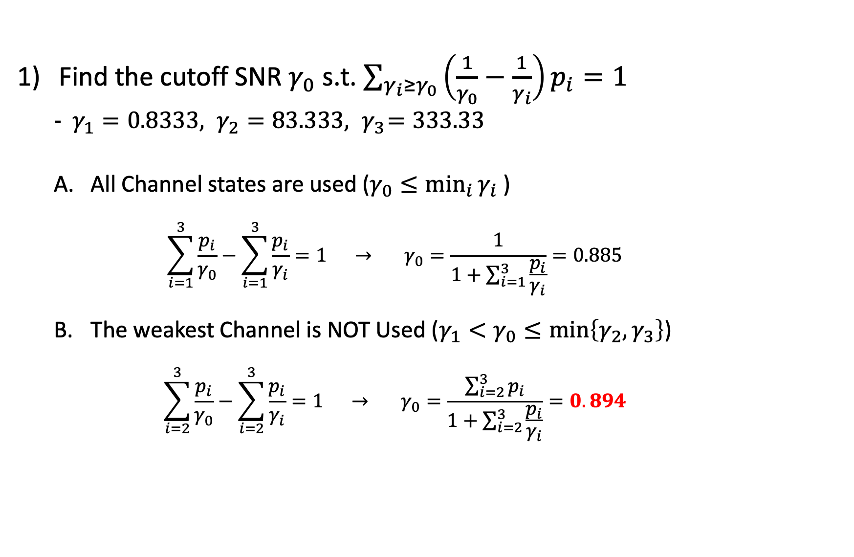
Adaptive Power Control
Find the cutoff SNR $γ_{0}$ s.t. $\sum_{γ_{i}≥γ_{0}}{\left(\frac{1}{γ_{0}}−\frac{1}{γ_{i}}\right)p_{i}=1}$
$γ_{1}=0.8333, γ_{2}=83.333, { γ}_{3}=333.33$
All Channel states are used ($γ_{0}≤\min_{i}{γ_{i} }$)
$$\sum_{i=1}^{3}{\frac{p_{i}}{γ_{0}}}−\sum_{i=1}^{3}{\frac{p_{i}}{γ_{i}}}=1 → γ_{0}=\frac{1}{1+\sum_{i=1}^{3}{\frac{p_{i}}{γ_{i}}}}=0.885$$
The weakest Channel is NOT Used ($γ_{1}<γ_{0}≤\min\left\{γ_{2},γ_{3}\right\}$)
$$\sum_{i=2}^{3}{\frac{p_{i}}{γ_{0}}}−\sum_{i=2}^{3}{\frac{p_{i}}{γ_{i}}}=1 → γ_{0}=\frac{\sum_{i=2}^{3}{p_{i}}}{1+\sum_{i=2}^{3}{\frac{p_{i}}{γ_{i}}}}=0.894$$

Slide 28
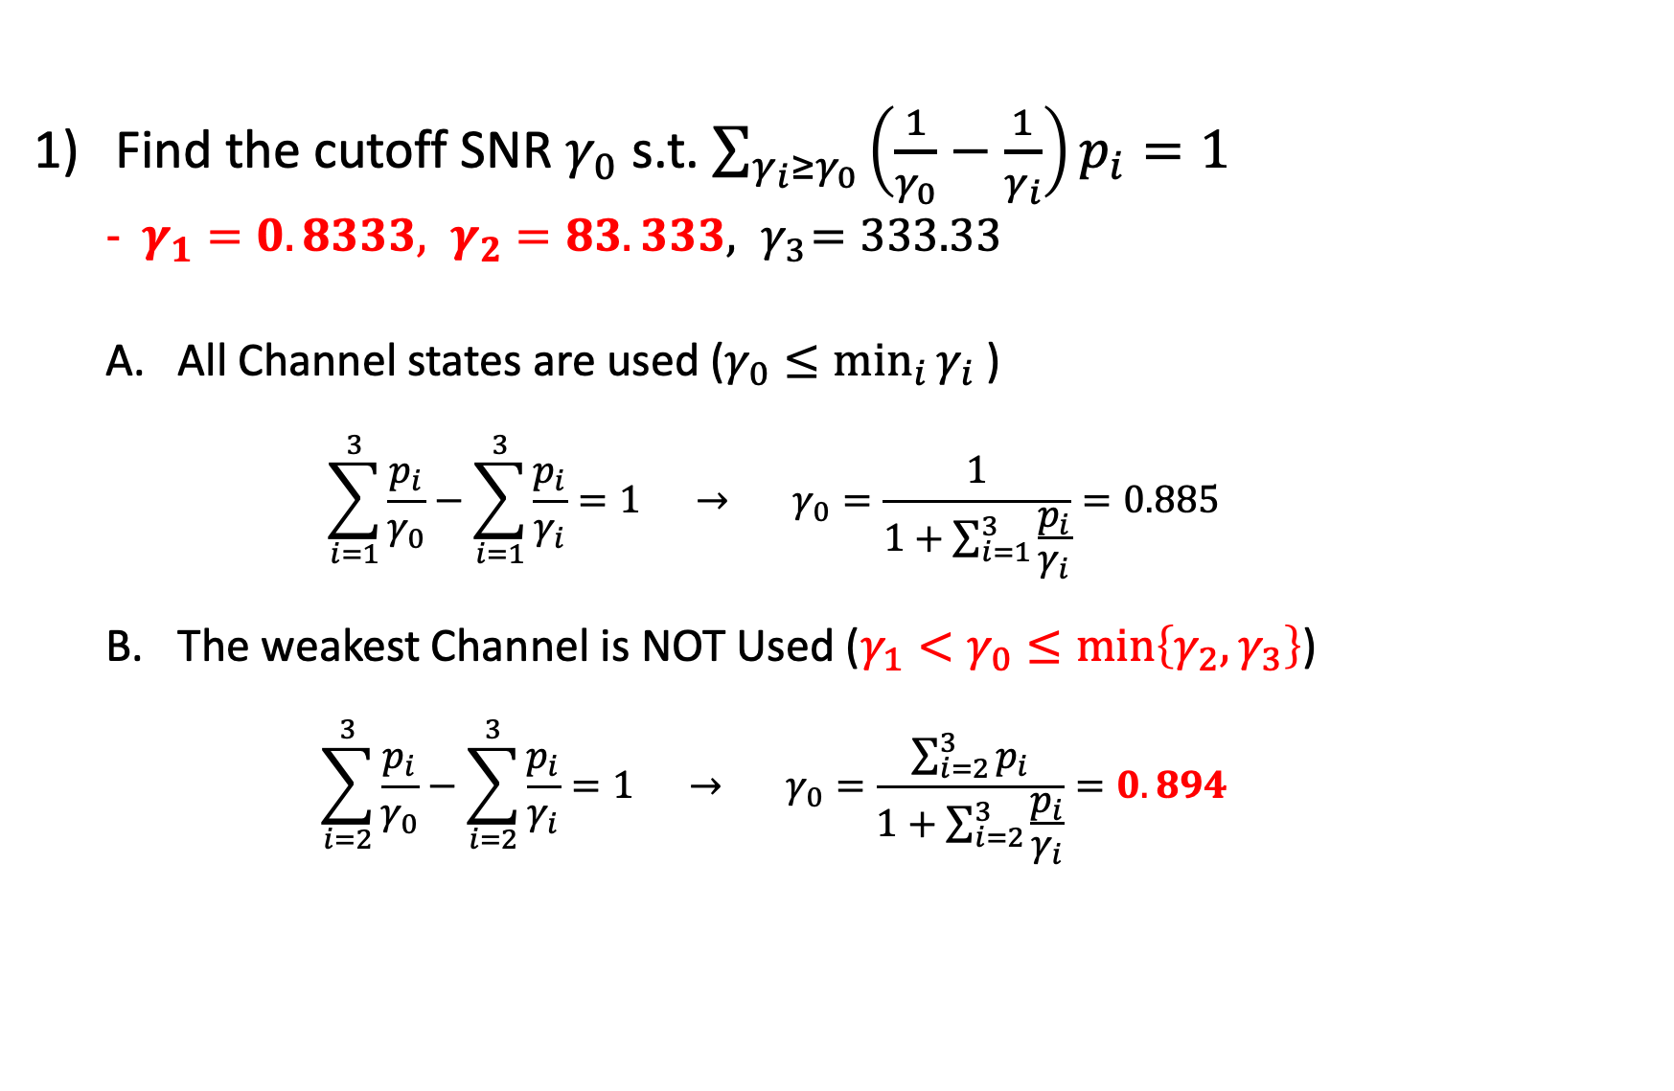
Adaptive Power Control
Find the cutoff SNR $γ_{0}$ s.t. $\sum_{γ_{i}≥γ_{0}}{\left(\frac{1}{γ_{0}}−\frac{1}{γ_{i}}\right)p_{i}=1}$
$γ_{1}=0.8333, γ_{2}=83.333, { γ}_{3}=333.33$
All Channel states are used ($γ_{0}≤\min_{i}{γ_{i} }$)
$$\sum_{i=1}^{3}{\frac{p_{i}}{γ_{0}}}−\sum_{i=1}^{3}{\frac{p_{i}}{γ_{i}}}=1 → γ_{0}=\frac{1}{1+\sum_{i=1}^{3}{\frac{p_{i}}{γ_{i}}}}=0.885$$
The weakest Channel is NOT Used ($γ_{1}<γ_{0}≤\min\left\{γ_{2},γ_{3}\right\}$)
$$\sum_{i=2}^{3}{\frac{p_{i}}{γ_{0}}}−\sum_{i=2}^{3}{\frac{p_{i}}{γ_{i}}}=1 → γ_{0}=\frac{\sum_{i=2}^{3}{p_{i}}}{1+\sum_{i=2}^{3}{\frac{p_{i}}{γ_{i}}}}=0.894$$

Slide 29
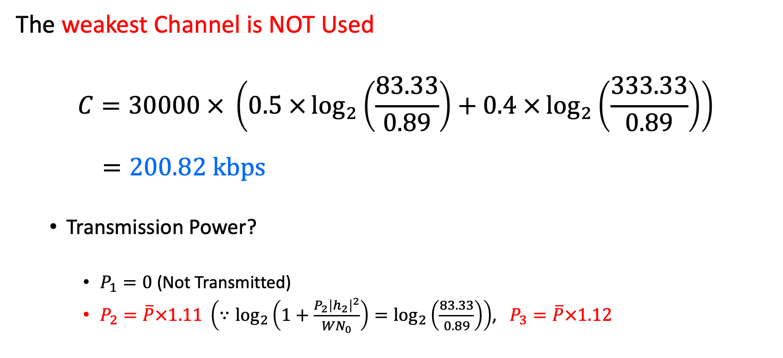
Adaptive Power Control
The weakest Channel is NOT Used
$$C=30000 × \left(0.5 ×\log_{2}\left(\frac{83.33}{0.89}\right)+0.4 ×\log_{2}\left(\frac{333.33}{0.89}\right)\right)$$
$$=200.82 kbps$$
Transmission Power?
$P_{1}=0$ (Not Transmitted)
$P_{2}=\overline{P}×1.11 \left(∵\log_{2}\left(1+\frac{P_{2}{\left|h_{2}\right|}^{2}}{WN_{0}}\right)=\log_{2}\left(\frac{83.33}{0.89}\right)\right)$, $P_{3}=\overline{P}×1.12$

Slide 30

Adaptive Power Control
Using the Optimal Power Control Method
Practical Issues remaining!
Shannon Channel Capacity (Perfect CSI at Tx and Rx)
$C=\sum_{γ_{i}≥γ_{0}}{p_{i}W\log_{2}\left(\frac{γ_{i}}{γ_{0}}\right)}$ [bits/s]

Slide 31
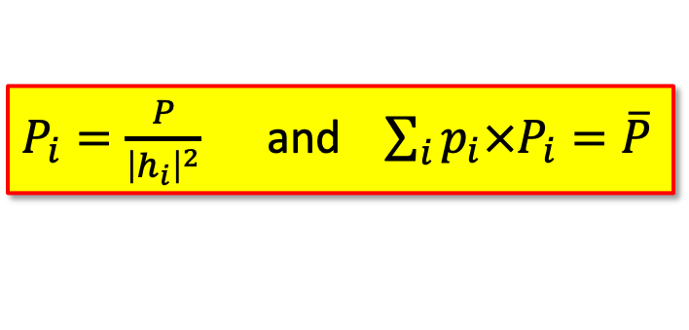
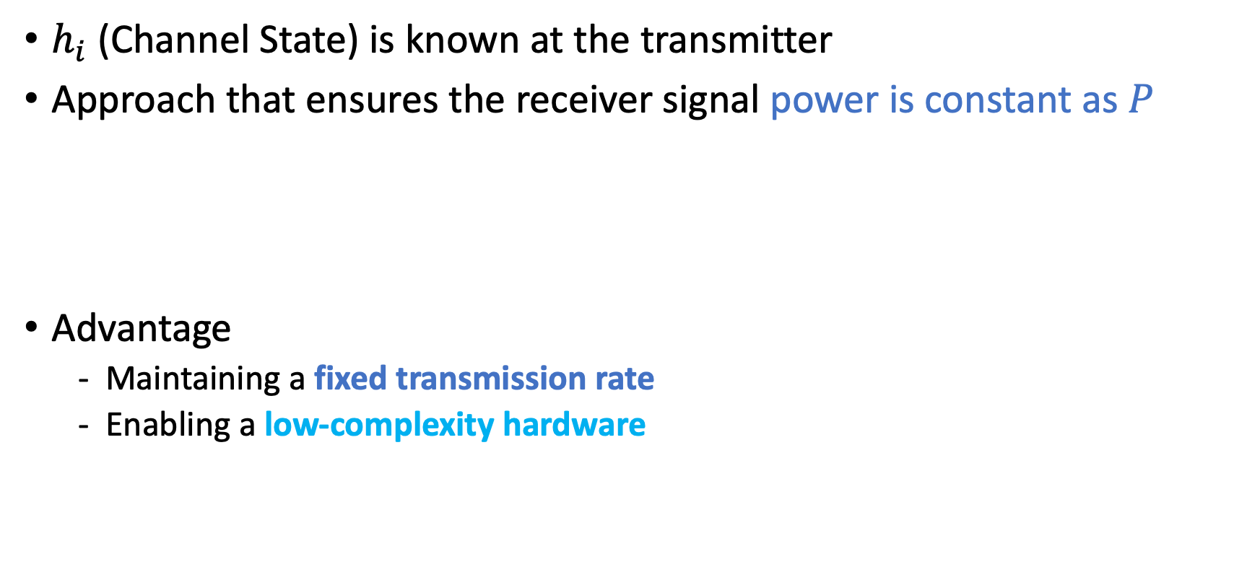
Channel Inversion
$h_{i}$ (Channel State) is known at the transmitter
Approach that ensures the receiver signal power is constant as $P$
Advantage
Maintaining a fixed transmission rate
Enabling a low-complexity hardware
$P_{i}=\frac{P}{{\left|h_{i}\right|}^{2}}$ and $\sum_{i}{p_{i}×P_{i}}=\overline{P}$

Slide 32
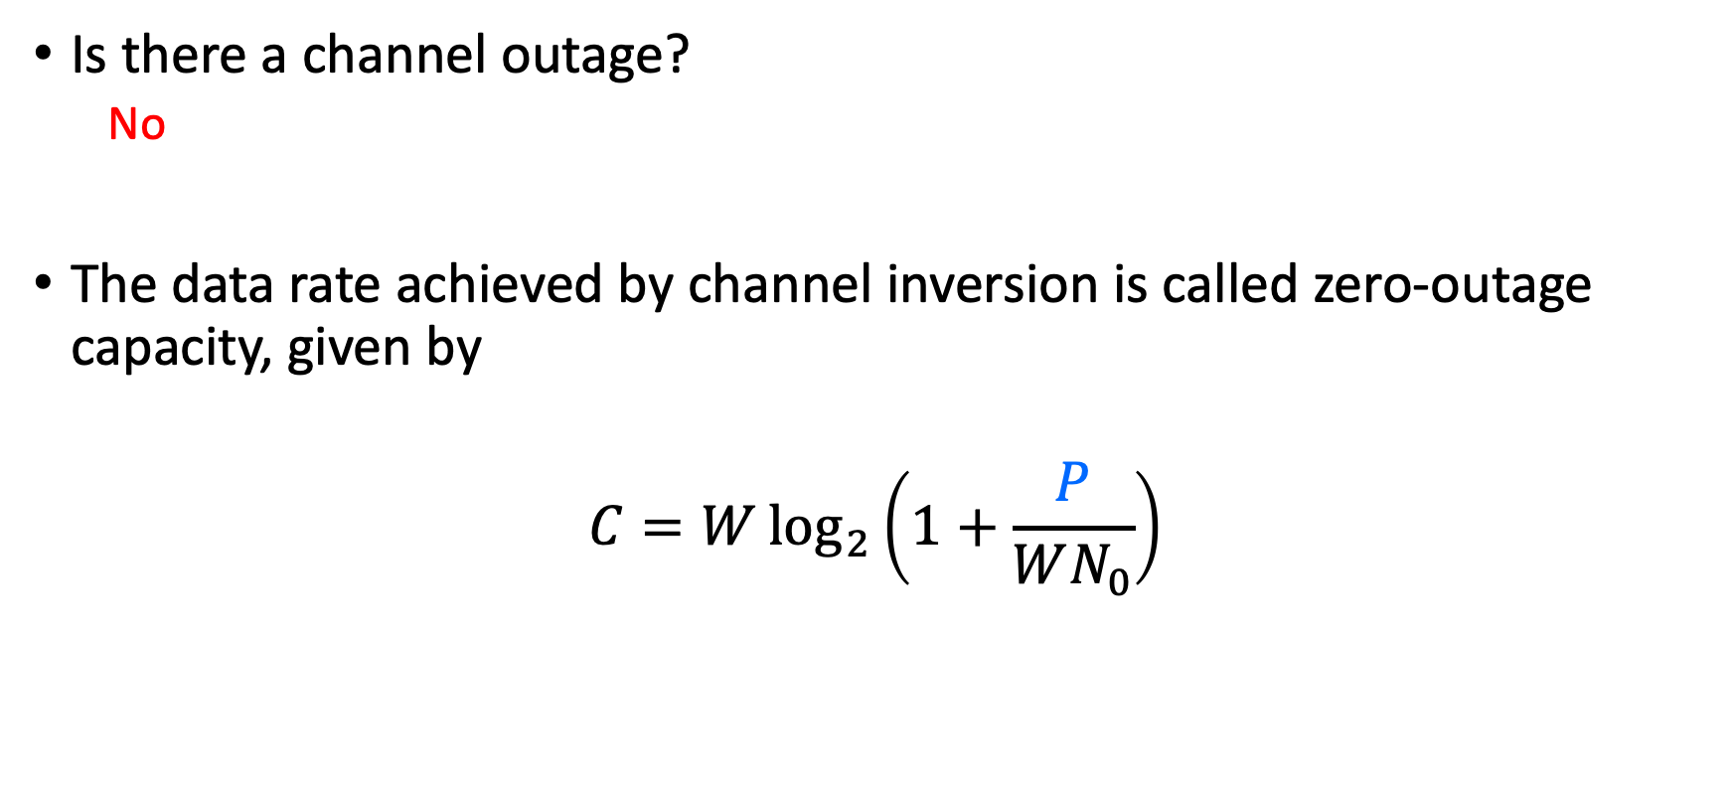
Channel Inversion
Is there a channel outage?
No
The data rate achieved by channel inversion is called zero-outage capacity, given by
$$C=W\log_{2}\left(1+\frac{P}{WN_{0}}\right)$$
Constant Received Power

Slide 33
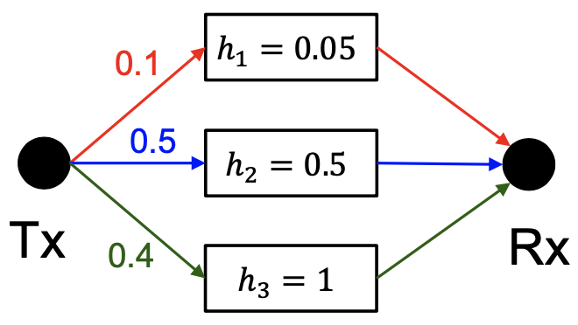

Channel Inversion
$\overline{P}=0.01 W$, $N_{0}={10}^{−9} W/Hz$, $W=30kHz$
Find a zero-outage capacity

Slide 34

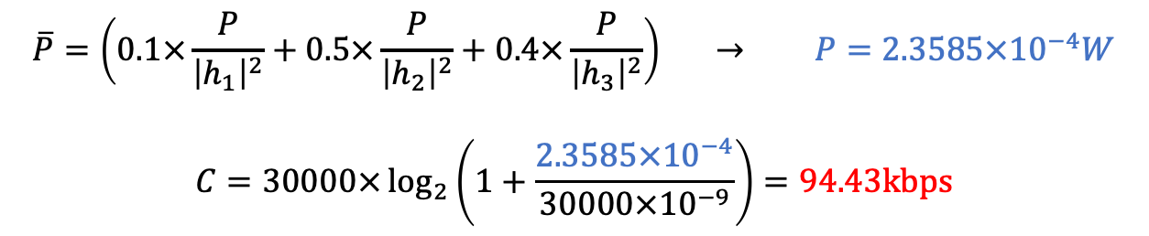
Channel Inversion
$\overline{P}=0.01 W$, $N_{0}={10}^{−9} W/Hz$, $W=30kHz$
Find a zero-outage capacity
$$\overline{P}=\left(0.1×\frac{P}{{\left|h_{1}\right|}^{2}}+0.5×\frac{P}{{\left|h_{2}\right|}^{2}}+0.4×\frac{P}{{\left|h_{3}\right|}^{2}}\right) → P=2.3585×{10}^{−4}W$$
$$C=30000×\log_{2}\left(1+\frac{2.3585×{10}^{−4}}{30000×{10}^{−9}}\right)=94.43kbps$$

Slide 35
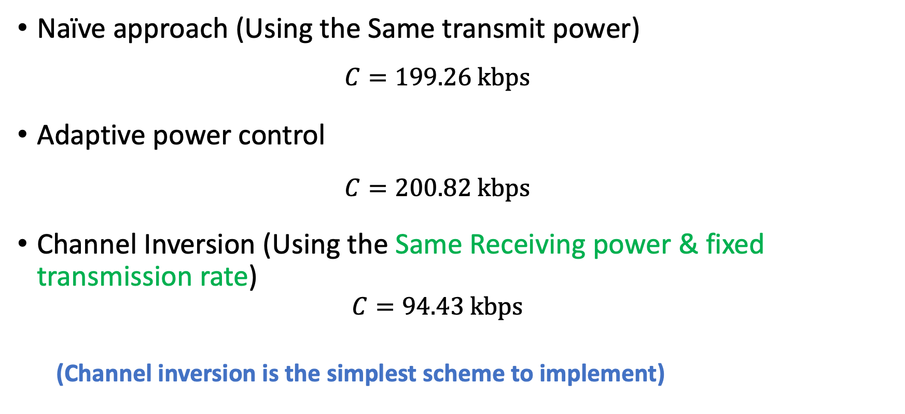
Comparison
Naïve approach (Using the Same transmit power)
$$C=199.26 kbps$$
Adaptive power control
$$C=200.82 kbps$$
Channel Inversion (Using the Same Receiving power & fixed transmission rate)
$$C=94.43 kbps$$
(Channel inversion is the simplest scheme to implement)

Slide 36

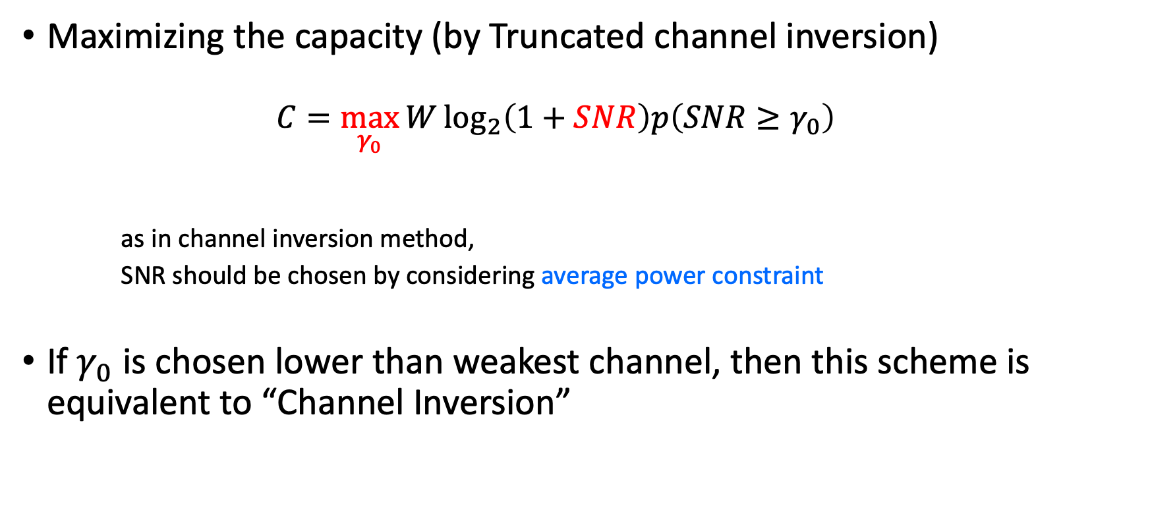
Truncated Channel Inversion
Maximizing the capacity (by Truncated channel inversion)
$$C=\max_{γ_{0}}{W\log_{2}\left(1+SNR\right)p\left(SNR≥γ_{0}\right)}$$
as in channel inversion method,
SNR should be chosen by considering average power constraint
If $γ_{0}$ is chosen lower than weakest channel, then this scheme is equivalent to “Channel Inversion”
“SNR is chosen as a function of $γ_{0}$”

Slide 37
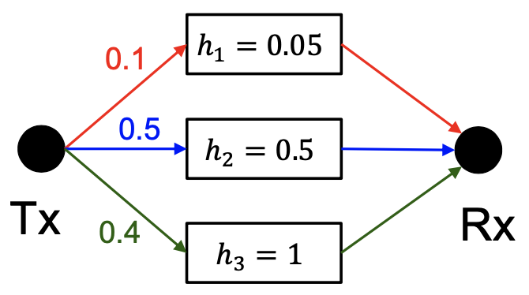

Truncated Channel Inversion
$\overline{P}=0.01W, N_{0}={10}^{−9} W/Hz$ , $W=30kHz$
Maximize the Capacity by Truncated Channel Inversion

Slide 38
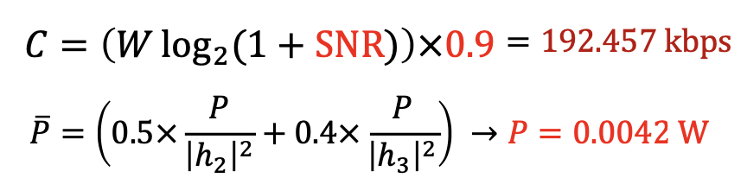

Truncated Channel Inversion
$\overline{P}=0.01W, N_{0}={10}^{−9} W/Hz$ , $W=30kHz$
Maximize the Capacity by Truncated Channel Inversion
CASE1) Assume “no transmission” at channel $h_{1}$

Slide 39
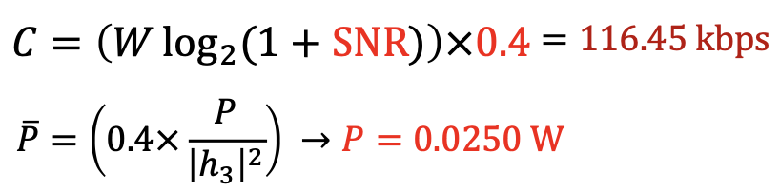

Truncated Channel Inversion
$\overline{P}=0.01W, N_{0}={10}^{−9} W/Hz$ , $W=30kHz$
Maximize the Capacity by Truncated Channel Inversion
CASE2) Assume “no transmission” at channel $h_{1}$ and $h_{2}$

Slide 40
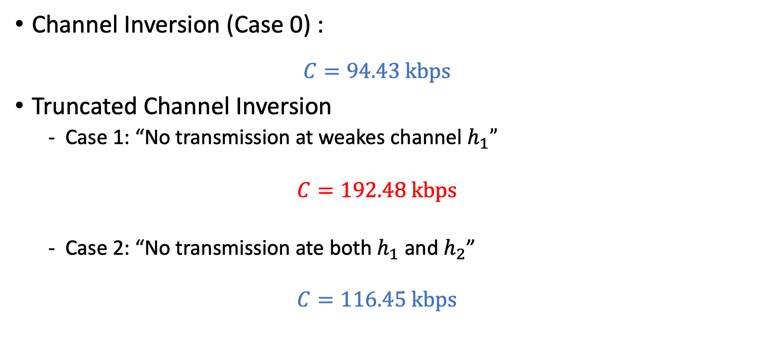
Comparison
Channel Inversion (Case 0) :
$$C=94.43 kbps$$
Truncated Channel Inversion
Case 1: “No transmission at weakes channel $h_{1}”$
$$C=192.48 kbps$$
Case 2: “No transmission ate both $h_{1}$ and $h_{2}$”
$$C=116.45 kbps$$

Slide 41
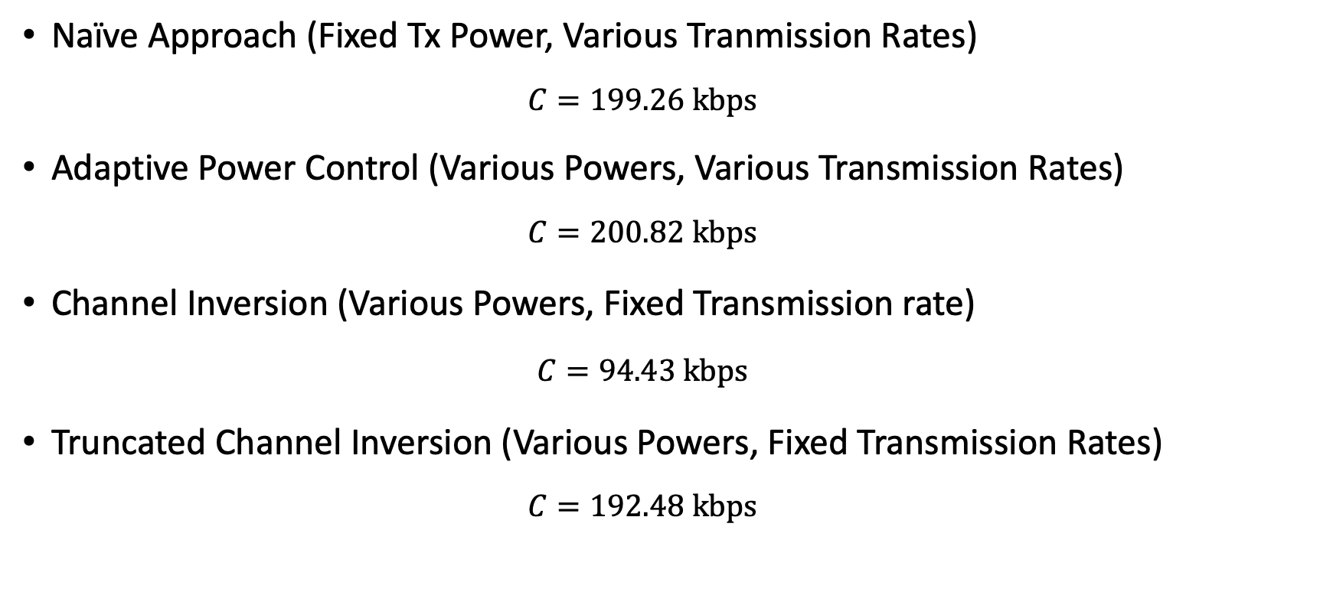
Final Comparison
Naïve Approach (Fixed Tx Power, Various Tranmission Rates)
$$C=199.26 kbps$$
Adaptive Power Control (Various Powers, Various Transmission Rates)
$$C=200.82 kbps$$
Channel Inversion (Various Powers, Fixed Transmission rate)
$$C=94.43 kbps$$
Truncated Channel Inversion (Various Powers, Fixed Transmission Rates)
$$C=192.48 kbps$$
“Optimal Performance”
“Good Practical Approach”

Slide 42
Thank You

