Slide 1
Wireless Communications Seminar 07
Sungweon Hong
Information and Intelligent systems lab
Hanyang university
Department of Electronic Engineering

Slide 2
Contents
QAM
Diversity Combining
Receiver Diversity
Transmit Diversity

Slide 3
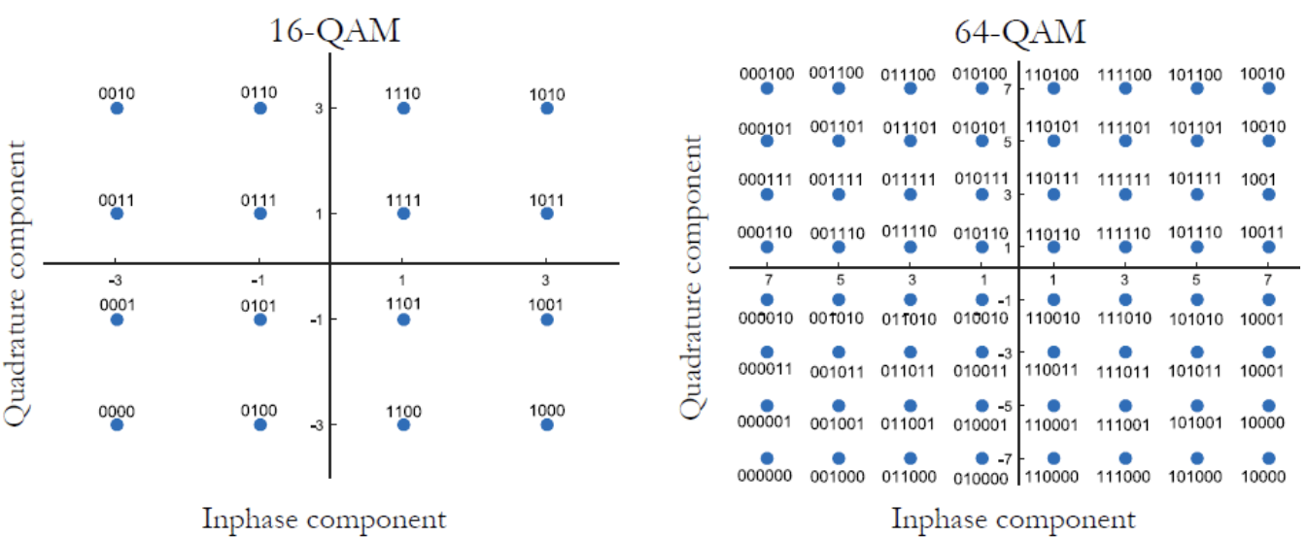
Quadrature Amplitude Modulation
(QAM)

Slide 4
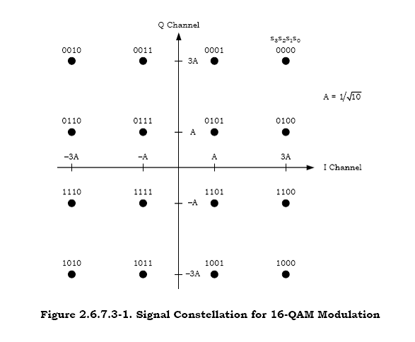
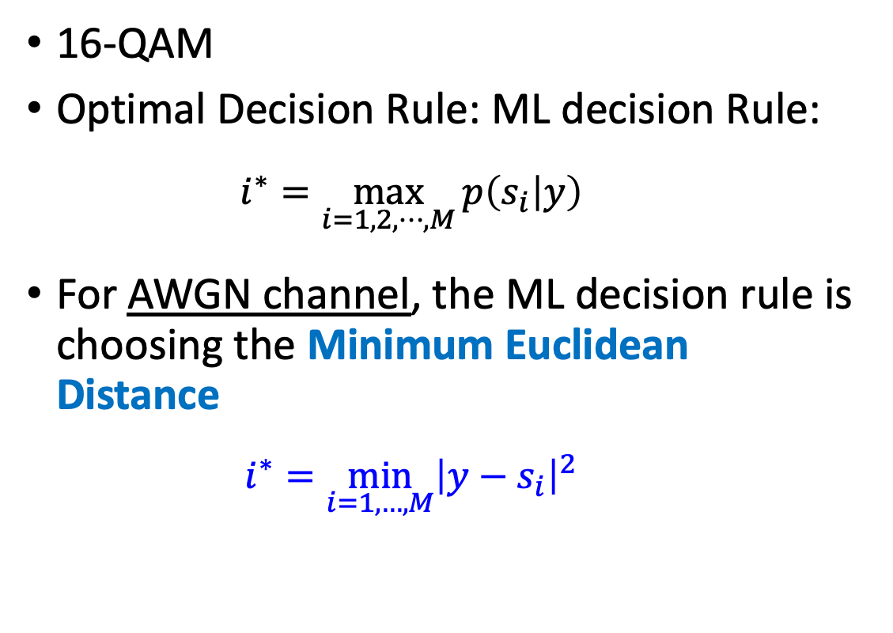
QAM
16-QAM
Optimal Decision Rule: ML decision Rule:
$$i^{∗}=\max_{i=1,2,⋯,M}{p\left(s_{i} | y\right)}$$
For AWGN channel, the ML decision rule is choosing the Minimum Euclidean Distance
$$i^{∗}=\min_{i=1,…,M}{{\left|y−s_{i}\right|}^{2}}$$

Slide 5

QAM
For AWGN channel, the ML decision rule is choosing the Minimum Euclidean Distance
$$i^{∗}=\min_{i=1,…,M}{{\left|y−s_{i}\right|}^{2}}$$

Slide 6
QAM
Error Probability Analysis
16-QAM modulation
Minimum Distance Detection
$$s_{5}$$
$$y$$

Slide 7
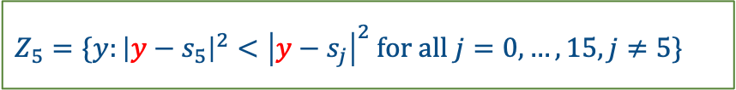
QAM
$Z_{5}=\{y:{\left|y−s_{5}\right|}^{2}<{\left|y−s_{j}\right|}^{2} for all j=0,…,15, j≠5\}$
Type-I
$$s_{5}$$
$$y$$

Slide 8
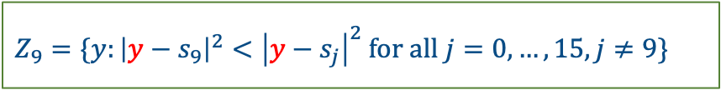
QAM
$Z_{9}=\{y:{\left|y−s_{9}\right|}^{2}<{\left|y−s_{j}\right|}^{2} for all j=0,…,15, j≠9\}$
Type-II
$$y$$
$$s_{9}$$

Slide 9
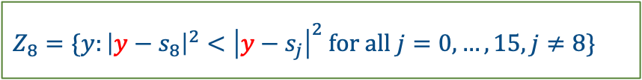
QAM
$Z_{8}=\{y:{\left|y−s_{8}\right|}^{2}<{\left|y−s_{j}\right|}^{2} for all j=0,…,15, j≠8\}$
Type-III
$$s_{8}$$
$$y$$

Slide 10

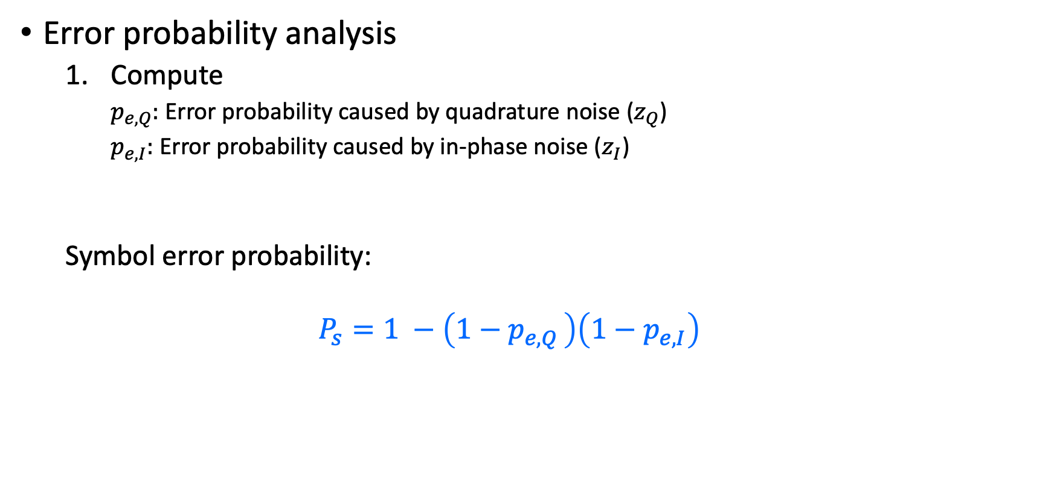
QAM
Error probability analysis
Compute
$p_{e,Q}:$ Error probability caused by quadrature noise ($z_{Q}$)
$p_{e,I}:$ Error probability caused by in-phase noise ($z_{I}$)
Symbol error probability:
$$P_{s}=1 −\left(1−p_{e,Q }\right)\left(1−p_{e,I}\right)$$
$∵$ statistically independent

Slide 11



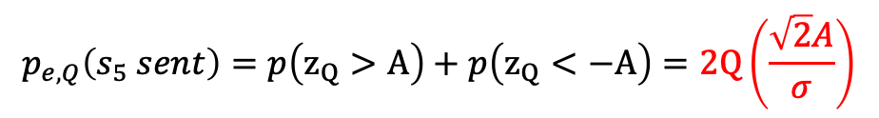

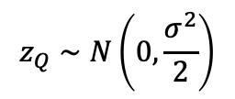

QAM
$$A$$
$$−A$$
$$s_{5}$$
$$A$$
Type-I
$$−A$$
$$z_{Q}∼N\left(0,\frac{σ^{2}}{2}\right)$$
$$s_{5}$$
$$y$$
$$p_{e,Q}\left(s_{5} sent\right)=p\left(z_{Q}>A\right)+p\left(z_{Q}<−A\right)=2Q\left(\frac{\sqrt{2}A}{σ}\right)$$

Slide 12



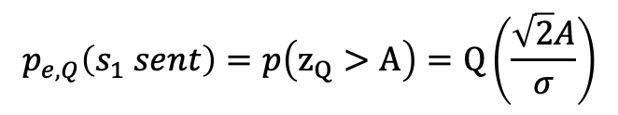

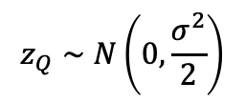

QAM
$$A$$
$$−A$$
$$s_{9}$$
$$A$$
$$−A$$
$$z_{Q}∼N\left(0,\frac{σ^{2}}{2}\right)$$
Type-II
$$p_{e,Q}\left(s_{1} sent\right)=p\left(z_{Q}>A\right)=Q\left(\frac{\sqrt{2}A}{σ}\right)$$
$$y$$
$$s_{9}$$

Slide 13
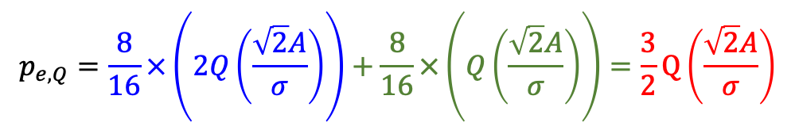
QAM
$$p_{e,Q}=\frac{8}{16}×\left(2Q\left(\frac{\sqrt{2}A}{σ}\right)\right)+\frac{8}{16}×\left(Q\left(\frac{\sqrt{2}A}{σ}\right)\right)=\frac{3}{2}Q\left(\frac{\sqrt{2}A}{σ}\right)$$

Slide 14
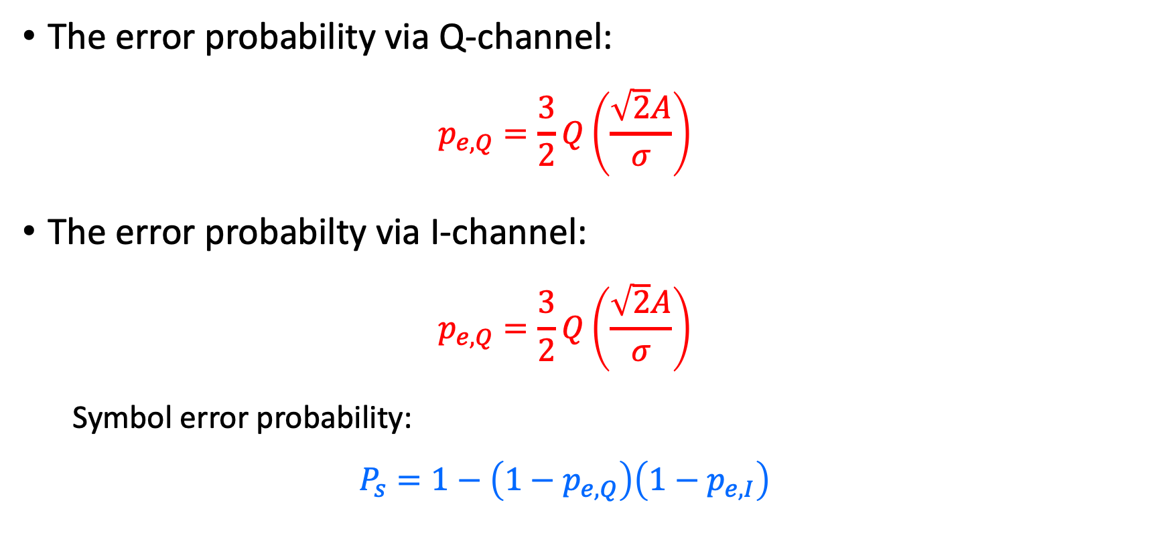
QAM
The error probability via Q-channel:
$$p_{e,Q}=\frac{3}{2}Q\left(\frac{\sqrt{2}A}{σ}\right)$$
The error probabilty via I-channel:
$$p_{e,Q}=\frac{3}{2}Q\left(\frac{\sqrt{2}A}{σ}\right)$$
Symbol error probability:
$$P_{s}=1−\left(1−p_{e,Q}\right)\left(1−p_{e,I}\right)$$

Slide 15
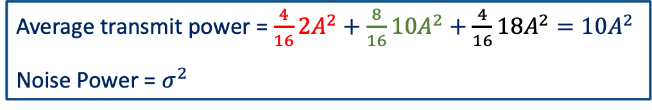
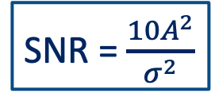
QAM
SNR
Average transmit power = $\frac{4}{16}{2A}^{2}+\frac{8}{16}10A^{2}+\frac{4}{16}18A^{2}=10A^{2}$
Noise Power = $σ^{2}$
SNR = $\frac{10A^{2}}{σ^{2}}$

Slide 16
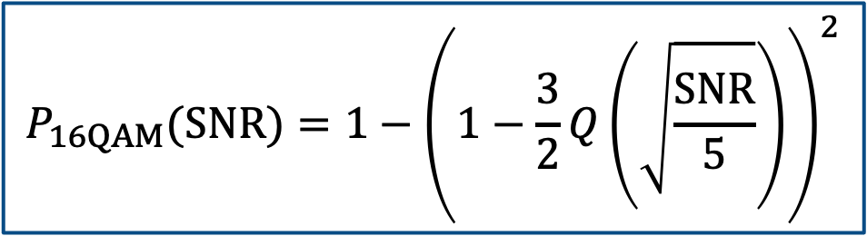


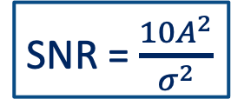

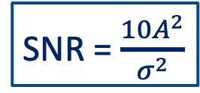

QAM
The error probability via Q-channel:
The error probabilty via I-channel:
Symbol error probability:
$$p_{e,Q}=\frac{3}{2}Q\left(\sqrt{\frac{SNR}{5}}\right)$$
$$p_{e,Q}=\frac{3}{2}Q\left(\frac{\sqrt{2}A}{σ}\right)$$
SNR = $\frac{10A^{2}}{σ^{2}}$
$$p_{e,Q}=\frac{3}{2}Q\left(\sqrt{\frac{SNR}{5}}\right)$$
$$p_{e,I}=\frac{3}{2}Q\left(\frac{\sqrt{2}A}{σ}\right)$$
SNR = $\frac{10A^{2}}{σ^{2}}$
$$P_{16QAM}(SNR)=1−{\left(1−\frac{3}{2}Q\left(\sqrt{\frac{SNR}{5}}\right)\right)}^{2}$$

Slide 17
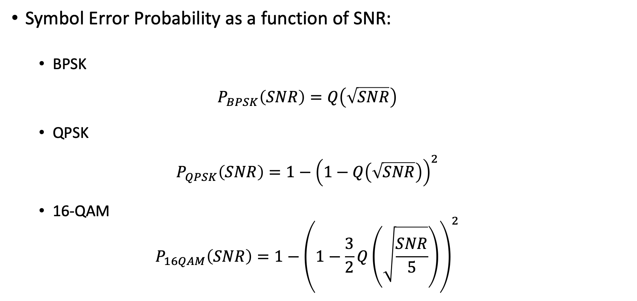
Error Probability
Symbol Error Probability as a function of SNR:
BPSK
$$P_{BPSK}\left(SNR\right)=Q\left(\sqrt{SNR}\right)$$
QPSK
$$P_{QPSK}\left(SNR\right)=1−{\left(1−Q\left(\sqrt{SNR}\right)\right)}^{2}$$
16-QAM
$$P_{16QAM}\left(SNR\right)=1−{\left(1−\frac{3}{2}Q\left(\sqrt{\frac{SNR}{5}}\right)\right)}^{2}$$

Slide 18
Diversity

Slide 19
Diversity
Combining techniques to mitigate the effect of fading
Receiver diversity
Transmit diversity

Slide 20
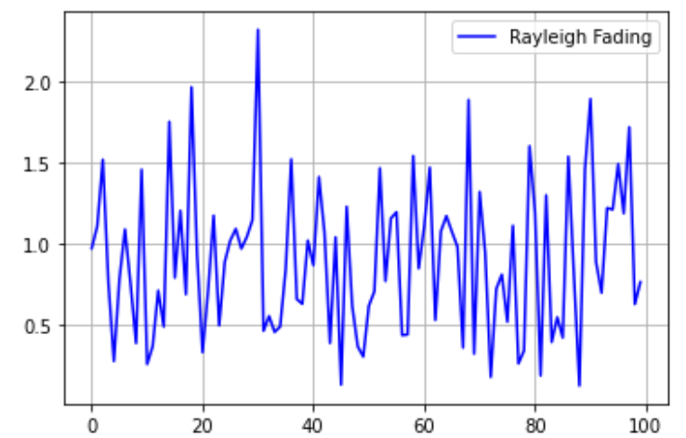
Diversity
Deep Fading

