Slide 1
Wireless Communications Seminar
Sungweon Hong
Information and Intelligent systems lab
Hanyang university

Slide 2
Contents
Communication System models
Propagation Characteristics
Channel / Path Loss Models
Outage Probability & Cell-Coverage

Slide 3
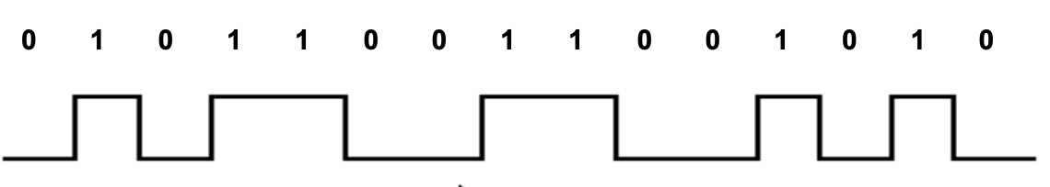
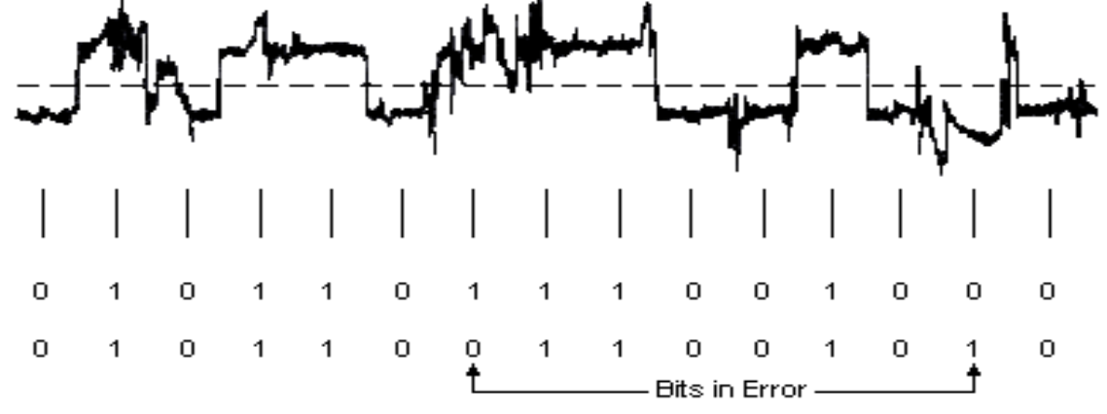

Communications
Wireless Channel
Probabilistic modeling ( e.g., AWGN, Fading, etc )
Transmitter
Channel
$$P\left(y | x\right)$$
Receiver
Tx
Rx
Nature Given
Design issue?

Slide 4
Propagation Characteristics
Path Loss
Shadowing
Multipath Fading

Slide 5
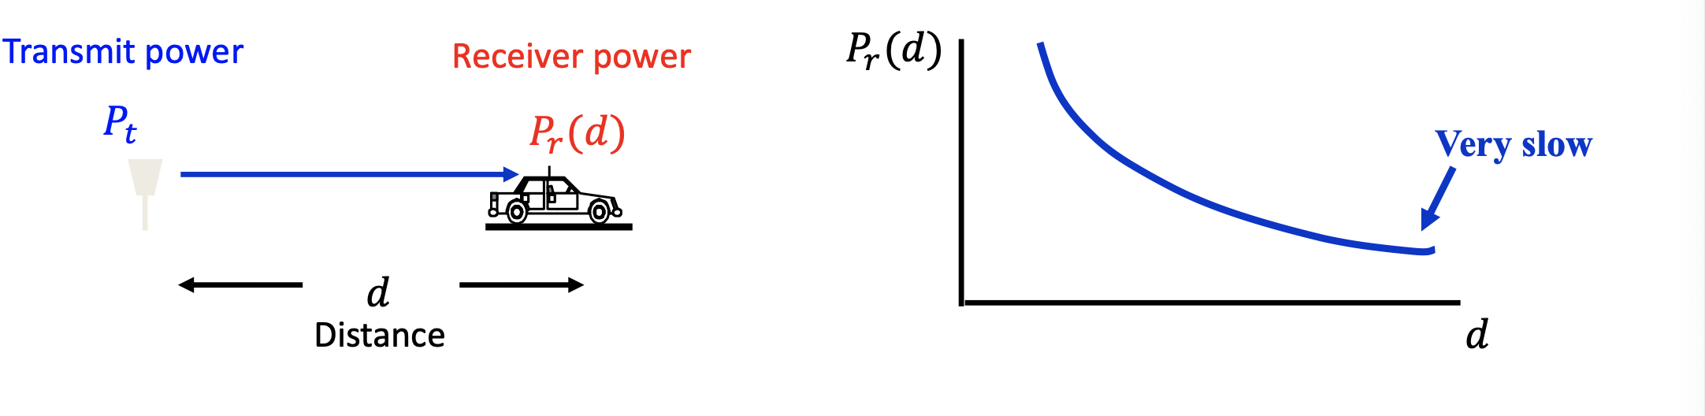

Propagation Characteristics
Path Loss
Also Known as ”Large Scale Fading”
A Function of Distance : $P_{r}\left(d\right)$

Slide 6
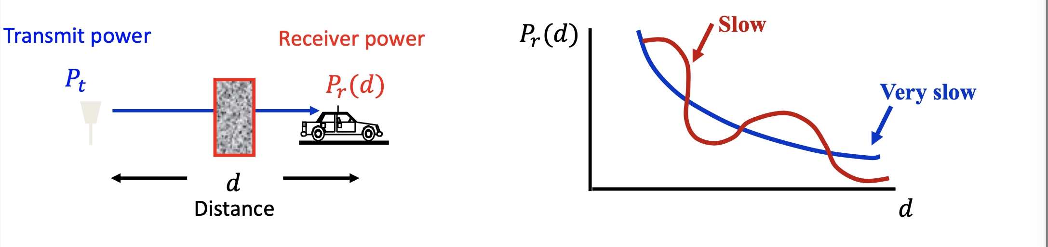
Propagation Characteristics
Shadow Fading
Objects in signal path causes random variation
Affected by a Propagation environment
Function of Distance

Slide 7
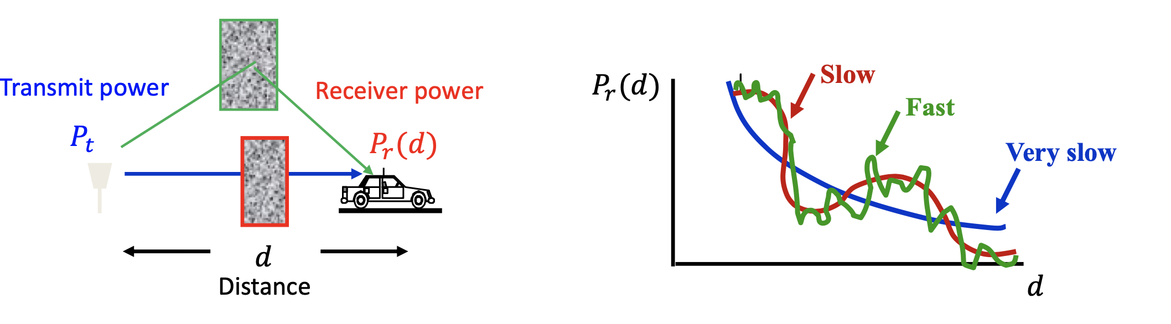
Propacation Characteristics
Multipath
Mathematically model the received power
Function of transmit power and distance?

Slide 8
Path Loss Models
Free-space Path loss model
Simplest model / wisely used for system engineers
Ray Tracing Model
Performance comparison in Standardization
Channel dependent technology
Empirical Path-Loss Model

Slide 9
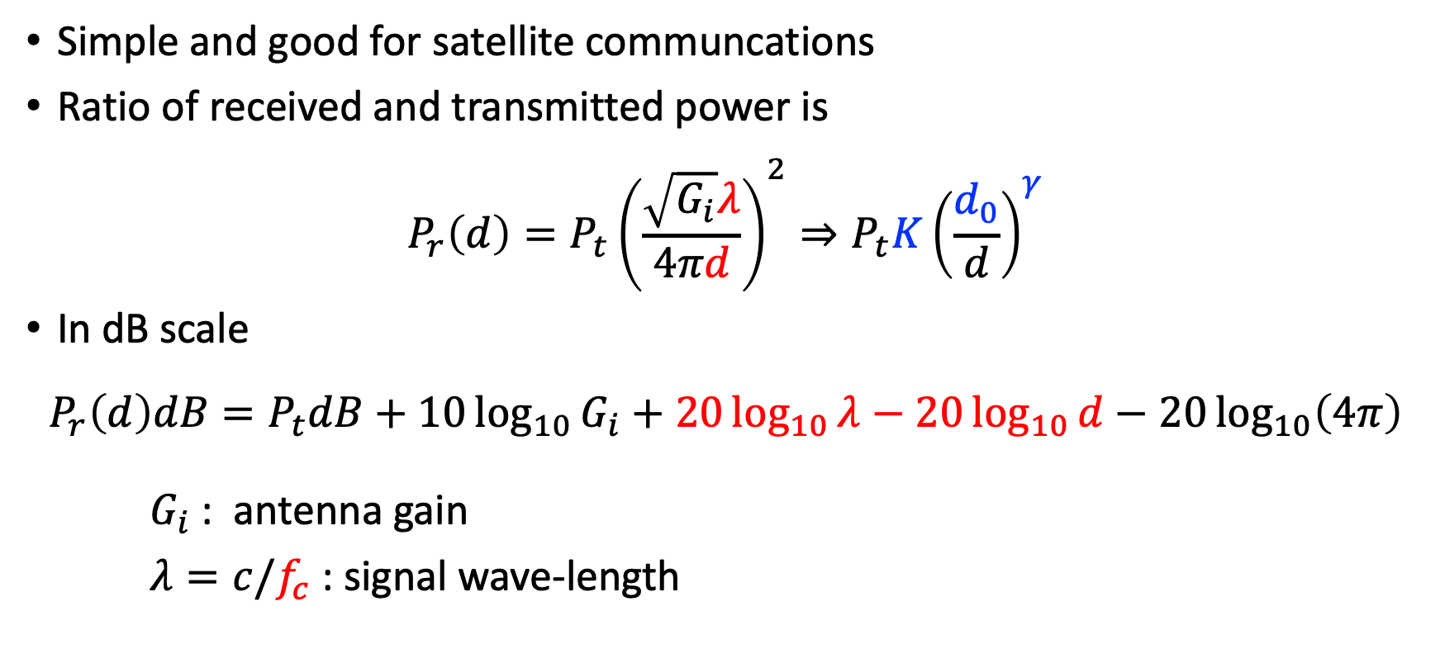
Free-Space Path Loss Model
Simple and good for satellite communcations
Ratio of received and transmitted power is
$$P_{r}\left(d\right)=P_{t}{\left(\frac{\sqrt{G_{i}}λ}{4πd}\right)}^{2}⇒P_{t}K{\left(\frac{d_{0}}{d}\right)}^{γ}$$
In dB scale
$$P_{r}\left(d\right)dB=P_{t}dB+10\log_{10}{G_{i}}+20\log_{10}{λ}−20\log_{10}{d}−20\log_{10}\left(4π\right)$$
$G_{i}$ : antenna gain
$λ=c/f_{c}$ : signal wave-length
Empirical measurements!
Simplified ( commonly ) used for design

Slide 10
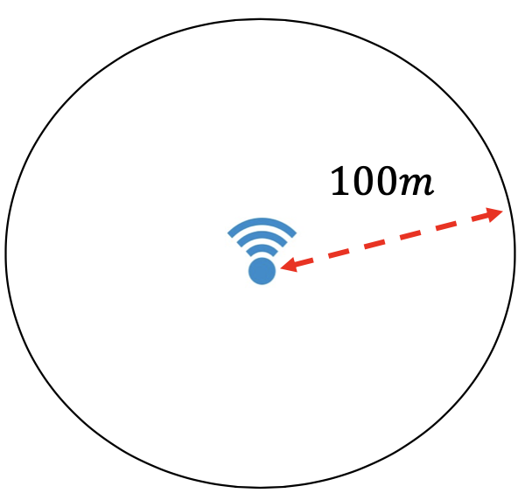
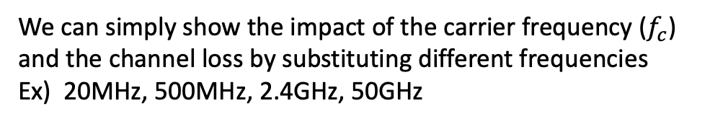
Free-Space Path Loss
We can easily compute the received power using the formula given
Carrier Frequency
Distance between receiver and transmitter
Or we can calculate the Minimum power at access point in a certain wireless cell given
Carrier Frequency
Cell Radius
Required minimum power
We can simply show the impact of the carrier frequency ($f_{c}$) and the channel loss by substituting different frequencies
Ex) 20MHz, 500MHz, 2.4GHz, 50GHz

Slide 11
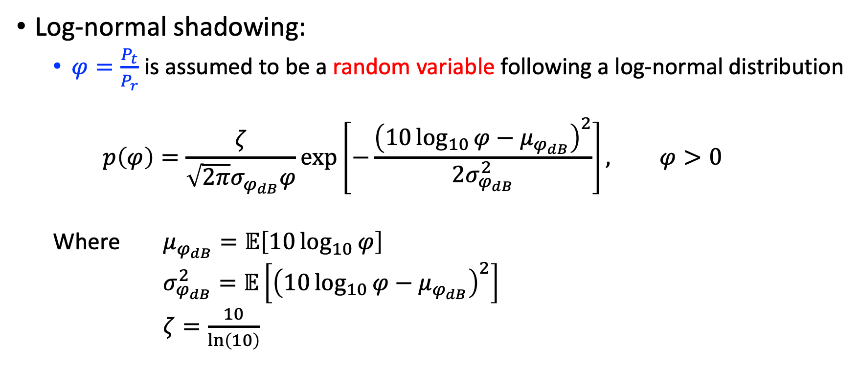
Shadowing
Log-normal shadowing:
$φ=\frac{P_{t}}{P_{r}}$ is assumed to be a random variable following a log-normal distribution
$$p\left(φ\right)=\frac{ζ}{\sqrt{2π}σ_{φ_{dB}}φ}\exp\left[−\frac{{\left(10\log_{10}{φ}−μ_{φ_{dB}}\right)}^{2}}{2σ_{φ_{dB}}^{2}}\right], φ>0$$
Where $μ_{φ_{dB}}=𝔼\left[10\log_{10}{φ}\right]$
$σ_{φ_{dB}}^{2}=𝔼\left[{\left(10\log_{10}{φ}−μ_{φ_{dB}}\right)}^{2}\right]$
$ζ=\frac{10}{\ln\left(10\right)}$

Slide 12
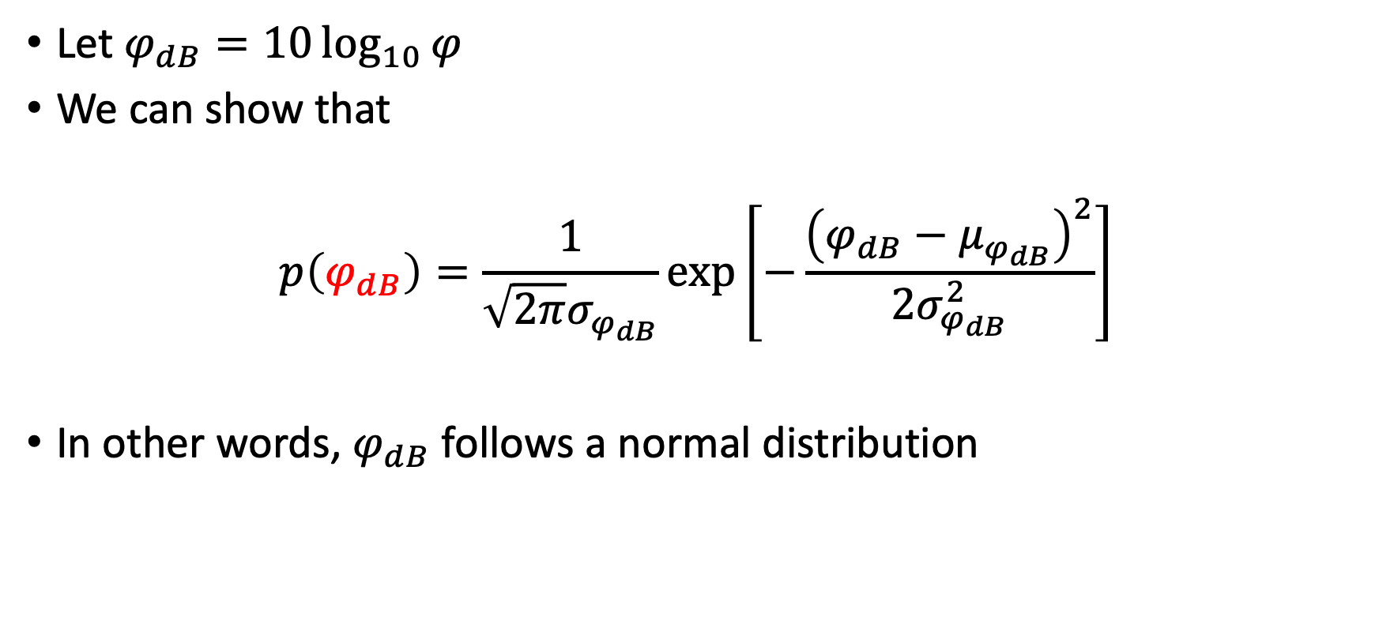
Log-Normal Shadowing
Let $φ_{dB}=10\log_{10}{φ}$
We can show that
$$p\left(φ_{dB}\right)=\frac{1}{\sqrt{2π}σ_{φ_{dB}}}\exp\left[−\frac{{\left(φ_{dB}−μ_{φ_{dB}}\right)}^{2}}{2σ_{φ_{dB}}^{2}}\right]$$
In other words, $φ_{dB}$ follows a normal distribution

Slide 13
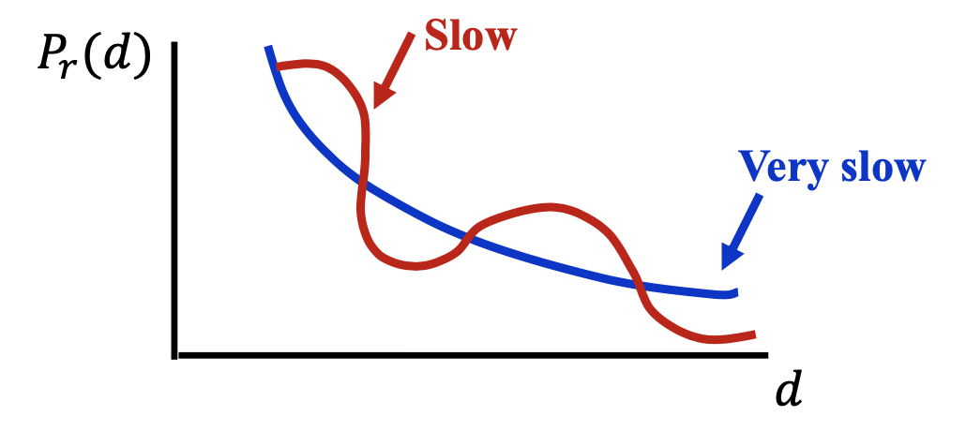

Path-Loss + Shadowing model
From the equation above from pathloss and the shadowing
$$P_{r}\left(d\right)dB=P_{t}dB+10\log_{10}{K}−10γ\log_{10}{\frac{d}{d_{0}}}−φ_{dB}$$

Slide 14
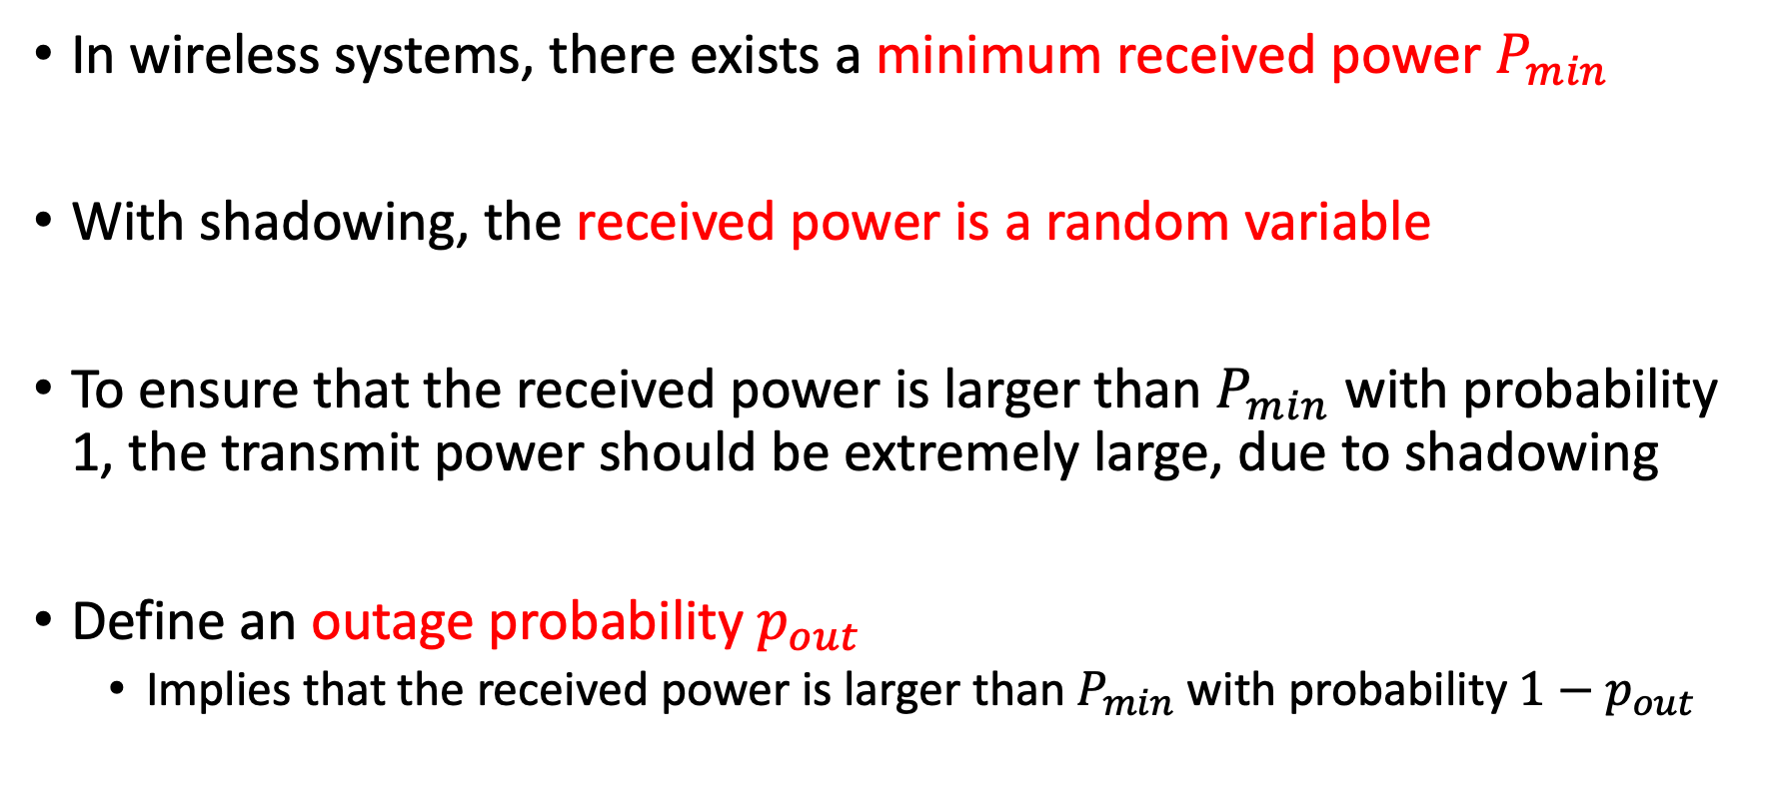
Outage Probability
In wireless systems, there exists a minimum received power $P_{min}$
With shadowing, the received power is a random variable
To ensure that the received power is larger than $P_{min}$ with probability 1, the transmit power should be extremely large, due to shadowing
Define an outage probability $p_{out}$
Implies that the received power is larger than $P_{min}$ with probability $1−p_{out}$

Slide 15
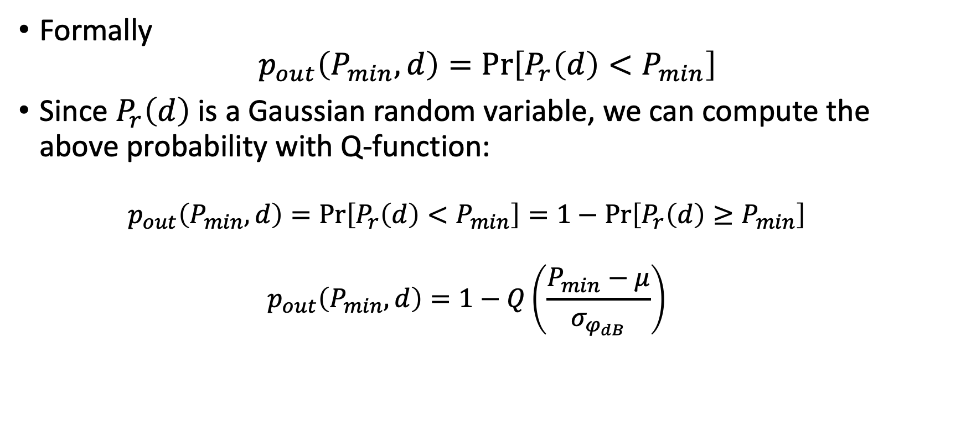
Outage Probability
Formally
$$p_{out}\left(P_{min},d\right)=\operatorname{Pr}\left[P_{r}\left(d\right)<P_{min}\right]$$
Since $P_{r}\left(d\right)$ is a Gaussian random variable, we can compute the above probability with Q-function:
$$p_{out}\left(P_{min},d\right)=\operatorname{Pr}\left[P_{r}\left(d\right)<P_{min}\right]=1−\operatorname{Pr}\left[P_{r}\left(d\right)≥P_{min}\right]$$
$$p_{out}\left(P_{min},d\right)=1−Q\left(\frac{P_{min}−μ}{σ_{φ_{dB}}}\right)$$

Slide 16
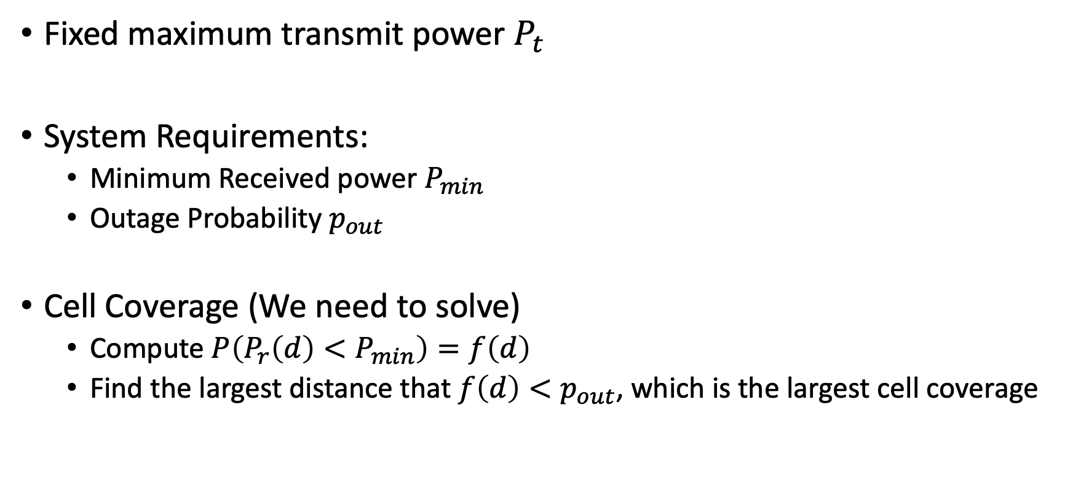
Cell Planning – Choosing Cell Size
Fixed maximum transmit power $P_{t}$
System Requirements:
Minimum Received power $P_{min}$
Outage Probability $p_{out}$
Cell Coverage (We need to solve)
Compute $P\left(P_{r}\left(d\right)<P_{min}\right)=f\left(d\right)$
Find the largest distance that $f\left(d\right)<p_{out}$, which is the largest cell coverage
?

Slide 17
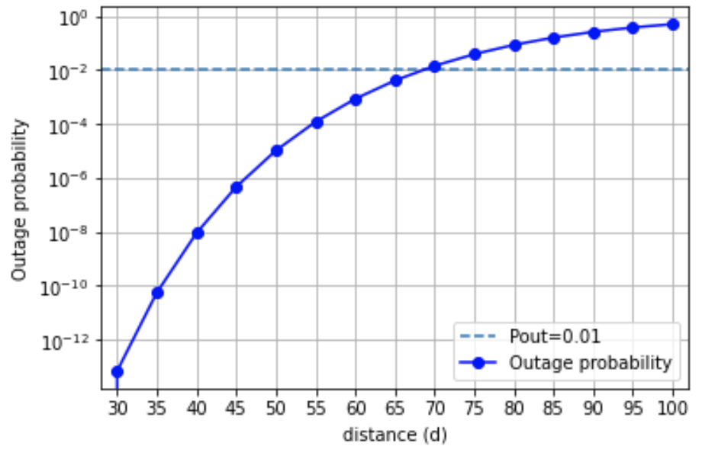
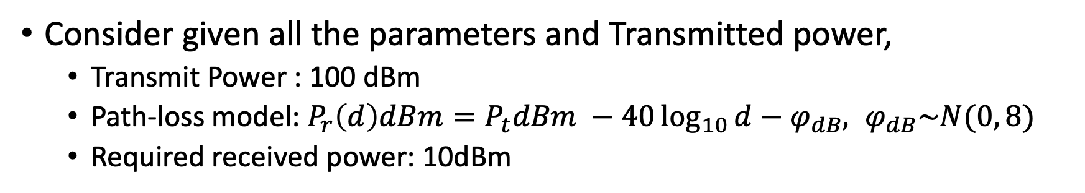
Cell Planning
Consider given all the parameters and Transmitted power,
Transmit Power : 100 dBm
Path-loss model: $P_{r}\left(d\right)dBm=P_{t}dBm −40\log_{10}{d}−φ_{dB}, φ_{dB}\sim N(0, 8)$
Required received power: 10dBm
The Cell Coverage distance with outage probability of approximately 0.01 can be figured out by the following plot (which is a curve by the outage probability formula)

Slide 18
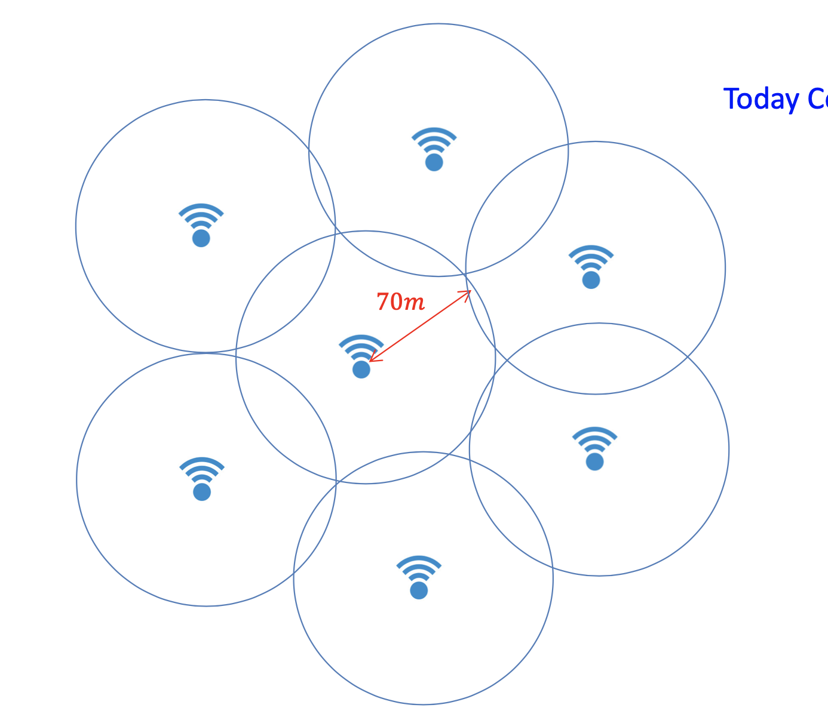
Cell planning

Slide 19
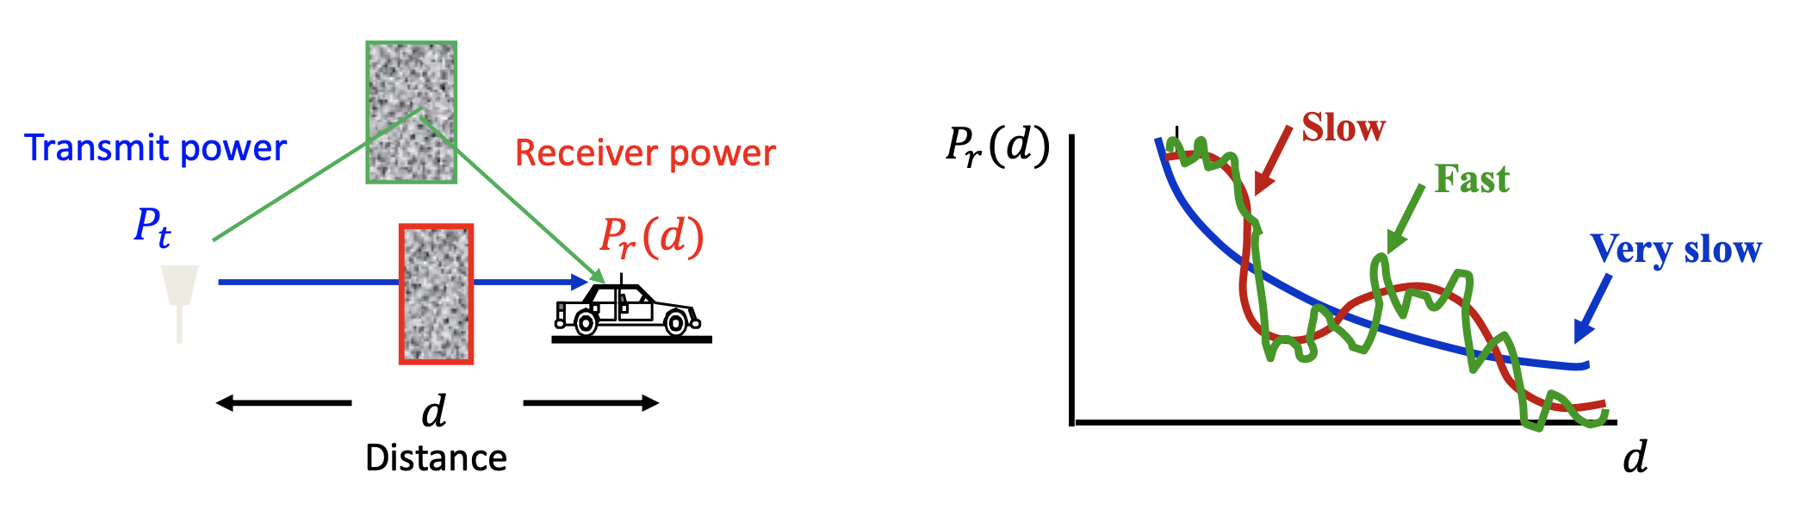
Small Scale Fading
\
Due to Constructive and destructive multipath
Time domain or frequency domain
Mobility
Multipath

Slide 20
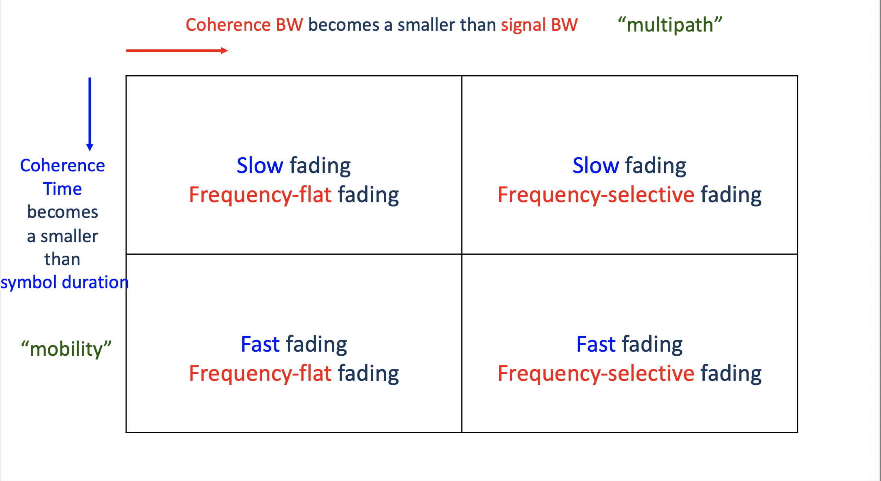
Small Scale Fading
The Channel can be classified in to
Frequency Flat or Frequency Selective Channel
Time invariant or Time Fading Channel

Slide 21
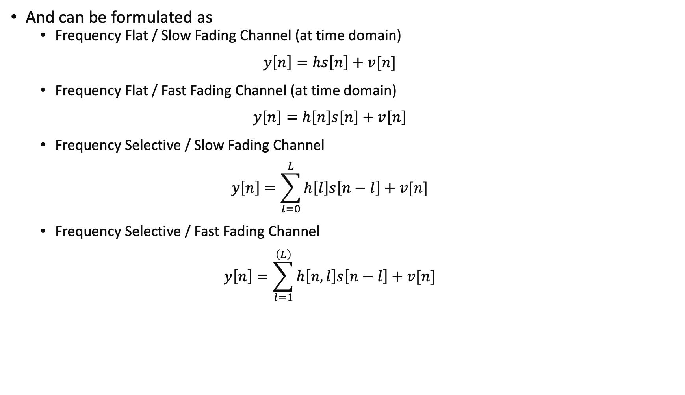
And can be formulated as
Frequency Flat / Slow Fading Channel (at time domain)
$$y\left[n\right]=hs\left[n\right]+v[n]$$
Frequency Flat / Fast Fading Channel (at time domain)
$$y\left[n\right]=h\left[n\right]s\left[n\right]+v\left[n\right]$$
Frequency Selective / Slow Fading Channel
$$y\left[n\right]=\sum_{l=0}^{L}{h\left[l\right]s\left[n−l\right]}+v[n]$$
Frequency Selective / Fast Fading Channel
$$y\left[n\right]=\sum_{l=1}^{\left(L\right)}{h\left[n,l\right]s\left[n−l\right]}+v[n]$$

Slide 22
Reference
ECE 432 Mobile Communications_Lecture2_Ajou_university lecture notes by S.N. Hong
Goldsmith, Andrea. Wireless communications. Cambridge university press, 2005.

Slide 23
QnA

Slide 24
Thank You

