Slide 1
Wireless Communication seminar 3
Sungweon Hong
Information and Intelligent systems lab
Hanyang university
Department of Electronic Engineering

Slide 2
Contents
Review
Coherence Bandwidth, Coherence Time
Discrete time Baseband models
Channel Capacity
AWGN channel
Frequency-Flat/Slow-Fading Channel
Frequency-Flat/Fast-Fading Channel
Frequency-Selective/Slow-Fading Channel
Frequency-Selective/Fast-Fading Channel

Slide 3
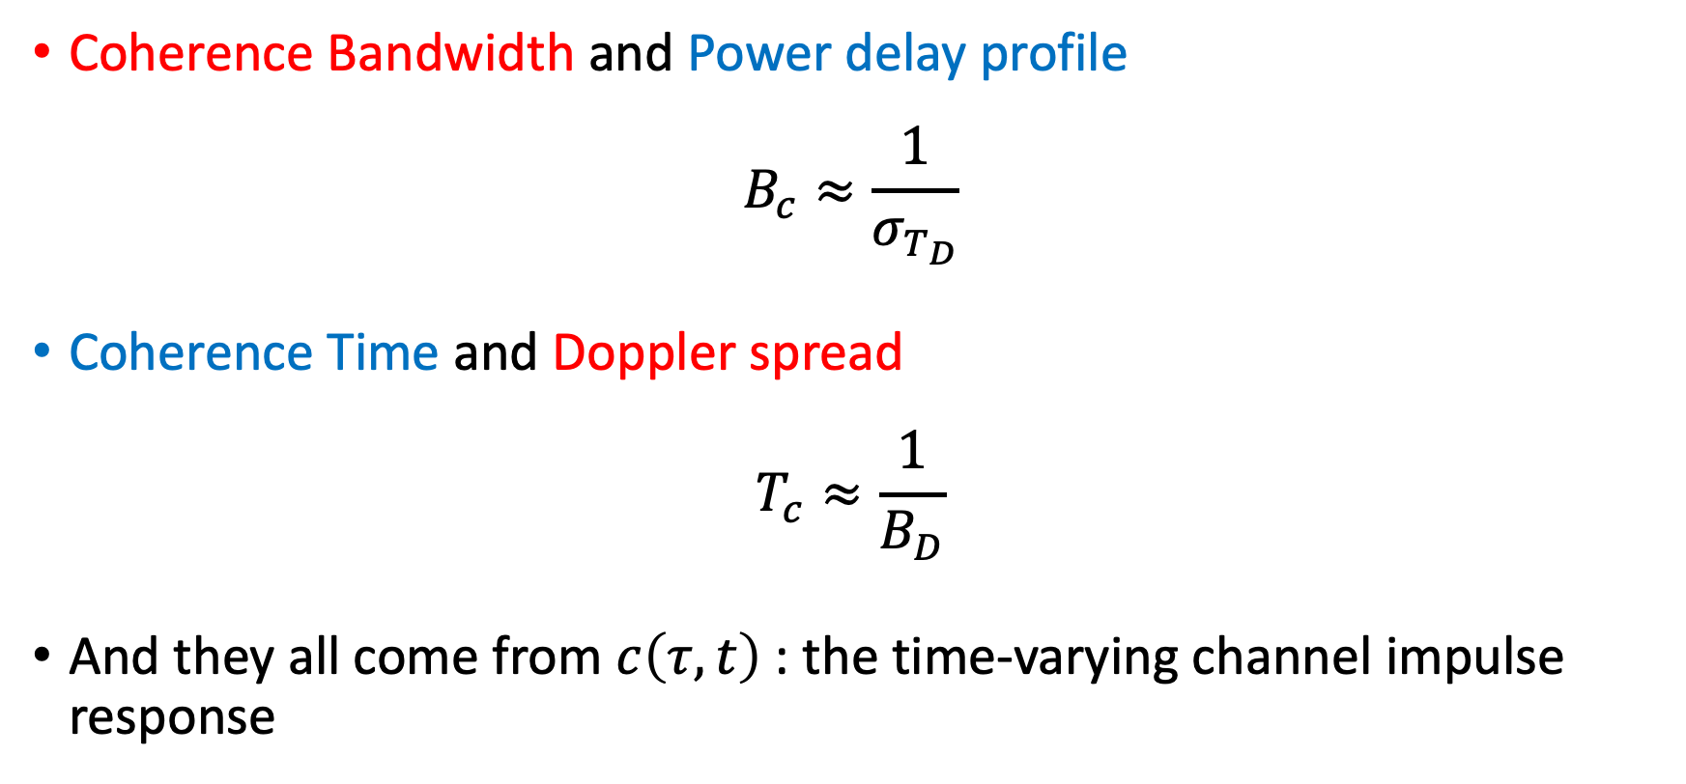
Review
Coherence Bandwidth and Power delay profile
$$B_{c}≈\frac{1}{σ_{T_{D}}}$$
Coherence Time and Doppler spread
$$T_{c}≈\frac{1}{B_{D}}$$
And they all come from $c\left(τ, t\right)$ : the time-varying channel impulse response

Slide 4


















Review
The Relationships of the Characteristics
$$Δt→0$$
Delay Spread
$$A_{c}(τ)$$
Power Delay Profile
Coherence Bandwidth
$$A_{c}\left(τ;Δt\right)$$
Autocorrelation function
$$ℱ_{τ}$$
$${\tilde{A}}_{C}(Δf)$$
$$ℱ_{ρ}^{−1}$$
$$ℱ_{Δf}^{−1}$$
$$ℱ_{Δt}$$
$${\tilde{A}}_{c}\left(Δf;Δt\right)$$
$$S_{c}\left(τ;ρ\right)$$
Scattering function
$$Δf→0$$
$${\tilde{A}}_{C}\left(Δt\right)$$
$$ℱ_{ρ}^{−1}$$
$$ℱ_{τ}$$
$$ℱ_{Δt}$$
$$ℱ_{Δf}^{−1}$$
$$S_{C}\left(Δf;ρ\right)$$
Coherence time
$$S_{c}(ρ)$$
Doppler Power Spectrum
Doppler Spread

Slide 5
Review
Coherence BW becomes a smaller than signal BW
“multipath”
Slow fading Frequency-flat fading | Slow fading Frequency-selective fading
Fast fading Frequency-flat fading | Fast fading Frequency-selective fading
Coherence
Time
becomes
a smaller
than
symbol duration
“mobility”

Slide 6
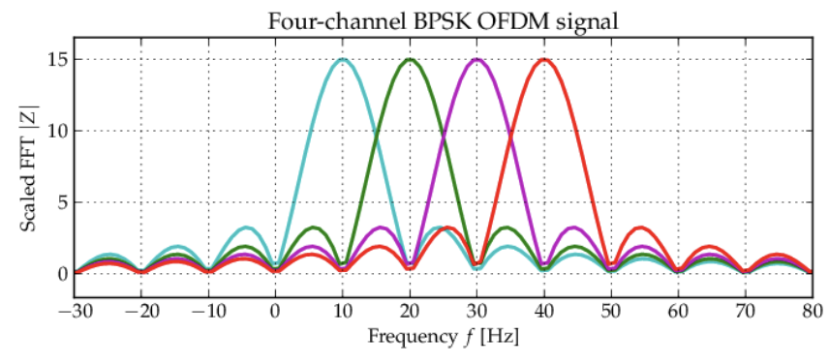
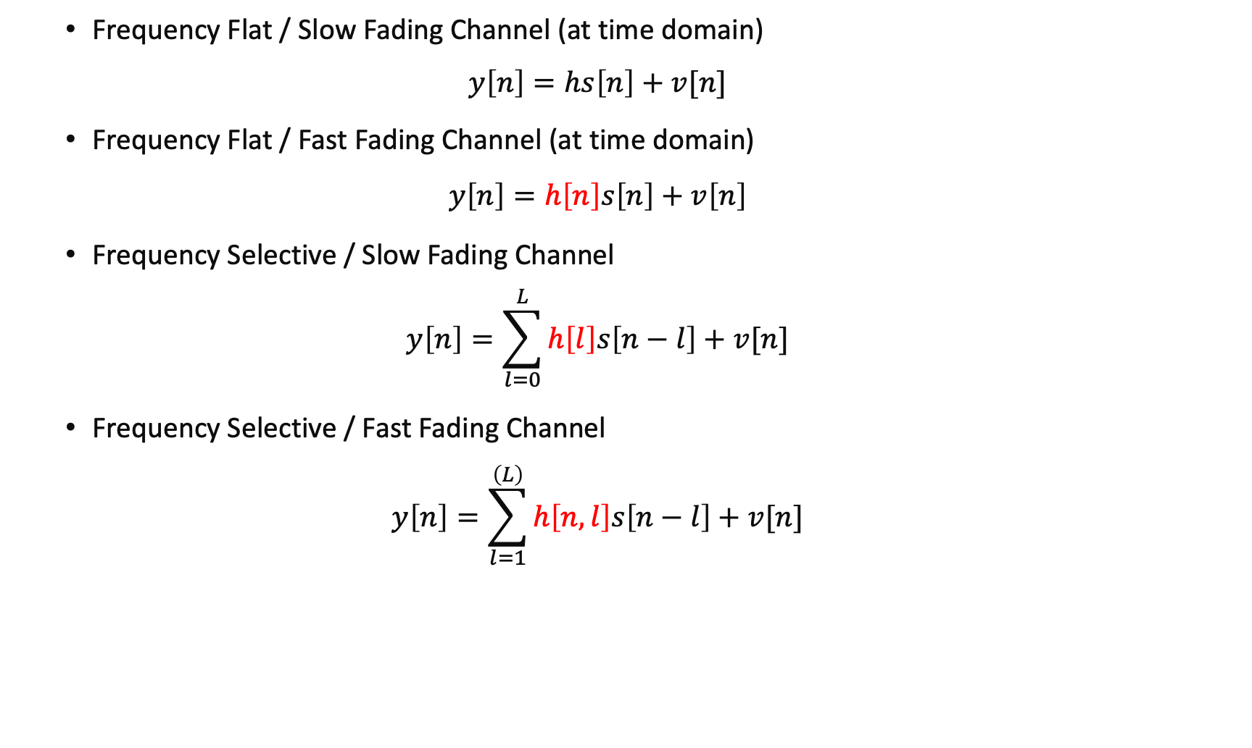
Review
Frequency Flat / Slow Fading Channel (at time domain)
$$y\left[n\right]=hs\left[n\right]+v[n]$$
Frequency Flat / Fast Fading Channel (at time domain)
$$y\left[n\right]=h\left[n\right]s\left[n\right]+v\left[n\right]$$
Frequency Selective / Slow Fading Channel
$$y\left[n\right]=\sum_{l=0}^{L}{h\left[l\right]s\left[n−l\right]}+v[n]$$
Frequency Selective / Fast Fading Channel
$$y\left[n\right]=\sum_{l=1}^{\left(L\right)}{h\left[n,l\right]s\left[n−l\right]}+v[n]$$
Channel tracking via Wiener/Kalman filters
OFDM modulation
V2V Communications
Notes:
Breaking down widebands into frequency selective channel into several flat channels

Slide 7
Channel Capacity

Slide 8
Channel Capacity
What is Channel Capacity?
The maximum data rates that can be transmitted over the wireless channel with asymptotically small error probability
https://www.dictionary.com/browse/asymptotic
Scope of this weeks Seminar:
Capacity of a single-user wireless channel where the transmitter and receiver has a single antenna
Time-Invariant AWGN channel
A Flat-Fading Channel
A Frequency Selective Fading channel

Slide 9

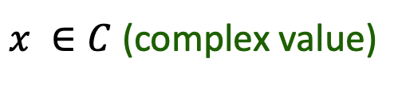
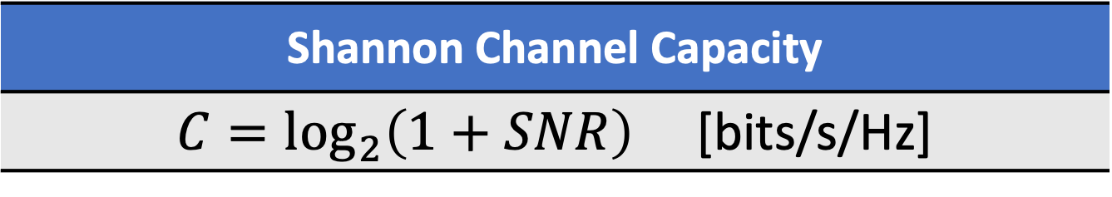


AWGN Channel
Additive White Gaussian Noise Channel
SNR (signal-to-noise Ratio) : The ratio of Signal Power to Noise Power
$x ∈C$ (complex value)
Received signal:
power constraint:
$$E\left[{|x|}^{2}\right]≤P$$
$$y=x+z$$
Tx
Rx
$$z∼CN(0,σ^{2})$$
Shannon Channel Capacity
$C=\log_{2}\left(1+SNR\right)$ [bits/s/Hz]

Slide 10


AWGN Channel Capacity
What does it mean?
Channel Capacity $(C)$ is the upper bound of Data Rate $\left(R\right)$ that can be sent with negligible errors
In other words, if the transmission data rate $\left(R\right)$ is higher than the Channel Capacity, the receiver cannot recover the message
We can think Channel as a Cup that can carry water

Slide 11
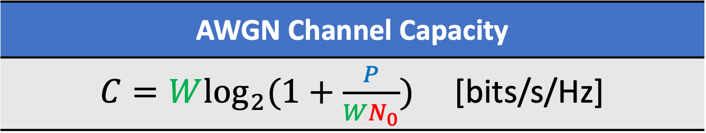



AWGN Channel Capacity
Power Constraint signal over bandwidth $W$[Hz]
SNR (signal-to-noise Ratio) : $SNR=\frac{P}{WN_{0}}$
$x ∈C$ (complex value)
Received signal:
power constraint:
$$E\left[{|x|}^{2}\right]≤P/W$$
$$y=x+z$$
SNR (signal-to-noise Ratio) :
Tx
Rx
$$z∼CN(0,N_{0})$$
AWGN Channel Capacity
$C=W\log_{2}{(1+\frac{P}{WN_{0}})}$ [bits/s/Hz]

Slide 12
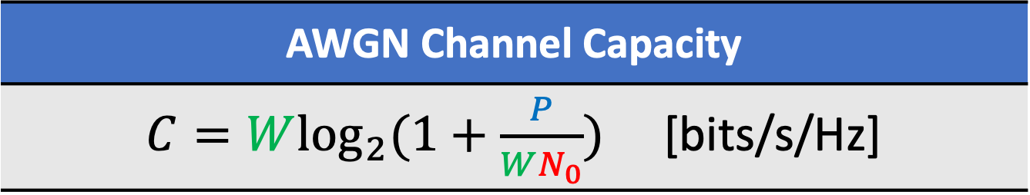
AWGN Channel Capacity
AWGN Channel Capacity
$C=W\log_{2}{(1+\frac{P}{WN_{0}})}$ [bits/s/Hz]
The performance of a communication system depends on the basic channel resources (e.g., power and bandwidth) available in the channel
At lower SNR regime, capacity increases linearly with SNR
At higher SNR regime, capacity increases logarithmically with SNR

Slide 13
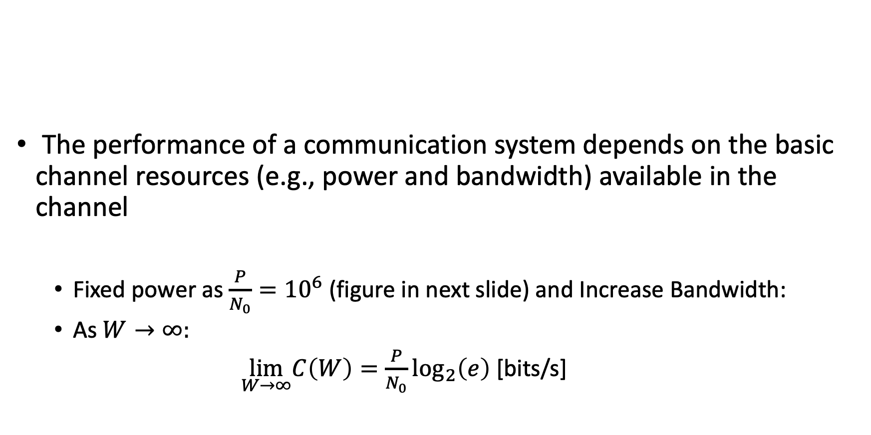
AWGN Channel Capacity
AWGN Channel Capacity
$C=W\log_{2}{(1+\frac{P}{WN_{0}})}$ [bits/s/Hz]
The performance of a communication system depends on the basic channel resources (e.g., power and bandwidth) available in the channel
Fixed power as $\frac{P}{N_{0}}={10}^{6}$ (figure in next slide) and Increase Bandwidth:
As $W→∞:$
$\lim_{W→∞}C\left(W\right)=\frac{P}{N_{0}}\log_{2}\left(e\right)$ [bits/s]

Slide 14

AWGN Channel Capacity
For a fixed power:
$$\lim_{W→∞}{C\left(W\right)}$$
Power limited region
Bandwidth limited region

Slide 15
case I:
Frequency-Flat/Slow Fading channel

Slide 16
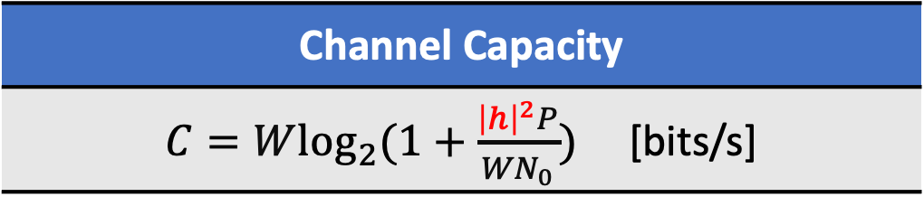






Frequency-Flat/Slow Fading Channel
The simplest case and it is nearly a Gaussian channel
$h$ is known only at the receiver
Thus, the SNR of the channel is
$$SNR=\frac{P{\left|h\right|}^{2}}{WN_{0}}$$
Power constraint
$$x[n] ∈C$$
$$P/W$$
$$y[n]=hx[n]+z[n]$$
Tx
Rx
$$h$$
$$z[n]∼CN(0,N_{0})$$
Channel Capacity
$C=W\log_{2}{(1+\frac{{\left|h\right|}^{2}P}{WN_{0}})}$ [bits/s]

Slide 17
case II:
Frequency-Flat/Fast Fading channel

