Slide 1
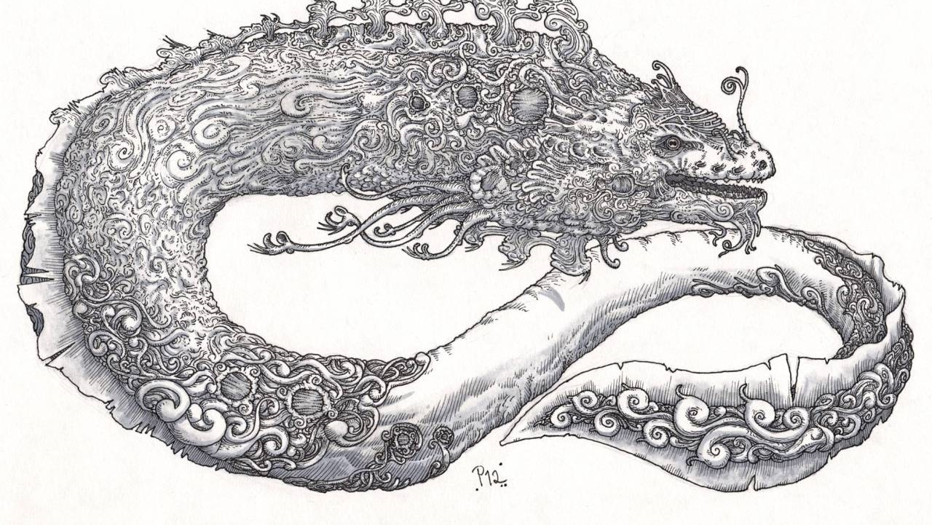
Parselmouth
A gateway to
pwsh language hacking

Slide 2

whoami /claims > IISRESETME\mjessen
Mathias R. Jessen
Professionally
Threat Detection Engineer Booking.com
Reads a lot of code, writes very little
Recovering {webdev,ops-person,heckler}
Privately
Obsessed with PowerShell
Addicted to
StackExchange
Black (?:Liquorice|Metal)

Slide 3
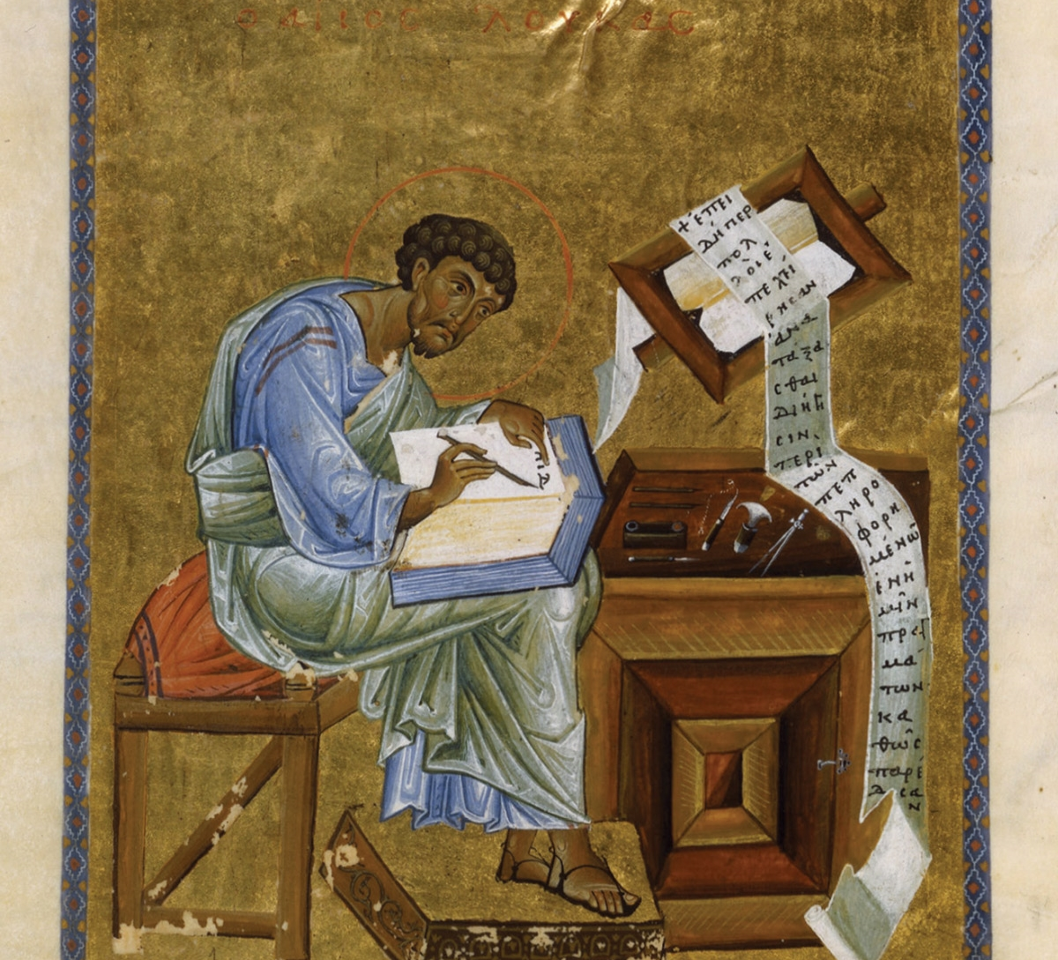
Agenda
Historical Context
S.M.A.Language
Let’s write op_X
Review existing op implementation
Write a plan (!!!)
Implement op_X!
Conclusion

Slide 4


Slide 5

Why are we here?
2002 – Monad Manifesto
2006 – PowerShell v1 GA
2009 – PowerShell 2.0 ships in Windows
2012 – PowerShell 3.0 (major refactor)
2016 – PowerShell 5.1 (classes, yay)
2018 – PowerShell Core GA (oss ftw)
(Mr. Thomas Rayner did cool AST stuff)

Slide 6
PowerShell Language Runtime (v2)
$abc = Get-Stuff
$abc | Select-Stuff
AST
Interpreter
ScriptAst
Frontend
Parser
StmtAst
StmtAst
Tokenizer
Execute AST
bottom up
AssignmentAst
PipelineAst
VariableAst
ExprAst

Slide 7
PowerShell Language Runtime (v3)
DLR Evalutation
Expression Tree
$abc = Get-Stuff
$abc | Select-Stuff
AST
Compiler
ScriptAst
Frontend
Parser
StmtAst
StmtAst
Tokenizer
AssignmentAst
PipelineAst
Generate Expressions
VariableAst
ExprAst

Slide 8
PowerShell Language Runtime (v4)
DLR Evalutation
Expression Tree
$abc = Get-Stuff
$abc | Select-Stuff
AST
Compiler
ScriptAst
Frontend
Parser
StmtAst
StmtAst
Tokenizer
DSC Stuff
AssignmentAst
PipelineAst
Generate Expressions
VariableAst
ExprAst

Slide 9
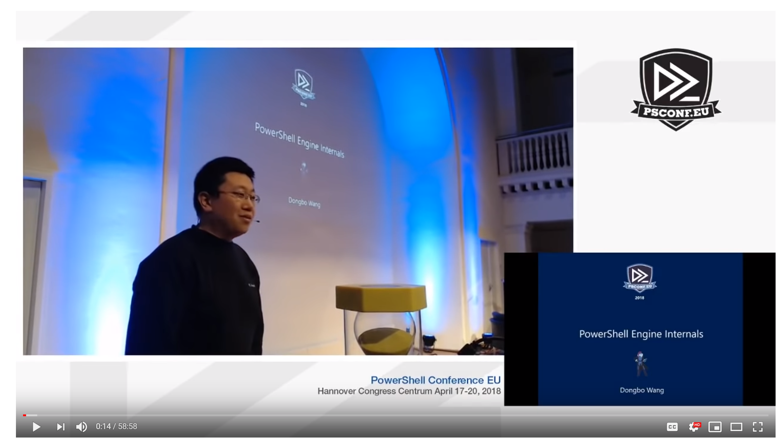
PowerShell Language Runtime (v5 -> )
DLR Evalutation
Expression Tree
$abc = Get-Stuff
$abc | Select-Stuff
AST
Compiler
ScriptAst
Define Types
Frontend
Parser
StmtAst
StmtAst
Tokenizer
DSC Stuff
AssignmentAst
PipelineAst
Generate Expressions
VariableAst
ExprAst

Slide 10
S.M.A.PSParser Demo
S.M.A.Language Demo

Slide 11
op_X
Wouldn’t it be nice with…
@(1,3,5,7) -any {$_ % 3 -eq 0}

Slide 12
Main Demo

Slide 13
Conclusion
PowerShell Language Infrastructure is complex but typical
Super fun to play with!
Open to anyone!
Now go build your own operators – you got this! 💪

