Slide 1
PSCache
simple strategies for magnificent performance

Slide 2
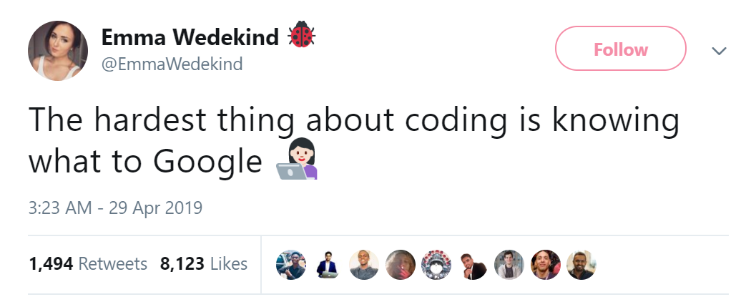

Slide 3

whoami /claims Mathias R. Jessen
Professionally
Threat Detection Engineer @ Booking.com
Mired in Windows behaviour
Privately
Obsessed with PowerShell
Addicted to
StackExchange
Black (?:Liquorice|Metal)
Find me on twitter/github/reddit:
@IISResetMe
/u/PowerShellStunnah

Slide 4
Agenda
We’re bounded by physics
We can get help – from math!
Basics of PowerShell performance
Array reversal
Output suppression
Must-have tools!
Pseudocode
Script profiling (2 approaches)
A case study: PSCache

Slide 5
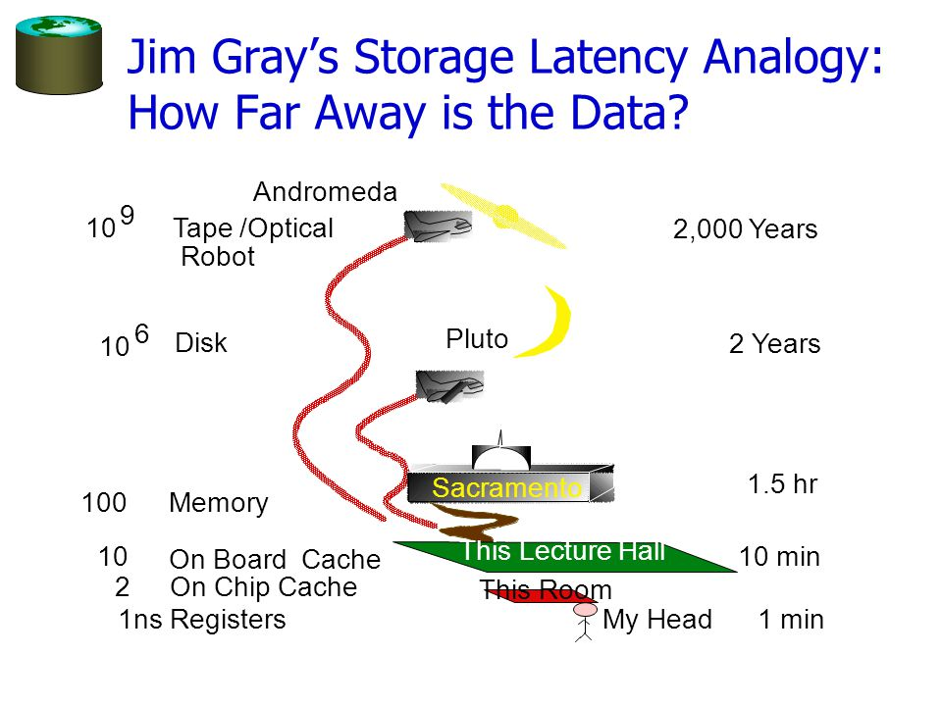

Slide 6
Scary-sounding terms you should google…
Computational runtime complexity
See also: Asymptotic analysis
TL;DR:
Avoid nested loops

Slide 7
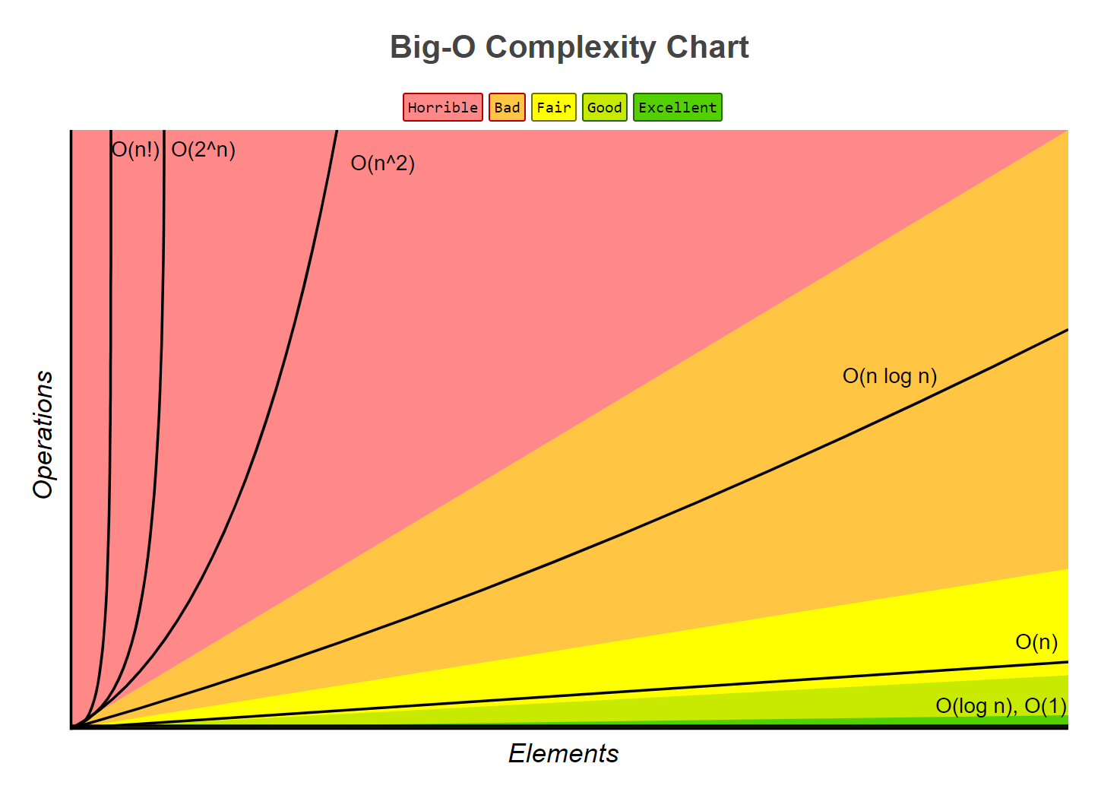
Big O Notation
http://bigocheatsheet.com/

Slide 8
PowerShell Performance 101
High
overhead
Low
Script functions
PS Builtins (operators, loop constructs), C# cmdlets
Compiled .NET code
Win32 APIs
Assembly/HAL
CPU

Slide 9
PowerShell Performance 101
Something is wrong
Memory
Trade-offs
Time

Slide 10

Array Reversal: Slow to Fast

Slide 11
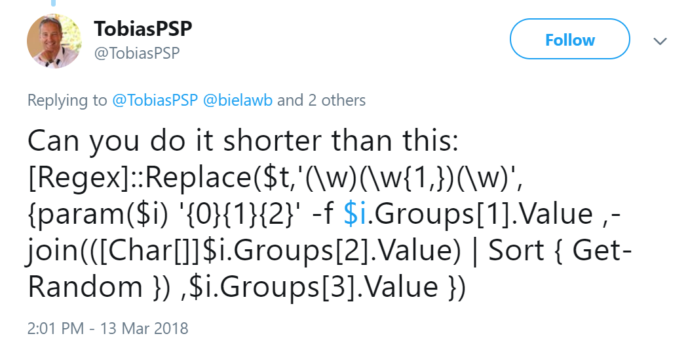
Array Reversal: Slow to Fast

Slide 12
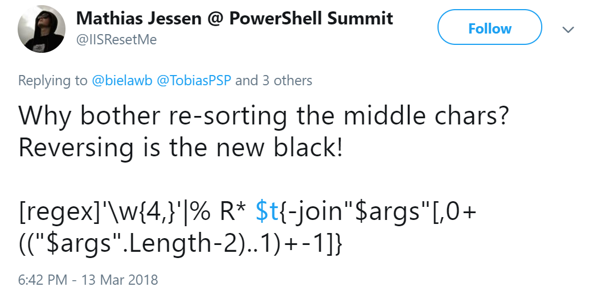
Array Reversal: Slow to Fast

Slide 13
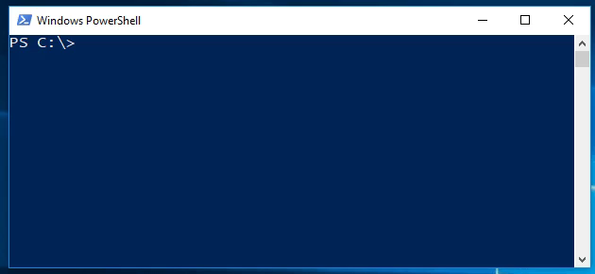
Array Reversal: Slow to Fast

Slide 14
Array Reversal Demo

Slide 15
Output Suppression Demo

Slide 16
Must-have tools
Learn how to express your algorithms in pseudo-code!
Check out existing profiling tools like:
Chronometer (@KevinMarquette)
MeasureScript (@lzybkr / @CosmosKey / @IISResetMe)

Slide 17
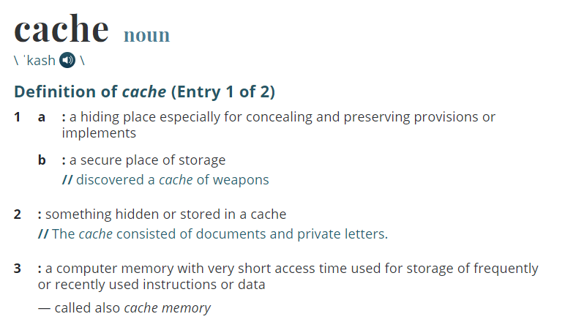

Slide 18
PSCache – original motivation
# Fetch call center agents
$Agents = Get-ADUser -Filter "title -like '*agent*'" -Properties *
# Output with Manager's Name
foreach($Agent in $Agents) {
[pscustomobject]@{
Agent = $Agent.Name
Manager = $(Get-ADUser -Identity $Agent.manager).Name
}
}

Slide 19
PSCache – original motivation
# Fetch call center agents
$Agents = Get-ADUser -Filter "title -like '*agent*'" -Properties manager
# Output with Manager's Name
foreach($Agent in $Agents) {
[pscustomobject]@{
Agent = $Agent.Name
Manager = $(Get-ADUser -Identity $Agent.manager).Name
}
}

Slide 20
PSCache – original motivation
$Agents = Get-ADUser -Filter "title -like '*agent*'" -Properties manager
# Save all users to a variable
$AllUsers = Get-ADUser -Filter *
foreach($Agent in $Agents){
[pscustomobject]@{
Agent = $Agent.Name
Manager = $AllUsers.Where({
$_.DistinguishedName -eq $Agent.manager
}).Name
}
}

