Slide 1

PowerShell User Group
South Coast 19/09/2017
@UKSthCoastPSUG

Slide 2
agenda!
7.00pm - Arrival
7.30pm - Welcome / User Group Introduction - Jonathan Medd @jonathanmedd
7.35pm - Introduction to PESTER - TDD for PowerShell - Rob Sewell @sqldbawithbeard
8.15pm - Break / Pizza / Refreshments
8.45pm - Working with different types of data in PowerShell - Jonathan Medd @jonathanmedd
9.30pm - Wrap up / Close

Slide 3
Welcome and Practicalities
Fire exits
Respect our hosts
Deposit and Public Liability Insurance is on me
THANK YOU!

Slide 4

Sponsor!

Slide 5
User Group
Aim to meet roughly every 1 – 2 months
Tue September 19th
Tue October 17th
Tue November 21st
December TBC – if we do something, it’ll be a social event
Notification from Meetup.com once the speakers are confirmed, but you can RSVP now

Slide 6


Slide 7
We need!
Speakers
Some lined up, discussions ongoing
Topic ideas – we need to know what you want to hear about
PowerShell Gallery
GitHub 101
Azure PowerShell 101
PowerShell DSC

Slide 8
Communication
Meetup.com - https://www.meetup.com/UK-South-Coast-PowerShell-User-Group/
Twitter - https://twitter.com/UKSthCoastPSUG
Slides and content will appear here: https://github.com/powershellorguk/SouthCoast
More on that last URL……

Slide 9
Links to other PowerShell User Groups
London
Scotland
Manchester
Ongoing discussions with leaders from all groups around co-ordinating activities under one organisation, but remaining locally independent

Slide 10
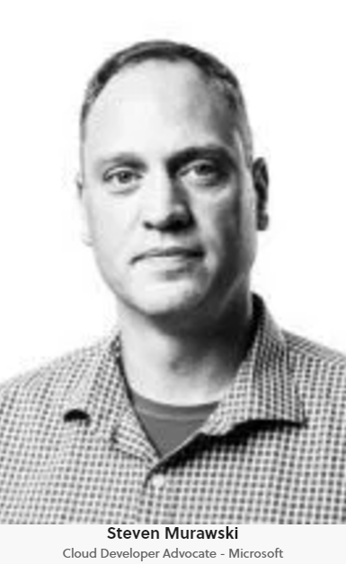

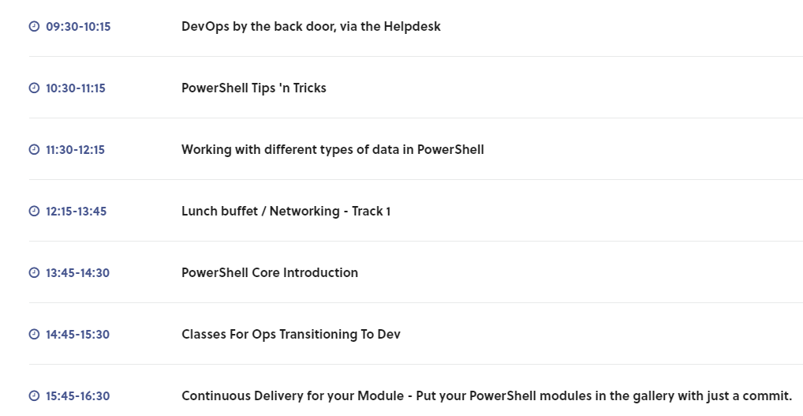
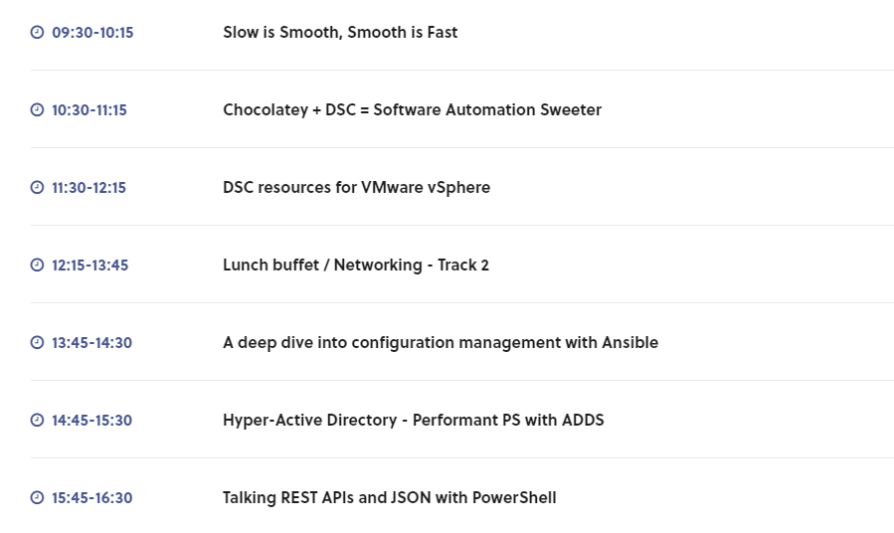
Other events
PSDayUK: Fri 22nd September
Tickets still available

Slide 11

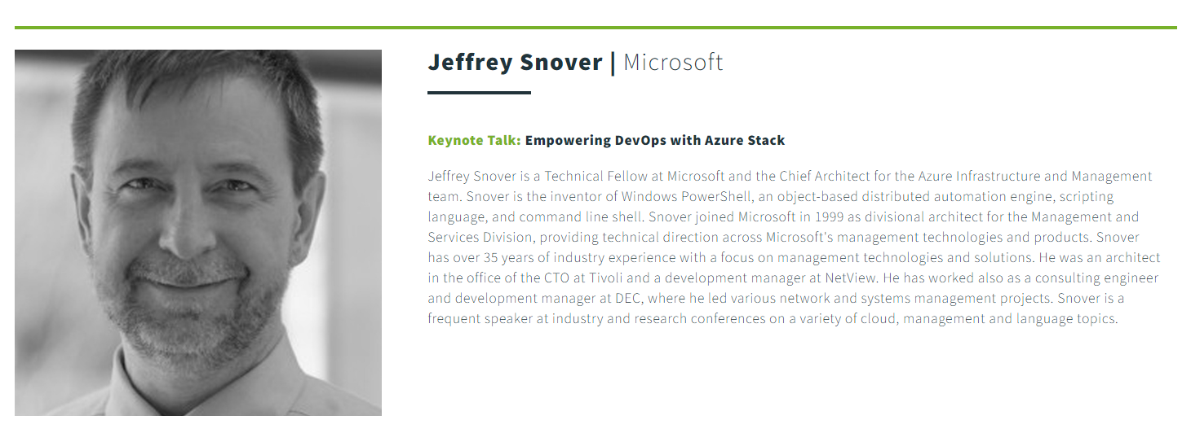
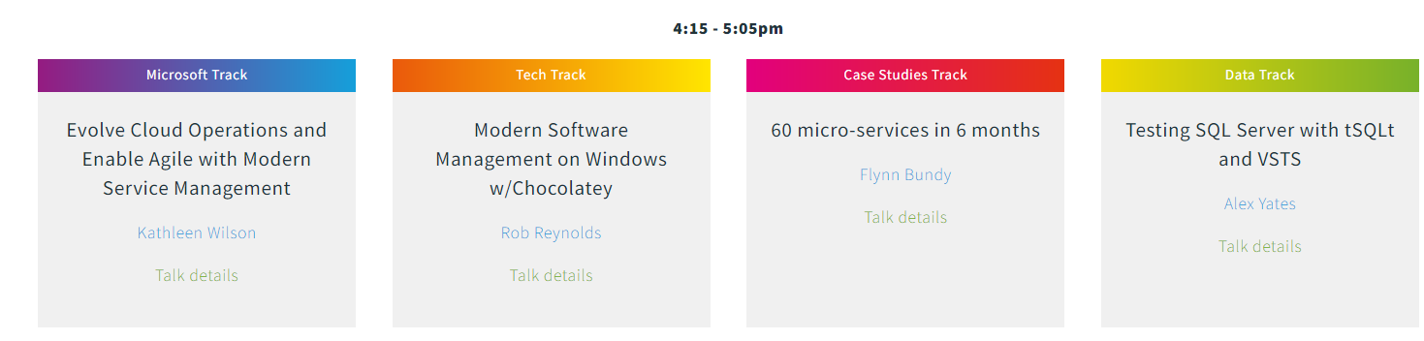
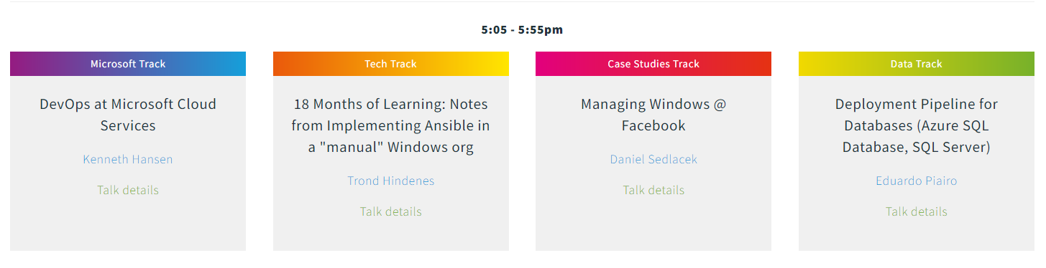
Other events
WinOps 2017: 20 – 21st September
Wed 20th workshop day sold out
Thr 21st conference day still available

Slide 12
Hurry up and move on!

