Slide 1

PowerShell User Group
South Coast 21/11/2017
@UKSthCoastPSUG

Slide 2
agenda!
7.00pm - Arrival
7.30pm - Welcome / User Group Introduction - @jonathanmedd
7.35pm - Part 1 - Terraform Apply: How and why Ticketmaster International created two cross-region Active Directory forests in AWS from scratch- @Dan1el42
8.15pm - Break / Refreshments
8.45pm – Part 2 - Terraform Apply: How and why Ticketmaster International created two cross-region Active Directory forests in AWS from scratch- @Dan1el42
9.30pm - Wrap up / Close

Slide 3
Welcome and Practicalities
Fire exits
Respect our hosts
Deposit and Public Liability Insurance is on me
THANK YOU!

Slide 4
SPONSOR
We’re looking for a new one
Thankful for the support Networkers gave us to help us get started

Slide 5
User Group
Aim to meet roughly every 1 – 2 months
December Social Meetup – Wed 13th Dec, venue TBC
2018
Tue Jan 23rd
Tue Feb 20th
Tue Mar 20th

Slide 6
Want to present?

Slide 7
Don’t do that, do this!

Slide 8
We need!
Speakers
Some lined up, discussions ongoing
Topic ideas – we need to know what you want to hear about
PowerShell Gallery - Rob is talking on this in November early 2018
GitHub 101
Azure PowerShell 101
PowerShell DSC

Slide 9

Communication
Meetup.com - https://www.meetup.com/UK-South-Coast-PowerShell-User-Group/
Twitter - https://twitter.com/UKSthCoastPSUG
Slides and content will appear here: https://github.com/powershellorguk/SouthCoast
More on that last URL……

Slide 10
Links to other PowerShell User Groups
London
Scotland
Manchester
This has already benefited us with speakers and co-organisation of PSDayUK

Slide 11
Other PowerShell events
PS ConfEU – Hanover, Germany
April 17-20, 2018: Registration opens end of Nov 2017
http://www.psconf.eu/
PowerShell Summit – Seattle, USA
April 9 – 12, 2018: Registration open
https://powershell.org/summit/

Slide 12
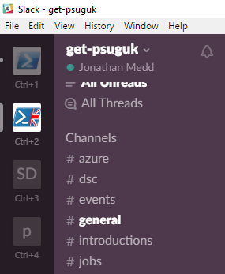
Slack
https://get-psuguk.slack.com/signup

Slide 13
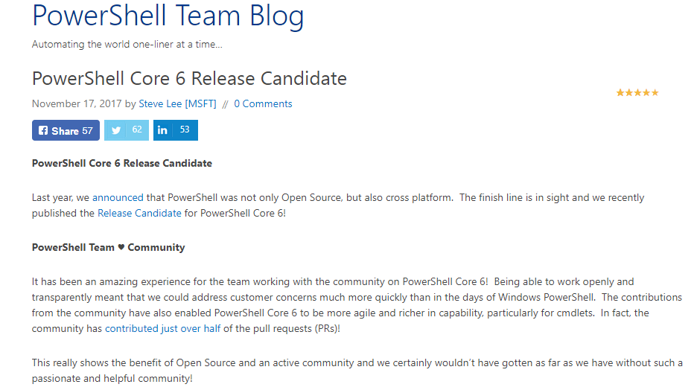
PowerShell news
PowerShell Core 6 Release Candidate: https://blogs.msdn.microsoft.com/powershell/2017/11/17/powershell-core-6-release-candidate/
GA is likely around Jan 10th 2018
6.1 already being discussed

Slide 14
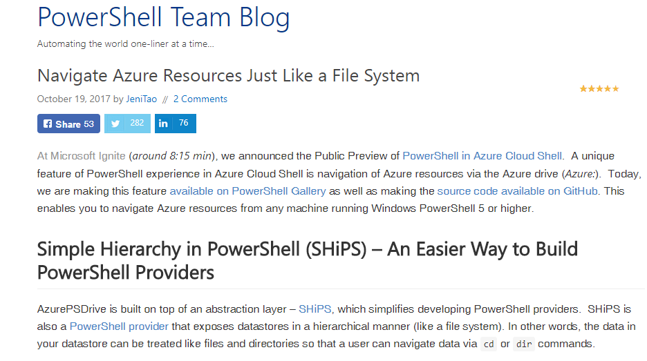
Question from last time
https://blogs.msdn.microsoft.com/powershell/2017/10/19/navigate-azure-resources-just-like-a-file-system/

Slide 15
Hurry up and move on!

