Slide 1

PowerShell User Group
South Coast 17/10/2017
@UKSthCoastPSUG

Slide 2
agenda!
7.00pm - Arrival
7.30pm - Welcome / User Group Introduction - @jonathanmedd
7.35pm - PowerShell Core Introduction - @iainbrighton
8.15pm - Break / Pizza / Refreshments
8.45pm – Azure PowerShell 101 - @jonathanmedd
9.30pm - Wrap up / Close

Slide 3
Welcome and Practicalities
Fire exits
Respect our hosts
Deposit and Public Liability Insurance is on me
THANK YOU!

Slide 4

Sponsor!

Slide 5
User Group
Aim to meet roughly every 1 – 2 months
Tue November 21st – speakers Rob Sewell / Daniel Krebs
December TBC – if we do something, it’ll be a social event
Hands up if you want us to arrange something!
We’ll be setting dates for Jan, Feb and Mar shortly

Slide 6
Want to present?

Slide 7
We need!
Speakers
Some lined up, discussions ongoing
Topic ideas – we need to know what you want to hear about
PowerShell Gallery - Rob is talking on this in November
GitHub 101
Azure PowerShell 101
PowerShell DSC

Slide 8

Communication
Meetup.com - https://www.meetup.com/UK-South-Coast-PowerShell-User-Group/
Twitter - https://twitter.com/UKSthCoastPSUG
Slides and content will appear here: https://github.com/powershellorguk/SouthCoast
More on that last URL……

Slide 9
Links to other PowerShell User Groups
London
Scotland
Manchester
This has already benefited us with speakers and co-organisation of PSDayUK

Slide 10
Other PowerShell events
PS ConfEU – Hanover, Germany
April 17-20, 2018: Registration opens end of Nov 2017
http://www.psconf.eu/
PowerShell Summit – Seattle, USA
April 9 – 12, 2018: Registration opens Nov 1st 2017
https://powershell.org/summit/

Slide 11
Other Local tech Groups
Southampton Digital - https://southampton.digital/
southamptondigital.slack.com
Docker Southampton - https://www.meetup.com/Docker-Southampton/
DevOps Southampton - https://www.meetup.com/meetup-group-kGbkdRBh/
SQL Southampton - https://www.meetup.com/Southampton-SQL-Server-User-Group/
Dev SouthCoast - https://www.meetup.com/DeveloperSouthCoast/

Slide 12
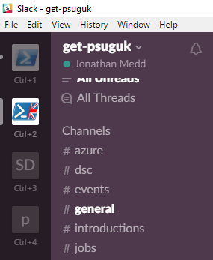
Slack
https://get-psuguk.slack.com/signup

Slide 13
Hurry up and move on!

