Slide 1

PowerShell User Group
South Coast 27/06/2017
@UKSthCoastPSUG

Slide 2
agenda!
7.00pm - Arrival
7.30pm - Welcome / User Group Introduction - Jonathan Medd @jonathanmedd
7.35pm - Can VSCode replace ISE? - Daniel Krebs @Dan1el42
8.15pm - Break / Pizza / Refreshments
8.45pm - Build Automation with psake - Dave Green @neongreenie
9.30pm - Wrap up / Close

Slide 3
Welcome and Practicalities
Fire exits
Respect our hosts
Deposit and Public Liability Insurance is on me
THANK YOU!

Slide 4

Sponsor!

Slide 5
User Group
Aim to meet roughly every 1 – 2 months
Tue September 19th
Tue October 17th
Tue November 21st
December TBC – if we do something, it’ll be a social event
Notification from Meetup.com once the speakers are confirmed, but you can RSVP now

Slide 6


Slide 7
We need!
Sponsor – we have one!
Without one it will cost around £150 to host each meetup
At least one person, ideally two, to help Nigel and I run the group
Speakers
Some lined up, discussions ongoing
Topic ideas – we need to know what you want to hear about

Slide 8
Communication
Meetup.com - https://www.meetup.com/UK-South-Coast-PowerShell-User-Group/
Twitter - https://twitter.com/UKSthCoastPSUG
Slides and content will appear here: https://github.com/powershellorguk/SouthCoast
More on that last URL……

Slide 9
Links to other PowerShell User Groups
London
Scotland
Manchester
Ongoing discussions with leaders from all groups around co-ordinating activities under one organisation, but remaining locally independent

Slide 10

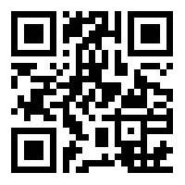
Join the PSUG Slack TEAM
We’re here:
https://get-psuguk.herokuapp.com
Or
http://bit.ly/2eQyxOD

Slide 11

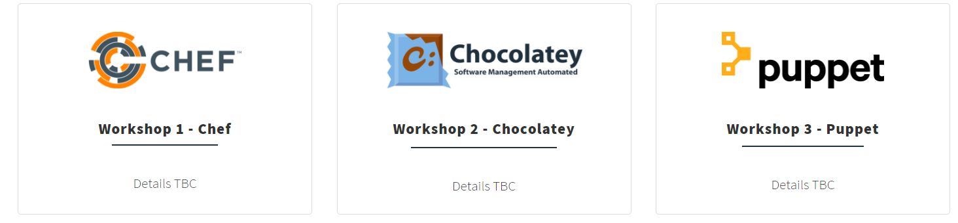
Other events
WinOps 2017
Wed 20 – Thr 21st September
Tickets are sale – early bird pricing
Keep Fri 22nd free if you are interested in PowerShell at the same venue……..

Slide 12
Hurry up and move on!

