Slide 1

PowerShell User Group
Southampton 24/04/2018
@PSSouthampton

Slide 2
Happy 1 year Birthday (almost)
Our first Meetup was 26th April 2017

Slide 3
agenda!
7.00pm - Arrival
7.30pm - Welcome / User Group Introduction - @jonathanmedd
7.35pm - Part 1 - Getting Started with a DSC Pipeline - @gaelcolas
8.15pm - Break / Refreshments
8.45pm – Part 2 - Automating everything with Microsoft Flow - @Jaap_Brasser
9.30pm - Wrap up / Close

Slide 4
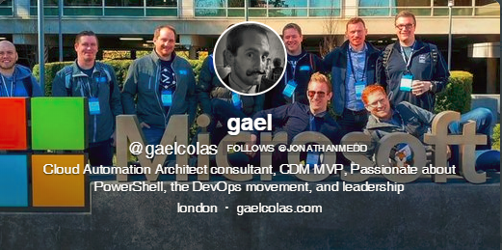
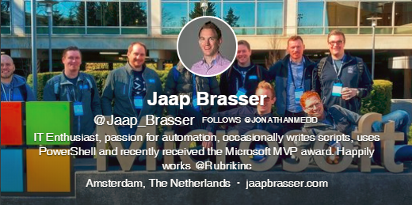

Presenters
There’s nothing like having an original Twitter profile picture……………

Slide 5
Welcome and Practicalities
Fire exits
Respect our hosts
Deposit and Public Liability Insurance is on me
THANK YOU!

Slide 6
WIFI for tonight
SSID: ASA-Guest-Network
Password: Welcome-To-ASA

Slide 7
User Group
Aim to meet roughly every 1 – 2 months
Tue May 22nd
Wed June 20th

Slide 8
SPONSOR
We’re looking for a new one…we have a few leads, but…..

Slide 9
Want to present?

Slide 10
We need!
Speakers
Some lined up, discussions ongoing
Topic ideas – we need to know what you want to hear about
GitHub 101
Azure PowerShell 101
PowerShell DSC

Slide 11
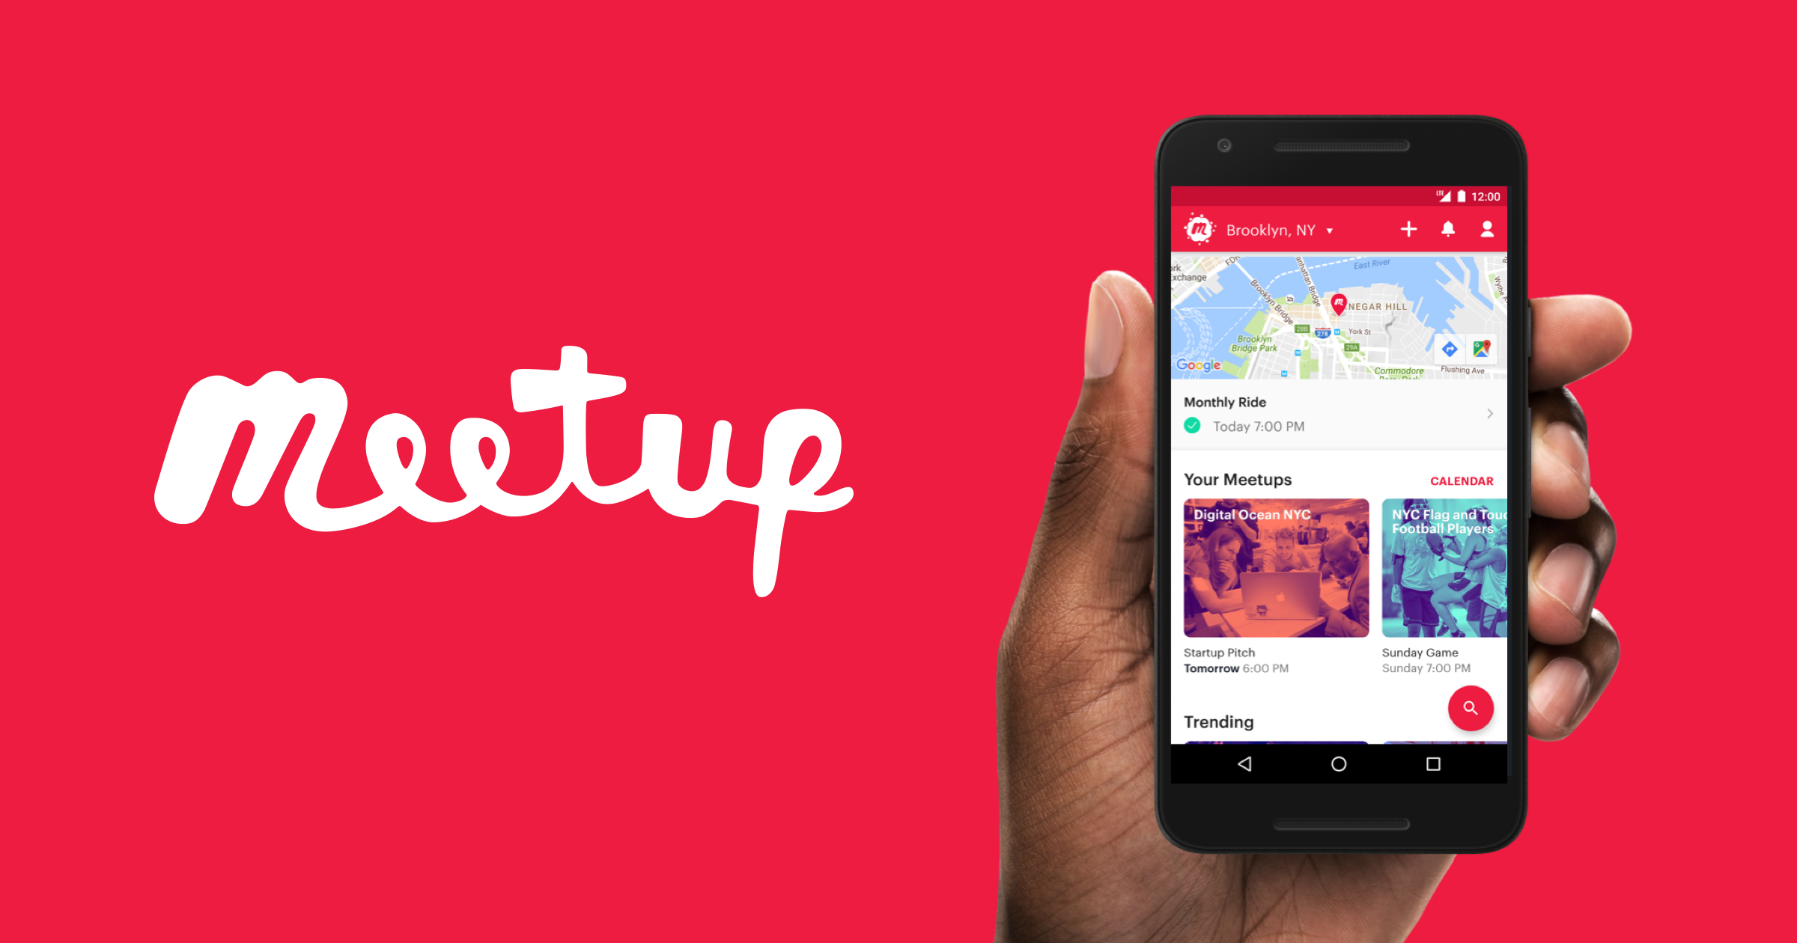
Communication
Meetup.com - https://www.meetup.com/PowerShell-Southampton
Twitter - https://twitter.com/PSSouthampton
Slides and content will appear here: https://github.com/powershellorguk/SouthCoast
Note the rename to PowerShell Southampton!

Slide 12
Hurry up and move on!

