Slide 1
PowersHell 2019 Hashtable & sPLATTING
Emad
Twitter: @Gobiman

Slide 2
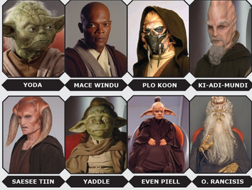
Jedi Council
Please ask Questions.

Slide 3
Hashtable
Data Structure
Key\Value pair (Dictionary or associative array)
Examples
key = Name, Value = Telephone Number
Key = HostName, Value = IP Address(es)

Slide 4


Jedi Council

Slide 5
Demo

Slide 6
Creating Hash Tables
To create a hash table, follow these guidelines:
Begin the hash table with an at sign (@).
Enclose the hash table in braces ({}).
Enter one or more key/value pairs for the content of the hash table.
Use an equal sign (=) to separate each key from its value.
Use a semicolon (;) or a line break to separate the key/value pairs.
Key that contains spaces must be enclosed in quotation marks. Values must be valid PowerShell expressions. Strings must appear in quotation marks, even if they do not include spaces.
To manage the hash table, save it in a variable.
When assigning an ordered hash table to a variable, place the [ordered] attribute before the "@" symbol. If you place it before the v

