Slide 1

PowerShell User Group
Southampton 20/02/2018
@PSSouthampton

Slide 2
agenda!
7.00pm - Arrival
7.30pm - Welcome / User Group Introduction - @jonathanmedd
7.35pm - Part 1 - Working with REST APIs in PowerShell - @jonathanmedd
8.15pm - Break / Refreshments
8.45pm – Part 2 - Working with REST APIs in PowerShell - @jonathanmedd
9.30pm - Wrap up / Close

Slide 3
Welcome and Practicalities
Fire exits
Respect our hosts
Deposit and Public Liability Insurance is on me
THANK YOU!

Slide 4
User Group
Aim to meet roughly every 1 – 2 months
Tue Mar 20th – PowerShell DSC special with @iainbrighton
Bring your laptops for a hands on workshop in part 2

Slide 5
SPONSOR
We’re looking for a new one

Slide 6
Want to present?

Slide 7
We need!
Speakers
Some lined up, discussions ongoing
Topic ideas – we need to know what you want to hear about
GitHub 101
Azure PowerShell 101
PowerShell DSC

Slide 8
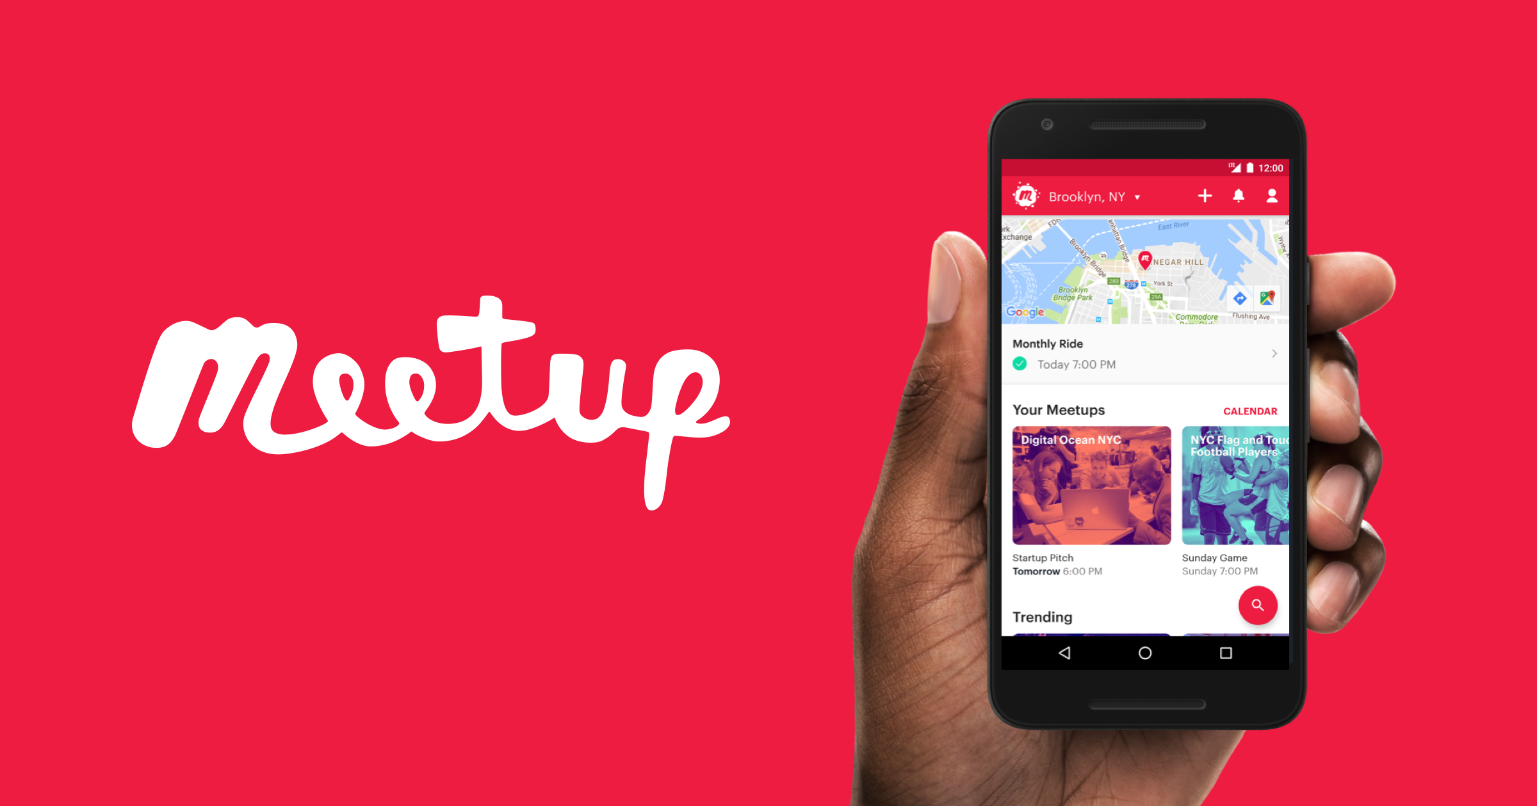
Communication
Meetup.com - https://www.meetup.com/PowerShell-Southampton
Twitter - https://twitter.com/PSSouthampton
Slides and content will appear here: https://github.com/powershellorguk/SouthCoast
Note the rename to PowerShell Southampton!

Slide 9
Links to other PowerShell User Groups
London
Scotland
Manchester
This has already benefited us with speakers and co-organisation of PSDayUK

Slide 10
Other PowerShell events
PS ConfEU – Hanover, Germany
April 17-20, 2018: Registration open
http://www.psconf.eu/
PowerShell Summit – Seattle, USA
April 9 – 12, 2018: Registration open
https://powershell.org/summit/
PowerShell & WinOps Fundamentals (Online monthly)
https://www.eventbrite.com/e/powershell-winops-fundamentals-tickets-38501821986

Slide 11
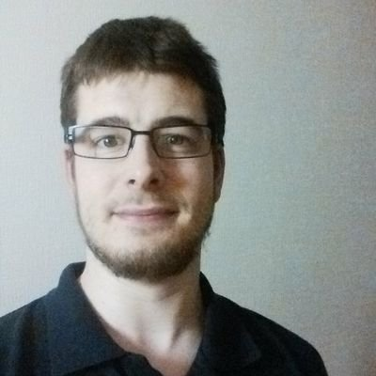

Thank you dave!
….and your projector

Slide 12
Hurry up and move on!

