Slide 1
Building a lab with PowerShell
Chris Murray - @chris18890

Slide 2
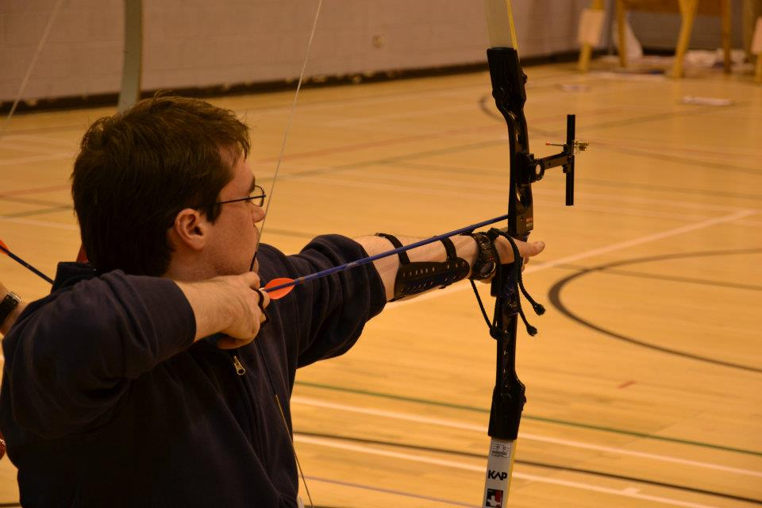

Who am I?
Chris Murray
Infra consultant at HCC (relocated from Belfast Jan 2017)
Makerspace Member
@chris18890 – Twitter/GitHub/LinkedIn/<insert social network here>
“working knowledge” of PowerShell

Slide 3
Why & how to lab
Testing
Learning
Fun?
Physical
Virtual
Local
Cloud based

Slide 4
Prerequisites
Lots of RAM
Relatively modern CPU that support VT-x, the more cores the better!
Lots of RAM
Virtualbox (https://virtualbox.org)
Open source, cross-platform
Could also use other Type 1/Type 2 Hypervisors
Windows ISOs
Lots of fast (SSD) storage
…Did I mention RAM?

Slide 5
Lab makeup
1 Server 2016 (full gui) VM (2 NICs, 2 GB of RAM, 100+ GB vDisk)
1 NIC connected to public/NAT network for internet access
1 NIC connected to internal/VM-only network
RRAS, DHCP, & WDS Server roles, AAD Connect
1 + Server 2016 core VM (1 NIC/1 GB of RAM, 100+ GB vDisk each)
AD DC + File/DFS server
1+ Win 7/Win 10 VMs (1 NIC/2 GB of RAM, ~50 GB vDisk each)
(optional) Office 365 (trial) subscription

Slide 6
Demo – Walkthrough of Scripts
Scripts location - https://github.com/chris18890/bts-scripts/

Slide 7
Demo – VirtualBox interface & creating VM

Slide 8
Demo – Using scripts

Slide 9
Other products/apps
AutomatedLab - https://github.com/AutomatedLab/AutomatedLab
https://docs.microsoft.com/en-us/exchange/plan-and-deploy/deploy-new-installations/create-azure-test-environments?view=exchserver-2016

Slide 10
Fin
Questions?

