Slide 1


AIIM – 2024
Insights on Computation Biology
& Structural Visualization of
Proteins
Anirudh Gupta, Susmit Roy
IISc Software

Slide 2
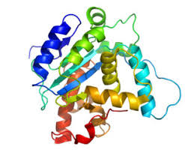
What we will cover today – Part I
Introduction to Computation Biology
Introducing Softwares used in Protein Visualisations like Pymol, Chimera, etc.
Brief discussion on various file types used eg. pdb, pqr, xyz, dx, etc.
Understanding Pymol UI
  Protein Visualisation
  Displaying sequences and messing around
  Alighnments of two proteins
  Morphing of two proteins
  Mutations

Slide 3
What we will cover today – Part II
Pymol with Python
Introduction to APBS used for Electrostatics
  Idea and Concepts behind APBS
  Calculating values using Web servers
Pymol and APBS
Command Line and Automation with APBS
Q n A’s

Slide 4
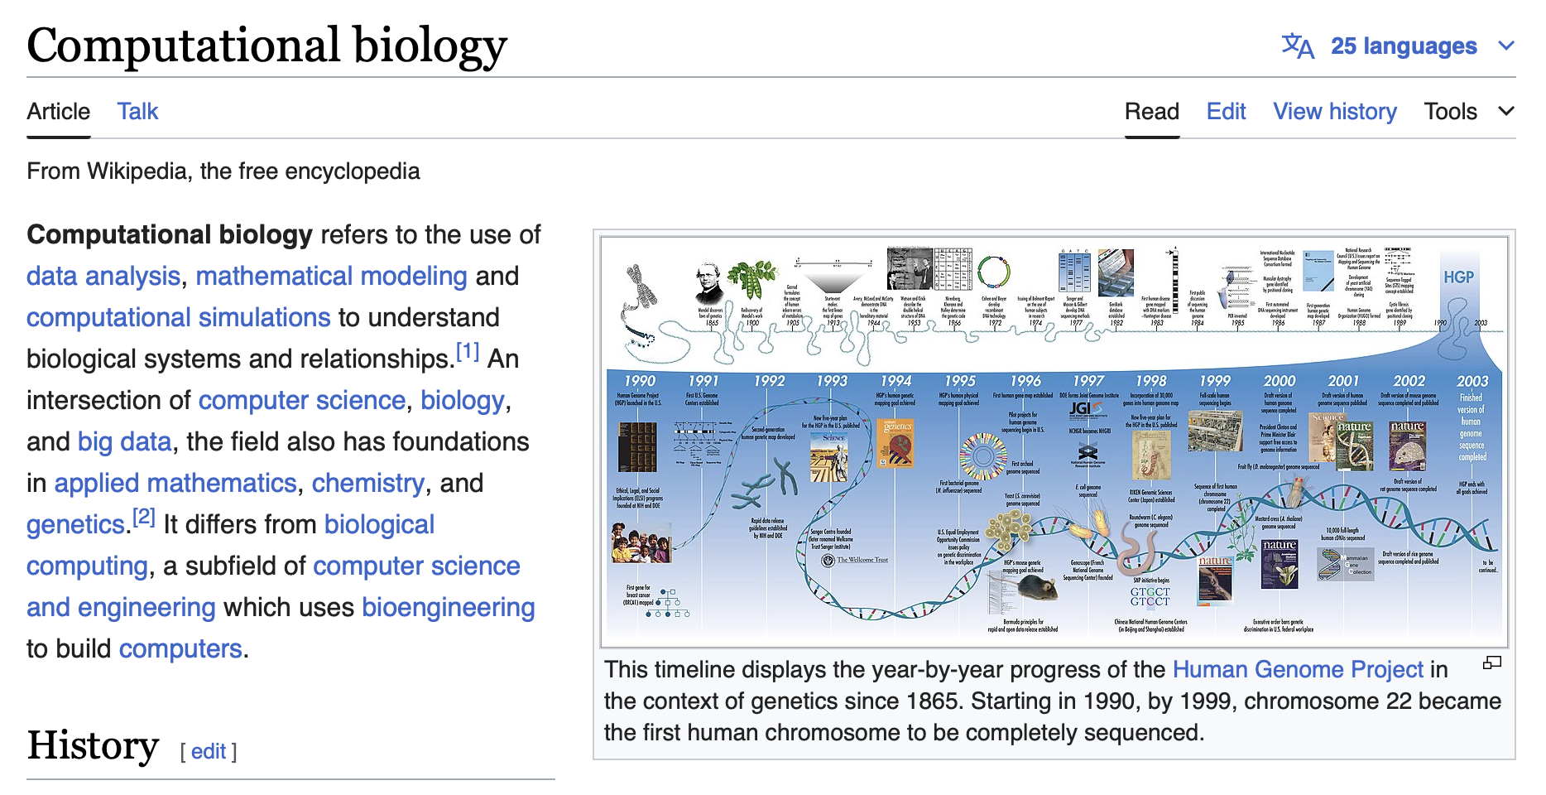
Introduction to Computational Biology
All of you may already know what computational biology by know, cause everyone here is a part of iGEM.
In short

Slide 5
Computation Biology for Protein Analysis
So what exactly is the role of computational biology in Protein Analysis???
Structural Prediction:
It enables the prediction of protein structures from amino acid sequences, providing insights into protein function and interactions.
Molecular Dynamics Simulations:
Simulations help in understanding the dynamic behavior of proteins, including conformational changes, folding processes, and interactions with other molecules.
Interaction Mapping between other biomolecules:
Computational tools enable the mapping of protein-protein and protein-ligand interactions, which is crucial for understanding cellular pathways and mechanisms. This includes docking.
High-Throughput Analysis:
Computational biology allows for the rapid analysis of large datasets, such as those generated by high-throughput sequencing, to identify and visualize potential protein structures and functions.

Slide 6
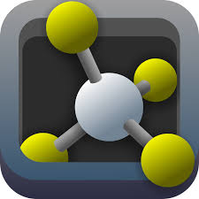
Softwares used for Protein Analysis
PYMOL
We will be using PyMOL today.
UCSF CHIMERA
Yet another and commonly used Protein Structure Visualiser
RasMOL
APBS Web server
For performing electrostatic calculations and visualizing them too
Etc.

Slide 7
Let’s Discuss Various Files commonly used
1. PDB(Protein Data Bank)
PDB files are the most important files used for getting raw data for various proteins. It contains subsections containing different types of data which can be utilized for various operations –
HEADER
It contains metadata about the PDB file, including the date of deposition, the molecule's name, and the source of the molecule. It often includes information about the experiment used to determine the structure, such as X-ray crystallography or NMR spectroscopy.
2. COMPOUND, HELIX’s RECORDS
This section provides the title of the experiment and detailed information about the molecules in the structure. The "COMPND" records specify the name of the molecule, chain identifiers, enzyme classification (EC) numbers, and other relevant details. Relevant information related to “HELIX” and other secondary structures are also present.

Slide 8
3. HETATM RECORDS
HETATM records describe heteroatoms, which are atoms not part of the standard amino acids or nucleotides. These might include metal ions, water molecules, ligands, or other small molecules. Each HETATM record specifies the atom's position in 3D space, the residue it belongs to, and its occupancy and temperature factor.
4. ATOM RECORDS
ATOM records provide the atomic coordinates for all atoms in the standard residues (amino acids for proteins, nucleotides for DNA/RNA). Each record includes information about the atom type, residue name, chain identifier, residue sequence number, and the x, y, z coordinates of the atom. It also includes the occupancy (which indicates the fraction of molecules in the crystal that contain the atom at the given position) and the temperature factor (which indicates the mobility of the atom).
5. Connectivity Records:
The connectivity section includes records such as CONECT, which describes the bonding between atoms in the structure, particularly important for non-standard residues and ligands. This section helps in understanding the molecular interactions and the chemical environment within the structure.

Slide 9
2. PQR File
P – Position Q- Charge R- Radius
This type of file is very important in terms of using for calculations and visualisations.
Many web servers and softwares prefer PQR Files for faster results
Does NOT usually contain METADATA (you can put if you want)
It contains information readily usable similar to section 4 of PDB.
P gives x y z coordinates, Q gives the charge at each atom and R gives the radius of each atom

Slide 10
3. XYZ Format
Very straight forward, it gives you the atom name, x y z coordinates with respect to origin.
This file is obtained when you use apbs command line to get the potential of each grid points.
The format is as mentioned in website at:
4. dx file for potentials(apbs)

Slide 11
PYMOL UI: Let’s get our hands dirty
Pymol is one of the software's used for structural visualizations of proteins along with various functionalities like mutations, alignment, morphing, APBS electrostatics, and many more.
PART 1:
Let’s understand the basic motions of Pymol Practically.

Slide 12
PART 2: Displaying sequences and Coloring
The sequences can be displayed using options present in pymol. You can also view the 3 letter or 1 letter codes for the.
Coloring is done by selecting a set of residues and going to the Color section, pick a shape and color.
PART 3: Alignment between 2 proteins
Protein alignment is very important aspect in understanding differences between conformations of proteins. You can do it using command `super` or using the inbuilt `align` function.

Slide 13
PART 4: Morphing two proteins
Morphing of proteins means creating a visual animation like showing you possible way of conversion from one form of protein to the other
PART 5: Mutations
Pymol allows mutations of residues with various rotamers to choose from. No 1 rotamer has maximum % of occurrence is usually chosen. However it may not be the one with the least strain.
For large proteins, point mutations wont effect the structure too much, but for very small proteins, it is recommended to use AlphaFold or search PDB for your protein.

Slide 14
PYTHON AND PYMOL
One of the big advantages of using Pymol is its ability to run python codes thus make it easy for automation
The `pymol` library supports `cmd` which allows the use of various functionalities like morphing, aligning, coloring, selecting residues, mutations, etc.
NOTE:
You cannot run python code in your terminal, you would have to run the python code by going to the directory containing the code inside the PYMOL COMMAND LINE and entering the command –
run pymol_code.py
Let’s look at various examples -

Slide 15
List of Some commands for python
GENERAL COMMANDS
cmd.fetch(protein)
cmd.align(protein1, protein2)
number_of_states = cmd.count_states("morph")
cmd.set_name(old_name, new_name)
cmd.delete(name)
cmd.create(name, selection) # for selection

Slide 16
List of Some commands for python
FOR MUTATIONS (in order)
cmd.wizard("mutagenesis")
cmd.get_wizard().set_mode(mutant)
cmd.get_wizard().do_select(f"chain A and resid {n}")
cmd.frame(1)
cmd.get_wizard().apply()
cmd.wizard(None)

Slide 17
APBS ELECTROSTATICS
(Adaptive Poisson Boltzmann Solver)
WHAT IS APBS?
It describes electrostatic interactions between molecular solutes in a solvent. This is crucial for understanding how charges within and around a protein influence its structure and function.
APBS calculates the electrostatic potential of biomolecules, providing insights into the distribution of electric charges.
The electrostatic potential maps generated by APBS can be visualized to reveal regions of positive and negative charge on the protein surface. T

Slide 18
USING APBS
PART 1: WEB SERVERS
There are many webservers among which the two primary webservers to use are
  APBS Webserver
  DelPhi
These webservers are easy-to-use, paramaters can also be easily set and results are calculated within minutes or more(depending on the size of protein).
Let’s take a look at Both of these APBS Webservers and do some calculations on them

Slide 19
Command line tool usages
The two main tools we will use are –
  Pdb2pqr – to convert pdb to pqr, generation of input files, changing ph and setting other properties
  Apbs – which calculates the potentials for us
BENEFITS OF THESE
Automating our work.
Calculating apbs values without using webservers can be faster and more flexible.
Some people (like me) just prefer command line

Slide 20
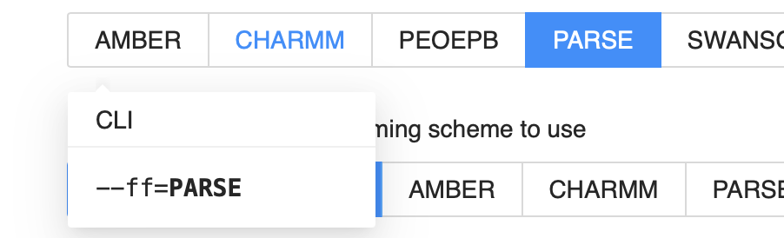
PDB2PQR and input file for APBS
We cannot input a pdb file to a apbs command line. There a protein.in is inputted with a particular format. Let’s take a look at the documentations on how this works.
Good thing is pdb2pqr command automatically generated the best input file wherein we can setup our parameters for the process to run.
Lets’s have a practical example of pdb2pqr!
If you don’t understand what to use to get the best output, the webservers provide an amazing feature of highlighting the parameters for you

Slide 21
But what does pdb2pqr exactly do?
Adding a limited number of missing heavy (non-hydrogen) atoms to biomolecular structures.
Estimating titration states and protonating biomolecules in a manner consistent with favorable hydrogen bonding.
Assigning charge and radius parameters from a variety of force fields.

Slide 22
Running APBS
Once you are done with the input file. Just run the magic!
From this you will get a .dx file whose format is as we discussed before. You will have to write a code which will extract the potential at each grid point.
You can visualize this in PYMOL, webserver or any other software as well!

Slide 23
That’s it!
QnA’s
THANK YOU!

