Slide 1
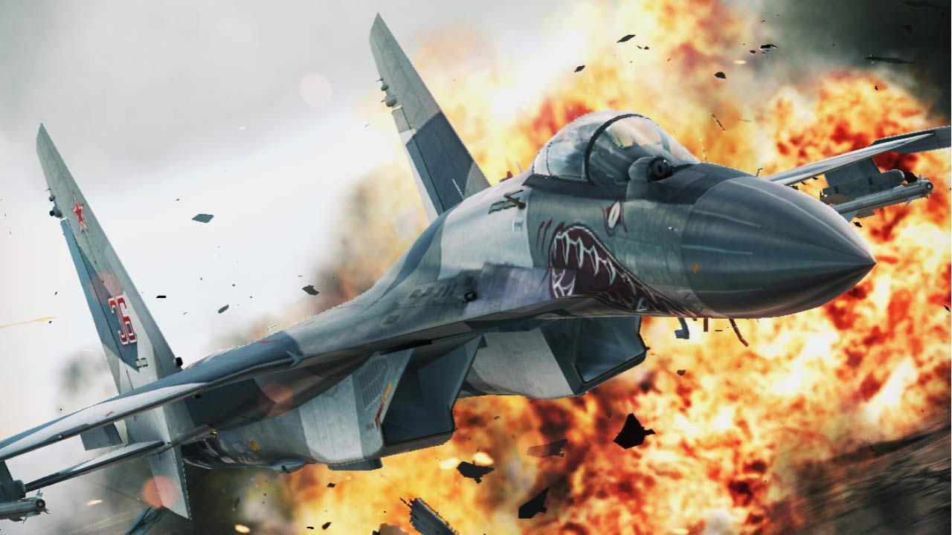
Airplane Sky-Force

Slide 2
Team Name : The Still Variable
Team members:
Anwar Kabir Sajib
Roll:ASH1825038M
Kamruzzaman Shekh
Roll:ASH1825035M
Emran Hossain
Roll:ASH1825002M
Team Mentor:
Dipok Chandra Das
Lecturer of IIT,NSTU

Slide 3
Contents:
Introduction
Requirement of the project
Implementation of requirement
Project primary Output Examples
Final Implementation output

Slide 4
Introduction:
It is very interesting to play our own developed game . Beside these It is more interesting to watch anyone else playing our own developed game . with these inspiration we are starting our project Airplane sky-force game . This project was developed during the 3rd semester of BSSE 1st Batch, IIT,NSTU, from January 2019 to end of the semester .

Slide 5
Requirement of the Game
There will be a air fighter who continuously throw bullet and destroy enemy who are coming from opposite direction.
Opposite direction enemy will be 4 or 5 type different colour airplane
Air fighter must have a life strength.
There must be level
Background scenery will change dynamically.
Game will continue a time period which user define type.
There will also some air fighter model.one can bye these model with his or her obtain coin..
Fighter Airplane can through 2 or 3 times its special bullet package

Slide 6
What we complete in our project:
There will be a air fighter who continuously throw bullet and destroy enemy who are coming from opposite direction.
Opposite direction enemy will be 4 or 5 type different colour airplane
Air fighter must have a life strength.
There must be level
Background scenery will change dynamically.
Game will continue a time period which user define type.
Incompleteness of our project:
There will also some air fighter model.one can bye these model with his or her obtain coin..
Fighter Airplane can through 2 or 3 times its special bullet package

Slide 7
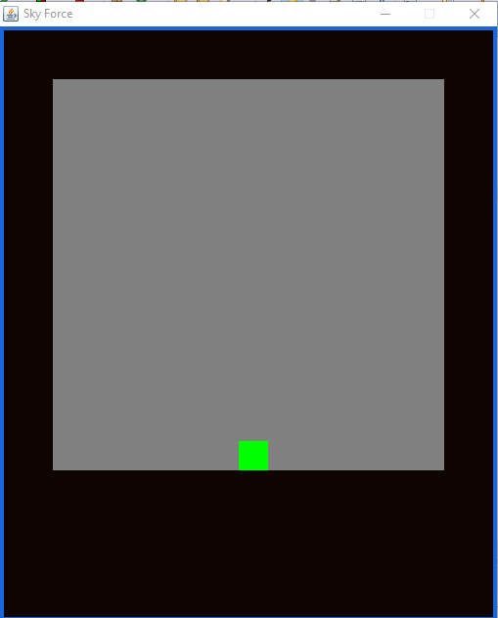
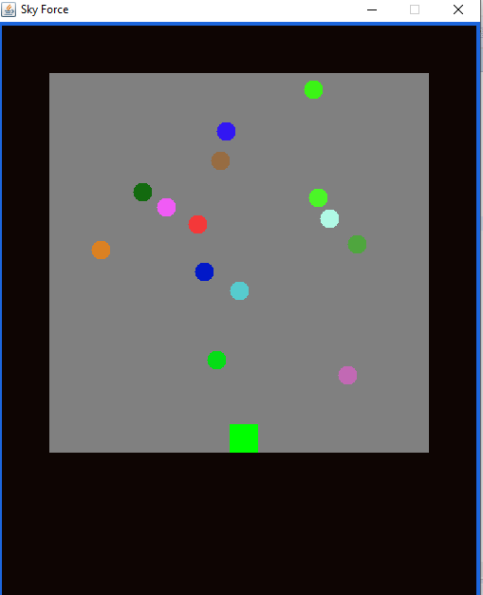
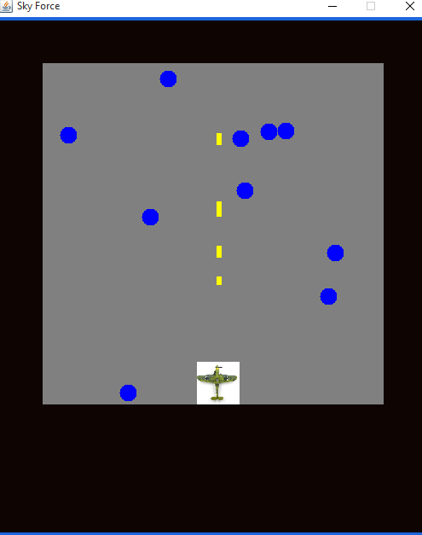
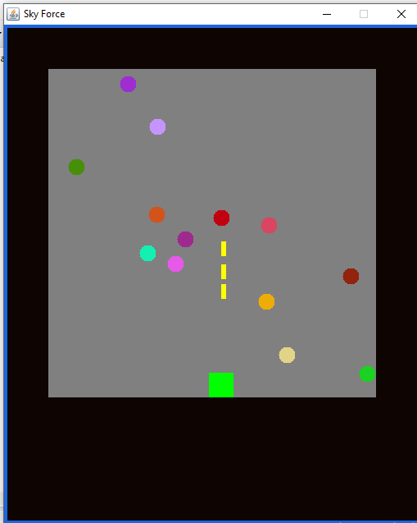
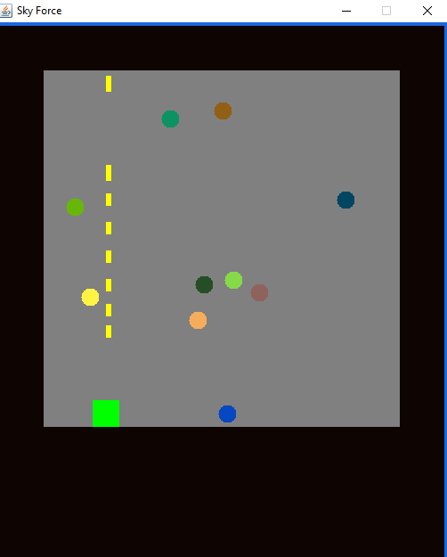
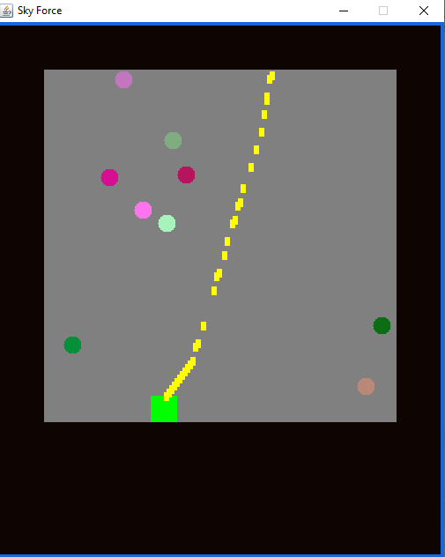
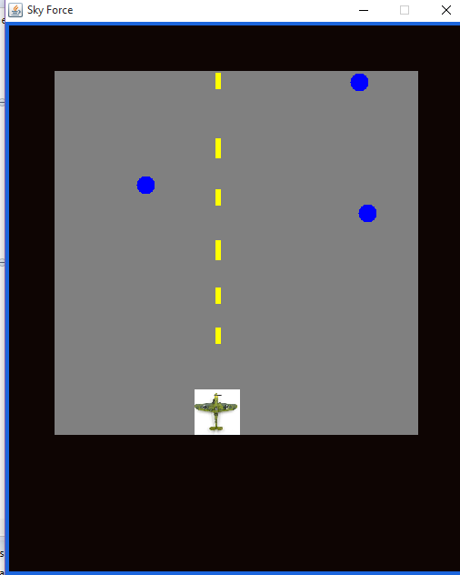
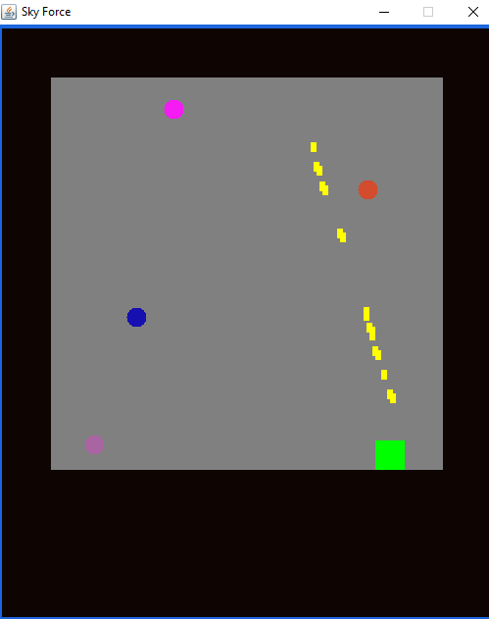
Primary output figures:

Slide 8
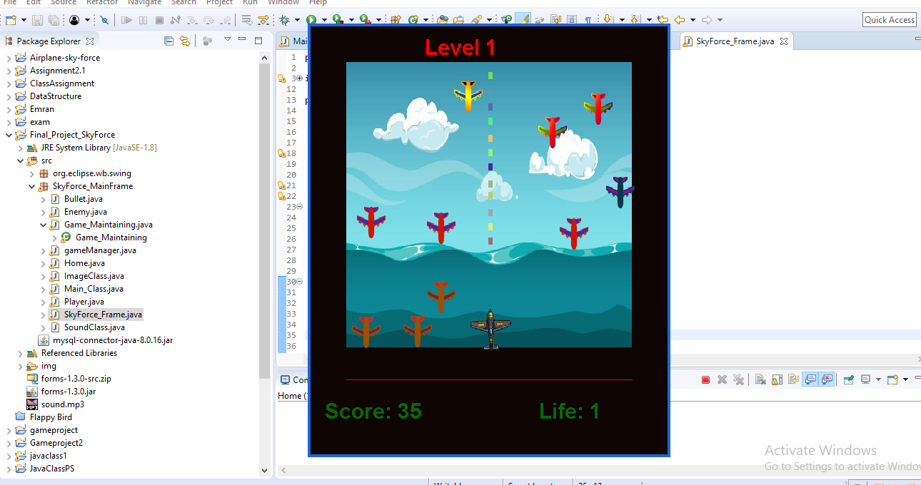
Final Implementation Output:

Slide 9
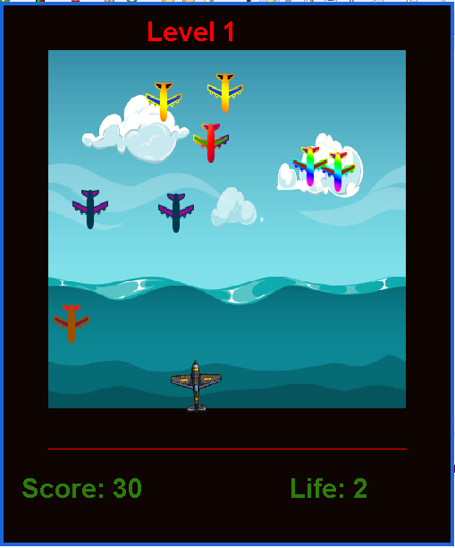
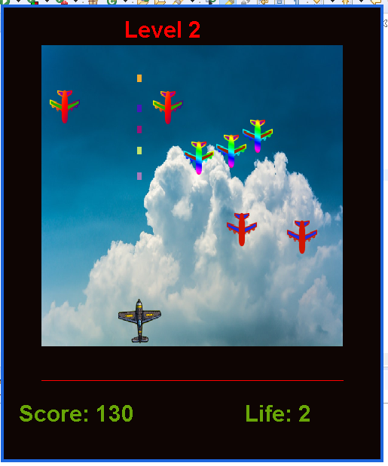
Final Implementation Output with level wise:

Slide 10
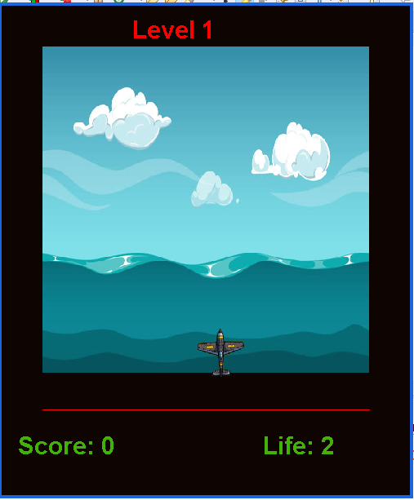
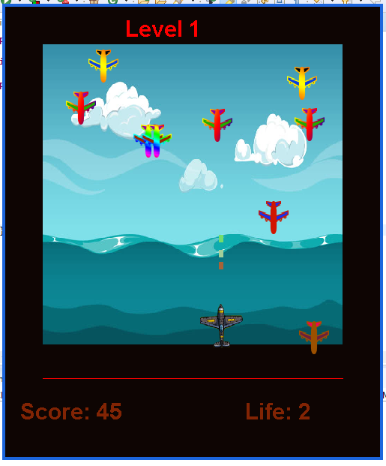
Implementation Output Examples:

Slide 11


