Slide 1

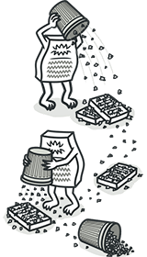
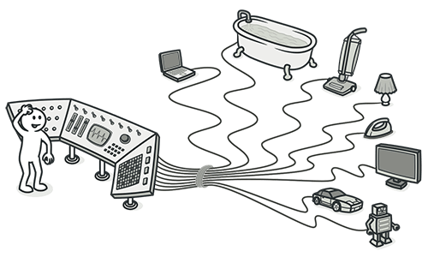
On the Influence of Human Factors for Identifying Code Smells
A Multi-Trial Empirical Study
Rafael Maiani de Mello
Department of Informatics, PUC-Rio
Roberto Oliveira
Department of Informatics, PUC-Rio
Alessandro Garcia
Department of Informatics, PUC-Rio
05/03/2023
01

Slide 2
Presented To
Dipok Chandra Das
Assistant Professor Institute of Information Technology(IIT) Noakhali Science and Technology University
05/03/2023
02

Slide 3
Presented By
Prosanto Deb
ASH1925005M
Year 03, Term 02 Institute of Information Technology(IIT) Noakhali Science and Technology University
05/03/2023
03

Slide 4
Table of contents
01
02
03
04
05
06
Problem Domain
Background and related work
Experiment Trials
Results and Finding
Limitations
Future Work
05/03/2023
04

Slide 5
Problem Domain
Code smells are symptoms of poor design problems observed
in the low-level structure of a software system
05/03/2023
05

Slide 6
The study investigates the influence of three human factors
Professional background
Module knowledge
Collaboration
Previous background in code reviews is not essential to
reach higher precision
Significantly
increases the precision of code smell identification
To reach high precision rates
05/03/2023
06

Slide 7
Background and Related Works
M. Fowler, 1999
I Macia, 2012
J. Padilha, 2014
“Refactoring: Improving the Design of Existing Code”. A Long Method tends to implement two or more concerns that should not be
together in a single method.
“Are Automatically-Detected Code Anomalies Relevant to Architectural Modularity?” Relied on the reports of the developers of the studied systems to support their analyses.
“On the Effectiveness of Concern Metrics to Detect Code Smells: An Empirical Study”. Same as I Macia,2012
M. Ferreira, 2014
F. Palomba, 2014
R. Oliveira, 2016
“Detecting Architecturally-Relevant Code Anomalies: A Case Study of Effectiveness and Effort”. Relied on the reports of a single reviewer.
“Do They Really Smell Bad? A Study on Developers' Perception of Bad
Code Smells,” found that developers without system knowledge frequently reported more
code smells, such as Feature Envies.
“Identifying Code Smells with Collaborative Practices: A Controlled Experiment” found that reviewers working in collaboration tend to share
complementary knowledge and reach consensus about smell occurrences.
05/03/2023
07

Slide 8
Strategy
Step 1
Step 3
Step 5
Population, Samples, and Systems
Composition of the Reference List
Validation
Step 2
Step 4
Modules Selection and Code Smells
Experimental Design
05/03/2023
08

Slide 9
Population, Samples, and Systems
Text T1 describes a study conducted in a Software Engineering class from a Brazilian University with 28 bachelor students as subjects.
The subjects were novice developers
Had no previous background in industrial software projects
Did not have any previous knowledge of such systems
while others had worked on an Agile Software Development course called Software Kaizen.
05/03/2023
09

Slide 10
Modules Selection and Code Smells
In the scope of T1, the following subset of code smells was considered:
Data Class
Duplicated Code
Lazy Class
Long Method
Message Chain
These types were selected because previous studies have reported that they occur most frequently.
05/03/2023
10

Slide 11
Composition of the Reference List
The researchers involved in the development of the three systems established the reference list for the code smells detected by the smell detection tool in the selected modules. They,
validated each code smell individually
attended a meeting to reach a consensus on any conflicts
The reference list was not definitive and was updated after the execution of the identification tasks. The whole process took 92 man-hours.
05/03/2023
11

Slide 12
Experimental Design
A training session was conducted to mitigate possible differences in awareness and knowledge on code smells.
The subjects were then asked to identify code smells in modules of each system along three rounds with a duration of 60 minutes each.
The authors adopted a crossed design to mitigate threats to validity concerning the influence of the learning curve over the results and the fact that one task could favor a specific treatment.
05/03/2023
12

Slide 13
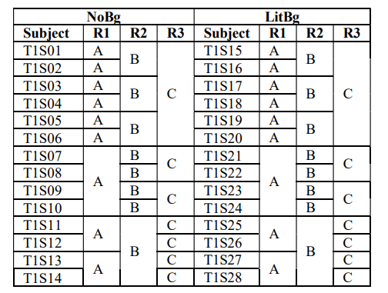
Experimental Design
NoBg: No professional background
LitBg: Little background
The authors selected three functional software projects – named as A, B, and C
Figure: Experimental Design From T1.
05/03/2023
13

Slide 14
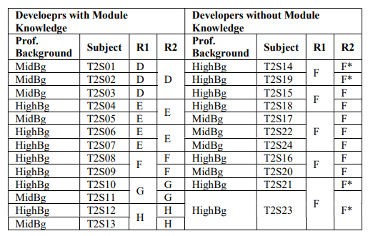
Experimental Design
Figure: Experimental Design From T2
05/03/2023
14

Slide 15
Evalution of Human Factors
The precision of smell identification achieved by reviewers with different levels of professional background are not different.
The precision of smell identification achieved by reviewers with and without module knowledge are not different.
The precision of smell identification performed individually and collaboratively are not different.
The precision of smell identification achieved by solo reviewers with and without module knowledge are different.
The precision of smell identification achieved by solo reviewers with different levels of professional
background are different.
The precision of smell identification achieved by collaborative reviewers with and without module knowledge are different.
05/03/2023
15

Slide 16
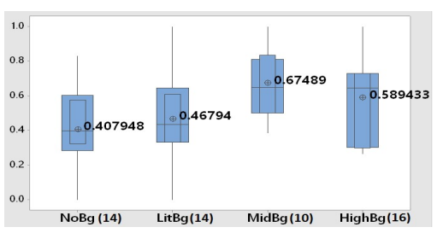
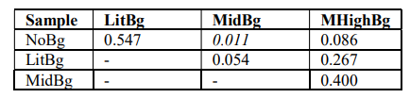
Results and Findings
Figure: P-VALUES: COMPARING PRECISION OF SOLO IDENTIFICATION
BY PROFESSIONAL BACKGROUND.
Figure: Precision by professional background: solo identification.
Even developers with high professional background tend not to reach high precision through solo smell identification
05/03/2023
16

Slide 17
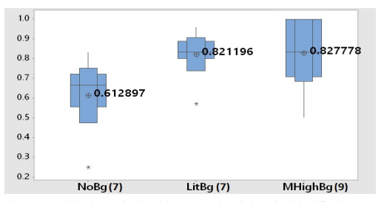

Results and Findings
Figure: P-VALUES: COMPARING PRECISION OF COLLABORATIVE
IDENTIFICATION BY PROFESSIONAL BACKGROUND.
Figure: Precision by professional background: collaborative identification
Collaborative identification performed by developers with
some professional background tend to reach high precision.
05/03/2023
17

Slide 18
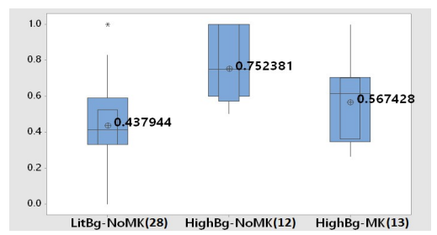

Results and Findings
Figure: P-VALUES: COMPARING PRECISION OF SOLO IDENTIFICATION
BY MODULE KNOWLEDGE AND PROFESSIONAL BACKGROUND.
Figure: Precision by module knowledge: solo identification
05/03/2023
18

Slide 19
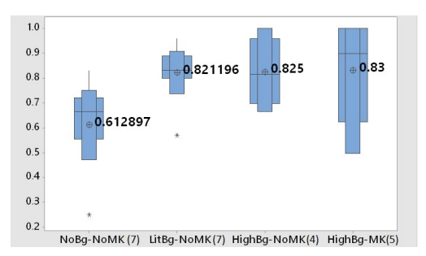

Results and Findings
Figure: P-VALUES: COMPARING PRECISION OF COLLABORATIVE
IDENTIFICATION BY MODULE KNOWLEDGE AND BACKGROUND.
Figure: Precision by module knowledge: collaborative identification
Module knowledge lead experienced reviewers to focus on
types of smells different from those frequently reported by
experienced reviewers without this knowledge.
05/03/2023
19

Slide 20
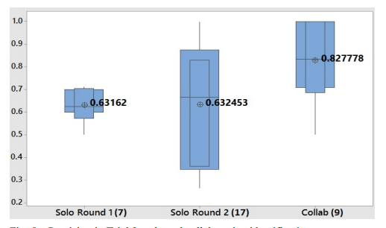

Results and Findings
Figure: P-VALUES: COMPARING PRECISION OF SOLO AND
COLLABORATIVE IDENTIFICATION FROM T2.
Figure: Precision in Trial 2: solo and collaborative identification.
Collaborative identification tasks performed by reviewers with a medium-high professional background tend to reach high precision when compared to solo identification.
05/03/2023
20

Slide 21
Limitations
Potential Threats
To the validity of a study on identifying code smells in software development
Differences in the protocol
In the trials, such as the number of code smells and complexity of the modules
Time Limit
The limited time for the tasks is also a threat, but has minimal impact on the results.
Uneven Sample Size
Trial was limited to Brazilian students and developers were external threats to validity
05/03/2023
21

Slide 22
Conclusion
Future Work
These findings can help researchers and project managers plan and allocate resources for smell identification tasks more effectively.
It includes investigating the influence of other contextual factors and developing evidence based guidelines to support the planning and conduction of smell identification tasks.
05/03/2023
22

Slide 23
Thanks
Do you have any questions?
Also available at prosato2514@student.edu.bd
05/03/2023
23

