Slide 1
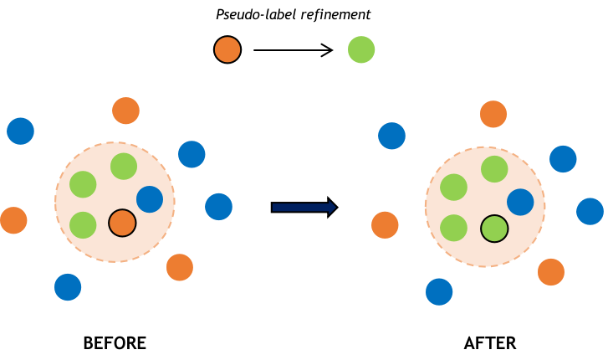
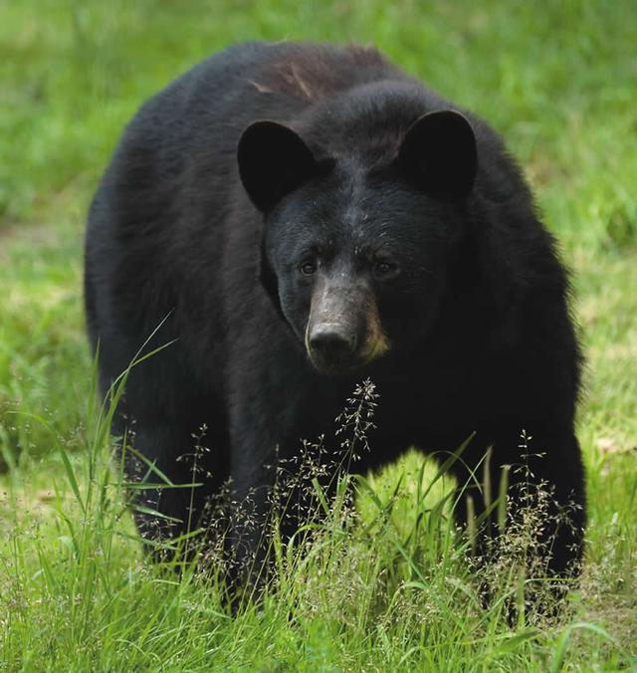
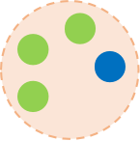
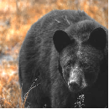

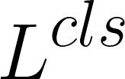


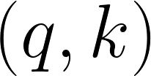

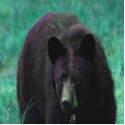


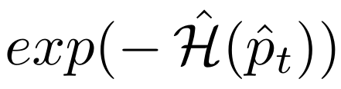
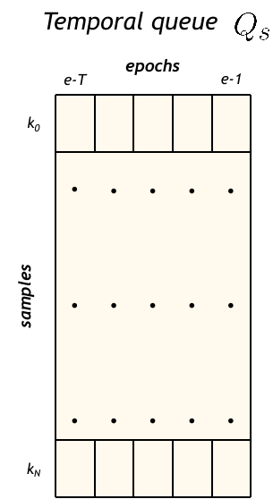




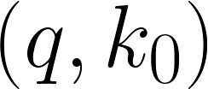
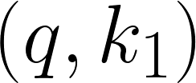
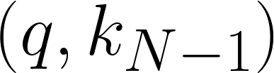
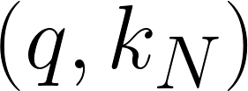
SOURCE
ENCODER
ENCODER
ENCODER
CLASSIFIER
Positive pairs
MOMENTUM
ENCODER
Keys queue features
Negative pairs
. . .

Slide 2
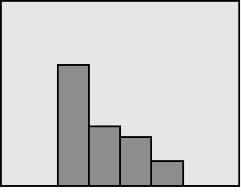
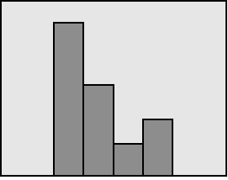
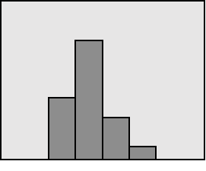
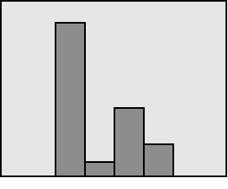
SOURCE
ENCODER
ENCODER
ENCODER
CLASSIFIER
MOMENTUM
ENCODER

Slide 3
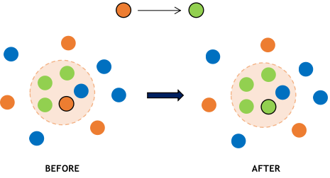

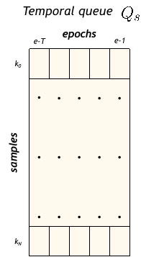
CLASSIFIER
FEATURE
EXTRACTOR
CONTRASTIVE
FRAMEWORK
Uncertainty estimation
0.7 | 0.1 | 0.2
Negative Pairs Exclusion

Slide 4
CLASSIFIER
FEATURE
EXTRACTOR
CONTRASTIVE
FRAMEWORK
0.7 | 0.1 | 0.2
...
Uncertainty estimation

Slide 5
SOURCE
ENCODER
ENCODER
BEFORE
AFTER

Slide 6






Temporal queue
epochs
e-T
e-1
.
.
.
k₀
. | . | . | . | .
. | . | . | . | .
. | . | . | . | .
0
1
.
.
.
1
0
samples
Keys features
k_{N}

Slide 7
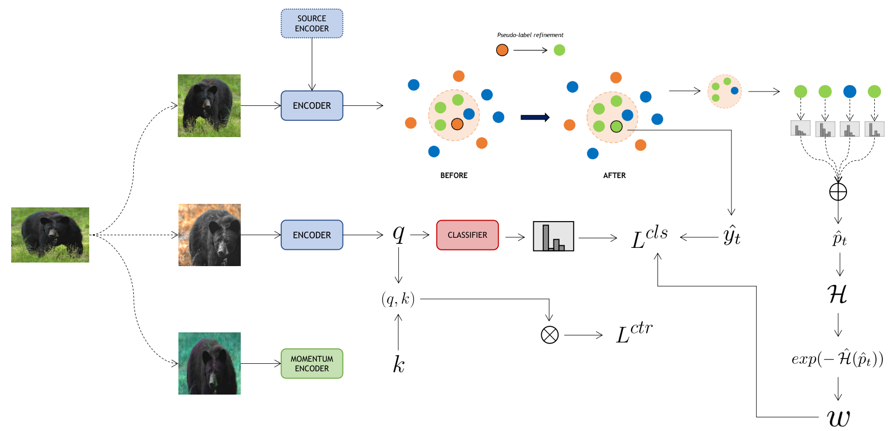

Pseudo-label Refinement
(a)
init.
Entropy-based Pseudo-labels Uncertainty Estimation
Weak aug.
(b)
shared
Target image
Strong aug.
Positive pair
(c)
Strong aug.
Self-supervised Contrastive Regularisation
Temporal Queue-based Negative Pairs Exclusion
Keys queue features
(d)
Negative pairs
LEGEND
. . .
Sample predicted as class A
Neighborhood
Entropy
Binary mask
Sample predicted as class B
Predicted probabilites
Entropy-based weight
Sample predicted as class C
Mask out
Refined pseudo-label
Current sample predicted as class C
quey/key features
,
classification/contrastive loss

Slide 8
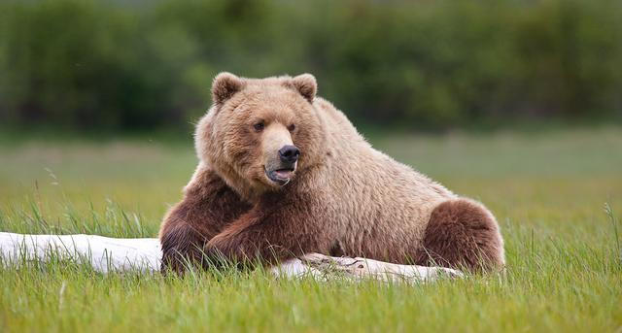
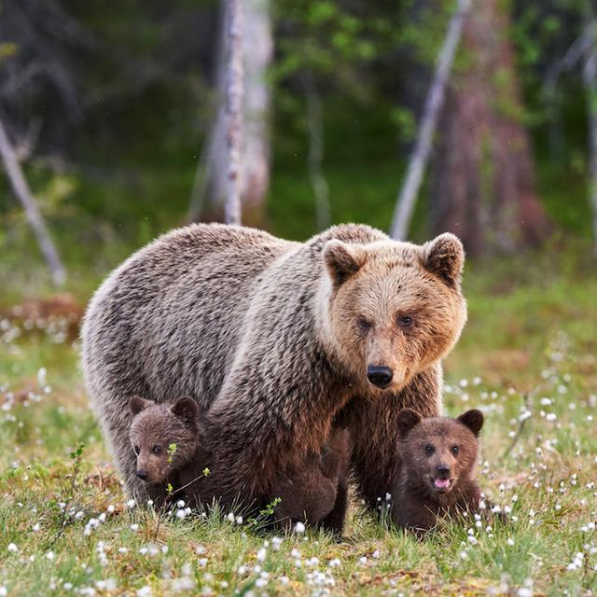
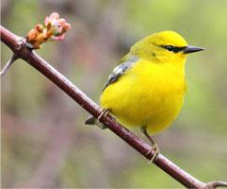
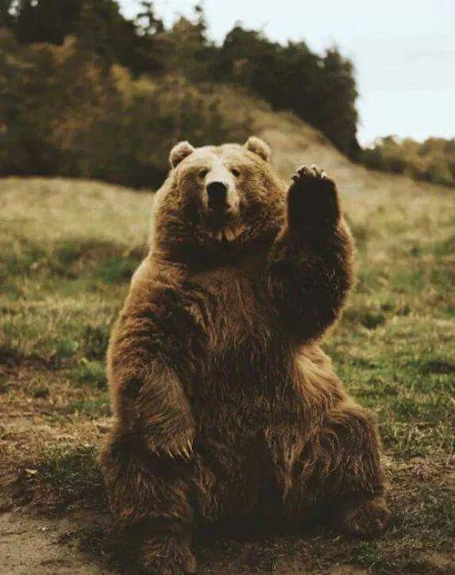
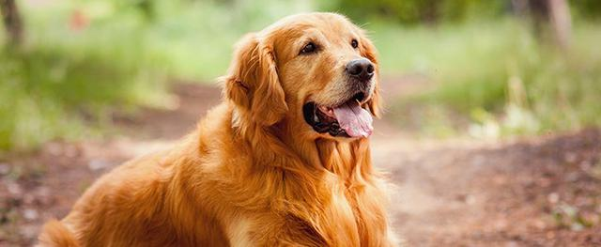
Predicted scores
Predicted scores
Neighborhood
0.6
0.1
0.3
Neighborhood
0.5
0.1
0.4
Averaged scores
Averaged scores
Target image
0.8
0.1
0.1
0.7
0.1
0.2
Target image
0.4
0.4
0.2
0.4
0.3
0.3
Low entropy
High entropy
High weight
Low weight
0.7
0.1
0.2
0.3
0.4
0.3

Slide 9
Target image
Target image
Neighborhood
Neighborhood
Predicted scores
Predicted scores
0.6 | 0.1 | 0.3
0.8 | 0.1 | 0.1
0.7 | 0.1 | 0.2
0.5 | 0.1 | 0.4
0.4 | 0.4 | 0.2
0.3 | 0.4 | 0.3
Averaged scores
Averaged scores
0.7 | 0.1 | 0.2
0.4 | 0.3 | 0.3
Low entropy
Low Uncertainty
High entropy
High Uncertainty
High weight
Low weight

Slide 10

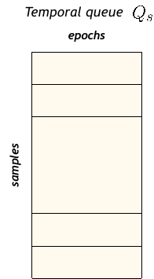
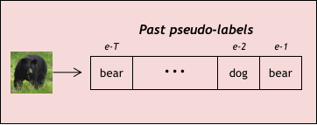
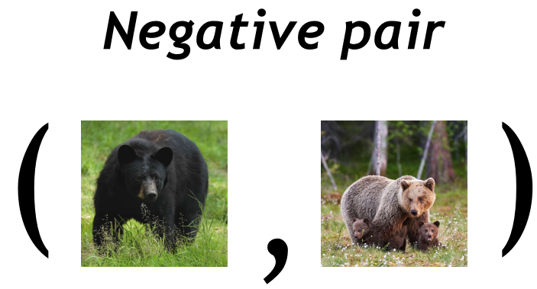
Past pseudo-labels
Past pseudo-labels
e-T
e-2
e-1
e-T
e-2
e-1
bear | ... | dog | bear
bird | ... | bear | dog
Current epoch pseudo-labels
bear
bear
NOT EXCLUDED
dog
dog
MoCo Contrastive Framework

Slide 11
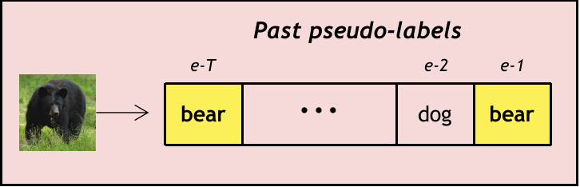
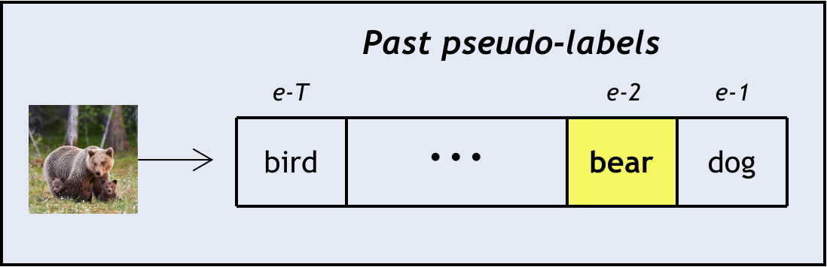
Current epoch pseudo-labels
bear
NOT EXCLUDED
dog
AdaContrast Contrastive Framework
Current epoch pseudo-labels
bear
EXCLUDED
dog
Our Contrastive Framework

Slide 12
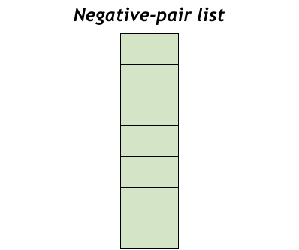

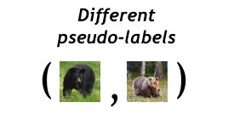
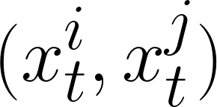


Current epoch pseudo-labels
bear
INCLUDED
Images with the same class are included in the negative pairs list
dog
AdaContrast Exclusion Strategy
Current epoch pseudo-labels
bear
NOT INCLUDED
dog
Images with the same class are NOT included in the negative pairs list
Ours Exclusion Strategy

Slide 13
Negative pair
(
,
)
Same pseudo-labels
within the queue
(
,
)
Temporal queue
Negative-pair list
samples

