Slide 1
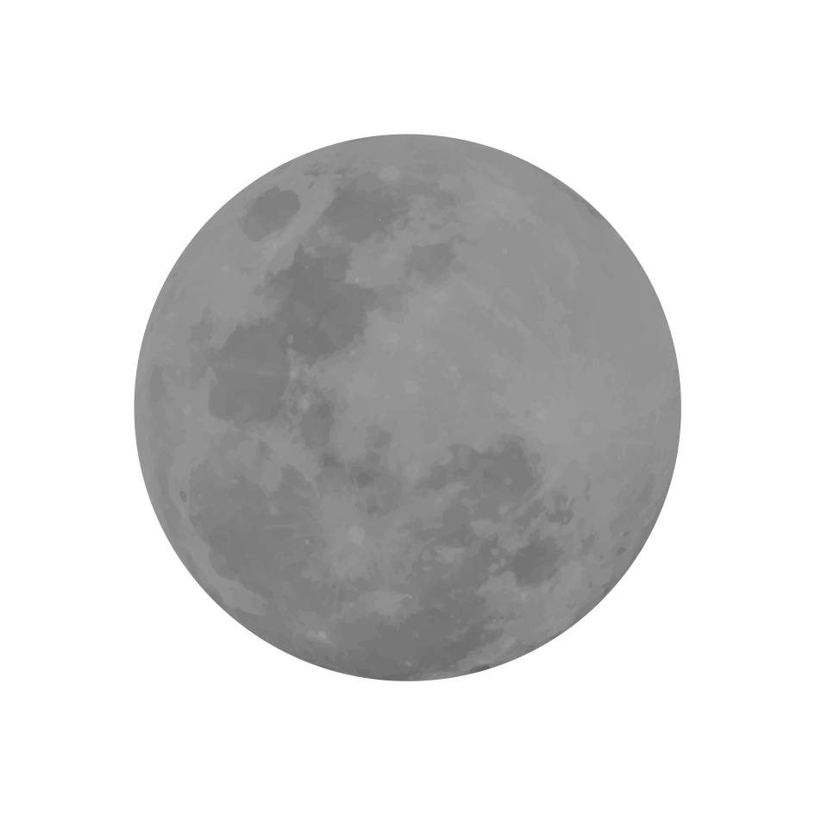
ISRO SUPER RESOLUTION AND MAKING OF A LUNAR MAP
TEAM ID-23

Slide 2
1. Develop an AI/ML model to generate high resolution (30 cm) lunar terrain images from medium/low resolution (5 m/ 10m) lunar terrain images.
2. To generate a global lunar atlas from the super resolved images.
PROBLEM STATEMENT

Slide 3
1. The super resolution required can go as high as 33x. It will be very difficult for a model to reconstruct to that resolution in one go.
2.The super-resolution for satellite images specially lunar images has far less literature when compared to super resolution of images of environmental objects .
3.Dataset preparation for making different models which share the resolution task.
4. The super resolution required can be either 16x or 32x.(5/10m to 30cm)
SUPER RESOLUTION CHALLENGES

Slide 4
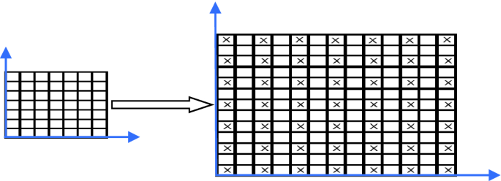
We propose a model pipeline which takes a TMC image and increases its resolution by 16x. We can achieve a super-resolution by a factor of 32x too by applying a bicubic interpolation on 16x super resolved image.
SUPER RESOLUTION

Slide 5






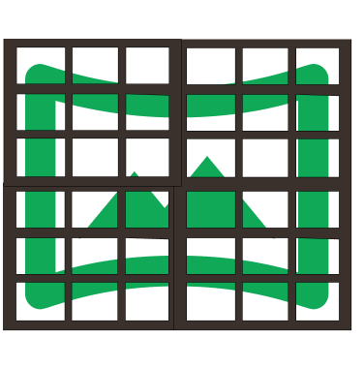

INFERENCE PIPELINE
TILE INTO 80X80 AFTER TRUNCATION
ORIGINAL IMAGE
80X80 TILE
MODEL 1
EACH 80X80 TILE
(80X4,80X4)
MODEL 2
CONCAT
16 (80X4,80X4) IMAGES
80X16 IMAGE
16 (80,80) IMAGES

Slide 6
DATASET FOR TRAINING THE MODEL
Observation-It is observed that for the same region, tmc images and downsampled(decimated) OHRC images have SSIM of about 0.86.
Therefore , downsampled OHRC images are used to train the models.
The OHRC images are tiled into (80*factor,80*factor ) sub-images and then they are downsampled .

Slide 7
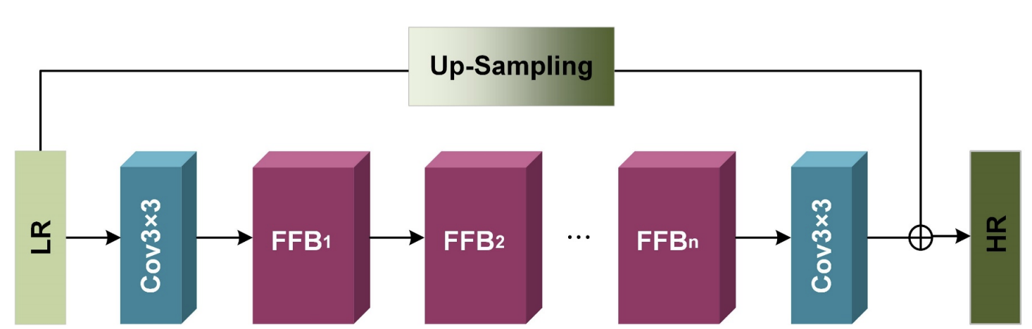
INDIVIDUAL MODEL ARCHITECTURE-CHANNEL SPATIAL ATTENTION

Slide 8
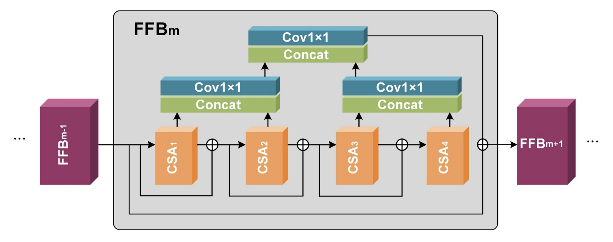
FEATURE FUSION BLOCK

Slide 9
REASONS BEHIND TWO STAGES DIVISION
1. The work of learning the reconstructing parameters is shared between two models.
2. The output of the first model which is 4x super resolved has to be tiled into 16 parts and then passed on to the second stage model because input size of second stage model is also 80*80.This provides lesser load on the second stage model. The 16 outputs that come out of second stage model are untitled (concatenated as required to form the image).
3. After second stage ,the image is 16x resolved .

Slide 10
1. The model for the first stage 4x super-resolution is trained using 1/32 downsampled version of (80*32, 80*32) tiled OHRC sub-images as input (80. 80) and ⅛ downsampled version of (80*32, 80*32) tiled OHRC sub-images as output (80*4, 80*4). The attributes of our training are : 600 epochs on 4.8k images, initial LR = 0.0001, batch_size = 128, Adam optimizer
2.The model for the first stage 4x super-resolution is trained using ⅛ downsampled version of (80*8, 80*8) tiled OHRC sub-images as input (80. 80) and ½ downsampled version of (80*8, 80*8) tiled OHRC sub-images as output (80*4, 80*4). The attributes of our training are : 600 epochs on 9k images, initial LR = 0.0001, batch_size = 128, Adam optimizer
TRAINING DETAILS

Slide 11
1. The whole architecture comprising of Model 1 followed by Model 2 takes an image and increases its resolution by 16x
2. Model 1 and Model 2 is jointly fine-tuned in end to end pipeline for better adaptation to task-sharing.
3.) Intuition - Model 1 is trained on its special task and Model 2 is trained on its special task. Then, they are fine-tuned to jointly perform the task end-to-end.
4.) Dataset - The input images (80, 80) are 1/32x downsampled images of (80*32, 80*32) tiled sub-images of OHRC images. The output images (80*16, 80*16) are 1/2x downsampled images of (80*32, 80*32) tiled sub-images of OHRC images. Note that min-max standardization is applied to all input images.
FINE-TUNING OF THE FINAL 16X ARCHITECTURE

Slide 12
An image as a 2d array (after min-max standardization in float32) of any shape can be given to object of the class Combined(model1_path,model2_path) we provide in our code.
1.It truncates the image shape to multiple of 80 in both dimensions .Then the image is tiled into (80*80) sub-images. Each of them is super -resolved 16 times.
2.Finally all the super-resolved sub images are arranged according to their position.
Getting 32x when required-
Bi-cubic interpolation is applied on the 16x super resolved image with scale of 2.
It can be removed from forward() func of Combined() if only 16x is required.
FINAL INFERENCE PIPELINE

Slide 13
The test-set comprises of 1.5k 80*80 downsampled subimages. SSIM results on the test set are as follows :-
1.For Model 1 (4x resolution from 1/32 to 1/8), the SSIM value was 0.81.
2.For Model 2 (4x resolution from 1/8 to 1/2), the SSIM value was 0.9.
3.For combined Model 1 and Model 2 followed by bicubic interpolation without fine-tuning, the SSIM value was 0.79.
4. For combined Model 1 and Model 2 followed by bicubic interpolation with fine-tuning, the SSIM value was 0.86.
RESULTS

Slide 14
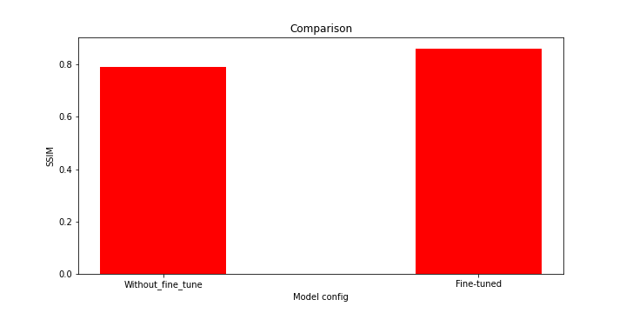
RESULTS

Slide 15
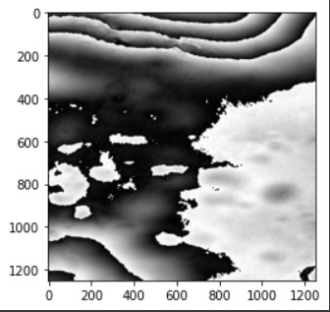
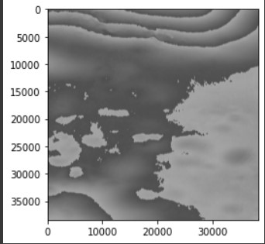
Original TMC Image 32x Super-Resolved TMC Image
RESULTS

Slide 16
1. First method was to pick pixels from TMC images, and assigning those pixels in their appropriate position in the map, but this left holes in the map.
2. To iterate through all images for each pixel would be very time consuming. Due to RAM constraint, they couldn't have been saved before processing either and so for every pixel, we would have to load each image.
3. On stitching, the edges of intersection was more defined and visible.
IMAGE STITCHING CHALLENGES

Slide 17
1. To deliver the map in boxes 1° long and 1° wide, we processed each image, and assigned them to all the boxes they appear in. This made it easier to run through images when making the map.
2. We assigned weights to the pixels in the image ranging from 0 to 1. If the image was closer to an edge, it would have a lower weight, and if the image was farther from the edge, it would have a higher weight.
3. We processed each pixel in the map, and if that pixel was present in any one of the images, we added the image value to the pixel position in the map. The final pixel value was the weighted mean of pixels from all images contributing there.
METHODOLOGY

Slide 18
1. Channel Spatial Attention Network for Lunar Image Super-Resolution https://dl.acm.org/doi/abs/10.1145/3512388.3512436
2. Automatic seamless stitching method for CCD images of Chang’E-1 lunar mission https://www.researchgate.net/figure/Flowchart-producing-global-lunar-map-with-the-seamless-stitching-method_fig3_225378842
REFERENCES

