Slide 1

IIT-PATNA-PROJECTS
IIT-Patna-Projects:
Engineering Ideas into Real-
World Solutions
Engineering Ideas into Real-World Solutions.
Cloud Computing
DevOps
Distributed Systems
Cybersecurity
AI
Software
Engineering

Slide 2

THE WORKSPACE
One workspace for building complete working systems
Build the whole system.
A centralized GitHub organization for technology projects, practical implementations, experimentation,
and technical learning.
Implement
Experiment
Learn
Connect technologies into
working applications.
Test system behavior under
controlled conditions.
Capture knowledge from
practical engineering.
The emphasis is complete working systems, rather than technologies learned in isolation.

Slide 3

PROJECT OBJECTIVES
Four objectives drive every project
Build practical solutions
Explore modern computing
Develop software and technology that address real
implementation needs.
Investigate cloud platforms and emerging
computing technologies.
Evaluate system quality
Document the evidence
Examine application performance, security, and
reliability.
Record technical knowledge and experimental
outcomes.

Slide 4

ENGINEERING SCOPE
Six technical domains, one engineering practice
Cloud Computing and Distributed
Systems
DevOps and Infrastructure
Automation
Performance Monitoring and
Reliability Engineering
Scaling, load balancing, serverless
CI/CD, containers, infrastructure
as code
Metrics, dashboards, recovery
testing
Cybersecurity and Information
Security
Artificial Intelligence and Data
Engineering
Software and Application
Development
Access control, least privilege
Data pipelines, notebooks,
analysis
Web apps, APIs, databases

Slide 5

TECHNOLOGY TOOLKIT
A flexible stack, chosen per project
Programming
Frontend
Backend
Cloud
Python, Java, C,
JavaScript,
TypeScript, SQL
React, HTML, CSS
FastAPI, REST APIs
AWS, Microsoft Azure,
Google Cloud
DevOps
Monitoring
Databases
Data Science
Docker, Jenkins,
GitHub Actions,
Terraform
Prometheus,
Grafana,
CloudWatch
PostgreSQL, MySQL,
Redis
NumPy, pandas,
Matplotlib, Jupyter
Technology choices vary by project.

Slide 6
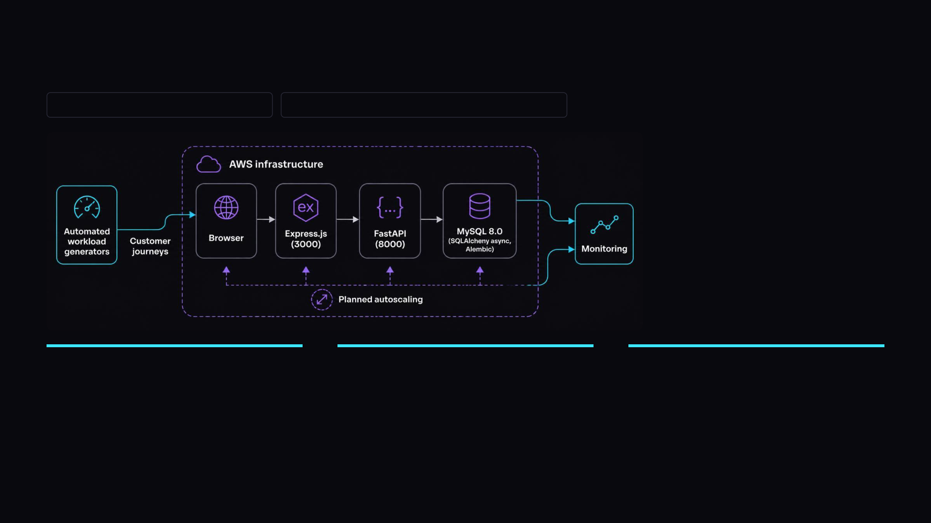
ShopScale: planned e-commerce scalability and reliability
PLANNED / IN DEVELOPMENT
NO COMPLETED DEPLOYMENT CLAIMED
Planned storefront
Planned experiments
Planned evaluation
Product catalog, cart, inventory,
simulated checkout
Automated customer journeys,
controlled traffic, performance
monitoring
SLA evaluation, recovery testing,
bot detection

Slide 7
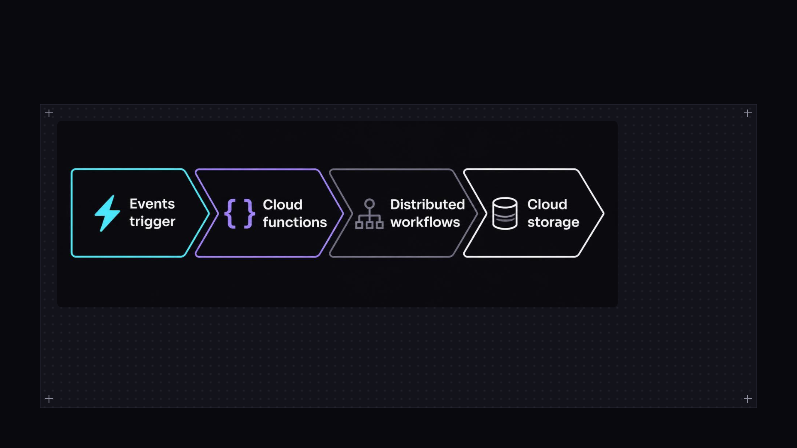
Serverless and cloud-native research: areas of exploration
EXPLORATION · NOT VERIFIED IMPLEMENTATION
Compute
Architecture
Evaluation
Serverless computing and
Function-as-a-Service
Distributed workflows, hybrid and
multi-cloud architectures
Cloud storage and performance
benchmarking

Slide 8
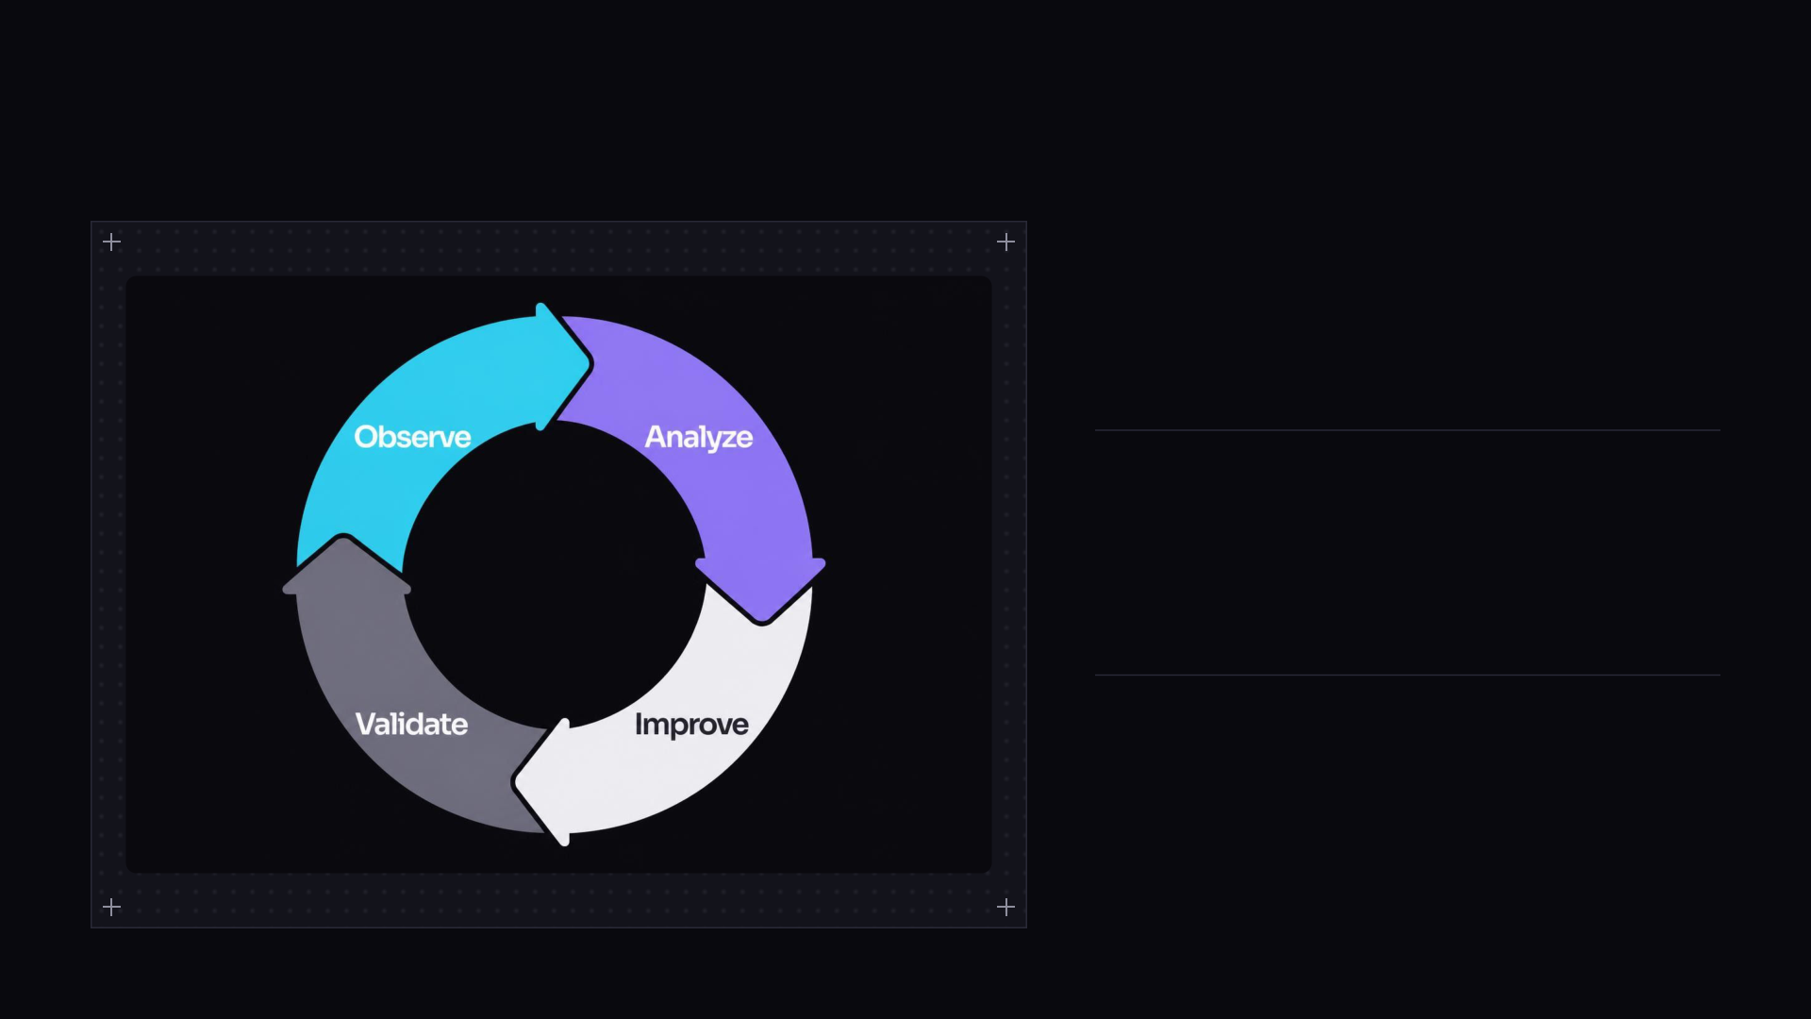
SYSTEM QUALITY
Dependable applications need observability and security
Observability
Metrics, logging, resource utilization
Security
Access control, least privilege
Reliability
Performance testing, incident detection,
recovery

Slide 9
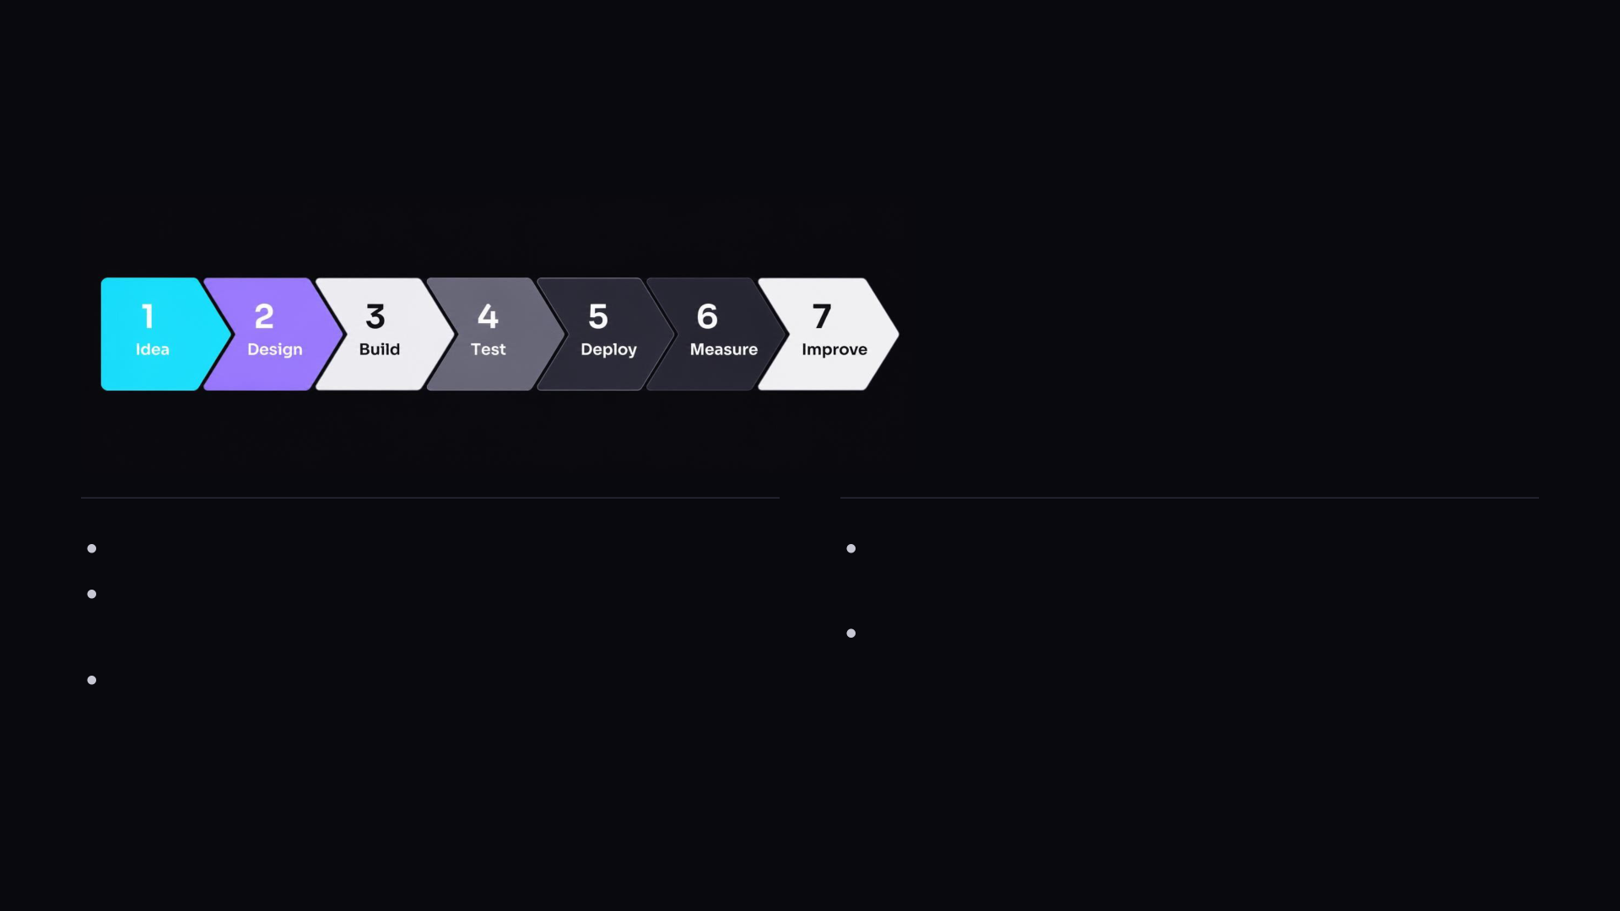
ENGINEERING METHOD
Prototype first, then measure everything
Build functional prototypes before adding complexity.
Document architecture, setup, testing, and
limitations.
Validate assumptions through controlled
experiments.
Collaborate, review, and continuously improve.
Measure outcomes instead of making unsupported
claims.

Slide 10

IIT-PATNA-PROJECTS · VISION
Learn by Building.
Grow by Experimenting.
A meaningful collection of practical projects across cloud engineering, DevOps, distributed systems, AI,
cybersecurity, and emerging technologies.
From Technical Concepts to Practical
Implementations.
Practical projects. Controlled experiments.
Documented learning.

